Slide 1

Data Analytics in Building Science
MAJOR PROJECT
Under the guidance of Prof. Prashant Anand
Hritik Kumar Garg | 20AR10014
Khushi Tayal | 20AR10016
Mobassir Shams | 20AR10020
Nidam Kumar Jha | 20AR10023
Niraj Yadav | 20AR10025
Shubham | 20AR10042

Slide 2
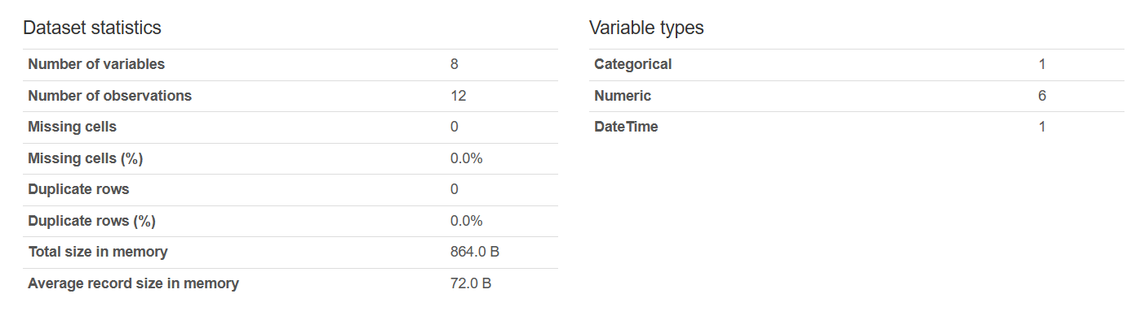
Overview of the Data

Slide 3
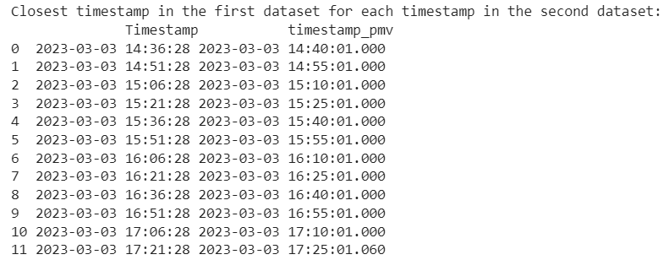
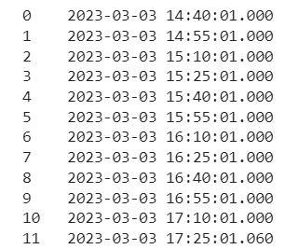
Comparing and merging the Timestamps

Slide 4
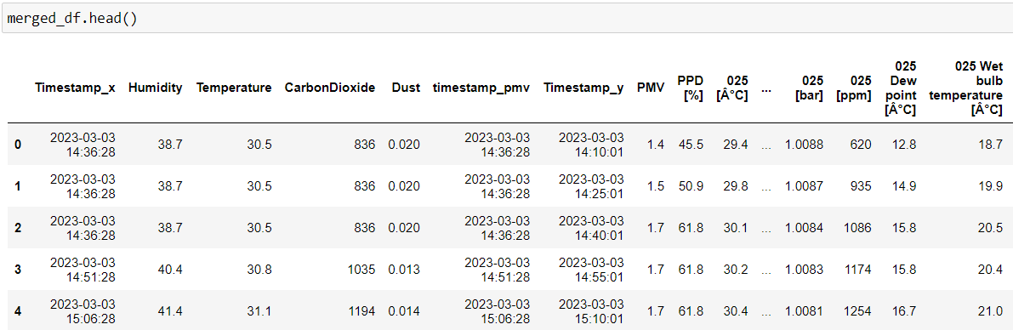
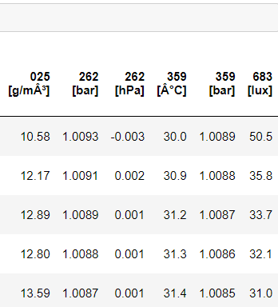
Predicting the data for new timestamp

Slide 5
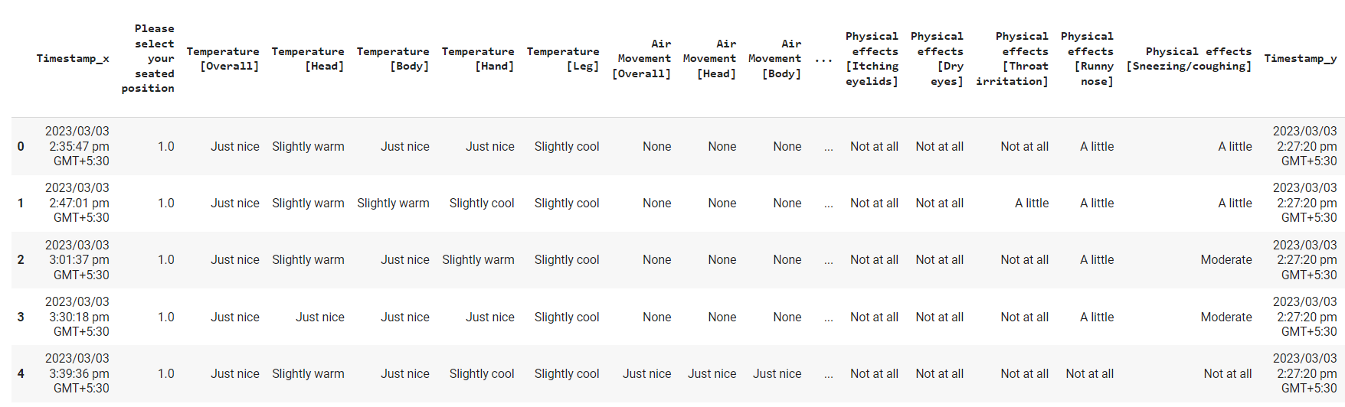
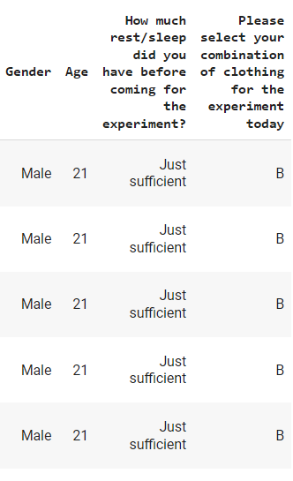
Predicting the data for new timestamp

Slide 6
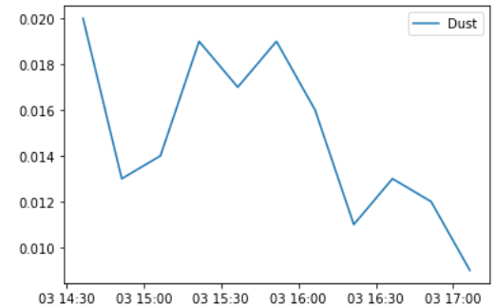
DUST

Slide 7
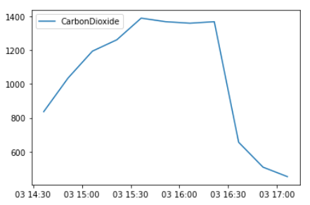
CARBON DIOXIDE

Slide 8
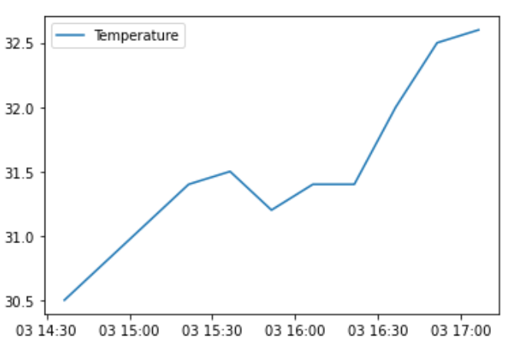
TEMPERATURE

Slide 9
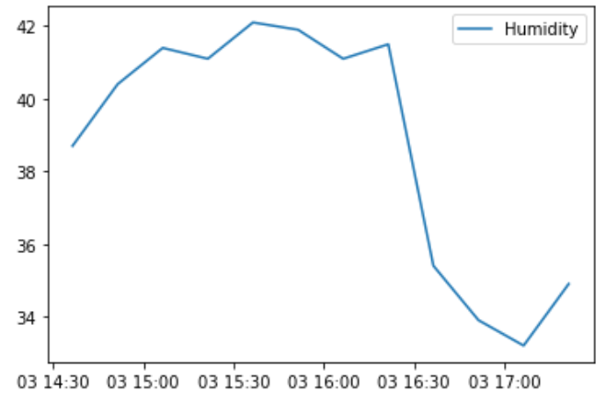
HUMIDITY

Slide 10
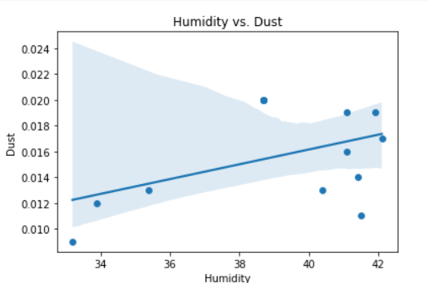
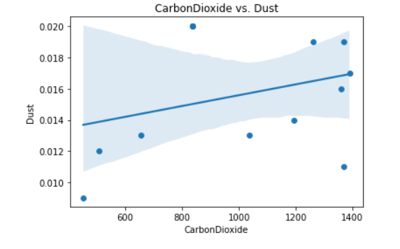
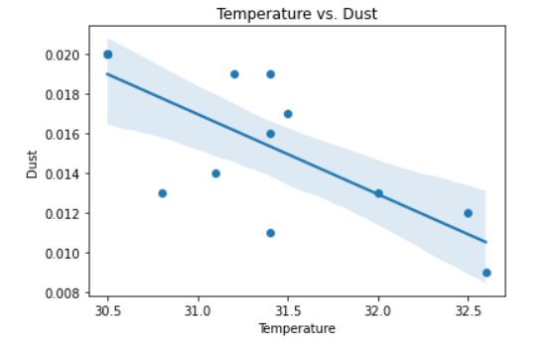
INTERACTIONS

Slide 11
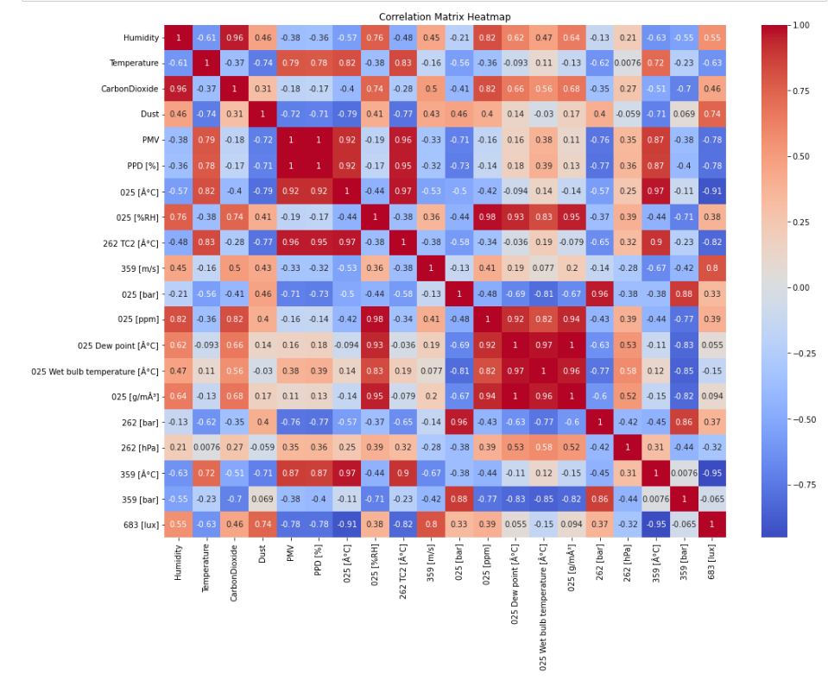
Correlation Metrics

Slide 12
Exploratory Data Analysis (EDA)

Slide 13
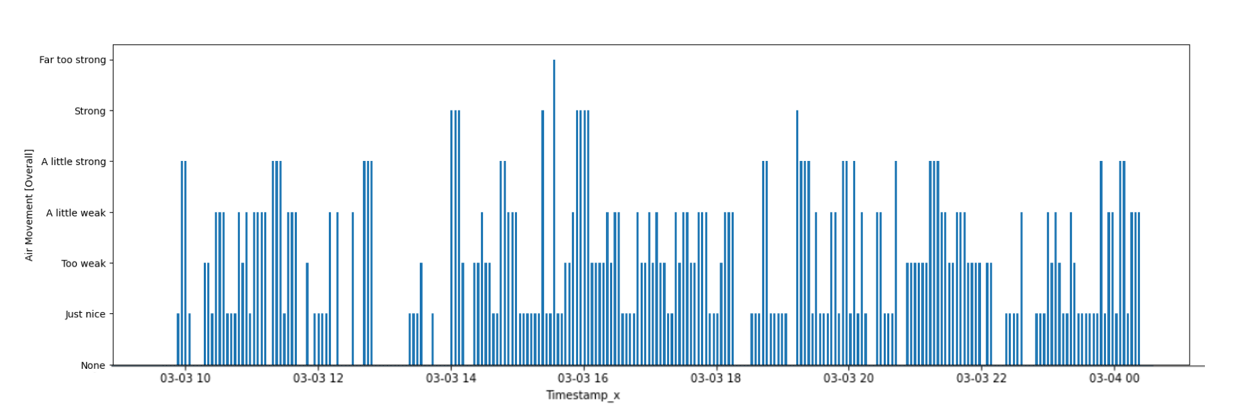
VARIABLES

Slide 14
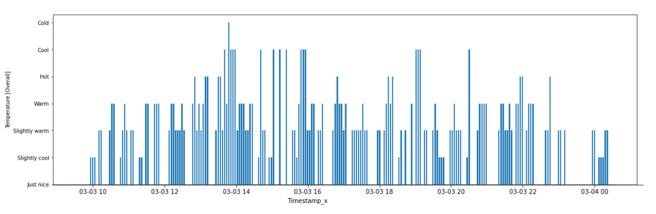
VARIABLES

Slide 15
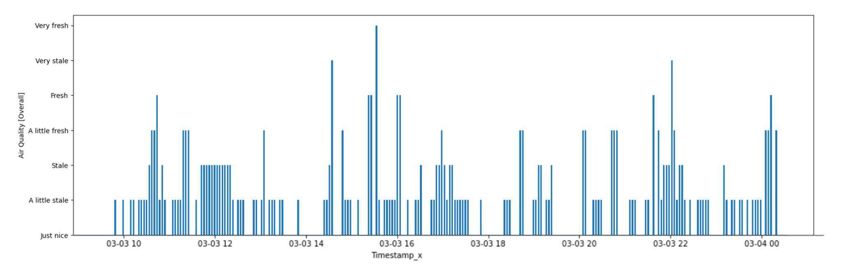
VARIABLES

Slide 16
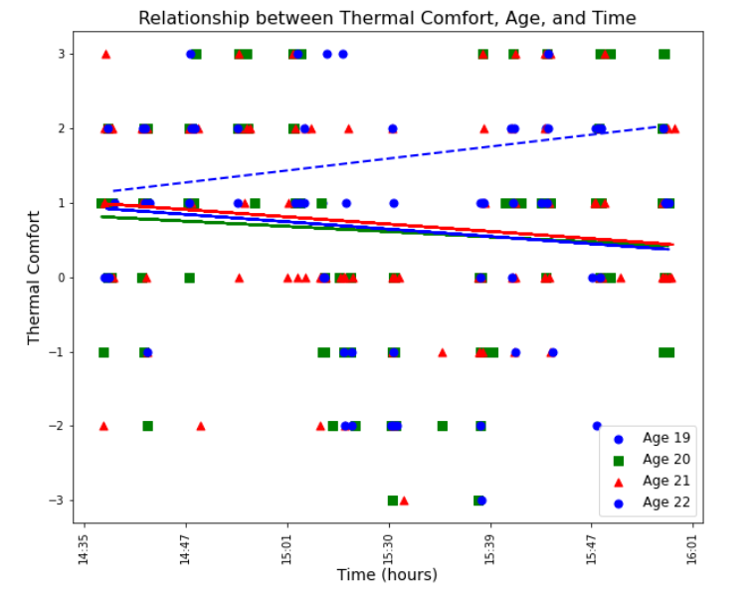
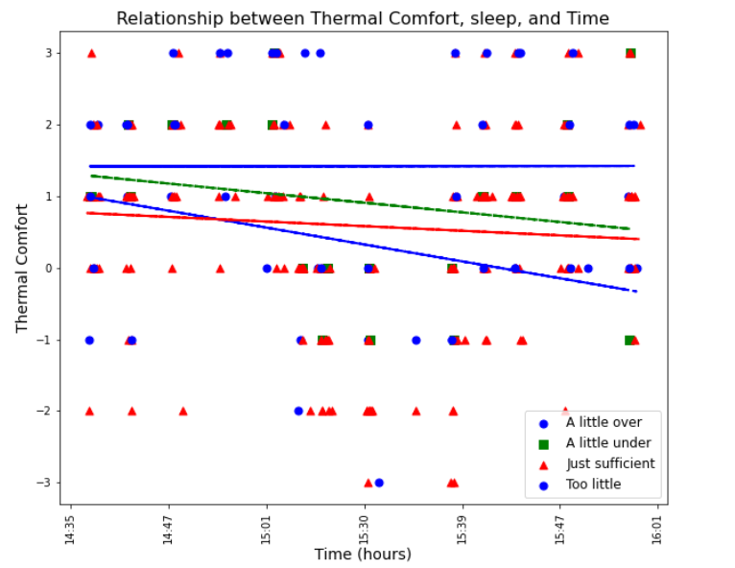
Relationship between Occupant Feedback Data and Occupant Personal Information

Slide 17
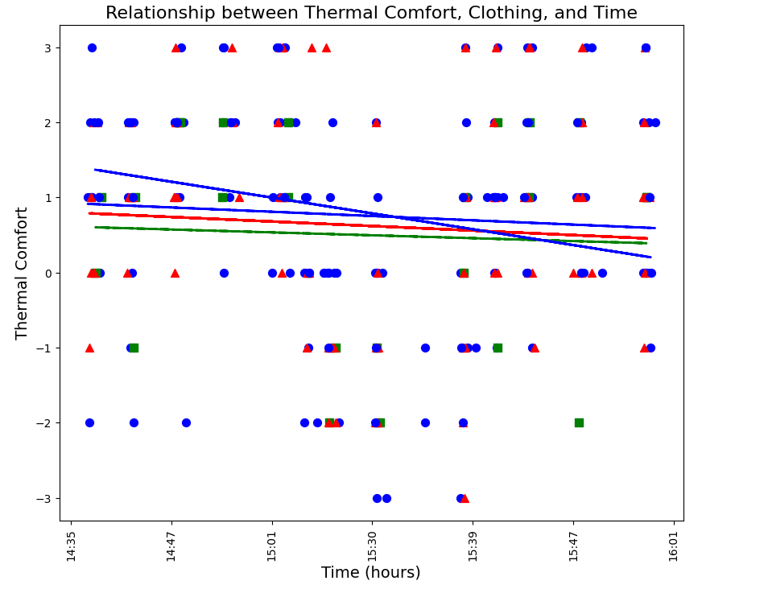
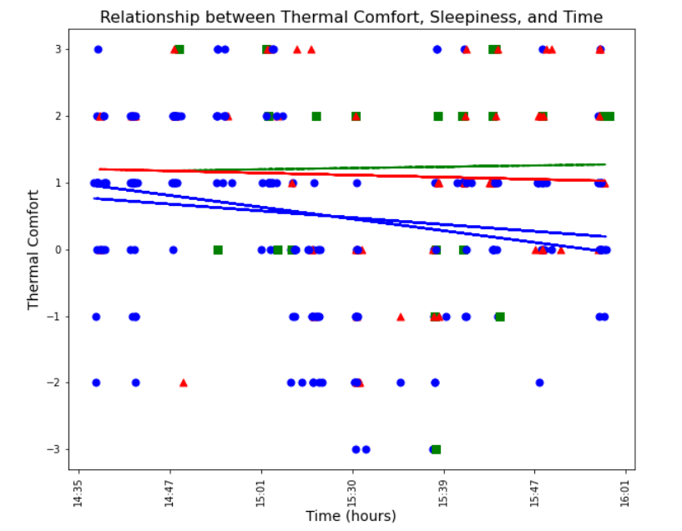
Relationship between Occupant Feedback Data and Occupant Personal Information

Slide 18
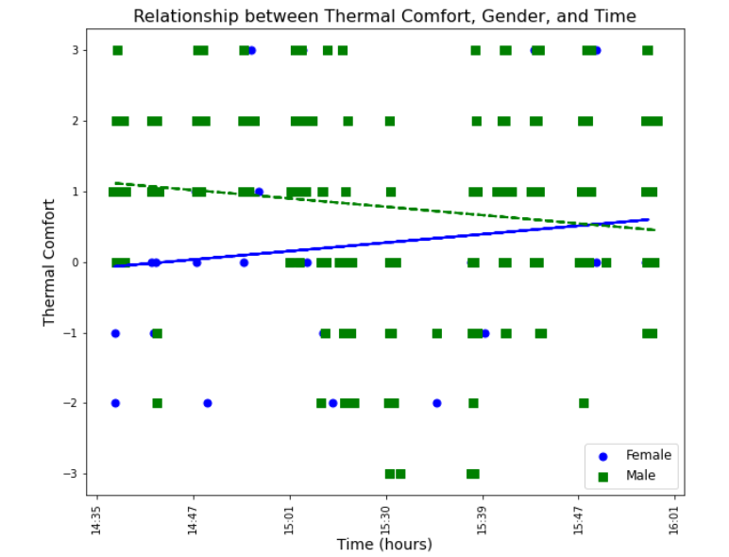
GENDER BASED

Slide 19
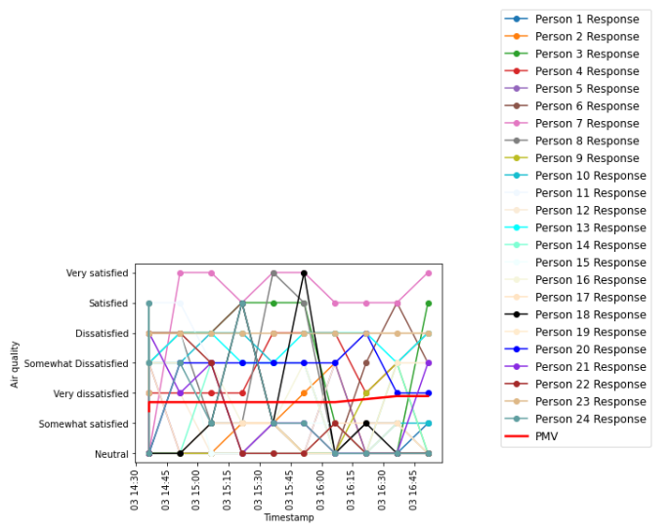
Relationship between Experimental and Occupant Feedback Data
PMV

Slide 20
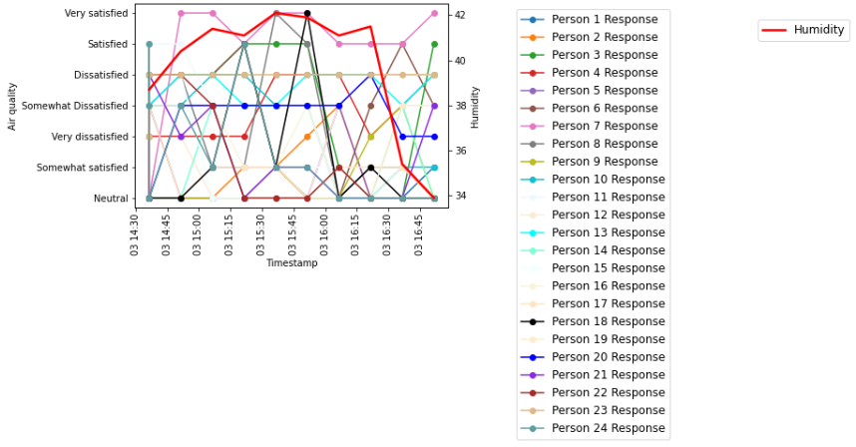
HUMIDITY

Slide 21
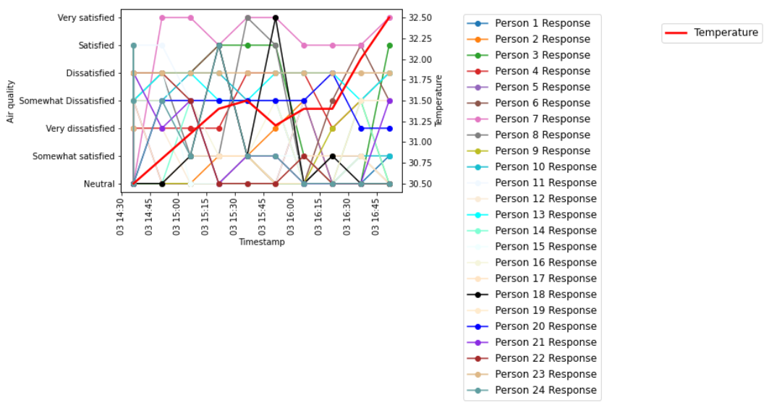
TEMPERATURE

Slide 22
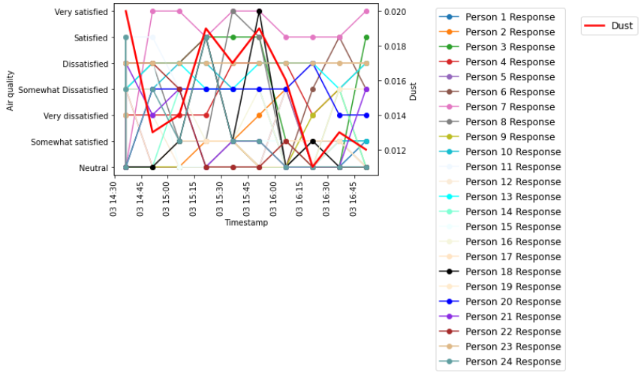
DUST

Slide 23
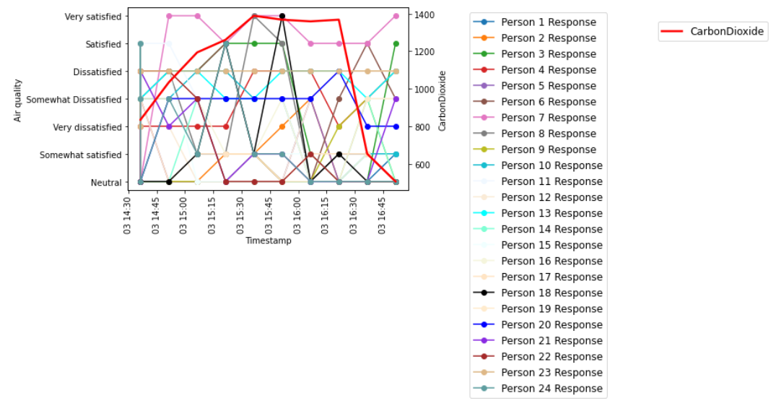
CARBON DIOXIDE

Slide 24
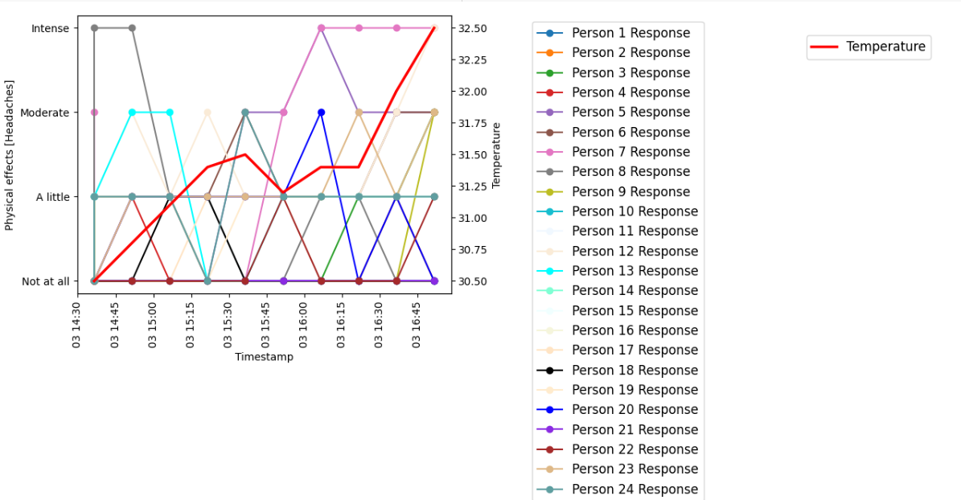
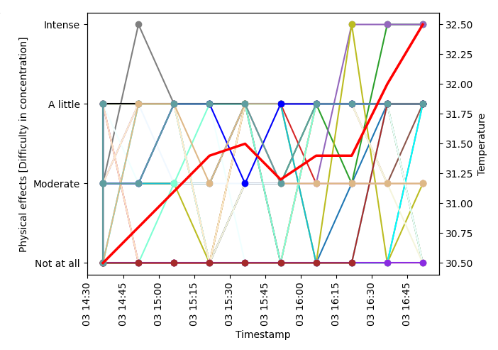
PHYSICAL EFFECTS WITH TEMPERATURE

Slide 25
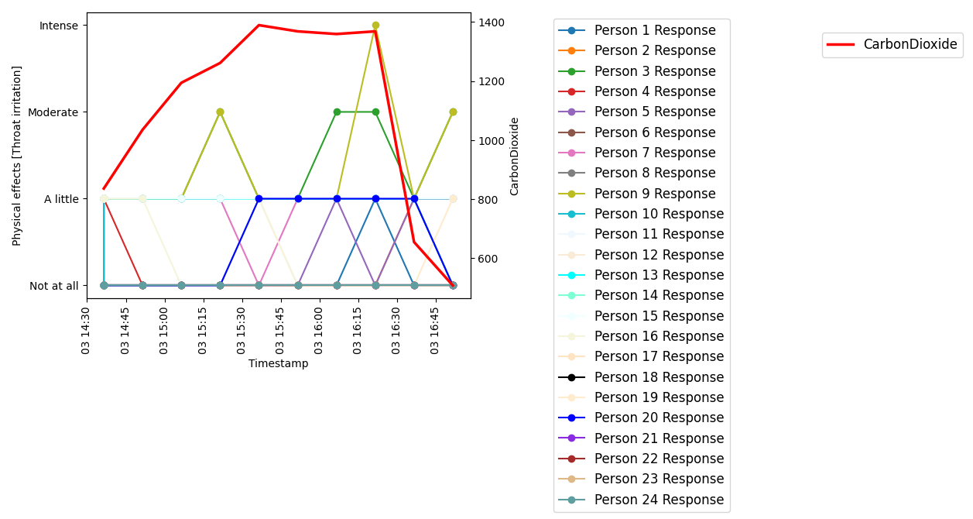
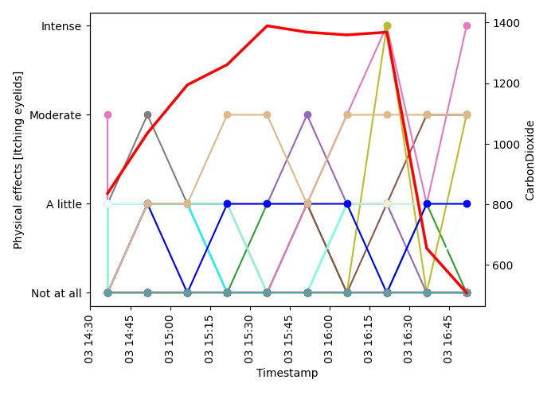
PHYSICAL EFFECTS WITH CARBON DIOXIDE

Slide 26
PHYSICAL EFFECTS WITH DUST

Slide 27
Thank You!

