Slide 1

Exploratory Data Analysis (EDA)
From raw data to insights
PRESENTED BY : HRITIK

Slide 2
What We’ve Cover
A structured journey through every stage of the EDA lifecycle.
01
02
03
What is EDA?
Complete EDA Workflow
Understanding & Cleaning Data
Definition, importance, and how it differs from preprocessing
End-to-end pipeline from business problem to ML readiness
Dataset profiling, missing values, duplicates, and formatting
04
05
Statistical Analysis
Feature Engineering & Insights
Univariate, bivariate, and multivariate exploration
Transformations, encoding, selection, and business takeaways

Slide 3

What Is EDA?
Exploratory Data Analysis is the practice of investigating datasets to understand their structure, uncover patterns, detect anomalies, and test assumptions — before any modeling begins.
EDA vs. Preprocessing
Why 70–80% of Project Time?
EDA explores and questions; preprocessing fixes and prepares. EDA drives what to clean.
Poor data understanding leads to flawed models. Teams invest heavily here to avoid costly downstream errors.

Slide 4
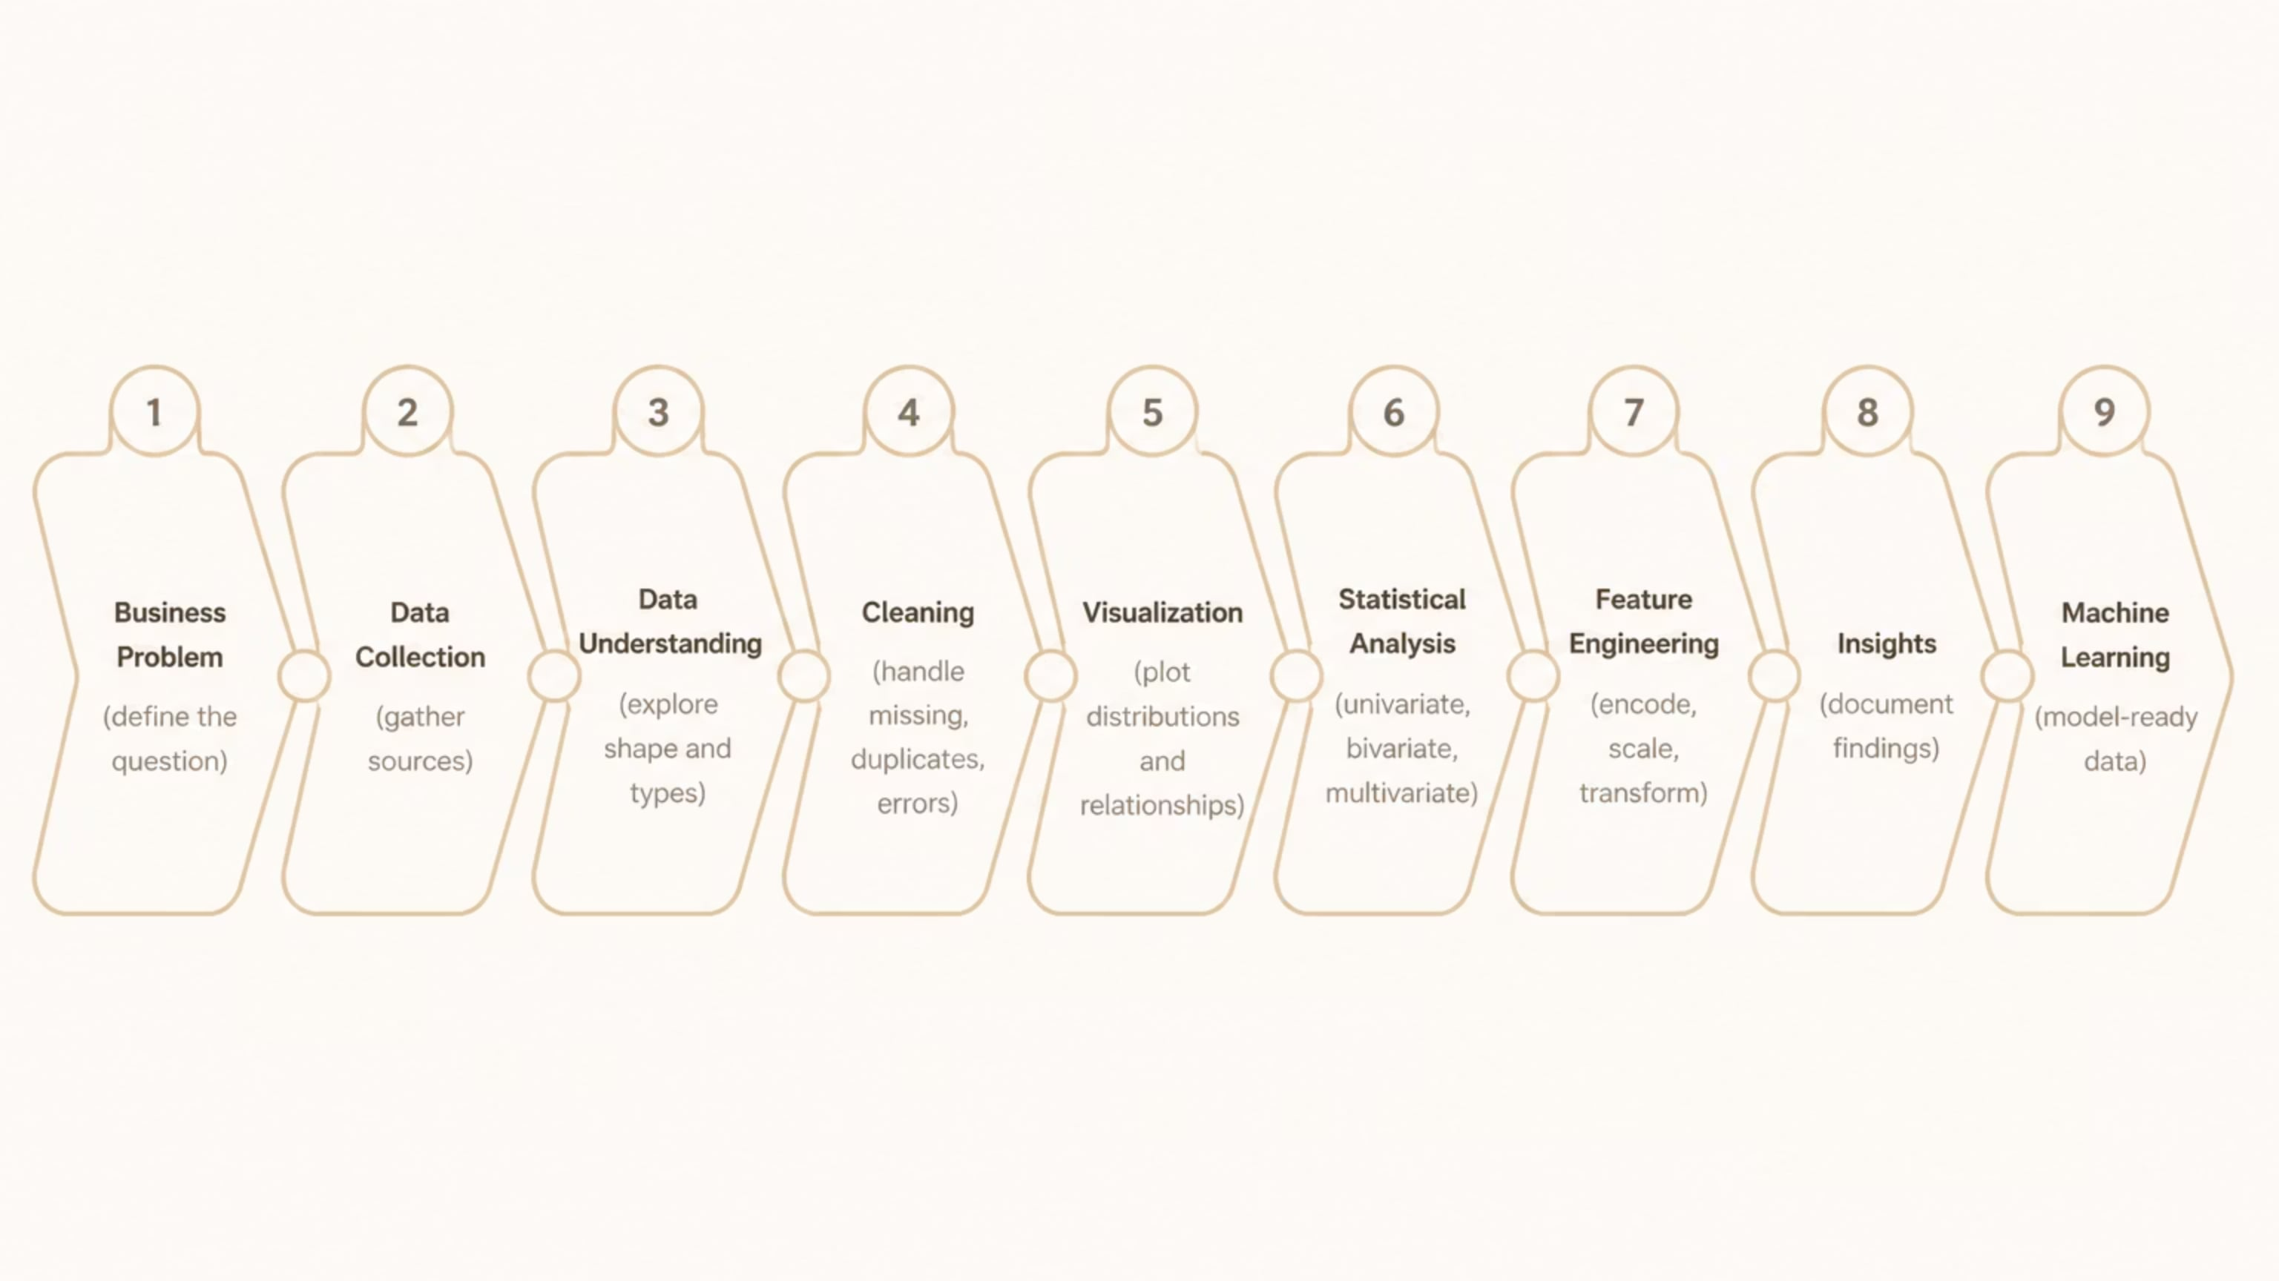
The Complete EDA Workflow
Each stage builds on the last — skipping steps introduces blind spots that compound through the pipeline.

Slide 5
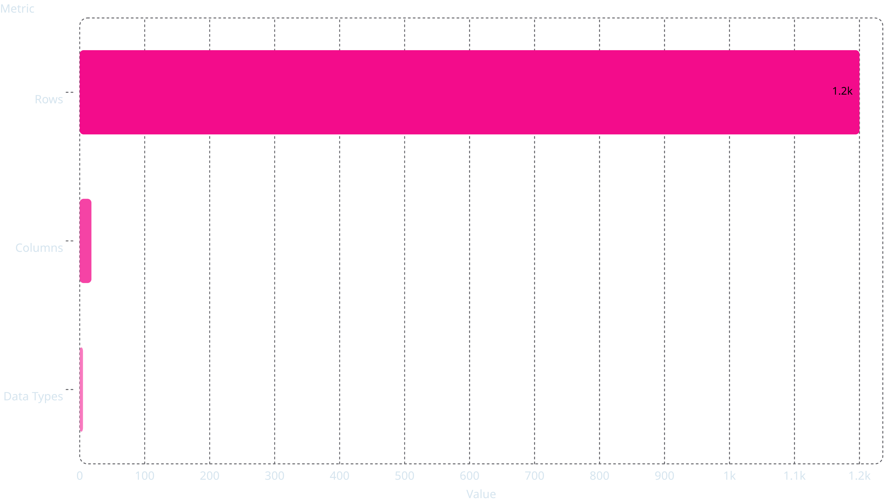
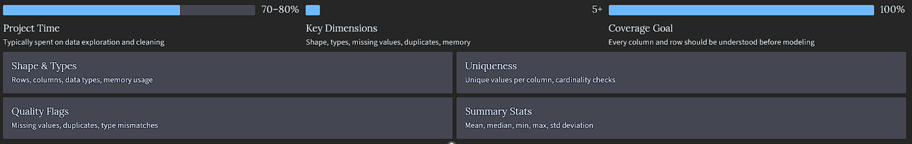
Understanding Your Dataset

Slide 6
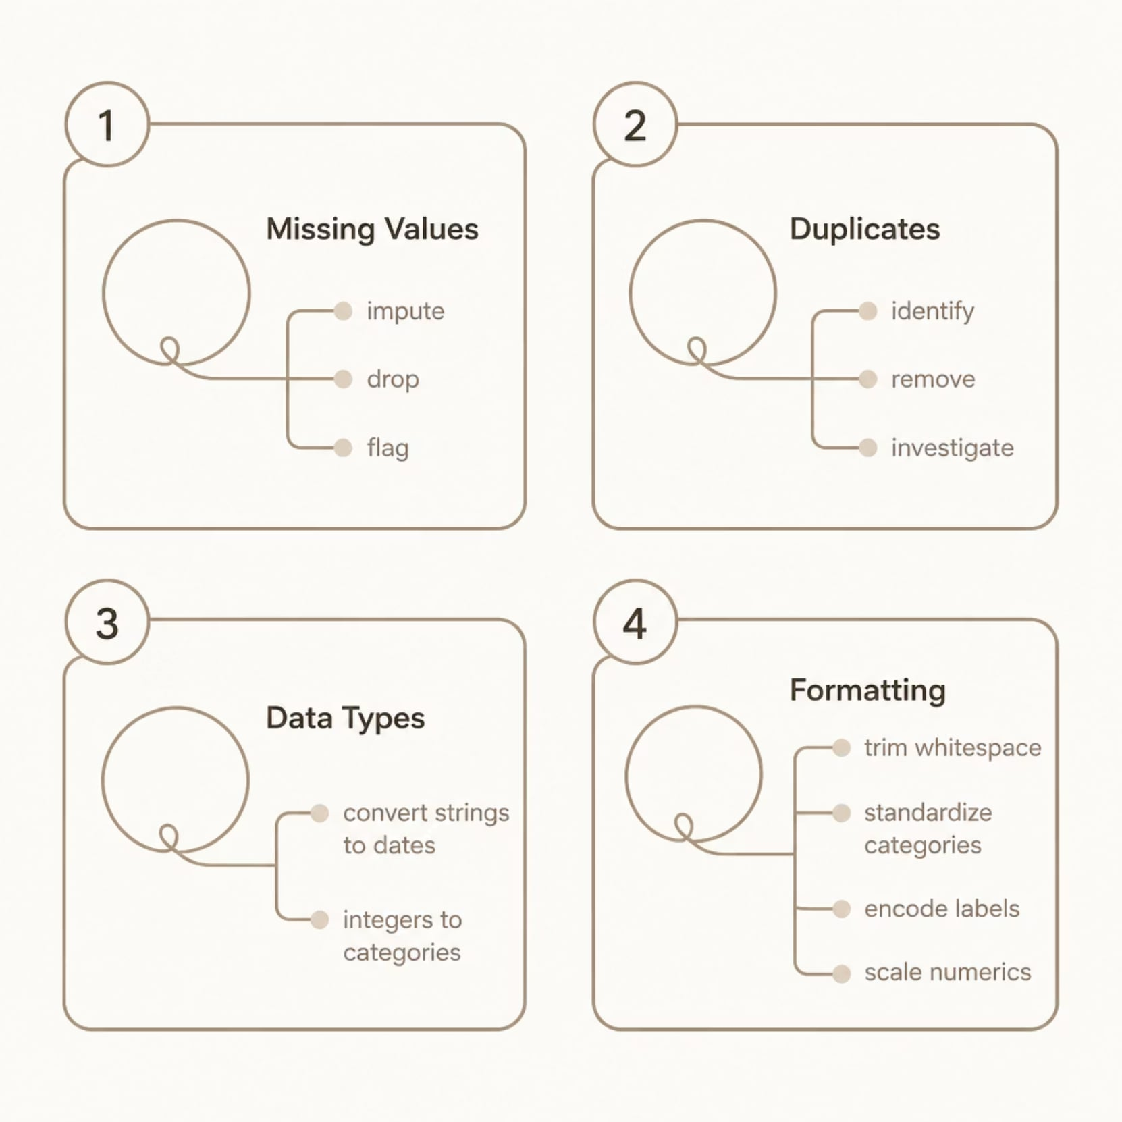

Data Cleaning
Clean data is the foundation of reliable analysis. Address quality issues systematically before any statistical work.
Real-World Examples
Missing values: Impute median income; flag missing customer segments
Duplicates: Remove duplicate transaction records from merged sources
Category standardization: "USA", "U.S.A.", "United States" → "USA"
Scaling: Normalize salary and age to comparable ranges for modeling
Always document cleaning decisions —
they affect reproducibility and auditability.

Slide 7

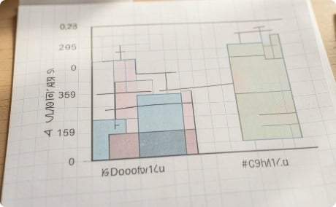
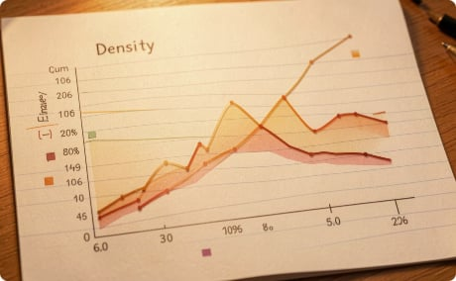
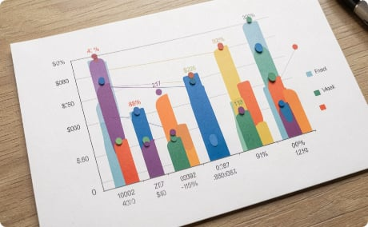
Univariate Analysis
Examine each variable in isolation — understand its distribution, central tendency, and spread before exploring relationships.
Histogram
Box Plot
Density Plot
Bar Chart
Reveals distribution shape, skewness, and modality. Business use: spot customer age clusters or sales seasonality.
Shows median, quartiles, and outliers at a glance. Business use: compare spending distributions across segments.
Smoothed distribution highlighting peaks and tails. Business use: identify most common transaction values.
Compares categorical frequencies. Business use: product category performance or regional breakdowns.

Slide 8
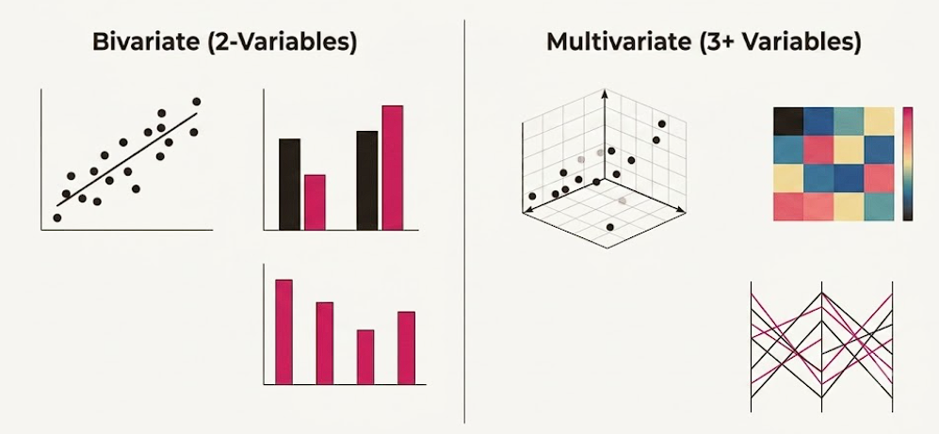

Bivariate & Multivariate Analysis
Move beyond single variables to uncover relationships, correlations, and feature interactions that drive business outcomes.
Analysis Types & Visualizations
Numerical vs. Numerical
Scatter plots + correlation matrices reveal linear relationships (e.g., ad spend vs. revenue).
Categorical vs. Numerical
Grouped boxplots compare distributions across segments (e.g., churn rate by plan type).
Categorical vs. Categorical
Stacked bar charts and contingency tables expose segment overlaps.
Multivariate
Heatmaps, pairplots, and parallel coordinates expose feature interactions and multicollinearity.

Slide 9





Feature Engineering
Transform raw variables into model-ready features that better represent the underlying business problem.
Encoding
Scaling
Transformations
One-hot, label, or target encoding for categorical variables
Standardization and normalization for distance-based models
Log, sqrt, or Box-Cox to correct skewness
Date Features
Feature Selection
Extract day, month, quarter, or season from timestamps
Remove low-variance, redundant, or irrelevant features

Slide 10

Outlier Detection & Visualization Best Practices
A practical guide to identifying anomalies, choosing the right charts, and building data-driven narratives — from EDA fundamentals to real-world industry application.

Slide 11
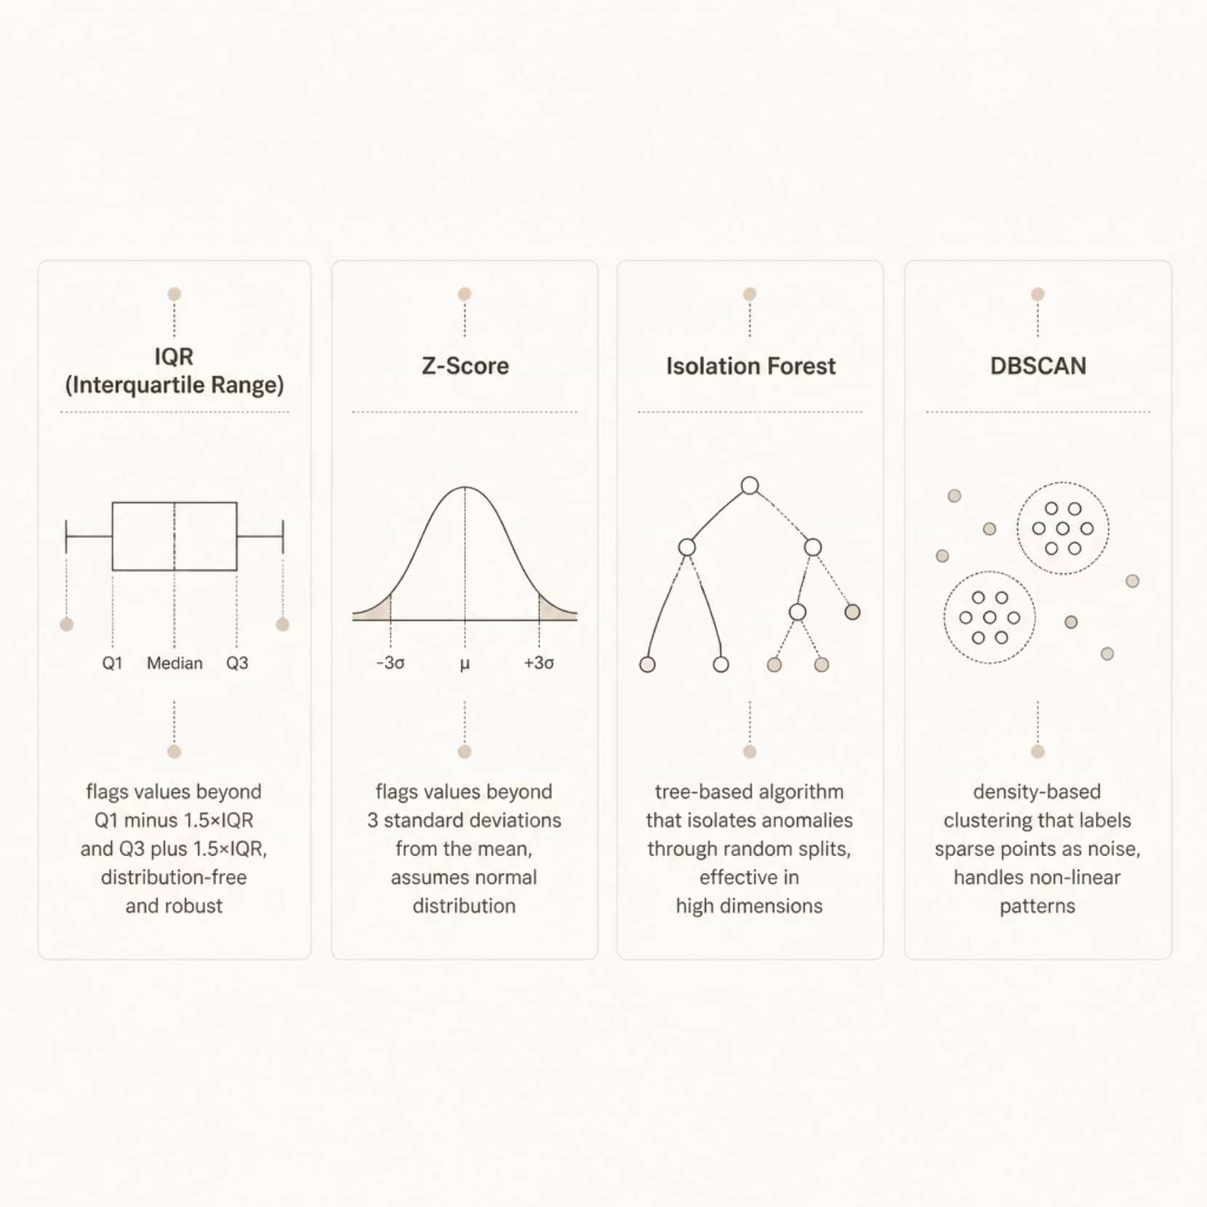
Statistical Methods for Identifying Outliers
Choosing the Right Method
Match your method to your data's characteristics:
IQR — distribution-free, ideal for skewed data
Z-Score — fast, requires normally distributed data
Isolation Forest — scalable, handles high-dimensional data
DBSCAN — spatial data, non-linear clusters
Always validate statistical outliers against business context
before removing them.

Slide 12
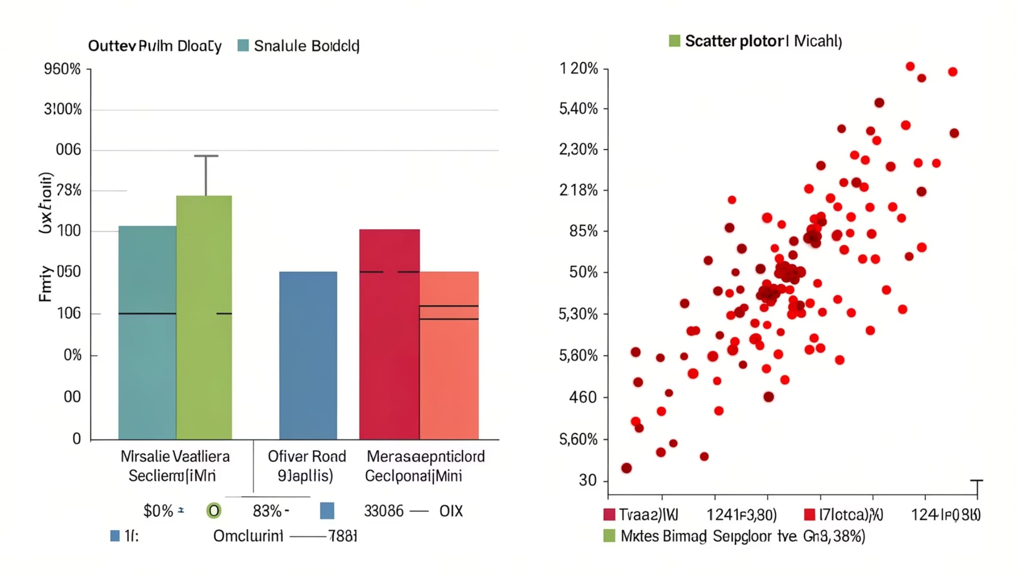
Visualizing & Treating Outliers
Key Visuals
Boxplot — instantly reveals IQR boundaries and extreme values
Scatter Plot — surfaces multivariate outliers and clusters
Treatment Strategies
Remove — when clearly erroneous or irrelevant
Cap / Winsorize — limit extremes to a percentile threshold
Transform — apply log or sqrt to reduce skew
Investigate — some outliers reveal critical business insights

Slide 13





Choosing the Right Chart
Distribution
Histogram, Boxplot, Violin Plot — understand spread, skew, and outliers
Relationship
Scatter Plot, Heatmap — reveal correlations and multivariate patterns
Trend Over Time
Line Chart, Area Chart — track metrics across time periods
Composition
Treemap, Bar Chart — compare parts of a whole (avoid Pie Charts for complex data)

Slide 14

Dashboard Design & Data Storytelling
Dashboard Design Principles
Data Storytelling Framework
Know your audience — executive vs. analyst needs differ
Limit to 5–7 key metrics — avoid cognitive overload
Use consistent color semantics — red = alert, green = good
Provide context — benchmarks, targets, and trends
Hook — lead with the most impactful finding
Context — explain why it matters to the business
Evidence — support claims with clear, labeled visuals
Action — close with a specific recommendation
A great dashboard answers questions before they're asked.

Slide 15

Customer Churn Prediction — Industry Case Study
A telecom company faced a 22% annual churn rate. The analytics team was tasked with identifying at-risk customers and building a predictive model to enable proactive retention.
Dataset
Tools Used
7,043 customers · 21 features · 26% churn rate
Python, Pandas, Seaborn, Scikit-learn
Model Goal
Predict churn probability per customer

Slide 16

EDA Process & Key Findings
Key Findings
Customers on month-to-month contracts churned 3× more
Fiber optic users had higher churn despite premium pricing
Tenure was the strongest negative predictor of churn
Missing values in TotalCharges correlated with new sign-ups
Model Impact
Removing outliers improved AUC by +4 points
Feature engineering on tenure boosted recall by 12%
EDA-driven feature selection reduced model complexity by 30%
This structured four-phase approach ensures no analytical blind spots
— from initial data profiling through hypothesis generation.

Slide 17

Common Mistakes in EDA & Visualization
🔍 Ignoring Data Quality
📊 Wrong Chart Selection
⚠️ Overlooking Outliers
Skipping checks for missing values, duplicates, and type mismatches corrupts all downstream analysis.
Using pie charts for multi-category comparisons or line charts for categorical data misleads stakeholders.
Treating outliers as noise without investigation can hide fraud, system errors, or high-value segments.
🔒 Data Leakage
📝 Poor Documentation
Including target-variable information in features during EDA inflates model performance unrealistically.
Undocumented assumptions and transformations make analyses non-reproducible and untrustworthy.

Slide 18


WRAP-UP
Best Practices & Key Takeaways
Start with the Business Question
Document Everything
Every EDA step should tie back to the problem you're solving — avoid analysis for its own sake.
Record cleaning decisions, assumptions, and findings. Reproducibility is non-negotiable.
Visualize Early and Often
Iterate, Don't Perfect
Charts reveal patterns that summary statistics miss. Let visuals guide your statistical choices.
EDA is cyclical. Initial findings will prompt new questions — that's a feature, not a bug.
Next Steps: Apply this workflow to your current dataset. Start with df.info(), df.describe(), and a correlation heatmap — then let the data speak.

Slide 19

Thank You
Any questions?

