Slide 1
Detection of Web links related to cyber frauds
© Templateswise.com

Slide 2

Problem Statement:
Typically, malicious links are used to lure a victim into clicking through to a payload that is hosted on third-party sites rather than the malicious content being directly available from the social media platform.
One-click exploits such as those used for account takeover could easily be distributed via social media and, when clicked, could exploit the victim in terms of profile takeover or misleading users for fake advertisements.

Slide 3

STATE OF THE ART
Black-listing is one of the basic and trivial mechanisms in detecting malicious URLs. Generally, Black-List is a database which contains the list of all URLs which are previously known to be malicious.
A database lookup is performed every time the system come across a new URL. Here, the new URL will be matched and tested with every previously known malicious URL in the blacklist.

Slide 4
The other existing approach Heuristic classification is
an improvement to the Black-Listing. Here the signatures
are matched and tested in order to find the correlation
between the new URL and signature of existing malicious
URL.
Even though both Blacklisting and Heuristic
Classification can effectively classify the malign and benign
URLs, however, they cannot cope up with the evolving
attack techniques. Recent statistics imply that there is 20
- 25% growth in the attacks yearly and the threats that are
coming from the newly created URLs are on the rise.

Slide 5
Solution:
Our solution will detect malicious links and its origin signature (first uploaded person-profile URL, name, email, number etc.) on a real time basis through Chrome Extension and provide advisory report to the public and corresponding agencies about those links source credibility.
We determine whether a url is Malicious or Legitimate using Machine Learning.
Additionally using Alexa ranking and domain registration for verifying results.
Using Whois Database to get the all details of URLs.
For example: Tracking down origin signature (name, email, number, Address, Organisation, City, State, Country), first uploaded person-profile URL, Domain, Date of registration, on a real time basis.
We have developed and deployed Rest API on Heroku servers to provide both web-application and Chrome extension for real-time detection, if user visits or is redirected to a malicious url, he/she would be informed about malicious site using popup from chrome extension and would be redirected to a safe site.
Database is updated dynamically through Chrome extension and application with searching option.

Slide 6
1. Dataset columns:
having_IPhaving_IP_Address',
URL_Length,
having_At_Symbol,
Double_Slash_redirecting,
Prefix_Suffix,
HTTPS_token,
SFH,
Submitting_to_email,
Redirect,
Age_of_domain,
Abnormal_URL,
web_traffic

Slide 7
2. Verifying the results :
We have tested this application for suspected urls published on phishtank and tallied results with Google’s Safe Browsing technology.
1 .Alexa Ranking
With Alexa ranking we are getting the ranking of that specific URL whenever it is searched:
Lower the rank more the probability of being Legitimate.
Higher the rank more the probability of being Malicious.
2. Domain registration:
We have marked URLs with registration time of more than 6 months as safe.
URLs must qualify for at least one category to be safe either it should have domain registration with more than 6 months registration or it should have lower alexa ranking.

Slide 8
3. Whois:
WHOIS (pronounced as the phrase "who is") is a query and response protocol that is widely used for querying databases that store the registered users or assignees of an Internet resource, such as a domain name, an IP address block or an autonomous system, but is also used for a wider range of other information. The protocol stores and delivers database content in a human-readable format. The current iteration of the WHOIS protocol was drafted by the Internet Society.
We have used this database to get the details of the URLs:
We are getting following details:
Address
Organisation
City,State,Country
Domain
Emails
Date of registration

Slide 9
REST-API
We have developed Rest API to use it on application and extension to provide the status and other details of URL
REST determines how the API looks like. It stands for “Representational State Transfer”. It is a set of rules that developers follow when they create their API. One of these rules states that you should be able to get a piece of data (called a resource) when you link to a specific URL.
An API is an application programming interface. It is a set of rules that allow programs to talk to each other. The developer creates the API on the server and allows the client to talk to it.

Slide 10
Searching:
We have used regular expression to execute our searching algorithm which can search on the basis of the details we extracted about the URLs ie. Address,Organisation ,City ,State,Country,Domain,Emails,Alexa Rank,Date
A regular expression, regex or regexp (sometimes called a rational expression) is a sequence of characters that define a search pattern. Usually such patterns are used by string searching algorithms for "find" or "find and replace" operations on strings, or for input validation. It is a technique developed in theoretical computer science and formal language theory.
Regular expressions are used in search engines for optimised efficiency..Many programming languages provide regex capabilities either built-in or via libraries.

Slide 11
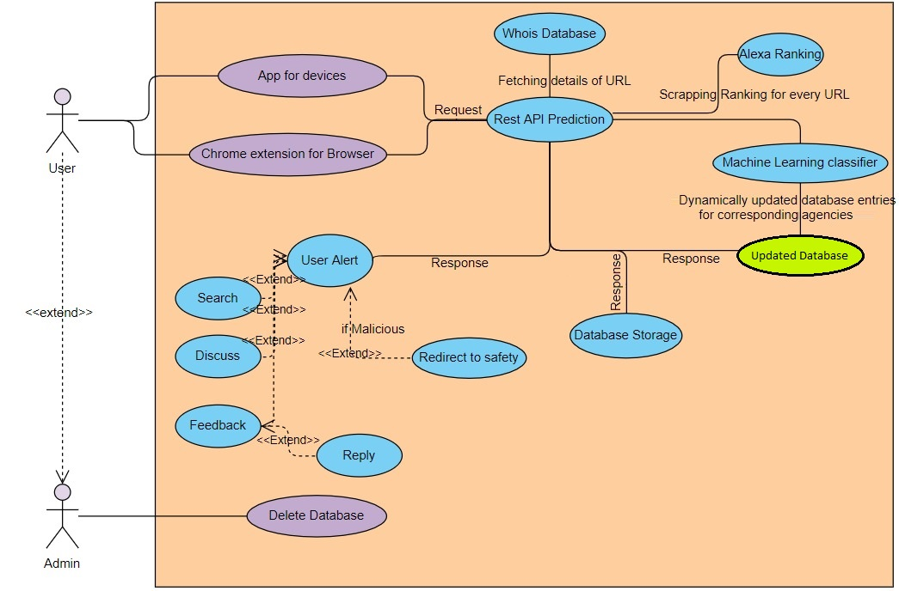
Use Case Diagram:

Slide 12
Thank You

