Slide 1

ENPM808A Final Project A car like Robot
By-
Hritvik Choudhari
UID: 119208793
Professor- Dr. Nikhil Chopra

Slide 2
Data pre-processing
Data preprocessing for the input is done in order to reduce noise and computation time. Transforming or scaling the inputs and reducing the number of features will help us save a lot of computational time and the model will run more effectively giving us better results. In the preprocess step, the data from the 3 sets namely “Corridor”, “Open_box” and “Special” were combined to form a complete training dataset. The data was then randomly shuffled and scaled using StandardScalar function before utilizing it for the training purpose. Similar process was done to obtain testing dataset. Similar process was followed for test dataset.

Slide 3
Feature Selection
The LIDAR data is read and tabulated as columns of the csv file, total 1080 columns named from ‘Laser 1’ to ‘Laser 1080’ where each column is a 0.25-degree scan of the LIDAR. Here we combine 20 columns of the LIDAR data into one by taking their mean which is equivalent to scanning at every 5 degrees. Since we know that quaternion q = qr + qi + qj + qk, we can add the qr and qk columns to a single column since qr and qi are equal to zero. This results in a dataframe that has 60 features and last 2 columns as outputs or target features.

Slide 4
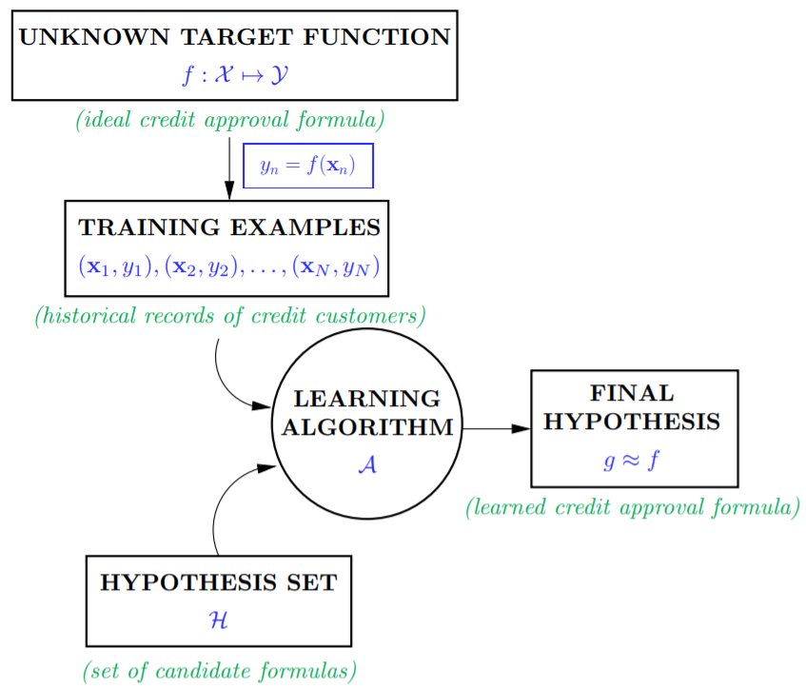
Models used
This is a regression problem since our problem statement requires us to predict the linear and angular velocities. So, we went ahead to try 3 different models namely Linear Regression, Support vector machines and Neural networks.
A pipeline was made where the data was firstly standardized to improve the computation and accuracy of the results. As we have multiple outputs, MultiOutputRegressor function was used in case of Linear Regression and SVM models.
General machine learning pipeline

Slide 5
Linear Regression(SGDRegressor)
Around 60000 datapoints( since the results were constant after certain data points and computing was high for more data) randomly from the training set was used for training and we selected the following hyper-parameters:
Penalty- [l1 , l2]
Alpha- [0.0001, 0.001, 0.01, 0.1] (Regularization term)
Learning rate- [constant, optimal, invscaling, adaptive]
Hyper-parameter tuning was performed where we selected among random 20 combinations of the above parameters using RandomizedSearchCV function. From this the best estimator and parameter was obtained which was. The optimal hyper parameter obtained were:
Best penalty- l2
Best alpha- 0.01
Best learning rate- adaptive
learning curve was obtained with scoring parameter of ‘R2’ along with the validation curves for each hyper-parameter.

Slide 6
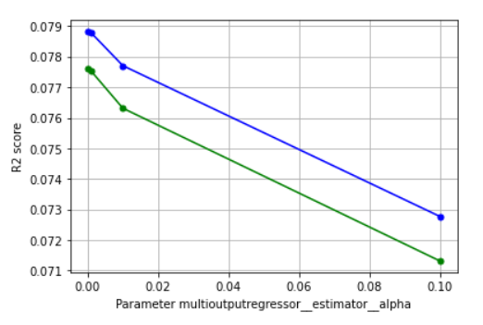
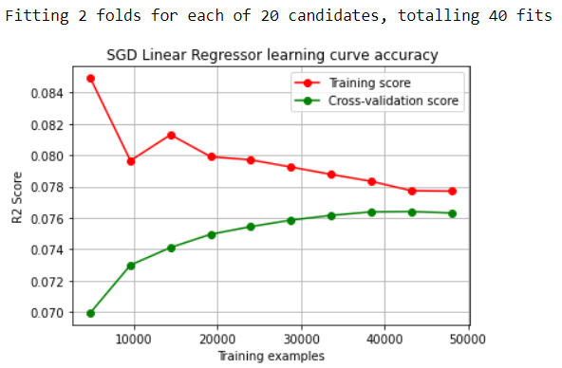
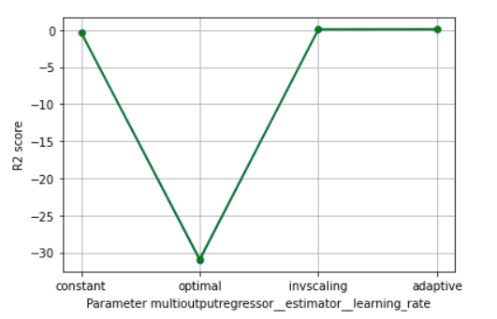
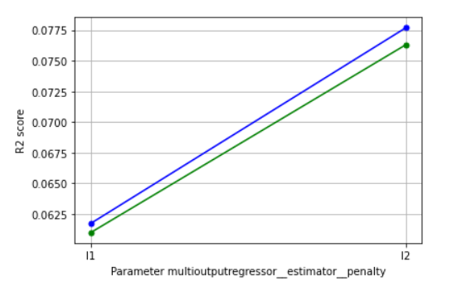
Learning and validation curves:
Model validation score for LR was (R2):
0.06

Slide 7
Support vector machines(SVR)
For the case of SVM model, around 60000 datapoints( since the results were constant after certain data points and computing was high for more data) randomly from the training set was used for training and we selected the following hyper-parameters:
C- [1, 10, 100] (Regularization parameter)
Gamma- [0.0001, 0.01, 1]
Kernel - [rbf, poly]
Degree- [1, 2]
Hyper-parameter tuning was performed where we selected among random 20 combinations of the above parameters using RandomizedSearchCV function. From this the best estimator and parameter was obtained which was. The optimal hyper parameter obtained were:
Best C- 100
Best gamma - 1
Best kernel- rbf
Later the learning curve was obtained with scoring parameter of ‘R2’ along with the validation curves for each hyper-parameter

Slide 8
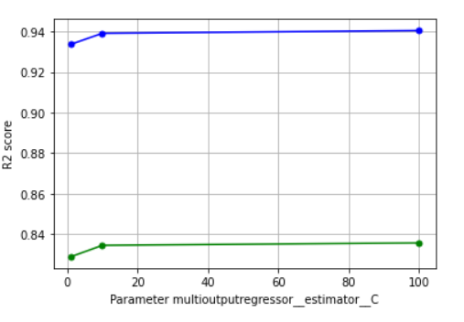
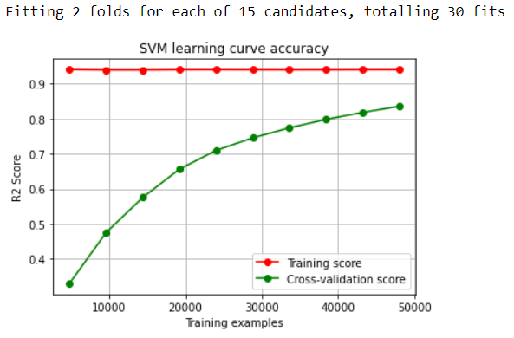
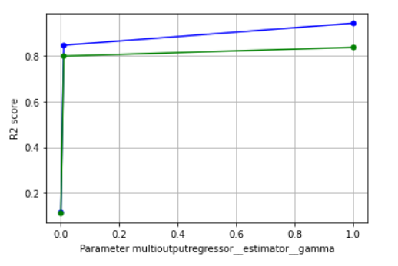
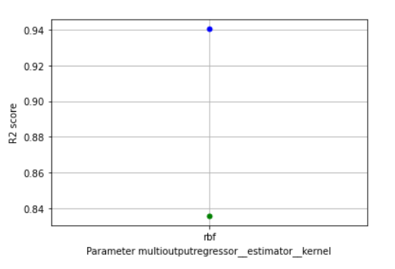
Learning and validation curves:
Model validation score for SVM was (R2):
0.72

Slide 9
Neural Network(MLPRegressor)
For the case of NN model, around 600000 datapoints randomly from the training set was used for training and we selected the following hyper-parameters:
solver- [adam, sgd] (Strength of the L2 regularization term)
activation- [relu, tanh]
alpha - [[0.001, 0.002, 0.003, 0.004, 0.005, 0.006, 0.007, 0.008, 0.009]]
hidden layers sizes- range(5,100)
Hyper-parameter tuning was performed where we selected among random 20 combinations of the above parameters using RandomizedSearchCV function. From this the best estimator and parameter was obtained which was. The optimal hyper parameter obtained were:
Best solver - sgd
Best activation - relu
Best alpha- 0.002
Best hidden layer size- (77,77,77)
Later the learning curve was obtained with scoring parameter of ‘R2’ along with the validation curves for each hyper-parameter

Slide 10
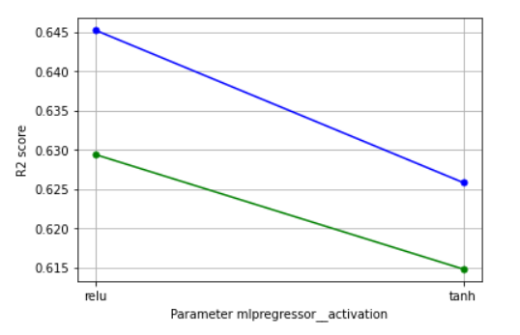
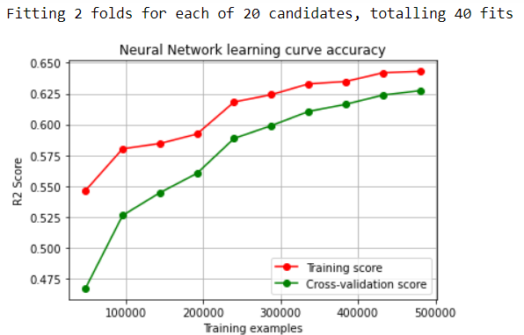
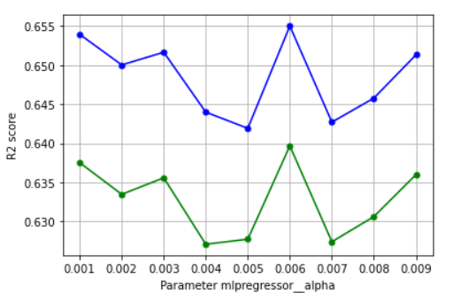
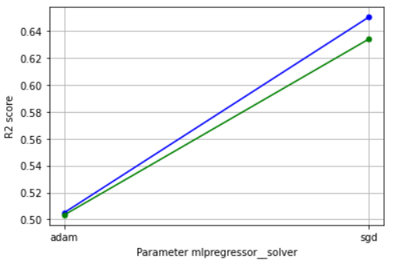
Learning and validation curves:
Model validation score for NN was (R2):
0.52

Slide 11

Testing best model
From the cross-validation score results obtained we have selected SVM as our optimum model with optimal hyper-parameters obtained during training, as it provided the best cross validation score (0.72) among the three. Now we deploy it for testing over the test dataset where similar procedure for data preprocessing is done and then fed to the model. We randomly shuffled the training data and took 80000 data points for the model testing. The scoring parameter used to find E_test is “r_2”.
E_test: 1- r2_score = 0.073
E_out= 0.08
The E_out found is approximately equal to the E_test found earlier. This means that we have learnt something outside outside the dataset we have used.

