Slide 1
IPL Winning Predictor
Submitted by
Hritwik Bhaumik(17BCE0548)

Slide 2
PROBLEM STATEMENT
Data Visualization is a used a lot in major sports to determine the outcome of the matches and is also used in fantasy sports, betting and simulation.
However with cricket, technology has not been utilized as much as in other major sports. This is an attempt to predict the matches of this sport in its shortest and most popular format – T20.
With the increase in number of teams and number of matches in each season of IPL (Indian Premiere League) year by year, it has become difficult to manage useful information from the available data of all the matches. This project is an attempt to visualize the data in a way, which makes it easier to make various predictions.

Slide 3
In this way, it can help decision makers during the IPL matches to evaluate the strength of a team against another.
This project presents the data of IPL (Indian Premiere League) from the past, all seasons which has then been used to visualize the past performance of various players on different parameters.
In addition, the data has been used to predict the outcome of a match using various parameters.

Slide 4
GAPS IDENTIFIED
The Current way of visualizing and predicting is not that effective. Its not that efficient and its not accurate and precise.
The current analysis does not have more parameters to make the predictions which again leads to inaccuracy.
Here we have used various parameters and analysed various graphs for even minute predictions.

Slide 5
PROPSED ALGORITHM
The user will enter the team names, the team entered first will be the home team. The user will also enter the toss decision and venue if needed. Using data mining and machine learning we will predict the winner of the match using the following methods-
a) First pre-process and clean the data set
b) Assign initials to the team full names
c) Find out the ratio of toss won and match won

Slide 6
d) Find out the correlation between home team and venue win percentage
e) Use labelencoder() to mark the labels needed for the three main columns.
f) Use decision tree and random forest to predict the winner
Building the model involves-
Using the scikitlearn library.
Labeling the objects using LabelEncoder()

Slide 7
Using other important modules like - :
Logistic Regression
Kfold cross validation
RandomForest Classiifier
Decision Tree

Slide 8
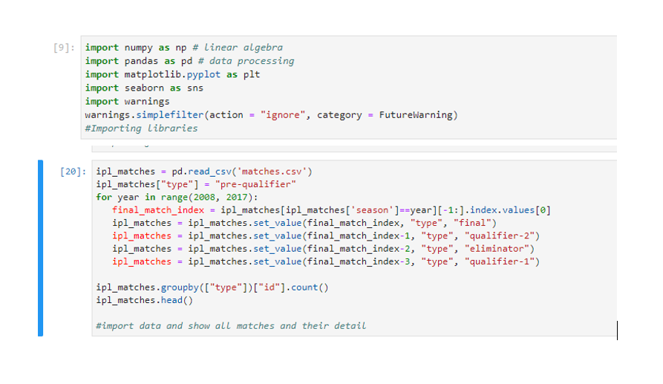
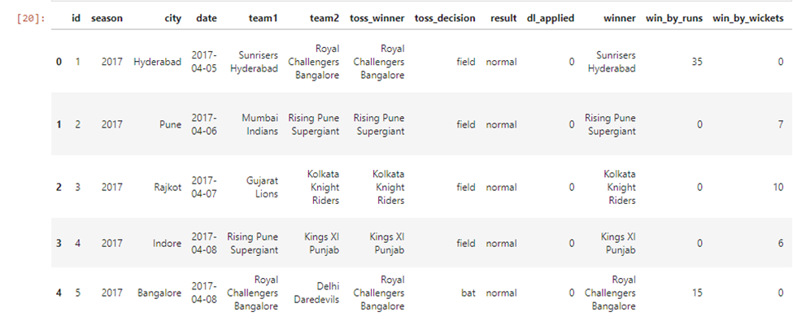
RESULT ANALYSIS
Here are some of our screenshots of result analysis-

Slide 9
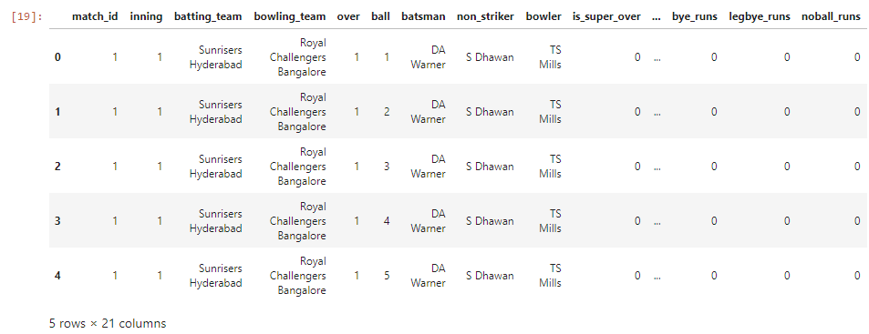
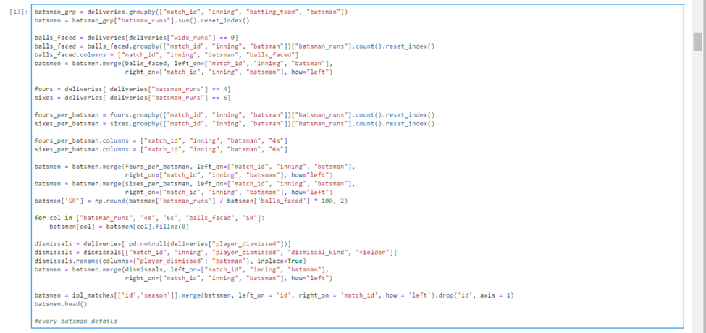
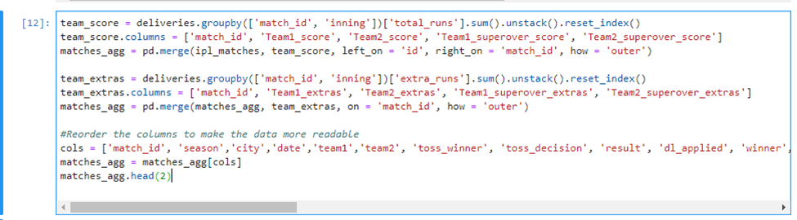
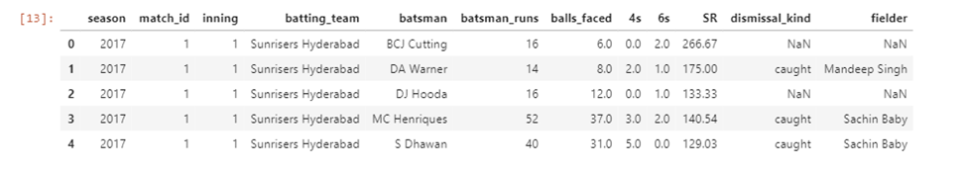
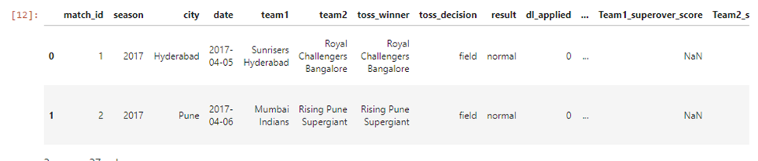

Slide 10
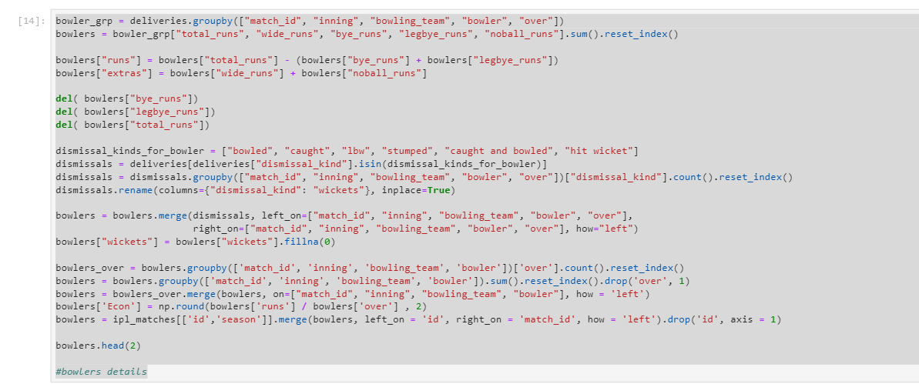

Slide 11
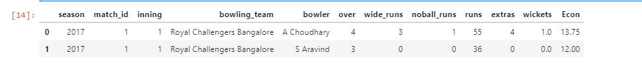
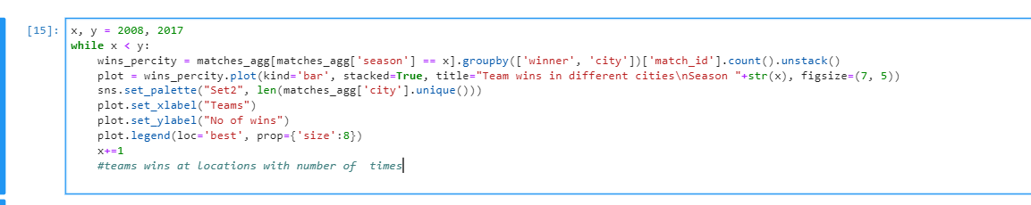
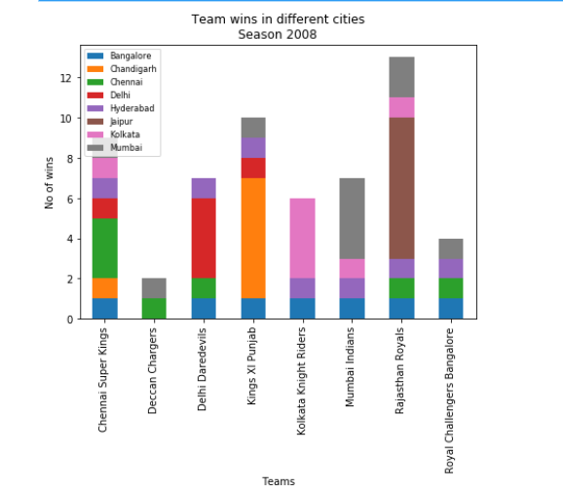
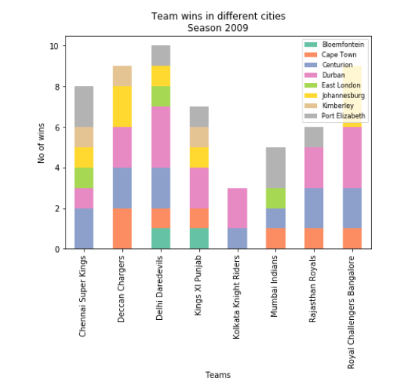
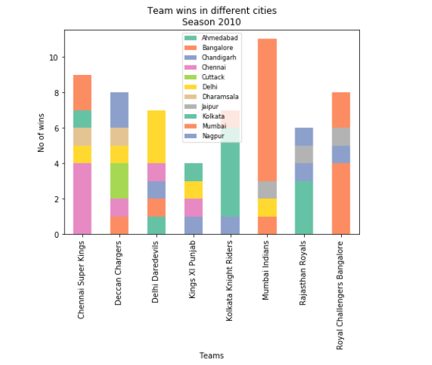

Slide 12
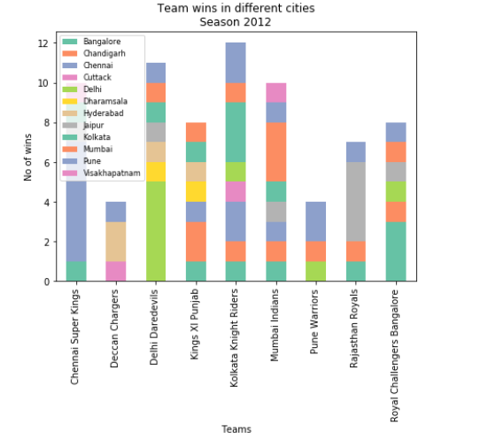
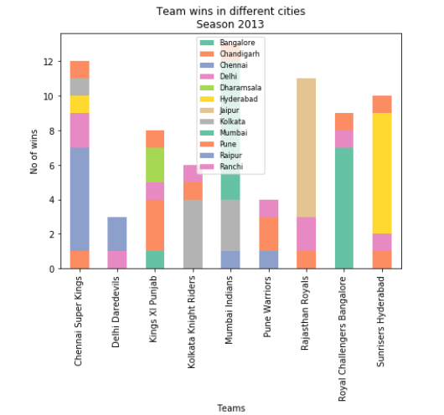

Slide 13
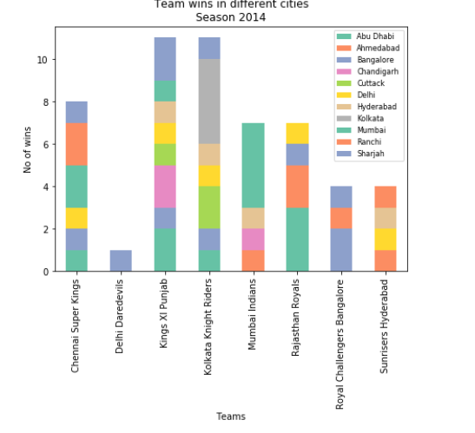
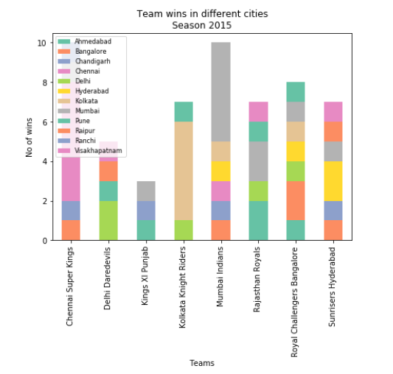
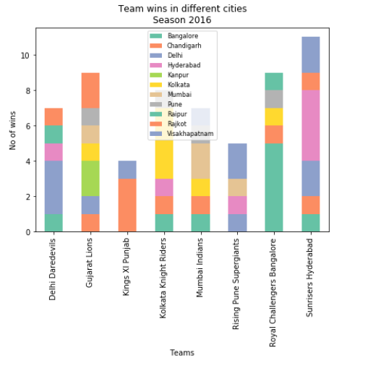

Slide 14
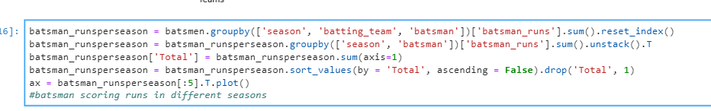
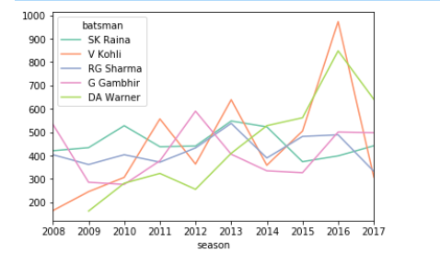
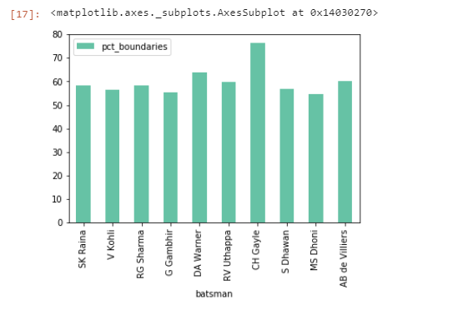
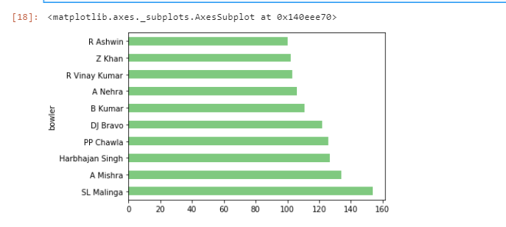
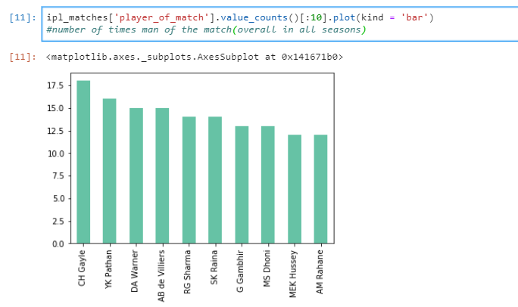

Slide 15
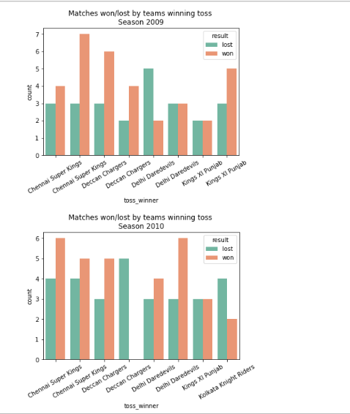
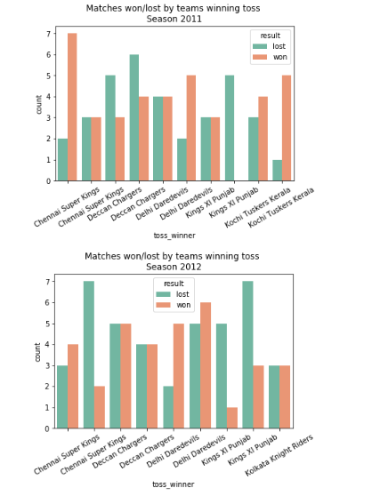
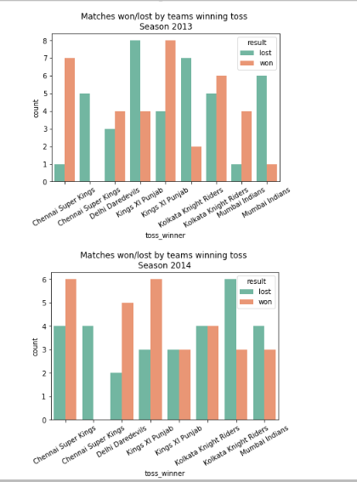
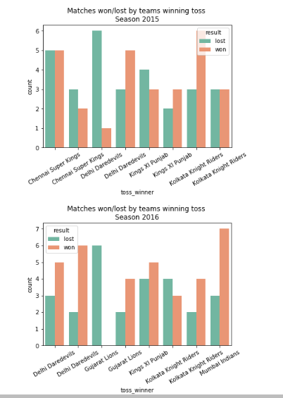

Slide 16
References
Passi, Kalpdrum & Pandey, Niravkumar. (2018) “Predicting Players' Performance in One Day International Cricket Matches Using Machine Learning” 111-126. 10.5121/csit.2018.80310.
I. P. Wickramasinghe et. al, "Predicting the performance of batsmen in test cricket," Journal of Human Sport & Exercise”, vol. 9, no. 4, pp.744-751, May 2014.
R. P. Schumaker, O. K. Solieman and H. Chen, "Predictive Modeling for Sports and Gaming” in Sports Data Mining, vol. 26, Boston,Massachusetts: Springer, 2010.
J. McCullagh, "Data Mining in Sport: A Neural Network Approach," International Journal of Sports Science and Engineering, vol. 4, no. 3,p. 131-138, 2012.
Bunker, Rory & Thabtah, Fadi. (2017) “A Machine Learning Framework for Sport Result Prediction. Applied Computing and Informatics”, 15. 10.1016/j.aci.2017.09.005.

Slide 17
Ramon Diaz-Uriarte and Sara, “Gene selection and classification of microarray data using random forest, BMC Bioinformatics”, doi:10.1186/1471-2105-7-3
Rabindra Lamsal and AyeshaChoudhary, “Predicting Outcome of Indian Premier League (IPL) Matches Using Machine Learning”
Akhil Nimmagadda et. Al, “Cricket score and winning prediction using data mining”, IJARnD Vol.3, Issue3.
Ujwal U J et. At, “Predictive Analysis of Sports Data using Google Prediction API” International Journal of Applied Engineering Research”, ISSN 0973-4562 Volume 13, Number 5 (2018) pp. 2814-2816.
Rameshwari Lokhande and P.M.Chawan, “Live Cricket Score and Winning Prediction”, International Journal of Trend in Research and Development, Volume 5(1), ISSN: 2394-9333.
Abhishek Naiket. Al, “Winning Prediction Analysis in One-Day-International (ODI) Cricket Using Machine Learning Techniques”, IJETCS, vol. 3, issue 2, ISSN:2455-9954, April 2018.
Esha Goel and Er. Abhilasha, “ Random Forest: A Review”, IJARCSSE, Volume 7, Issue 1, DOI: 10.23956/ijarcsse/V7I1/01113, 2017.
Amit Dhurandhar and Alin Dobra, “ Probabilistic Characterization of Random Decision Trees”, Journal of Machine Learning Research, 2008.

Slide 18
WORK DISTRIBUTION
Work was distributed evenly among both the team members.
The work involved first pitching data and extracting and cleaning the data.
Next step involved to decide the predictions that the analysis of this data will lead to.
After this the major step involved deciding the parameters on which this whole analysis will be done. This naturally took a very long time.
The final step involved implementing the data via coding on Jupyter lab.

