Slide 1
Improved LEACH Protocol for Increasing Network Lifetime Based on Circular Patches Clustering
Awj R. Tarawneh, Banan Malahmeh, Abdullah Al-Odienat
Members:
Nishita Agarwal
Hritwik Singhal

Slide 2
The nodes are capable of performing several data operations like sensing the environment, gathering, processing the data and other operations. They receive the essential energy for performing these processes from the batteries embedded in these nodes. It is very important to reduce energy consumption and to make the lifetime of the network as long as possible.
For this purpose, the Low Energy Adaptive Clustering Hierarchy (LEACH) routing protocol has been developed. In this paper, a modified model of LEACH protocol is developed to further reduce energy consumption and consequently, increasing the lifetime of the network.
Abstract:

Slide 3
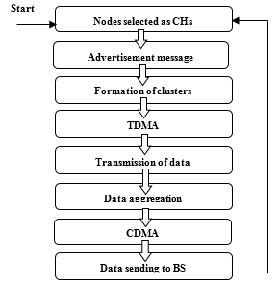
LEACH protocol is used as a probabilistic formula for the selection of the node in a random way.
The tasks of sensing and transmitting the data to the cluster head are performed by a normal node. Whereas, the cluster head performs the duties of processing, aggregation, receiving and transmitting data to the sink or base station. So the cluster head spends more energy than non-cluster head one.
Every node will be chosen as a cluster head to continue the process of transmitting data. The consumption of the node's energy will be done systematically until the last node loses its energy and become dead and that will increase the lifetime of the network
LEACH PROTOCOL

Slide 4
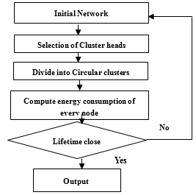
In LEACH protocol, the cluster heads are distributed randomly, near or far from the base station. The random situated CH may lead to more energy consumption based on the distance between the CH and base stations. The number of cluster heads in LEACH is varied in different rounds.
Whereas, the improved LEACH [I-LEACH] divides the network into circular clusters where every cluster has its cluster head. The number of cluster heads is an optimal predetermined value.
The restriction on [circular clusters] is based on the width of the network (W) and the diameter of each circular cluster equals the width divided by the number of segments on each side. It will be obvious that the circular clustering will increase the lifetime of the network by organizing the process of sending packets to the base station or sink.
IMPROVED LEACH PROTOCOL(I-LEACH)

Slide 5
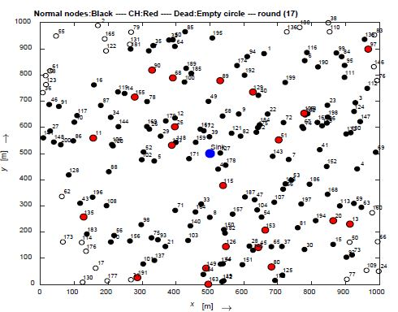
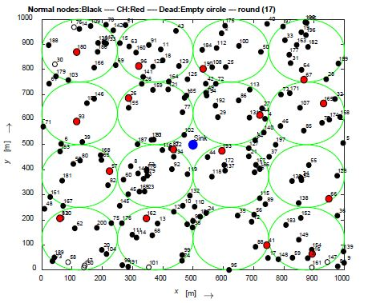
CLASSIC LEACH
IMPROVED LEACH

Slide 6
Simulation
Parameter | Values
Network size | 1000 m2
Number of nodes | 200
Initial Energy (E0) | 2 J
Cluster head percentage | 0.1%
Number of rounds | 200
Energy for transmitting one bit (Etrans) | 1.0000e-07
Energy for receiving one bit (Erec) | .1.0000e-07
Data aggregation energy (Eagg) | 1.0000e-08
The energy of free space model amplifier (Efs) | 0.3400e-9
Table 1

Slide 7
In the first case, the parameters of the network are taken from table 1.
The results for the network configuration before and after improvement, the total energy dissipated, the number of alive sensor nodes and the number of throughputs or number of packets is depicted in (Figures
4,5,6,7 and 8), respectively.
Case 1:

Slide 8
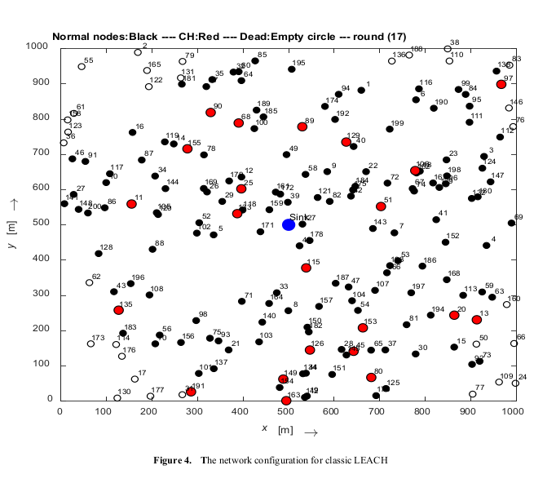
Figure 4 shows the network configuration for the classic LEACH.
the black bold dots indicate the normal nodes and the black empty dots indicate the dead nodes, whereas, the red ones are the cluster heads (CHs). The blue circle in the middle of the network is for the sink or base station.
In this configuration, the cluster heads are chosen randomly

Slide 9
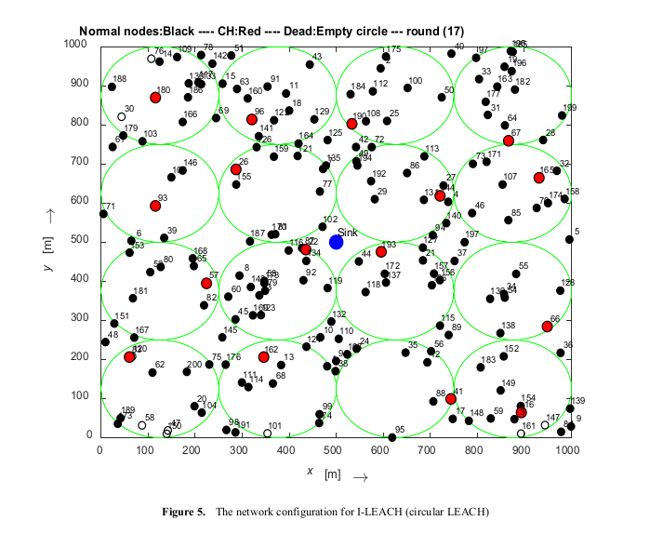
whereas the network configuration for the I-LEACH in Fig. 5 separated the network into a number of circular clusters (green circles) and the cluster head is chosen inside each
circle only (the red dot).

Slide 10
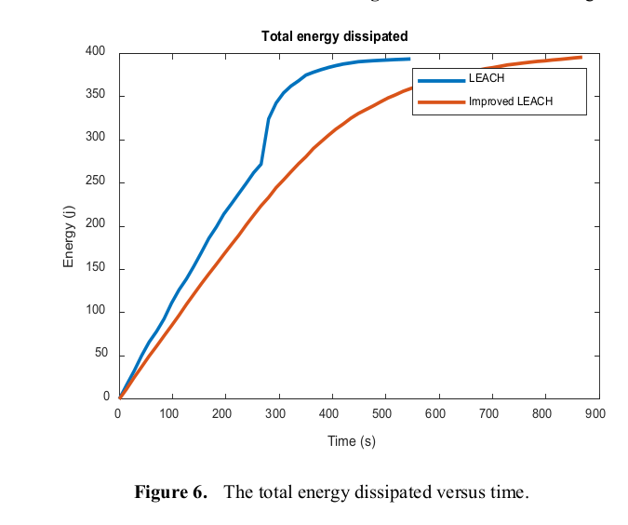
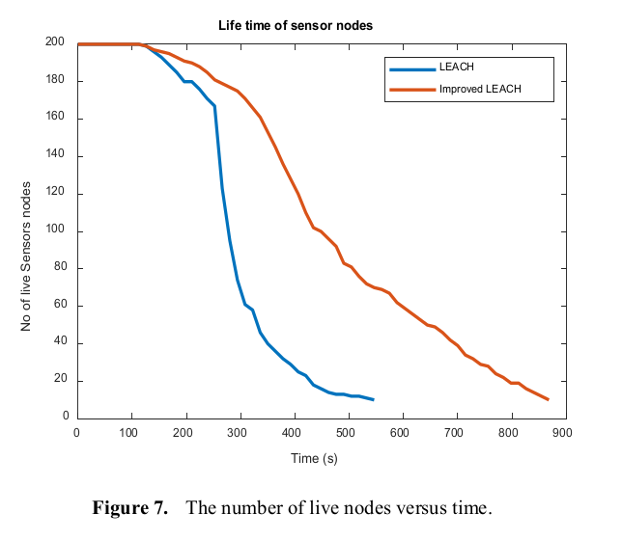
Classic LEACH takes 600 seconds to dissipate the total amount of energy while the circular cluster takes 1300 seconds. Moreover, before the time of 300 seconds, the number of dead nodes for the I-LEACH is almost zero, which proves the effectiveness of the proposed I-LEACH as compared to the classic one.
The total energy dissipated by the classic LEACH is
greater than I-LEACH, as shown in fig. 6.

Slide 11
Case 2
In this case, the number of nodes is increased to 400 node and the remaining parameters are the same as in the first case. As shown in (Figures 8 and 9) the number of dots increased (number of nodes) and the number of green
circles also increased with the increasing number of the
cluster heads.
The results are shown in figures 10, 11 and 12. The circular cluster is better than the normal one. Energy dissipation is lower and the time taken until the last node becomes dead is more than 2000 seconds. The number of packets sent to the sink node is higher. On the other hand, classic LEACH takes only 1000 seconds until the last node becomes dead and sends only 10×106 packets to the sink node.

Slide 12
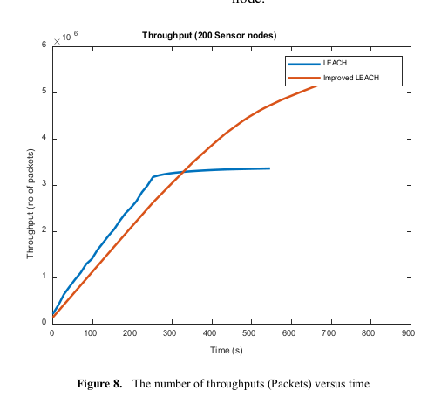
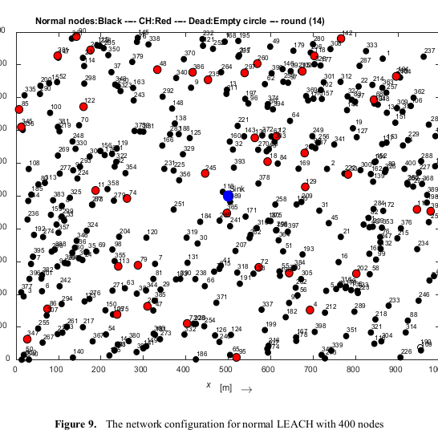
The number of throughput or packets sent to the sink node for the circular LEACH is higher than the classic LEACH as shown in figures 7 and 8, respectively.

Slide 13
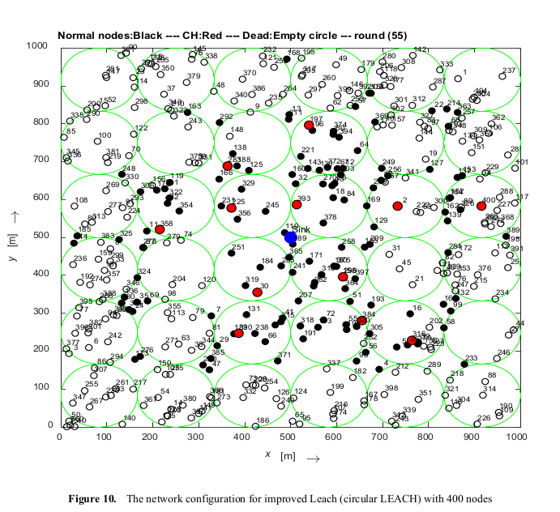
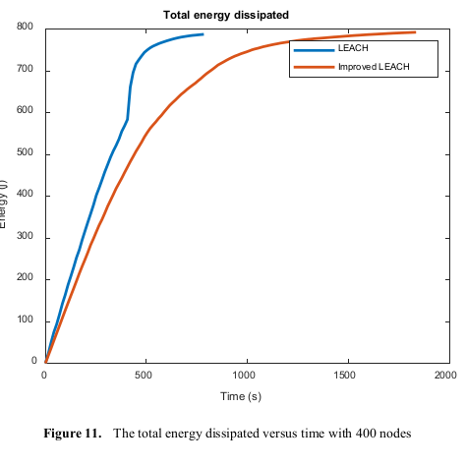

Slide 14
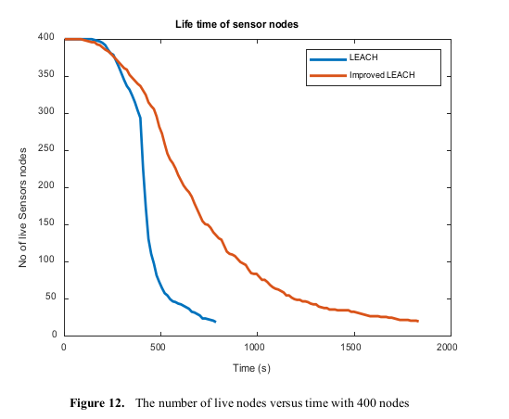

Slide 15
Case 3
In the third case, the initial energy increased from 2 to 4
Joules and the other parameters are kept the same as case one.
The network configurations are the same as in case one since the number of nodes does not change.
The other results are shown in (Figures 14, 15 and 16).

Slide 16
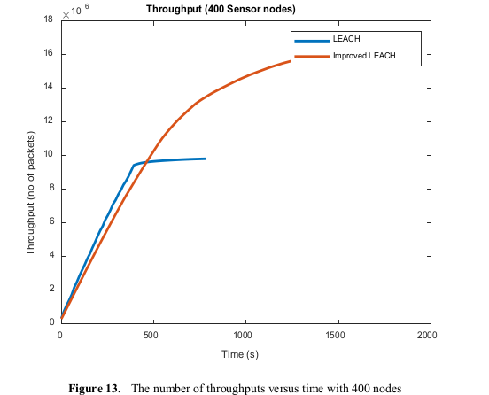
When the initial energy of the nodes increases, the time required for the last node to become dead increases also.
This is shown in figure 13 where the nodes in the classic LEACH take more than 1000 seconds to dissipate the whole energy while in the case of I-LEACH it takes more than 2200 seconds.

Slide 17
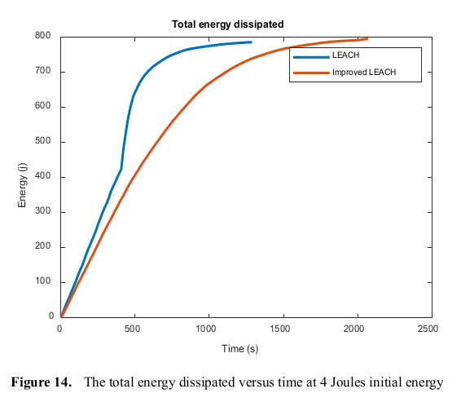

Slide 18
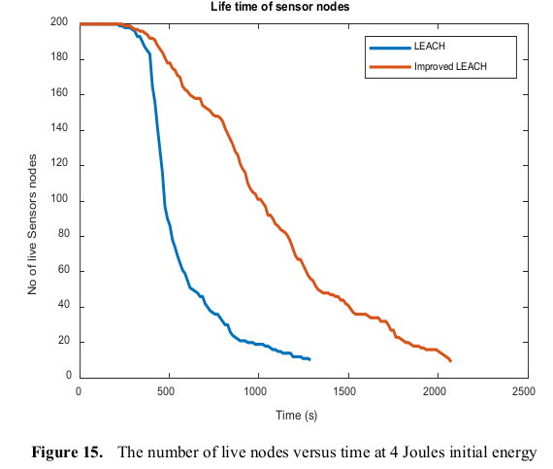
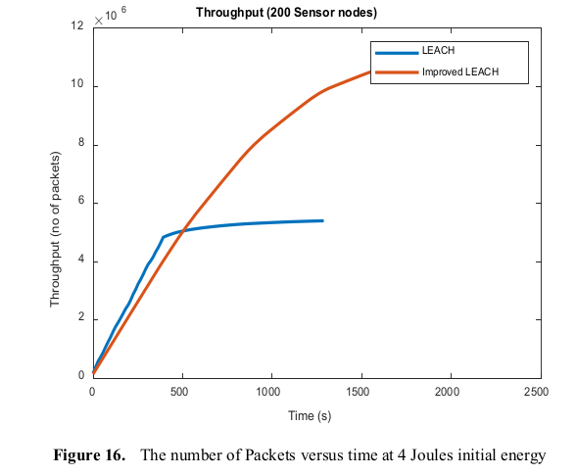
From (Figures 15 and 16) it clear that I-LEACH
outperforms the classic one in both the number of live nodes and the number of packets sent to the base station.

Slide 20
Results.
Simulation Parameters
Parameter | Values
Network size | 1000 m2
Number of nodes | 200
Initial Energy (E0) | 2 J
Cluster head percentage | 0.1%
Number of rounds | 200
Energy for transmitting one bit (Etrans) | 1.0000e-07
Energy for receiving one bit (Erec) | .1.0000e-07
Data aggregation energy (Eagg) | 1.0000e-08
The energy of free space model amplifier (Efs) | 0.3400e-9

Slide 21
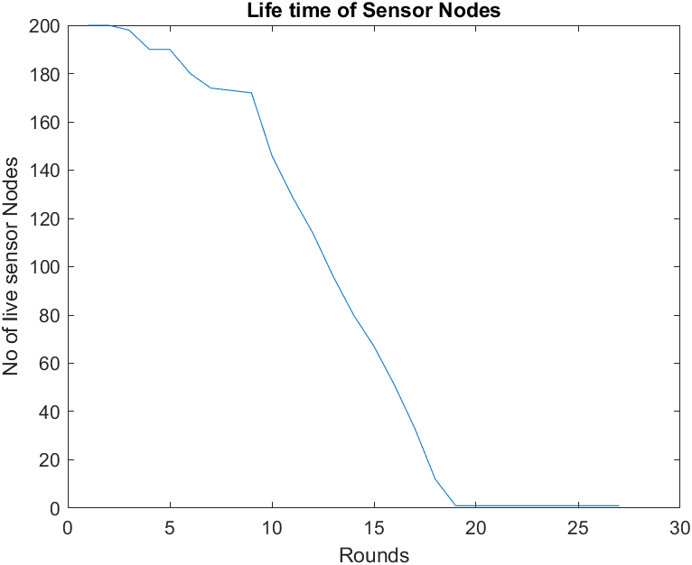
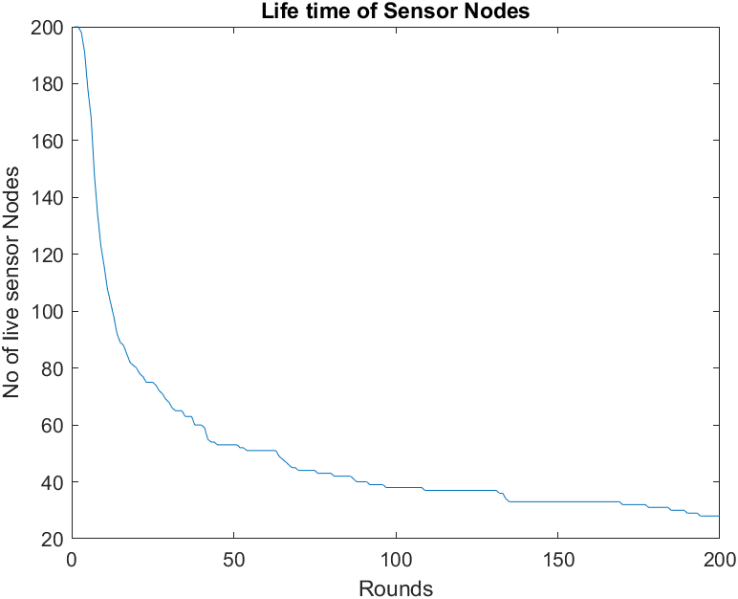
CASE 1
BASIC LEACH
IMPROVED LEACH
CASE 1:

Slide 22
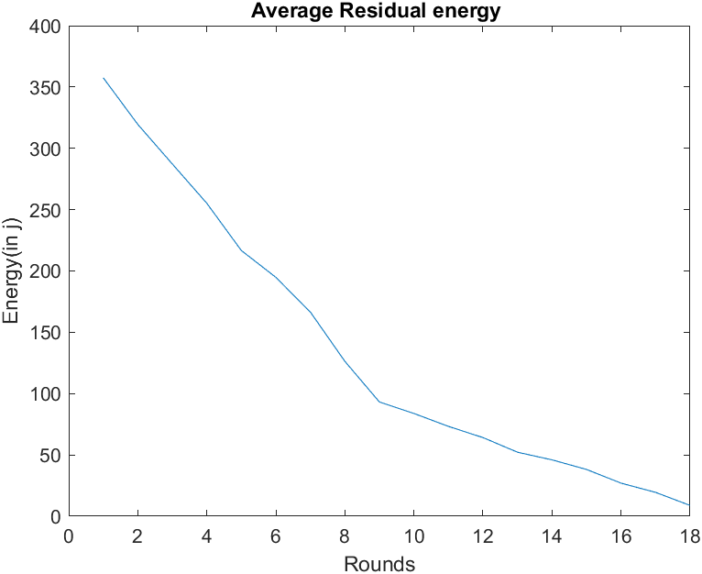
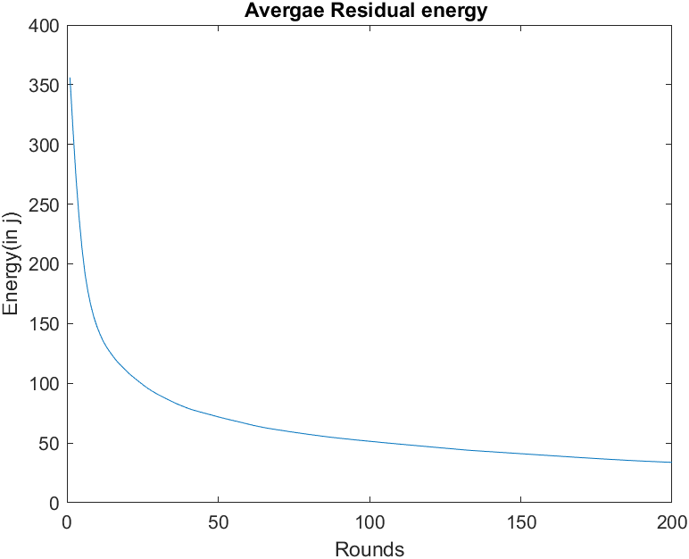
CASE 1
BASIC LEACH
IMPROVED LEACH

Slide 23
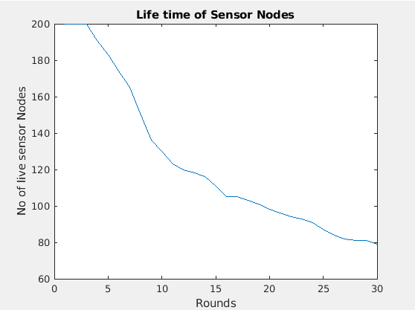
CASE 1
BASIC LEACH
IMPROVED LEACH

Slide 24
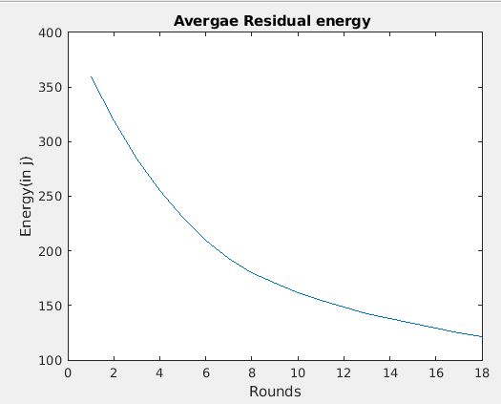
CASE 1
BASIC LEACH
IMPROVED LEACH

Slide 25
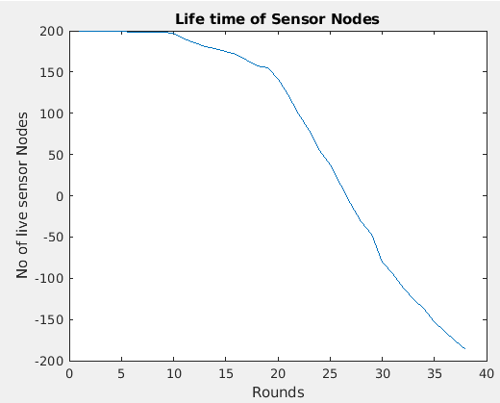
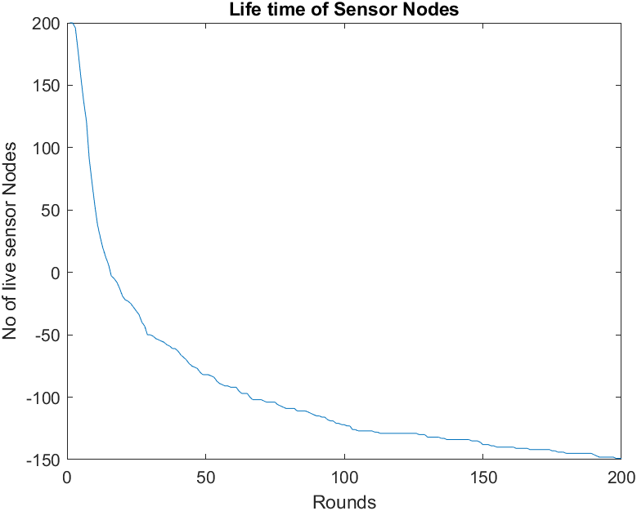
CASE 2: number of nodes increased to 400
BASIC LEACH
IMPROVED LEACH

Slide 26

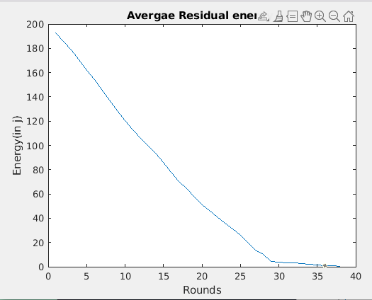
CASE 2: number of nodes increased to 400
BASIC LEACH
IMPROVED LEACH

Slide 27
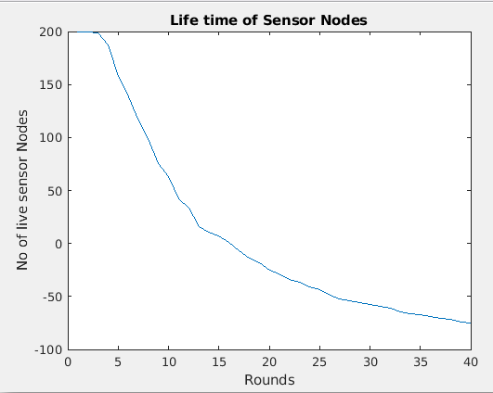
CASE 2: number of nodes increased to 400
BASIC LEACH
IMPROVED LEACH

Slide 28
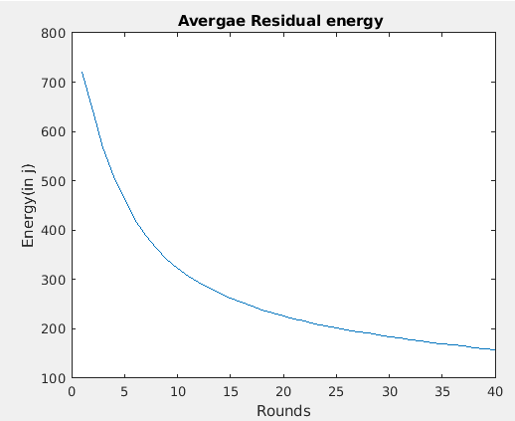
CASE 2: number of nodes increased to 400
BASIC LEACH
IMPROVED LEACH

Slide 29
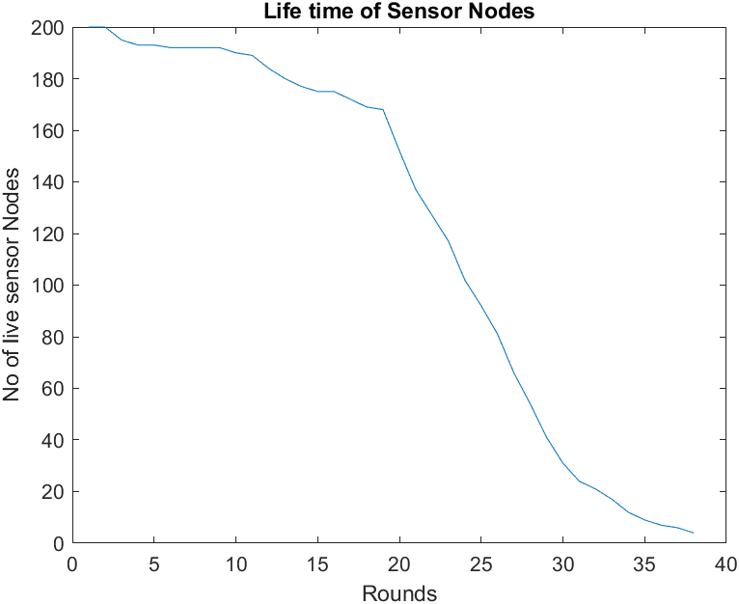
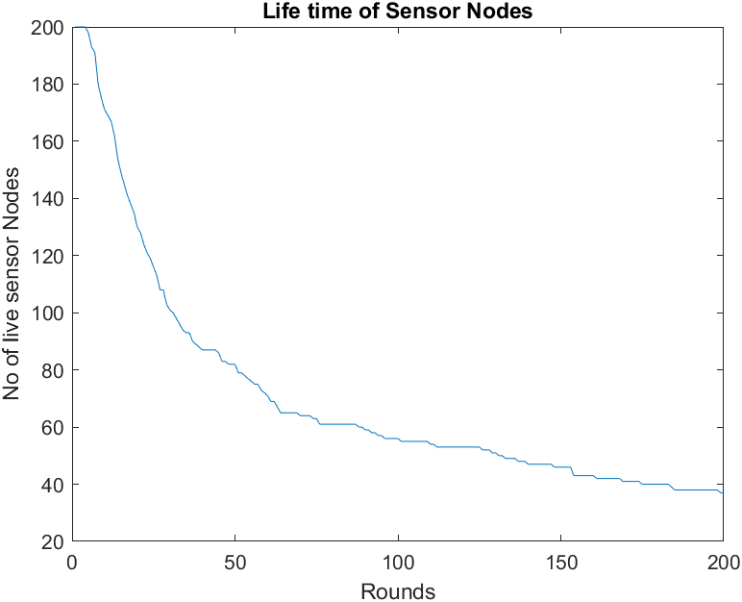
CASE 3: initial energy increased from 2 to 4 Joules
BASIC LEACH
IMPROVED LEACH

Slide 30
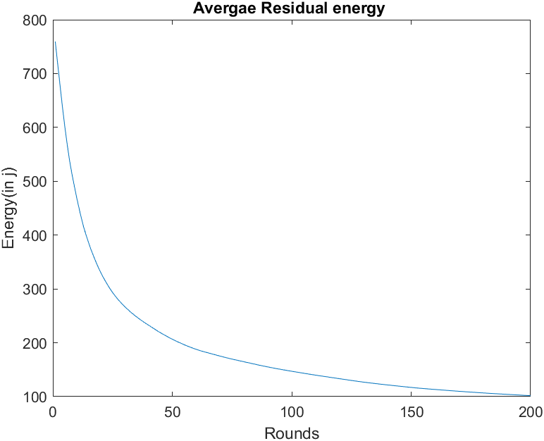
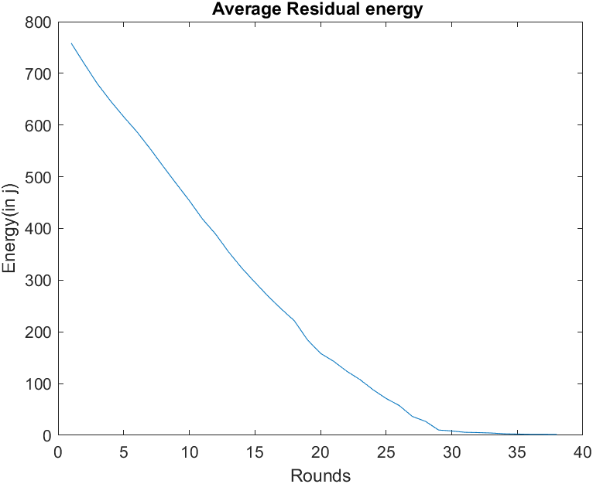
CASE 3: initial energy increased from 2 to 4 Joules
BASIC LEACH
IMPROVED LEACH

Slide 31
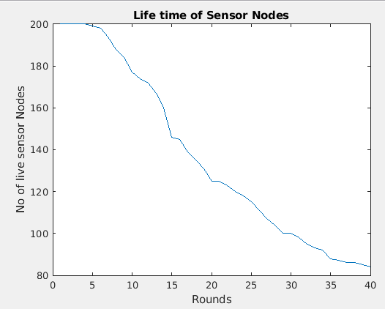
CASE 3: initial energy increased from 2 to 4 Joules
BASIC LEACH
IMPROVED LEACH

Slide 32
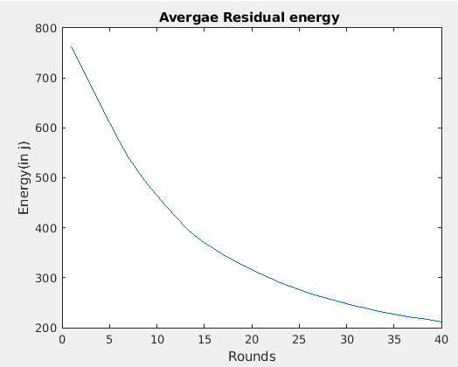
CASE 3: initial energy increased from 2 to 4 Joules
BASIC LEACH
IMPROVED LEACH

Slide 33
Conclusion
A new improved LEACH protocol is proposed, and this new modification on the LEACH protocol is achieved by dividing the network into circular clusters.
The proposed I-LEACH protocol is superior to classic LEACH in many aspects. From the simulation results, I-LEACH protocol decreases the energy consumption and significantly increases the network lifetime as compared to the original LEACH protocol by decreasing the number of dead nodes and increasing the number of alive nodes through the 200 rounds to continue the process of transmitting data in WSN.

