Slide 1

SiVa

Slide 2
SiVa – Signature Validation Software
SiVa is a web service for validating digitally signed documents. SiVa has:
REST ETSI compliant API;
SOAP ETSI compliant API.
SiVa supports the following file formats:
PDF version 1.7 and later signed with PadES-profile signatures;
DDOC starting from version 1.0;
BDOC starting from version 2.1;
X-Road v6 security server ASiCE containers.

Slide 3
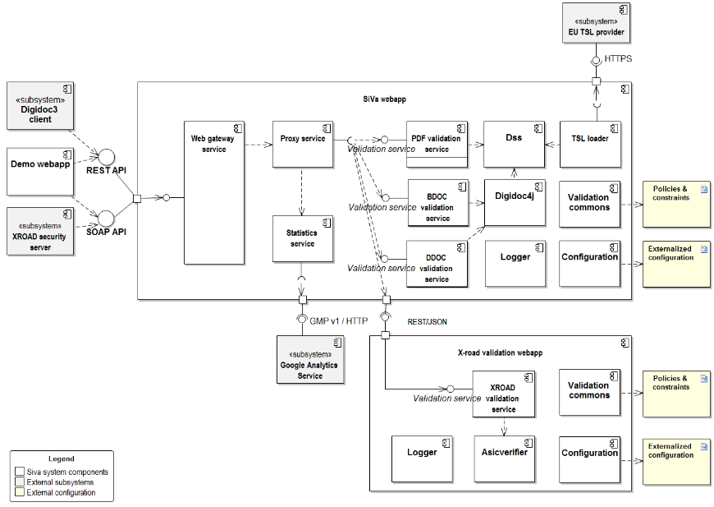
SiVa Components’ Model

Slide 4
Supported Formats’ Levels
Signature format | BASELINE_B_BES | BASELINE_B_EPES | BASELINE_T | BASELINE_LT | BASELINE_LT_TM | BASELINE_LTA
BDOC | NOK | NOK | NOK | OK | OK | OK
X-Road signature (simple form) | NOK | NOK | NOK | OK | NOK | NOK
X-Road signature (batch signature) | OK | OK | NOK | NOK | NOK | NOK
PAdES | NOK | NOK | NOK | OK | NOK | OK
DIGIDOC-XML 1.0...1.3 | NOK | NOK | NOK | NOK | OK | NOK
DIGIDOC-XML 1.0...1.3 hashcode | NOK | NOK | NOK | NOK | OK | NOK

Slide 5
ETSI Standards
Container format | Signature / container object format | Existing Baseline Profile reference in eIDAS | New Baseline Profile reference (ETSI EN standard) | Notes
ASiC-S | XAdES | ETSI TS 103 174 [5], chap. 7.3.1 | ETSI EN 319 162 [9], chap. 5.3.2 | -
 | CAdES | ETSI TS 103 174 [5], chap. 7.3.2 | ETSI EN 319 162 [9], chap. 5.3.2 | -
 | time-stamp token | ETSI TS 103 174 [5], chap. 7.3.3 | N/A | This profile is not included in Baseline Profile of the new ETSI EN standard
ASiC-E | XAdES | ETSI TS 103 174 [5], chap. 8.3 | ETSI EN 319 162 [9], chap. | Add support additional features, without restrictions introduced in BDOC 2.1 standard
 | CAdES | ETSI TS 103 174 [5], chap. 8.4 | N/A | This profile is not included in Baseline Profile of the new ETSI EN standard
 | time-stamp token | ETSI TS 103 174 [5], chap. 8.5 | N/A | This profile is not included in Baseline Profile of the new ETSI EN standard
PAdES | N/A | ETSI TS 103 172 [3] | ETSI EN 319 142 [8] | Support all features, including PAdES with XAdES, if it is Baseline Profile compliant
N/A | XAdES | ETSI TS 103 171 [2] | ETSI EN 319 132 [7] | -
N/A | CAdES | ETSI TS 103 173 [4] | ETSI EN 319 122 [6] | -

Slide 6
API for Integrators
Validation request interfaces
REST JSON Endpoint
POST https://<server url>/validate
SOAP Endpoint
POST https://<server url>/soap/validationWebService/validateDocument
JSON request
{
"filename":"sample.ddoc",
"documentType":"DDOC",
"document":"PD94bWwgdmVyc2lvbj0iMS4....",
"signaturePolicy": "POLv1"
}

Slide 7
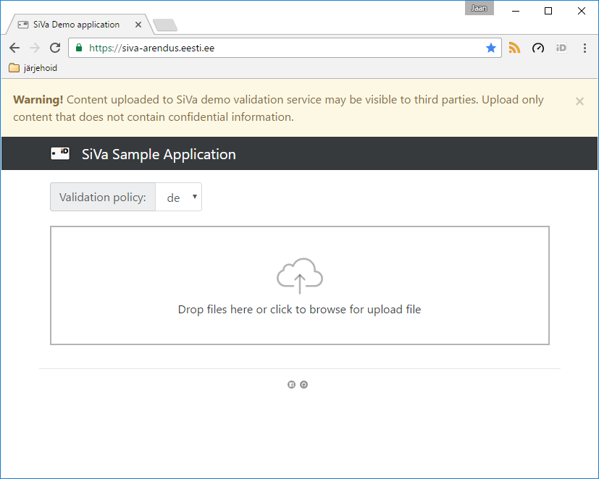
Demo Application

Slide 8
For integrators
Demo Application
https://siva-arendus.eesti.ee/
Github repo including code https://github.com/open-eid/SiVa
Documentation
http://open-eid.github.io/SiVa/

