Slide 1
FPROG – War and Peace classification
Stefan Hromada, Marcel Wartecker

Slide 2
Read file

Slide 3
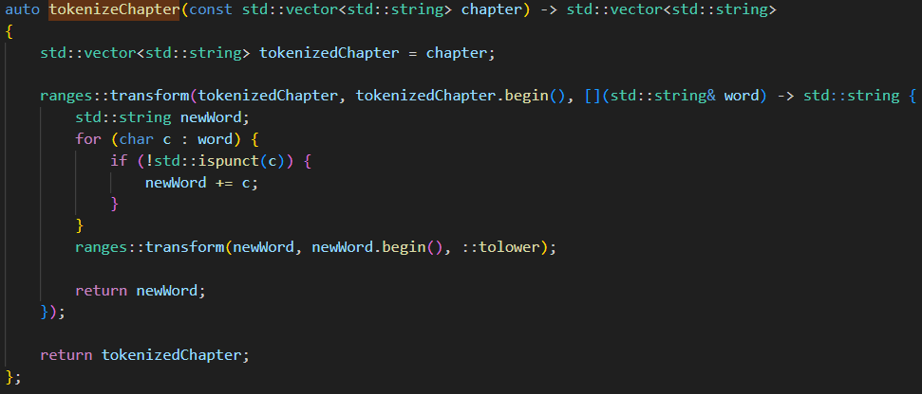
Tokenize text

Slide 4
Filter words

Slide 5
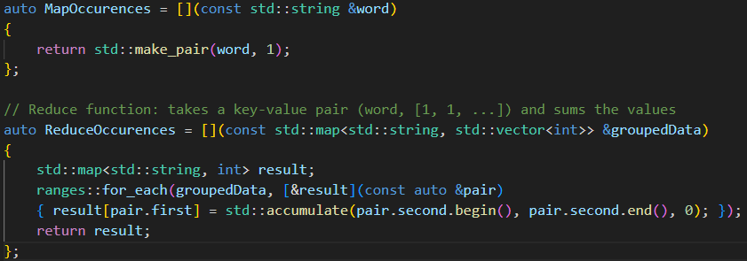
Count occurences

Slide 6
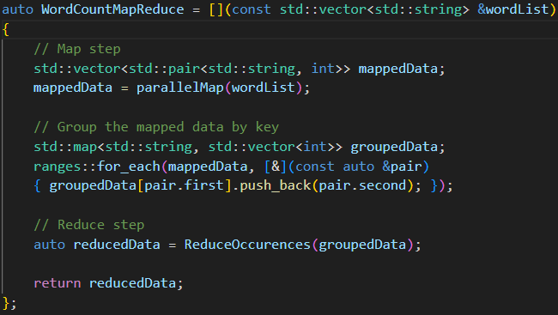

Slide 7
Calculate term density

Slide 8
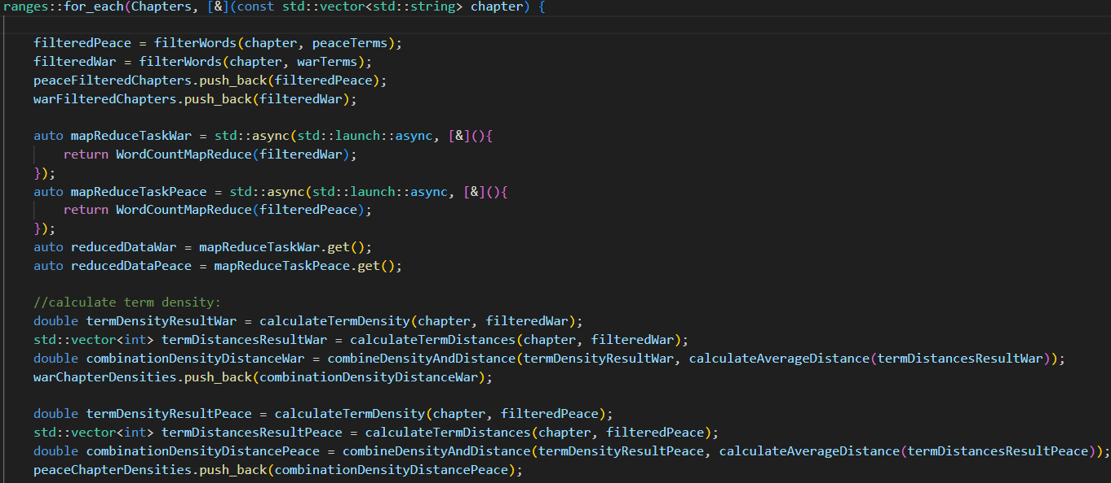
Processing chapters

Slide 9
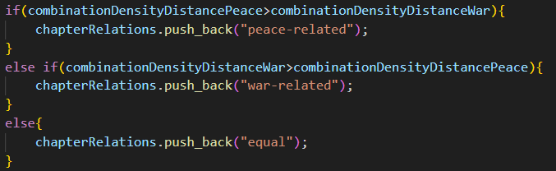
Results

