Slide 1
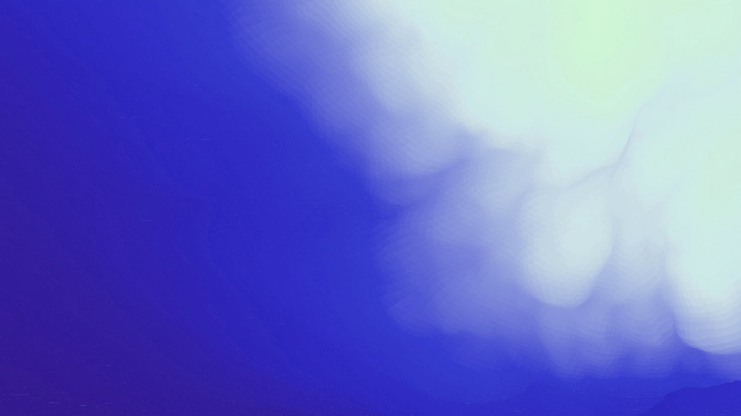
Real Time Multi-Object Detection using YOLO v3
Presentation By:
Hrriday Agarwal (2K20/IT/58)

Slide 2
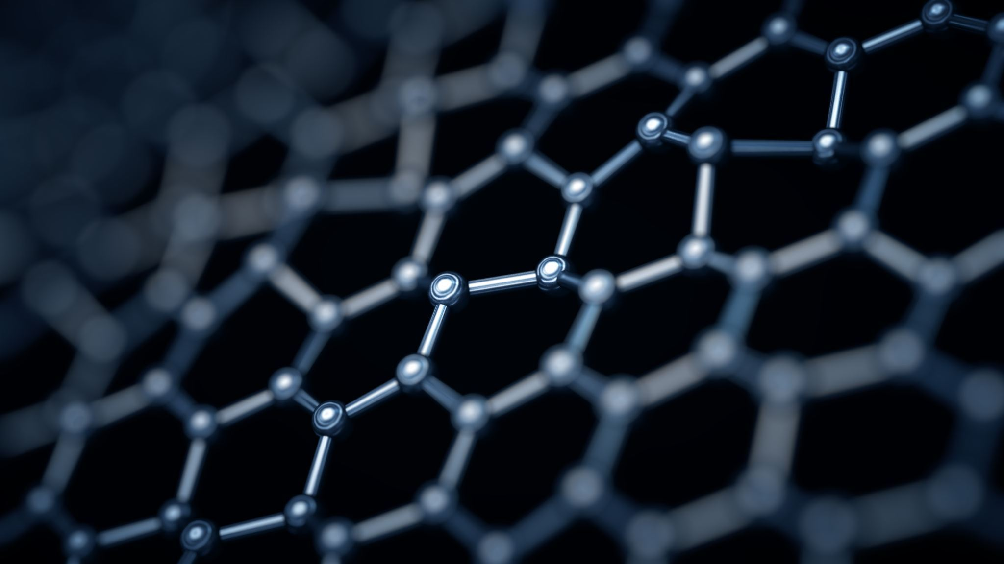
Object Detection
Object detection refers to the task of locating and classifying objects within an image or video. In the context of car object detection, the problem involves identifying and localizing all instances of cars within an image or video frame.​
The problem of object detection can be broken down into two main sub-tasks:​
Object localization: This involves identifying the location of all objects within the image or video frame. Typically, object localization is done by drawing bounding boxes around the objects of interest.​
Object classification: Once the objects have been localized, the next step is to classify them into different categories. In the case of object detection, this involves distinguishing between different objects in the scene.

Slide 3
YOLO V3
YOLO (You Only Look Once) is a popular object detection algorithm that can recognize objects in images and videos in real-time. YOLOv3 is the latest version of this algorithm and has significantly improved the detection accuracy compared to its earlier versions.
The main idea behind YOLO is to divide the input image into a grid of cells and for each cell, the algorithm predicts a set of bounding boxes, confidence scores, and class probabilities.
The predicted bounding boxes are parameterized relative to the corresponding cell, and they predict the center coordinates, width, and height of the object.
The confidence score indicates how confident the algorithm is that there is an object in that box, and the class probabilities predict the probability of the object belonging to each class.

Slide 4
YOLOv3 introduced a number of improvements over its predecessor, including:
Feature Pyramid Network (FPN): YOLOv3 uses an FPN to extract features at different scales, allowing it to detect objects of different sizes.
Darknet-53 Backbone: YOLOv3 uses a deep neural network architecture called Darknet-53 as its backbone. Darknet-53 is a powerful convolutional neural network that can extract features from images at different levels of abstraction.
Spatially-Separable Convolutional Layers: YOLOv3 uses a new type of convolutional layer called spatially-separable convolutional layers. These layers are more computationally efficient and allow YOLOv3 to run faster on GPUs.
YOLOv3 has 3 output layers which is uses to detect objects of small, medium or large size.
Overall, YOLOv3 is a fast and accurate object detection algorithm that can be used for a wide range of applications, from surveillance to autonomous driving.

Slide 5
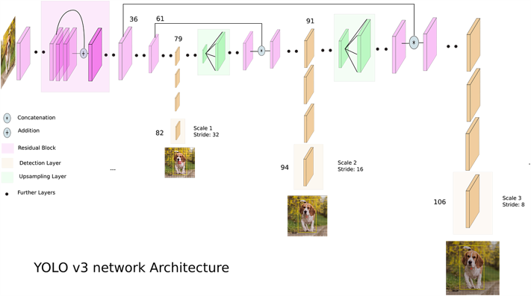

Slide 6
Implementation
Importing needed libraries like OpenCV.
Loading trained YOLO Objects Detector with the help of 'dnn' library from OpenCV. OpenCV's 'dnn' library has many custom functions for implementing darknet, getting blobs of a custom size from image and implementing non-maximal suppression.
Loading input image. We have used images from PASCAL VOC 2007 dataset for object detection.
Getting blob from input image. We use the custom function cv.dnn.blobFromImage() to get a blob of size 416*416 from our input image. A blob is a multi-dimensional array that contains the image pixel values and is processed by deep learning models. The resulting blob is then used as input to the YOLOv3 model for object detection.

Slide 7
Implementing forward pass with our blob and only through output layers. We store the results from the three output layers.
Going through all output layers after feed forward and answer from network. YOLOv3 generates output in the form of normalized bounding boxes and class probability predictions.
Implementing non maximum suppression of given boxes and corresponding scores. After applying the YOLOv3 model on the input images, it generates a large number of bounding boxes for each image with their respective confidence scores. However, many of these bounding boxes may overlap and represent the same object. To filter out these redundant boxes, we need to perform non-maximum suppression (NMS). NMS is a process that removes overlapping boxes based on their Intersection over Union (IoU) score.
After applying probability-based filtration on the predicted bounding boxes, we use OpenCV's dnn.NMSBoxes() function to perform NMS on the remaining boxes. However, this function only applies NMS to one output at a time. Therefore, we need to create a custom function that can apply NMS to multiple outputs generated by the YOLO model.

Slide 8
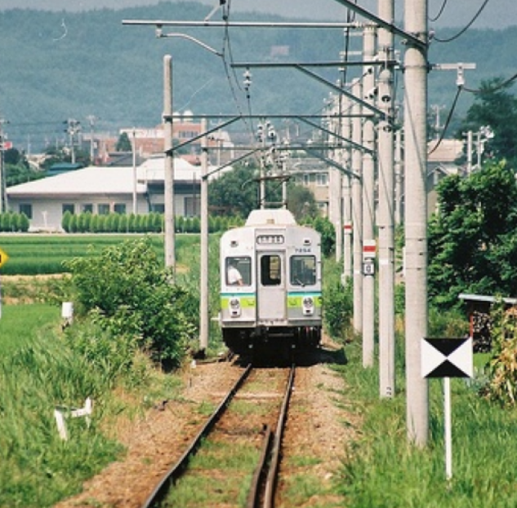
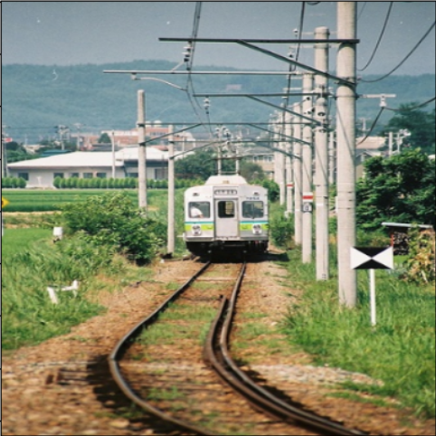

Input Image Blob from our Image Output Image with prediction
This is how our model predicts the class, confidence of prediction and the bounding box for the detected objects.
We can now use this model to predict the bounding boxes for many images and even for real time video object detection.

Slide 9
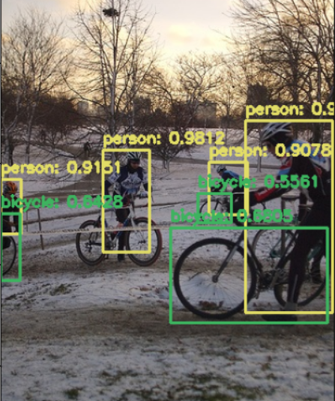
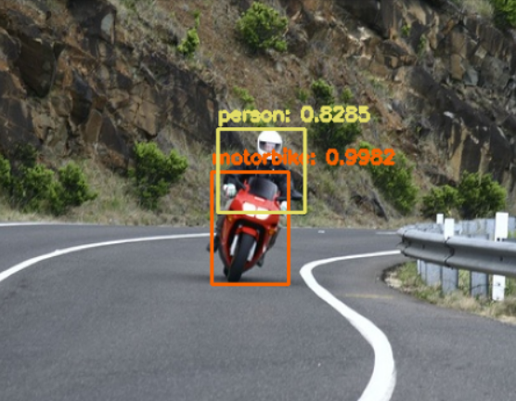
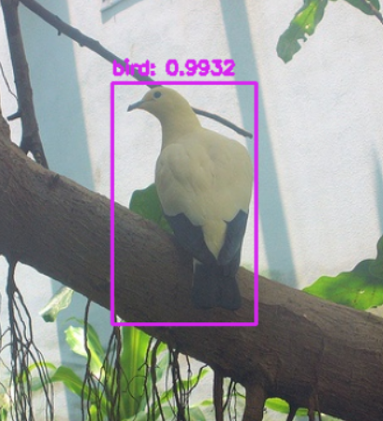
Predictions
Let's look at some of the predictions made by this model.
We can see that the model is able the predict multiple objects with high confidence score and good accuracy.

Slide 10
Conclusion
We have successfully created a model for real time multi-object detection using YOLOv3.
We have used OpenCV for the implementation as it provides us with multiple inbuilt functions for tasks like implementing darknet, converting image to blob and applying non-maximal suppression to get optimal bounding boxes.
We have seen from the examples that our model achieves high confidence on predictions and makes accurate bounding boxes.
YOLOv3 is a very efficient algorithm and can be used for image object detection as well as real time video object detection.

Slide 11

THANK YOU

