Slide 1


Superstore Analytics
Profitability Drivers & Discount Strategies

Slide 2
Executive Summary
Technology Drives Profit Technology sub-categories, particularly Copiers and Phones, are the primary engines of profitability, boasting high margins even with moderate discounts.
The Furniture Deficit The Furniture category is heavily underperforming. Sub-categories like Tables and Bookcases are actively destroying profit margins due to aggressive discounting.
Strategic Realignment Needed Discounts exceeding 15% consistently correlate with net losses. A strict revision of the discounting policy is required to return loss-leaders to profitability.

Slide 3
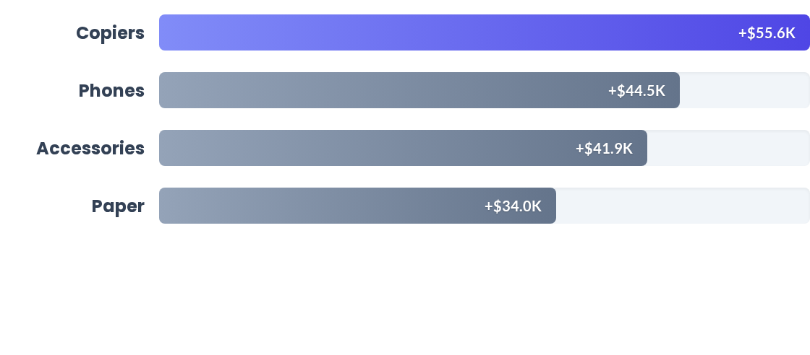
Top Profit Centers
Copiers generate exceptional profit ($55.6K) despite lower overall sales volumes. The Technology and Office Supplies categories dominate the top performers.

Slide 4
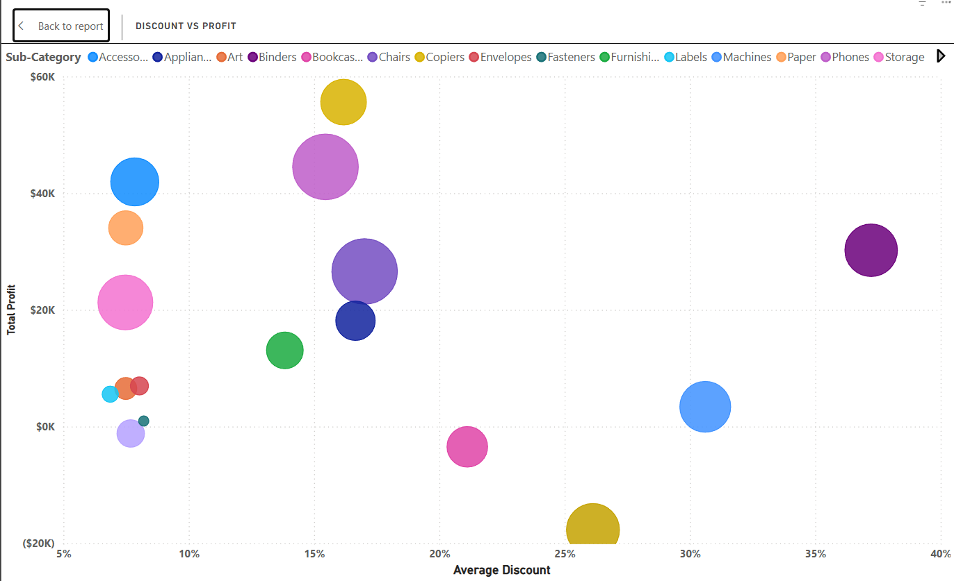

The Discount Trap
High Discounts Can Pressure Profitability
Our analysis shows a weak negative relationship (-0.22) between average discount and total profit. The impact is particularly visible in several Furniture sub-categories.
•
Tables: ~26% average discount → -$17.7K profit
•
Bookcases: ~21% average discount → -$3.4K profit
•
Some sub-categories maintain positive profit even at higher discount levels.
Insight: Discounting appears to be an important profitability factor, but its impact
varies by sub-category and should be evaluated alongside pricing and costs.

Slide 5

Strategic Action Plan (1/2)
1. Profit Margin Rehabilitation
Review discount thresholds and product-level costs for loss-making Furniture sub-categories, particularly Tables and Bookcases. Implement bundle pricing strategies to clear slow-moving Furniture inventory without further sacrificing base margins.
Target: Reduce the combined $21.1K loss from Tables and Bookcases through improved pricing, discount control, and inventory strategies.
2. Growth Acceleration
Reallocate promotional focus toward high-profit sub-categories such as Copiers, Phones, and Accessories. Prioritize targeted marketing campaigns and growth opportunities in these high-yield areas to improve overall return on investment.

Slide 6
Strategic Action Plan (2/2)
3. Implement Discounting Guardrails Establish category-specific discount guidelines for products with high discount levels and weak profitability. Review high-discount transactions to reduce unnecessary margin erosion while maintaining competitive pricing.
4. Ongoing Performance Tracking Establish a monthly review of Sales, Profit, and Discount performance. Track volatile categories and sub-categories regularly to identify emerging margin pressure and enable timely pricing and promotional adjustments.

