Slide 1
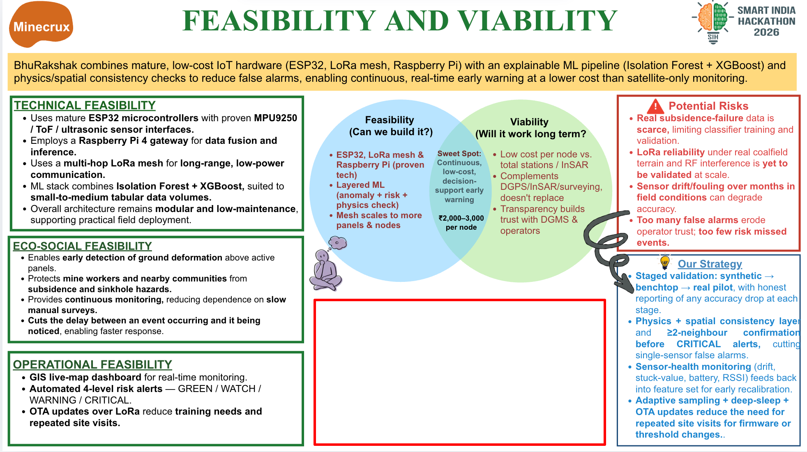
Same locked synthetic holdout; recall vs NORMAL false alarms.
*₹3,826/node; gateway Pi 4 + LoRa board. Excludes Pi accessories,
shipping, wiring, field fit & labour. Retail snapshot: 29 Sep 2026.
Notes:
ML: reports/final_eval.md and reports/test_lock.json. One locked synthetic holdout (seed 20260929, evals_run=1). Paired values, percent: tuned XGBoost critical recall 9.33, normal false-alarm rate 15.08; default XGBoost 4.57, 3.72; logistic regression 76.50, 62.63; threshold rule 4.16, 1.74. Synthetic corpus only; not a real-mine evaluation.
Cost snapshot: 29 Sep 2026, Indian retail listings. Per sensor node: Heltec Wireless Stick V3 with antenna and Li-ion charging/protection ₹2,749 (https://vihaaniotgateway.in/product/heltec-wireless-stick-v3-sx1262-esp32-lora-oled/); MPU-6050 breakout ₹173 (https://robokits.co.in/sensors/accelerometer-and-magnetometer/triple-axis-accelerometer-gyro-mpu-6050-breakout?cPath=72_213); VL53L1X ToF ₹570 (https://www.ktron.in/product/vl53l1x-laser-ranging-module-tof/); vibration switch module ₹42 (https://robokits.co.in/development-board/sensors-compatible-with-arduino); waterproof DS18B20 probe ₹55 (https://robu.in/product-category/sensor-modules/temperature-humidity-sensor/); 18650 2200mAh cell ₹110 (https://robodo.in/products/icr-18650-2200mah-2c-lithium-ion-battery); F4-2 100x68x50mm IP65 ABS box ₹127 (https://robu.in/product-category/workbench-tools-and-kits/). Total ₹3,826/node; six nodes ₹22,956.
Gateway core: Raspberry Pi 4 Model B 4GB ₹5,649 including GST (https://robu.in/product-category/microcontroller-development-board/raspberry-pi-microcontroller-development-board/official-boards-and-accessories/raspberry-pi-4/) plus Heltec Wireless Stick V3 LoRa board ₹2,749 (same product link), total ₹8,398. Combined priced-parts subtotal ₹31,354. The Pi radio-interface pairing is a costing assumption and has not been built or validated in this project. The subtotal omits Pi storage, power supply, case, cables, wiring, connectors, enclosure adaptations, shipping, labour, field installation, solar/battery backup for the gateway, and commissioning. Retail prices and stock can change; this is an indicative component basket, not an installed system quote or an ROI claim.

