Slide 1
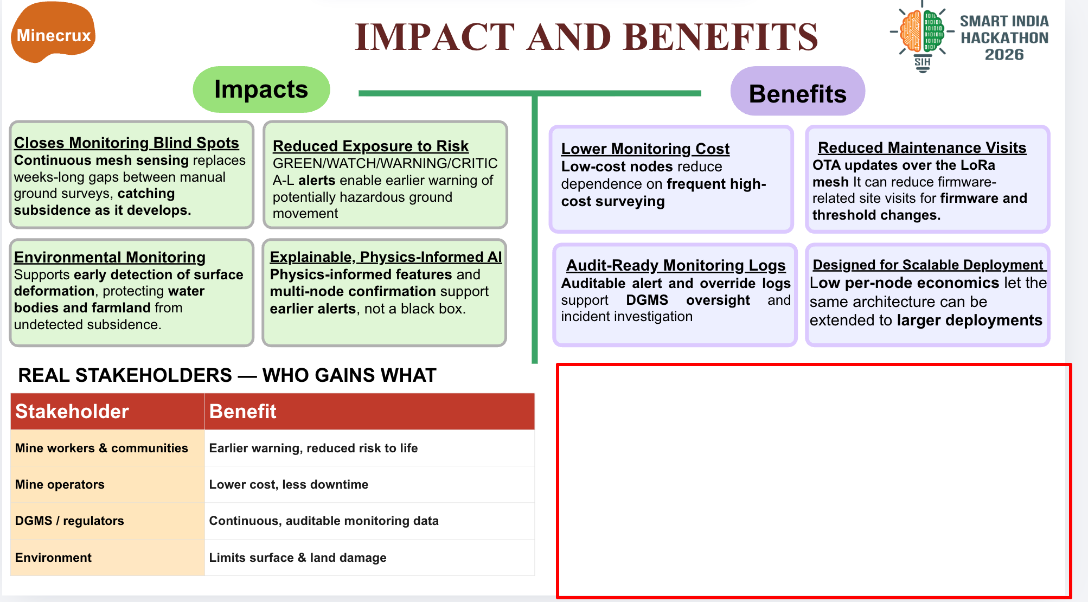
WHAT THE LOCKED TEST ACTUALLY SHOWS
Classifier trade-off · one synthetic held-out corpus
TUNED XGBOOST vs DEFAULT
CRITICAL recall
4.6% → 9.3%
+4.8 percentage points
NORMAL false-alarm rate
3.7% → 15.1%
+11.4 percentage points
End-to-end alert median lead: −3.3 h
Locked synthetic test · tuning raised recall but also false alarms. Negative alert lead means early-warning benefit is not demonstrated; no real-mine validation.
Notes:
Evidence source: reports/final_eval.md and reports/test_lock.json. One-time locked evaluation of the synthetic held-out corpus, seed 20260929, evals_run=1. Scatter plot x=normal false-alarm rate (%), y=CRITICAL recall (%): tuned XGBoost (15.08, 9.33); default XGBoost (3.72, 4.57); logistic regression (62.63, 76.50); threshold rule (1.74, 4.16). Headline delta is tuned XGBoost vs default XGBoost: +4.76 percentage points CRITICAL recall, and +11.36 percentage points NORMAL false-alarm rate. End-to-end alert figures, same locked evaluation: median lead time -3.3334 hours and 0.0460798 false-alert episodes per normal event day. reports/acceptance_criteria.md explicitly states no early-warning success claim is supported; physical tabletop and real-mine validation are absent. All outcomes are synthetic-test results, not evidence of realized field benefit.

