Slide 1
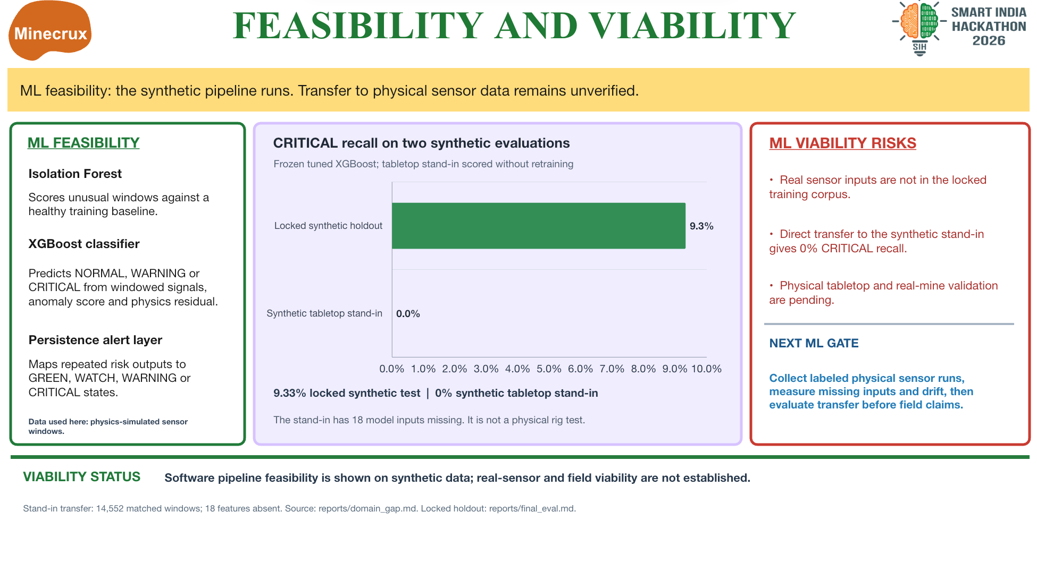
TECHNICAL FEASIBILITY / ML VALIDATION
ML Performance Trade-off (Locked Synthetic Test)
Critical recall compared with normal false alarms · same held-out test
Evaluation on held-out synthetic data; real-mine performance remains unvalidated.
Notes:
ML Validation results from the one-time locked synthetic evaluation in reports/final_eval.md; reports/test_lock.json records evals_run=1. Values displayed exactly as provided: Threshold Rule: normal false alarms 1.7%, Critical recall 4.2%; Logistic Regression: 62.6%, 76.5%; Default XGBoost: 3.7%, 4.6%; Tuned XGBoost: 15.1%, 9.3%. This is held-out synthetic data, not real-mine evaluation.

