Slide 1
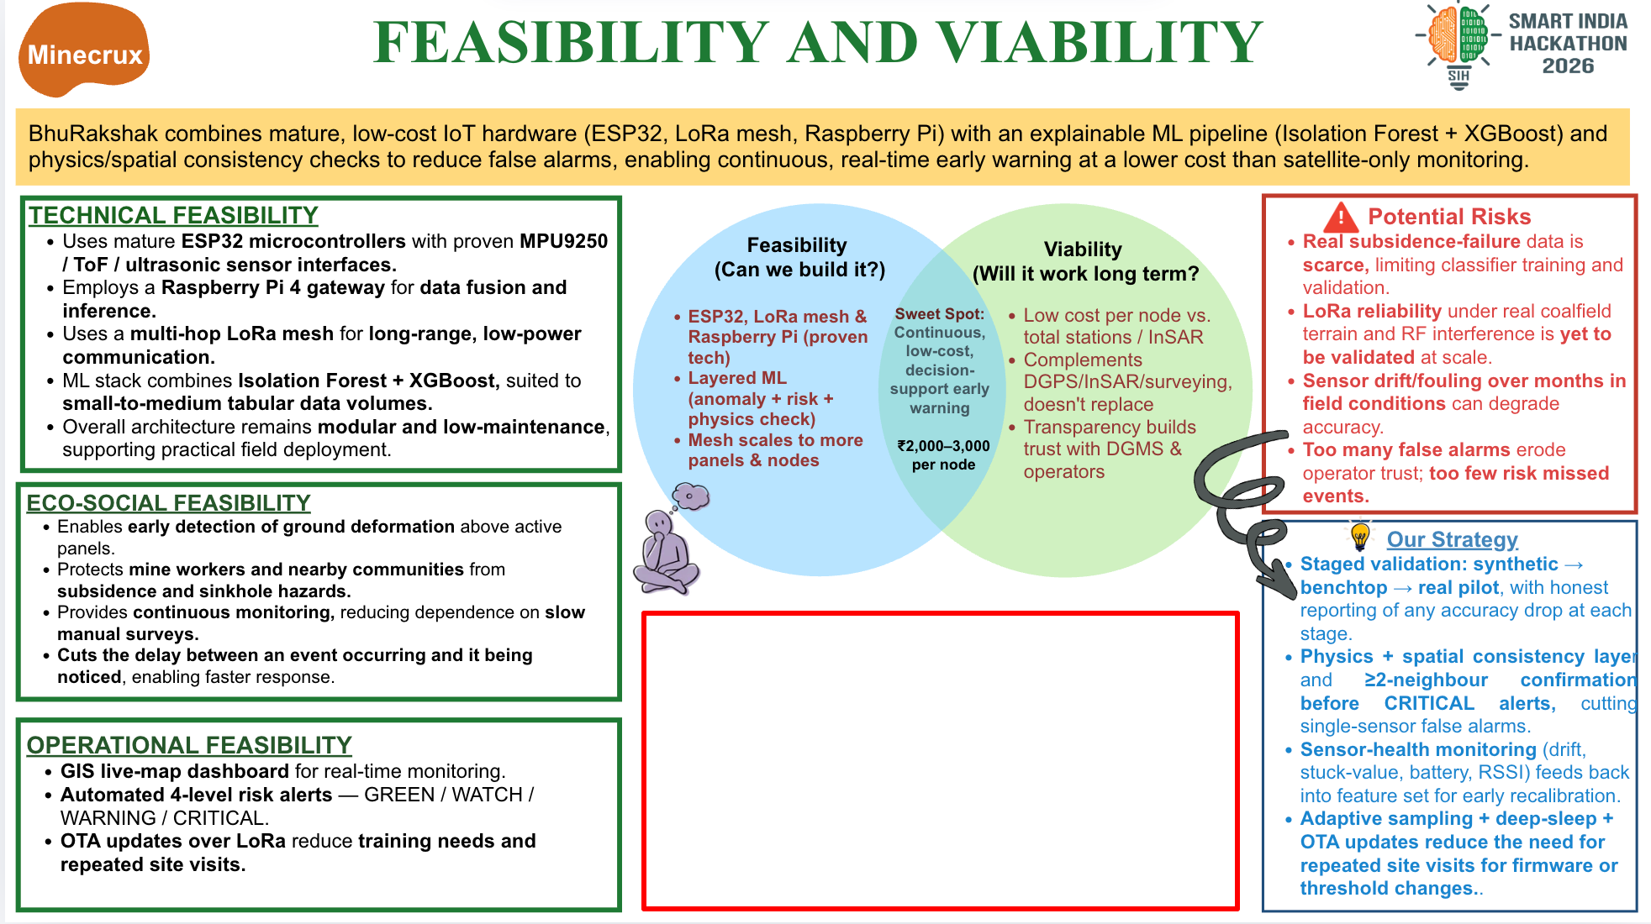
*Synthetic fixture, 18 inputs missing; no physical-rig result.
PRD small-batch estimates; recheck vendor prices.
Notes:
ML data source: reports/final_eval.md (one-time locked synthetic held-out evaluation; tuned XGBoost CRITICAL recall 0.0933) and reports/domain_gap.md (seeded synthetic tabletop stand-in, frozen model without retraining; CRITICAL recall 0.0000; 18 inputs absent; not a physical rig). Economic source: prd.md §8.1, rough India small-batch estimates: per-node ₹2,600–4,600, gateway ₹8,500–13,500, six-node plus gateway prototype ₹24,000–40,000. The total is a separate prototype estimate and must not be added to the component estimates.

