Slide 1
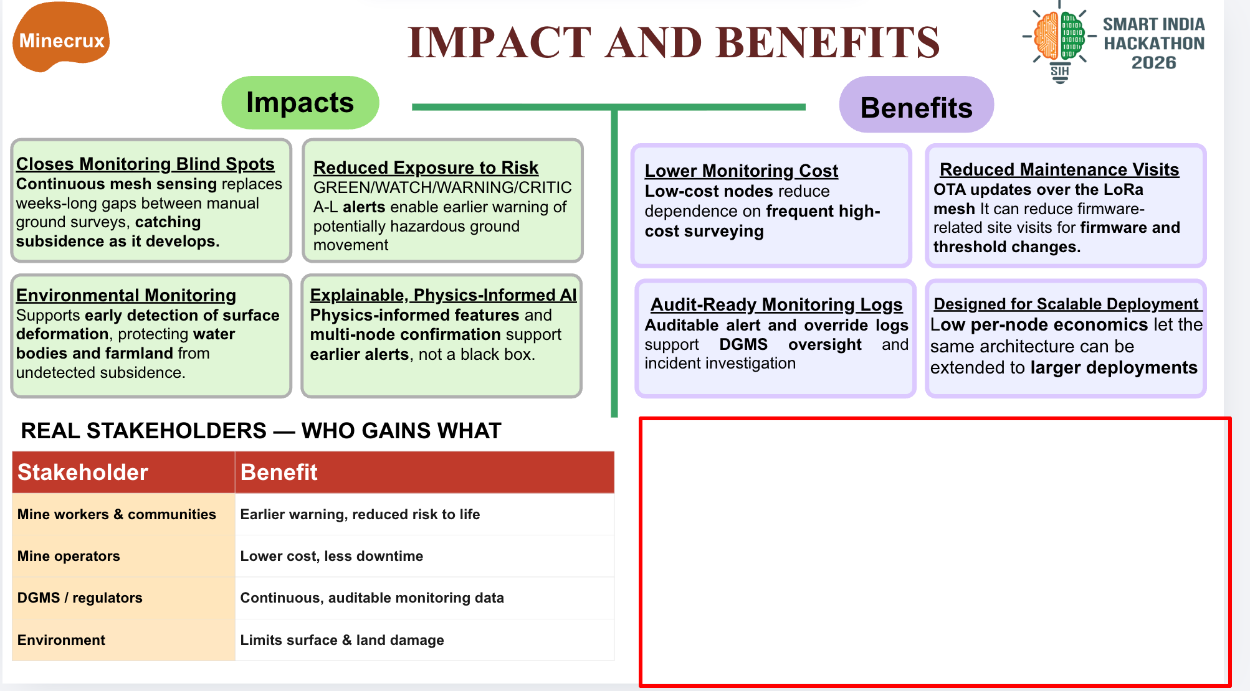
HOW ML COULD HELP
From sensor-like data to a risk pattern for review
1 INPUT
2 ML SCREENS
3 ALERT LOGIC
4 HUMAN REVIEW
Simulated sensor patterns
(current model evidence)
→
Anomaly score +
physics check +
risk classification
→
Combines repeated
risk into an alert
level
→
Could help focus
which patterns need
follow-up
POSSIBLE BENEFIT
Highlight changing risk patterns so teams can prioritize follow-up.
Evidence today: synthetic tests only. Earlier warning and real-mine benefit are not demonstrated.
Notes:
This graphic explains the intended ML benefit pathway, not a demonstrated operational outcome. The current model evaluation uses the synthetic held-out corpus (reports/final_eval.md and reports/test_lock.json, evals_run=1). Source architecture: src/pipeline.py combines model inputs including anomaly_score and physics_residual; src/risk/alert_engine.py applies alert thresholds and persistence; reports/acceptance_criteria.md says there is no early-warning success claim, no physical tabletop/real-mine validation, and the reported locked-test alert median lead is -3.33 hours. The intended user value is helping prioritize patterns for follow-up. No claim is made that the current model has reduced harm, improved early warning, or been used in field operations.

