Slide 1
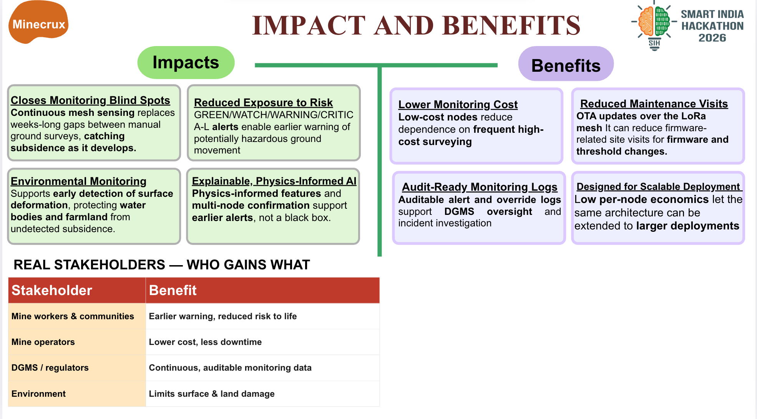
ML APPROACH
LOCKED TEST
Detect unusual patterns
CRITICAL recall and NORMAL false alarms
Isolation Forest scores each sensor window against a healthy-baseline training set.
Estimate ground-risk class
XGBoost predicts NORMAL, WARNING or CRITICAL from windowed signals and a physics residual.
Convert scores to alert states
Persistence logic maps risk probabilities to GREEN, WATCH, WARNING or CRITICAL.
Tuned XGBoost: 9.3% CRITICAL recall, with 15.1% NORMAL false alarms.
Training and evaluation data: physics-simulated sensor windows.
All scores shown are from one locked synthetic test. No real-mine validation.
Current evidence
Median alert lead time was −3.3 hours on the synthetic holdout. Early warning has not yet been demonstrated.
Related research context is cited in speaker notes; its InSAR/LSTM results are separate from this project.
Notes:
Project evidence: reports/final_eval.md and reports/test_lock.json. The locked synthetic test was evaluated once (evals_run = 1). Metric definitions are implemented in scripts/final_eval.py: CRITICAL recall is class recall; NORMAL false-alarm rate is the share of NORMAL windows predicted as another class. Alert-engine median lead time is −3.3334 hours, so this test does not support an early-warning benefit claim. Results are synthetic and not real-mine or physical-tabletop validation.
Model pipeline source: src/pipeline.py, src/anomaly/isolation_forest.py, src/physics/consistency.py, src/risk/xgboost_model.py, and src/risk/alert_engine.py. The risk classifier has NORMAL, WARNING, and CRITICAL classes. Spatial neighbor confirmation is unavailable in the one-node-per-event locked corpus.
External research context only, not project evidence: Mirmazloumi et al. (2023), “InSAR time series and LSTM model to support early warning detection tools of ground instabilities: mining site case studies,” Bulletin of Engineering Geology and the Environment. The study evaluates InSAR time-series forecasting and adjacent-series analysis at three mining sites. https://doi.org/10.1007/s10064-023-03388-w

