Slide 1
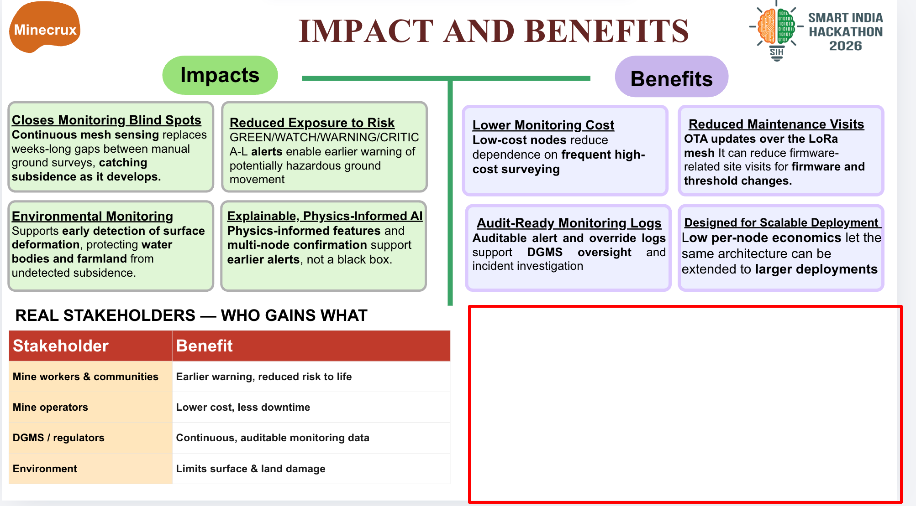
WHAT THE ML CHANGED
Tuned XGBoost vs default · same locked synthetic test
THE SIMPLE TAKEAWAY
It detected more CRITICAL cases
+4.8 points
It also raised NORMAL false alarms
+11.4 points
Overall: early-warning benefit is not demonstrated (alert median −3.3 h).
Synthetic test only · no real-mine validation. Higher recall came with more false alarms; a net safety benefit has not been shown.
Notes:
Evidence source: reports/final_eval.md and reports/test_lock.json. One-time locked evaluation of the synthetic held-out corpus, seed 20260929, evals_run=1. Scatter plot x=normal false-alarm rate (%), y=CRITICAL recall (%): tuned XGBoost (15.08, 9.33); default XGBoost (3.72, 4.57); logistic regression (62.63, 76.50); threshold rule (1.74, 4.16). Headline delta is tuned XGBoost vs default XGBoost: +4.76 percentage points CRITICAL recall, and +11.36 percentage points NORMAL false-alarm rate. End-to-end alert figures, same locked evaluation: median lead time -3.3334 hours and 0.0460798 false-alert episodes per normal event day. reports/acceptance_criteria.md explicitly states no early-warning success claim is supported; physical tabletop and real-mine validation are absent. All outcomes are synthetic-test results, not evidence of realized field benefit.

