Slide 1
PLANT DISEASE RECOGNITION

Slide 2
Team Details
Hruday Chowdary Gurijala – S20210020278
Jayaraj Chippada - S20210020263
Sridhar Chunduri – S20210020266

Slide 3
Table of contents
01
Introduction
02
Problem Specifications
03
Feature Extraction
04
Classification Models
05
Conclusion

Slide 4
01 INTRODUCTION
As farmers and agriculture field are the important part of our life , farmers are the root level building blocks in the economy of any country . They work really heard for a whole season to grow a specific crop for survival of his family. Sometimes these crops on which he dedicated his whole 3-6 months to nurture these crops got disease as result of which they can't sell their crops on the price he was expecting. And He thinks if he knew these if he knew the plant disease before hand , he can use specific pesticides and fertilizers to get over these disease. What if we can use deep learning techniques to help famers to know about specific disease , so that they can be ready before harvesting their crops

Slide 5
02 PROBLEM SPECIFICATIONS
The dataset used (from Kaggle) is built using offline augmentation from the original dataset. The original dataset can be found on this github repo. This dataset consists of about 87K rgb images of healthy and diseased crop leaves which is categorized into 38 different classes. The total dataset is divided into 80/20 ratio of training and validation set preserving the directory structure. A new directory containing 33 test images is created later for prediction purpose. From this data we build models to classify and identify different diseases of plants. This project also explores the impact of feature extraction techniques like wavelet transform, on classification performance.

Slide 6
02 PROBLEM SPECIFICATIONS
Our primary goal is to develop an efficient plant disease recognition system capable of early detection and classification. By leveraging machine learning, we aim to provide a tool that empowers farmers with timely information for effective disease management. This project holds significance in enhancing agricultural practices by automating the identification of plant diseases. We aim to explore the effectiveness of different models like resnet50, ANN, KNN , Random forest Classifier etc and CNN in accurately classifying a diverse set of plant diseases.

Slide 7
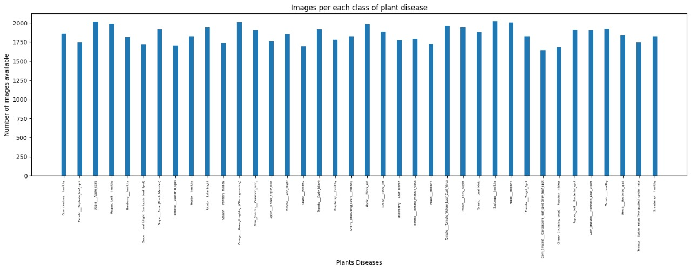
Data Distribution

Slide 8
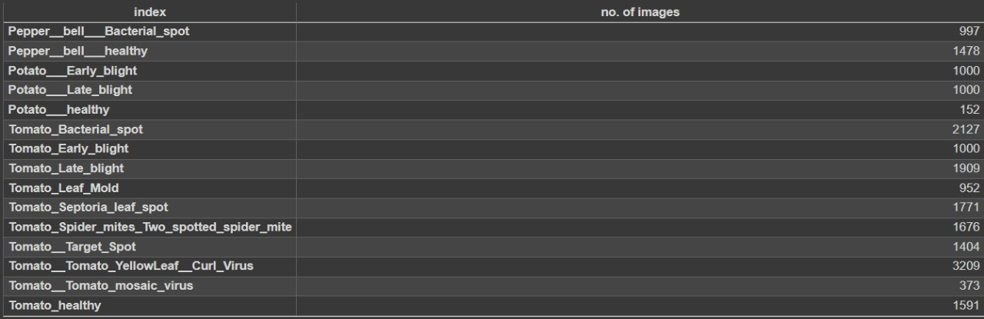
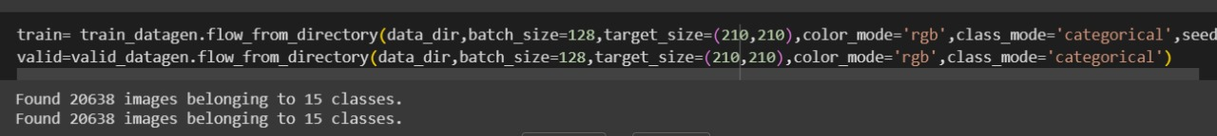

Slide 9
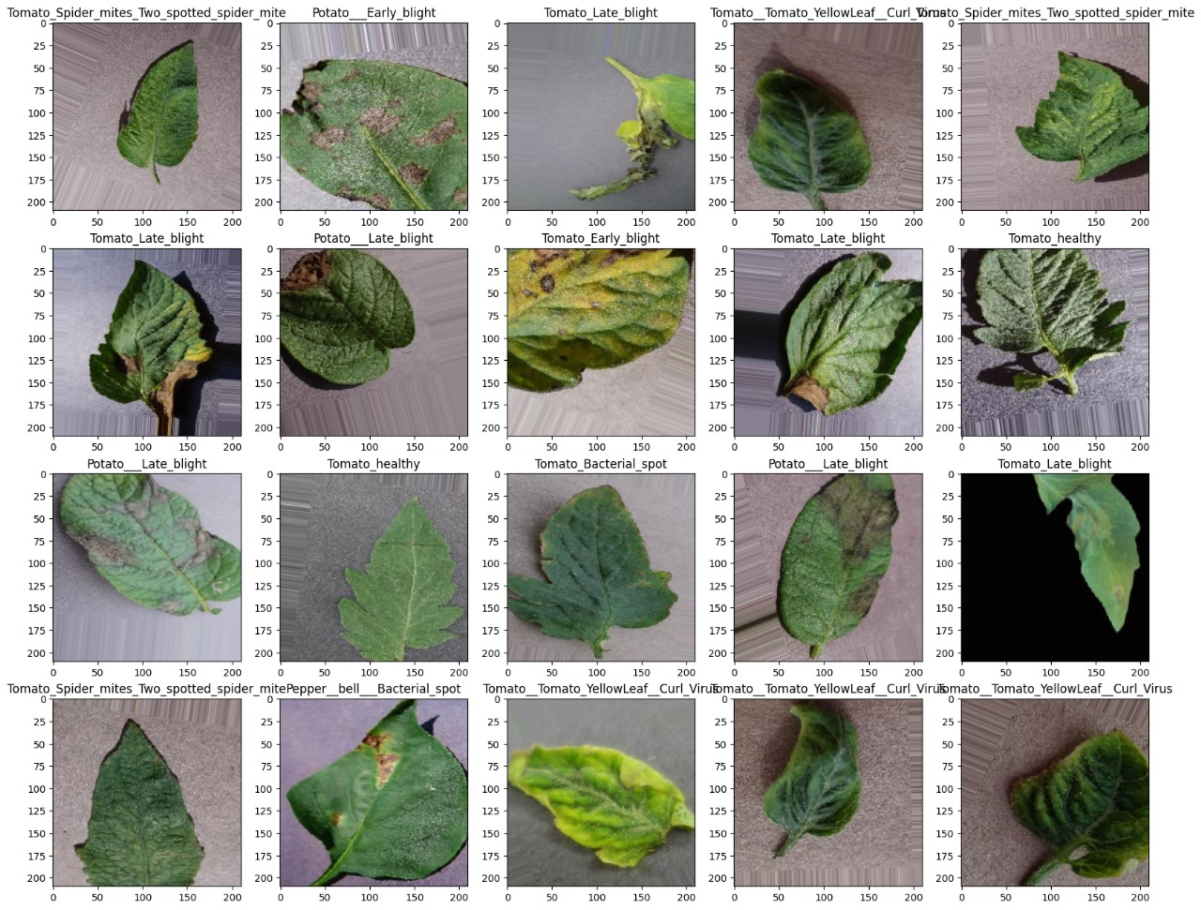
Sample Input Data

Slide 10
03 FEATURE EXTRACTION
1.Histograms: - Description: Histograms represent the distribution of pixel intensities in an image. For color images, separate histograms can be computed for each color channel. - Use in Feature Extraction: Histograms capture the global color distribution, providing information about the dominant colors and overall image contrast. 2. Color Moments: - Description: Color moments (e.g., mean, standard deviation, skewness) quantify the statistical properties of color distributions in an image. They describe the central tendency, spread, and shape of color data. - Use in Feature Extraction: Color moments offer insights into the image's color characteristics, helping to distinguish between different color patterns and textures in the image.

Slide 11
03 FEATURE EXTRACTION
3.Gabor Filter: -Description: Utilized for texture analysis, the Gabor filter identifies specific frequency content in the image, particularly in localized regions around the points or areas under examination. -Use in feature extraction: The response of Gabor filters at different orientations and scales is used to generate feature maps. These feature maps highlight different texture patterns present in the image. The responses from multiple filters create a set of features that describe the texture characteristics of the plant leaf image.

Slide 12
04 CLASSIFICATION MODELS
1. KNN (K-Nearest Neighbors): KNN is a simple, instance-based learning algorithm that classifies data points based on the majority class of their nearest neighbors in the feature space. 2. ANN (Artificial Neural Network): ANN is a computational model inspired by the human brain, composed of interconnected nodes organized in layers, used for various machine learning tasks, including classification and regression. 3. CNN (Convolutional Neural Network): CNN is a specialized deep learning architecture designed for processing structured grid data, such as images. It utilizes convolutional layers to automatically learn hierarchical features.

Slide 13
04 CLASSIFICATION MODELS
4. Random Forest: Random Forest is an ensemble learning method that constructs multiple decision trees during training and outputs the mode of the classes as the prediction, providing high accuracy and robustness. 5. GaussianNB (Gaussian Naive Bayes): GaussianNB is a probabilistic classifier based on Bayes' theorem, assuming that features follow a Gaussian distribution. It's particularly effective for simple and fast classification tasks. 6. Decision Tree: Decision Tree is a tree-like model where each internal node represents a decision based on a feature, leading to different branches. It's used for both classification and regression tasks. 7. Logistic Regression: Logistic Regression is a linear model for binary classification that predicts the probability of an instance belonging to a particular class, utilizing the logistic function to model the relationship between features and class probabilities.

Slide 14
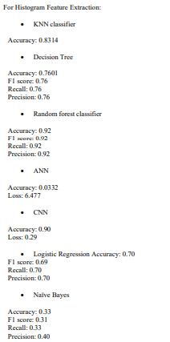
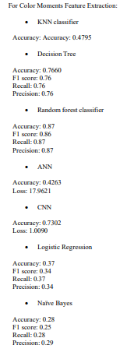
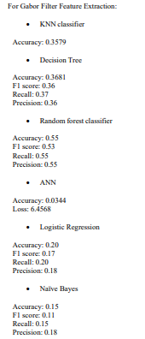

Slide 15
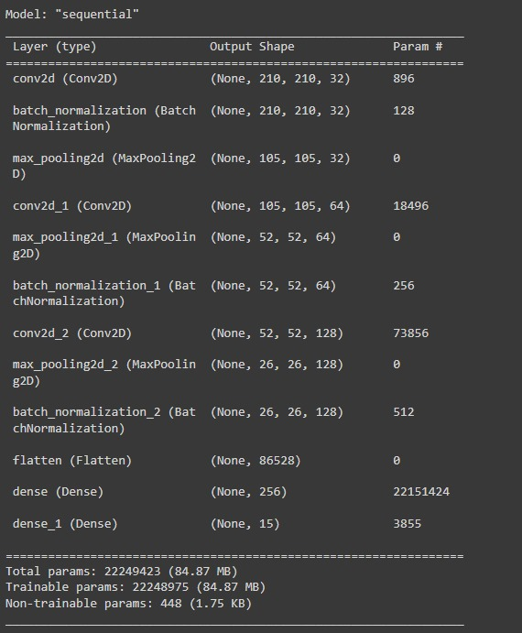
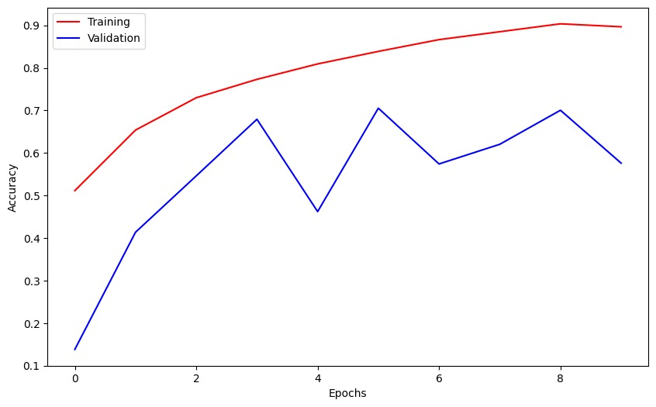
CNN without feature extraction

Slide 16
05 Conclusion
CNN for comparison without any feature extraction technique is giving 91.58% accuracy. Random forest classifier with histogram feature extraction technique is giving 92% accuracy being the better classifier.

Slide 17
PLANNED CONTRIBUTIONS
Jayaraj Chippada: Histograms feature extraction technique with mentioned models. Sridhar Chunduri: Gabor filter feature extraction technique with mentioned models.
Hruday Chowdary Gurijala: Color moments feature extraction technique with mentioned models and CNN. Regular team gatherings have been organized to facilitate in-depth discussions on our project's advancements, tackle any challenges encountered, and explore opportunities for potential improvements.

Slide 18
Thanks You!

