Slide 1

Basic Details of the Team and Problem Statement
Theme Name: Smart Education
Problem Statement Title: Bringing power of AI/ML to aid of teacher in a classroom
Team Name:
Team Leader Name: Hrushikesh Kachgunde
Institute Name: Dr. D Y Patil Institute of Engineering Management and Research

Slide 2
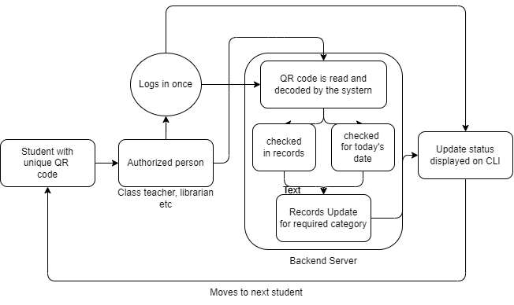
Idea/Approach Details
Describe your idea/Solution/Prototype here:
Generate QR codes for each individual student and attach them to identity card’s (back side).
Class teacher, librarian and person authorized for the mid-day meal (also other tasks) will do a one time login each day, to authorize himself then scan the QR codes of students with his mobile phones.
This will update the records for each day and will be maintained digitally with easy access at any point hence reducing the time for data tracking and reduction in consumption of resources.
The UI will be a website where the authorized person logs in and starts scanning QR codes.
Describe your Technology stack here:
Programming language used throughout the system building will be python. Html, css and javascript will be used for the web front end.
Libraries like pandas and numpy will be used to manipulate the records.
Opencv, pyzbar and qrcode libraries to generate qrcodes and read data from them.

Slide 3
Idea/Approach Details
Describe your Use Cases here
Describe your Dependencies / Show stopper here
A student enrolled in a particular institution will need to carry his unique QR code that will be printed on backside of his ID card provided by the institution. He will show this QR to the authorized person (class teacher, librarian or meal provider).
The authorized person needs to do a one time login for the day to access the QR scan functionality on his phone. Then he can start scanning the QR codes and at the end of the day have access to all this data in digital format.
This way resources are bounded to each individual student.
An access to a mobile phone or similar device is must. Internet connection will be required too.
If the student loses his QR/ID card and the authorities are not told about this, the QR can be misused.
Students have a habit of forgetting things if the QR is left at home a copy of all the QRs can be maintained by the institution.

Slide 4
Team Member Details
Team Leader Name: Hrushikesh Kachgunde
Branch (Btech/Mtech/PhD etc): B.E. Stream (ECE, CSE etc): AI & Data Science Year (I,II,III,IV): II
Team Member 1 Name: Prathamesh Parit
Branch (Btech/Mtech/PhD etc):B.E. Stream (ECE, CSE etc): AI & Data Science Year (I,II,III,IV): II
Team Member 2 Name: Riddhi Gujarathi
Branch (Btech/Mtech/PhD etc): B.E. Stream (ECE, CSE etc): AI & Data Science Year (I,II,III,IV): II
Team Member 3 Name: Type Rupesh Suryawanshi
Branch (Btech/Mtech/PhD etc): B.E. Stream (ECE, CSE etc): AI & Data Science Year (I,II,III,IV): II
Team Member 4 Name: Type Saniya Mulla
Branch (Btech/Mtech/PhD etc): B.E. Stream (ECE, CSE etc): AI & Data Science Year (I,II,III,IV): II
Team Member 5 Name: Type Sukanya Biradar
Branch (Btech/Mtech/PhD etc): B.E. Stream (ECE, CSE etc): AI & Data Science Year (I,II,III,IV): II
Team Mentor 1 Name: Type Your Name Here
Category (Academic/Industry): Expertise (AI/ML/Blockchain etc): Domain Experience (in years):
Team Mentor 2 Name: Type Your Name Here
Category (Academic/Industry): Expertise (AI/ML/Blockchain etc): Domain Experience (in years):

Slide 5
Technology Stack
Please mention the technology stack
Python
Flask
Sql_alchemy
Pandas, Numpy & Matplotlib
Opencv
Qrcode, Pyzbar

