Slide 1
EDA Integration — Ollama
Exploratory Data Analysis automation with Ollama LLM
Prepared by: Hrushi · January 06, 2026

Slide 2
Agenda
1. Project overview
2. EDA pipeline & outputs
3. Ollama model integration
4. Key findings / visualizations
5. Demo & next steps
Prepared by: Hrushi · January 06, 2026

Slide 3
Project Overview
Automate EDA to produce human-readable insights and charts.
Combine standard EDA outputs with LLM-generated summaries.
Prepared by: Hrushi · January 06, 2026

Slide 4
EDA Pipeline
1. Load dataset (CSV)
2. Generate summary statistics & plots
3. Create prompts and query Ollama for natural-language insights
4. Save outputs and present findings
Prepared by: Hrushi · January 06, 2026

Slide 5
Key Findings (Example)
- Missing values concentrated in columns: Age, Cabin
- Strong correlation between Fare and Passenger Class
- Possible class-based survival differences (requires further testing)
Prepared by: Hrushi · January 06, 2026

Slide 6
Ollama Integration
- Ollama client used in code to generate EDA insights.
- Model used in this repo: gemma3:270m
- Example: ollama.chat(model="gemma3:270m", messages=[...])
- Run Ollama locally or point to remote host via OLLAMA_HOST
Prepared by: Hrushi · January 06, 2026

Slide 7
Demo & Next Steps
- Run the CLI or Gradio UI to generate live EDA outputs
- Tune prompts to get more targeted insights
- Add model selection and caching for production
Prepared by: Hrushi · January 06, 2026

Slide 8
Contact
Prepared by: Hrushi
Email: your-team@example.com
Prepared by: Hrushi · January 06, 2026

Slide 9
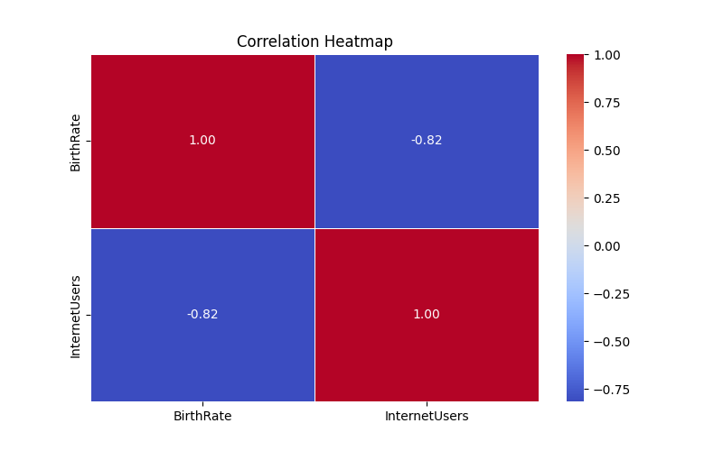
Correlation Heatmap
Prepared by: Hrushi · January 06, 2026

Slide 10
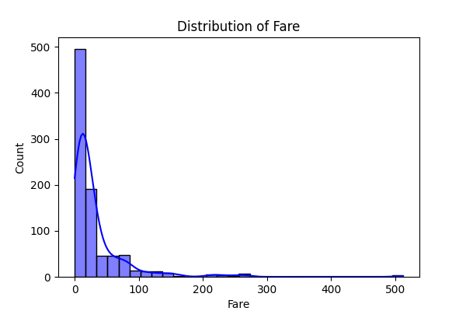
Fare Distribution
Prepared by: Hrushi · January 06, 2026

Slide 11
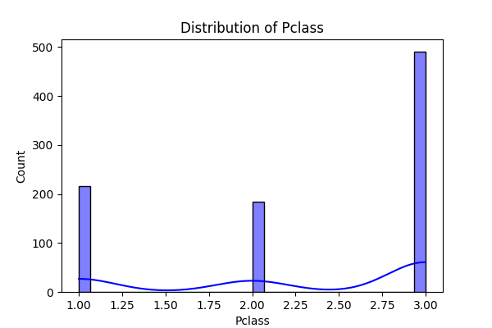
Pclass Distribution
Prepared by: Hrushi · January 06, 2026

