Slide 1

E-commerce User Behavior Analysis & Recommendation System
Team – ecom wizards
Sri Harsha Allam
Hrushika Papani
Suchona Akter
Akshitha Reddy Nelavetla

Slide 2
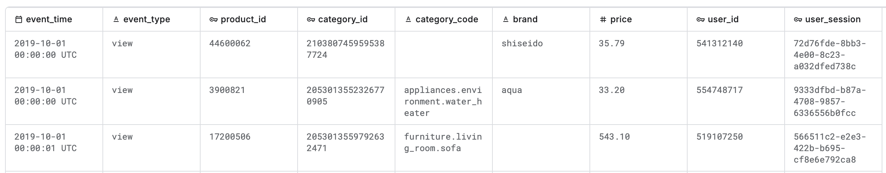
Dataset
Name of Dataset: ecommerce-behavior-data-from-multi-category-store
We choose only Oct-2019 data because of dataset size
>>> df.count()
>>> 42,448,764
>>> df_ecom=df.filter((col('category_code').isNotNull()&(col('brand').isNotNull())))
>>> 26,560,622
>>> df_part=df_ecom.withColumn('user_partition_group',hash(col('user_id'))%100)
>>> df_part.repartition(100,'user_partition_group’)
>>> df_part.write.mode('overwrite').partitionBy('user_partition_group').parquet('/user_partition/')

Slide 3
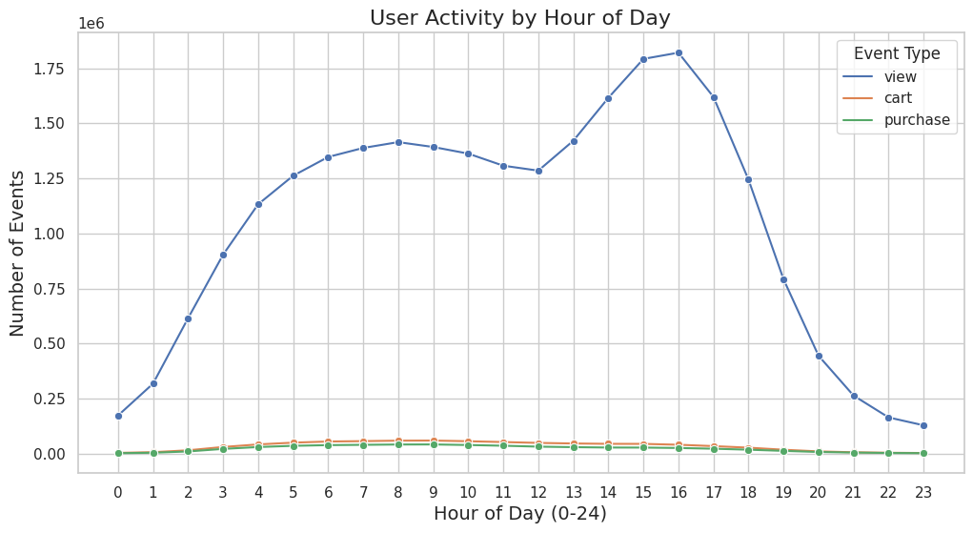
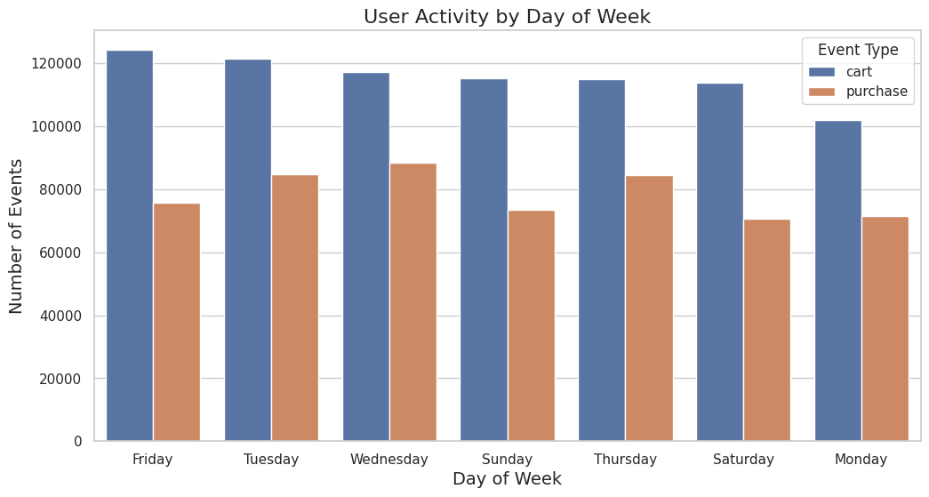
User Browsing and Purchasing Patterns
>>> df_time=df_ecom_part.withColumn('event_hour',hour ('event_time')).withColumn('event_day',dayofweek('event_time’))
>>> hourly_activity=df_time.groupBy('event_hour','event_type’). agg(count('*').alias('event_hour_cnt')).orderBy(col('event_hour_cnt').desc())
>>> daily_activity=df_time.groupBy('event_day','event_type’) .agg(count('*').alias('event_day_cnt')).orderBy(col('event_day_cnt').desc())
>>> day_mapping = {1: "Sunday", 2: "Monday", 3: "Tuesday", 4: "Wednesday", 5: "Thursday", 6: "Friday", 7: "Saturday"}
>>> daily_pd["day_name"] = daily_pd["event_day"] .map(day_mapping)

Slide 4
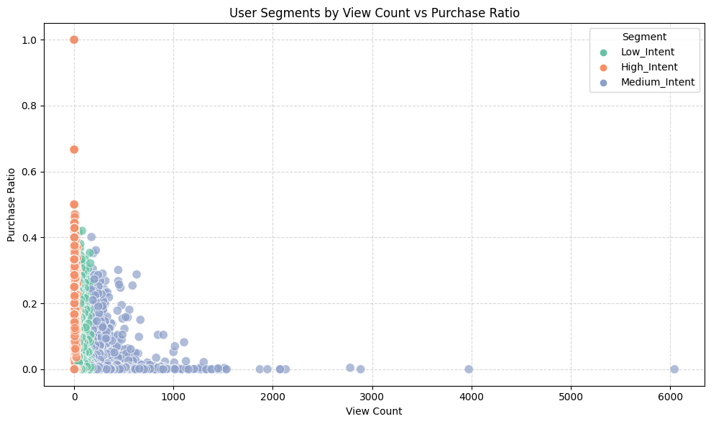
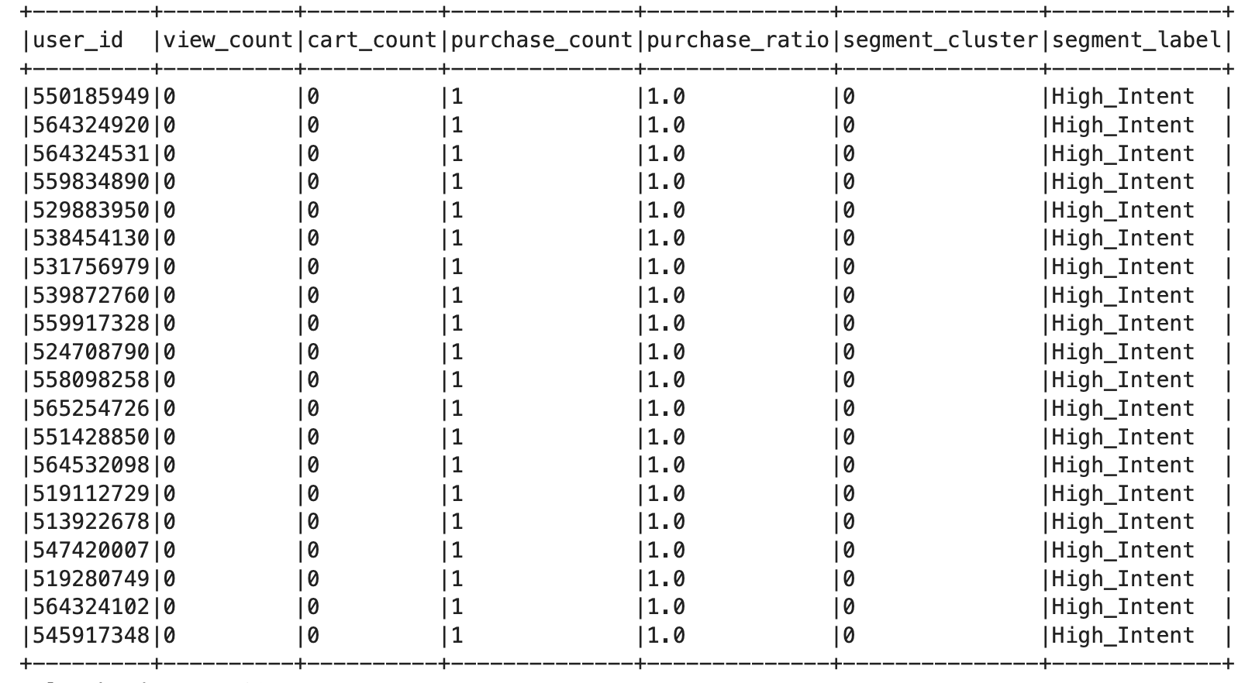
User Segmentation Based on Behavior
K-Means Clustering with k=3
Input features: View Count, Cart_count, Purchase_count, Purchase_ratio
0 = High_Intent
1 = Medium_Intent
2 = Low_Intent

Slide 5
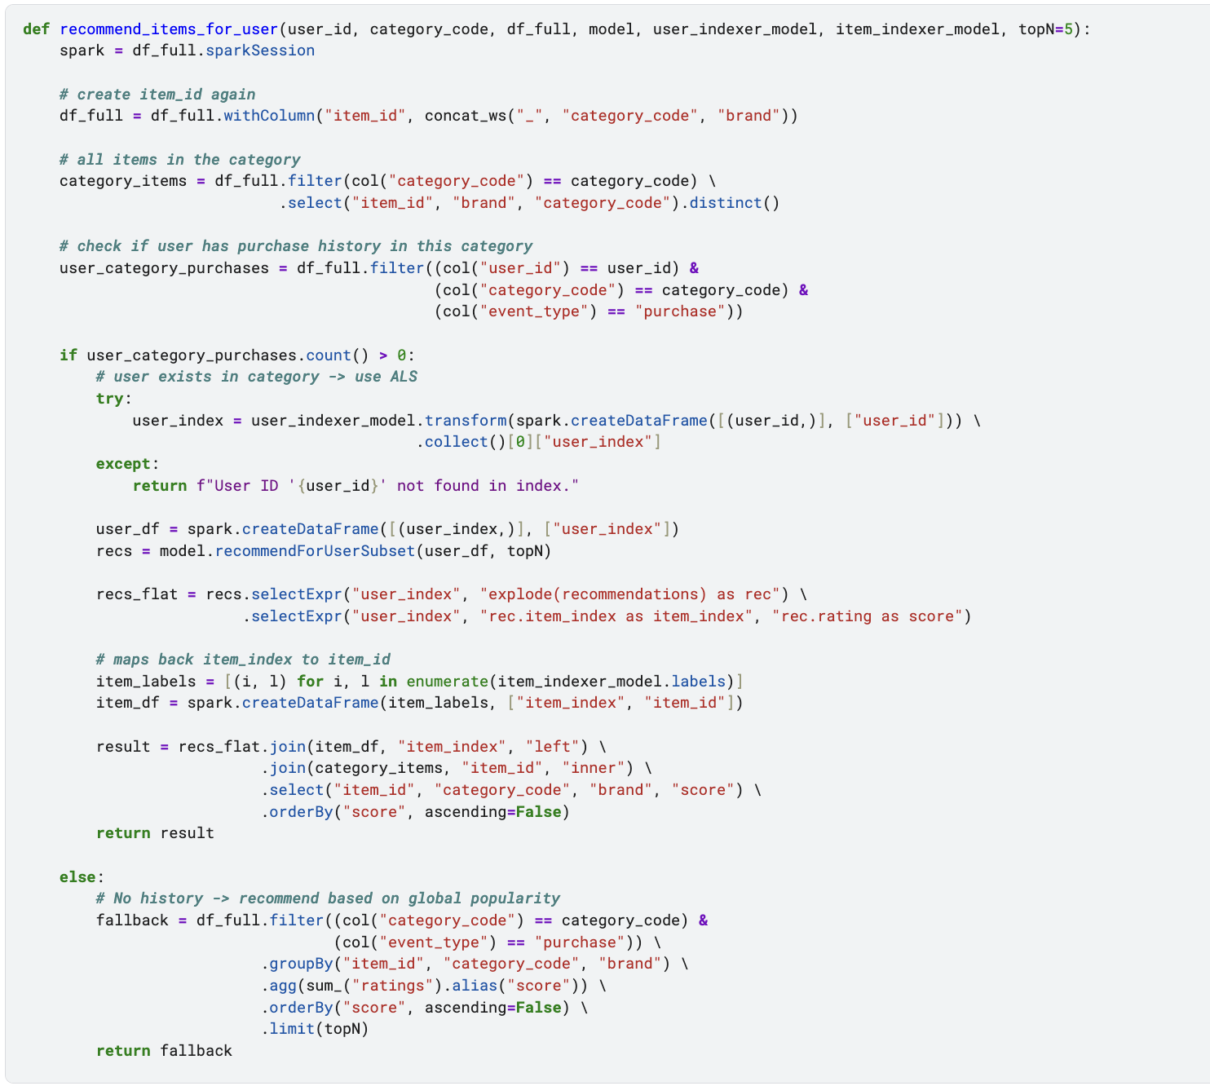
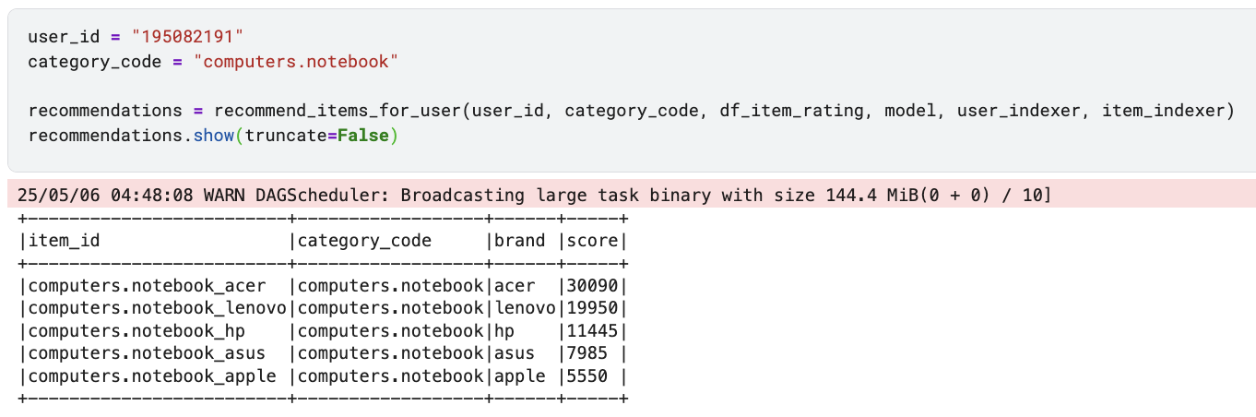
Collaborative Filtering Recommendation System
Collaborative Recommendations:
Category-Based Personalised Recommendations: Picks top five
products from the same category where the user has past history, by rating
  according to the event type using ALS model.
Generalised Recommendations: Suggests top five trending or
  Best-selling when the user has no prior history in the category.
Caption

Slide 6
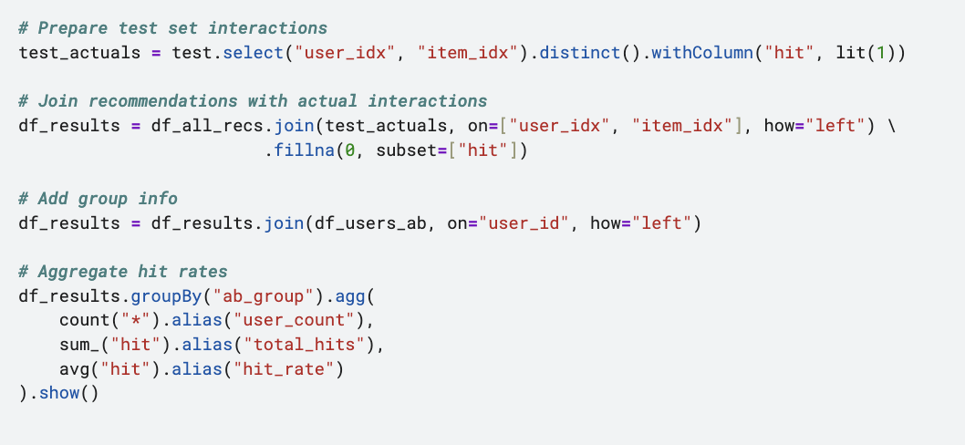
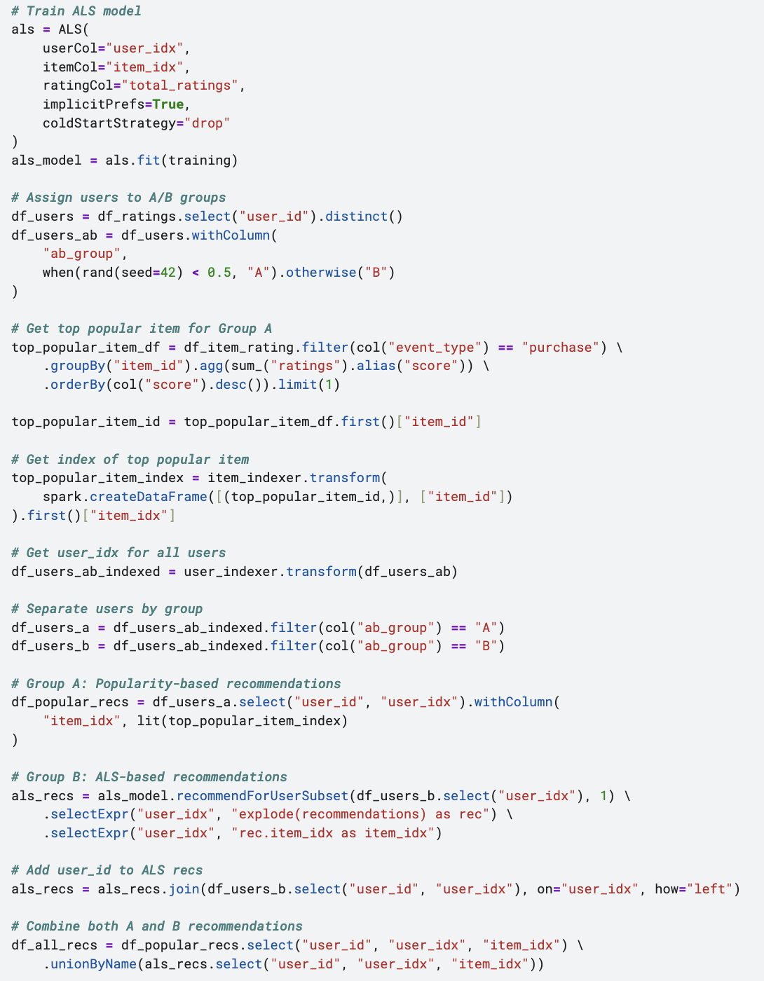
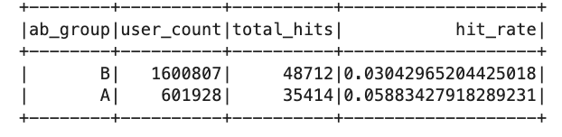
A/B testing
Caption
Hit rates are 5.8% and 3.04% for A and B groups respectively.
Summary:
Users in Group A were more likely to have interacted with the recommended item in the test data than users in
  Group B.
  Even though ALS is more complex and personalised, it’s underperforming.
    Could be because we have wide range of users but very few interactions with purchase event.
    Group B users are cold, ALS can’t learn good representations.
    Most users probably have many view events, but few cart/purchase actions. Weak signals(views) can
      dilute strong one’s.
Caption

Slide 7
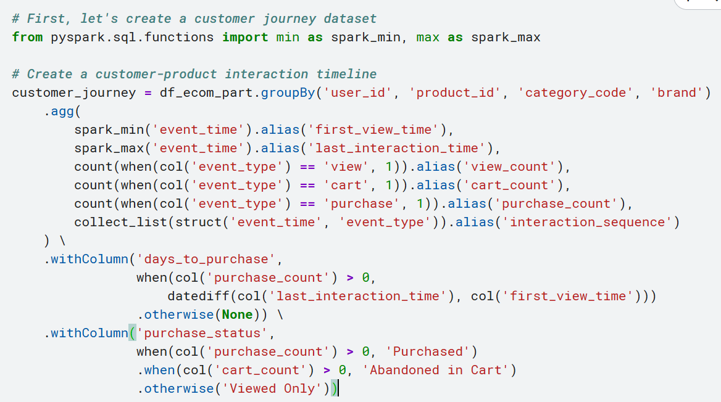
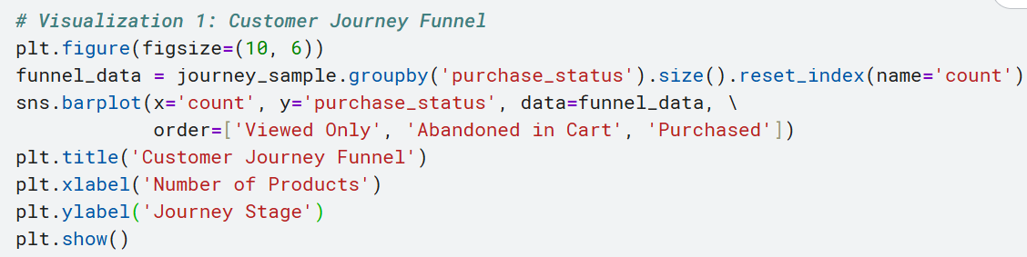
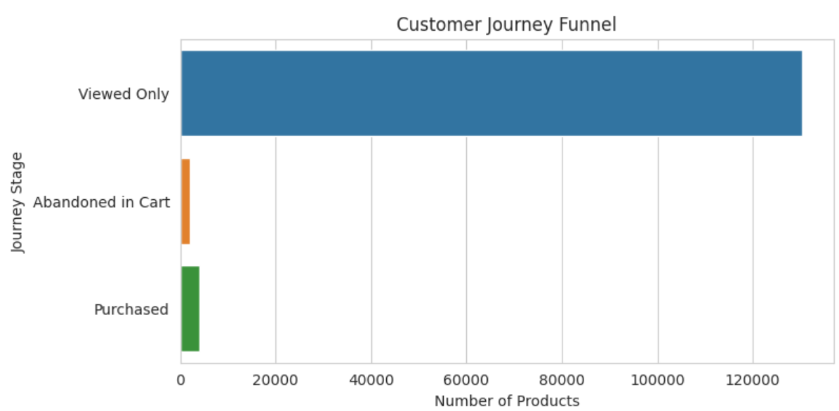

customer-product history system that visualizes the full customer journey

Slide 8
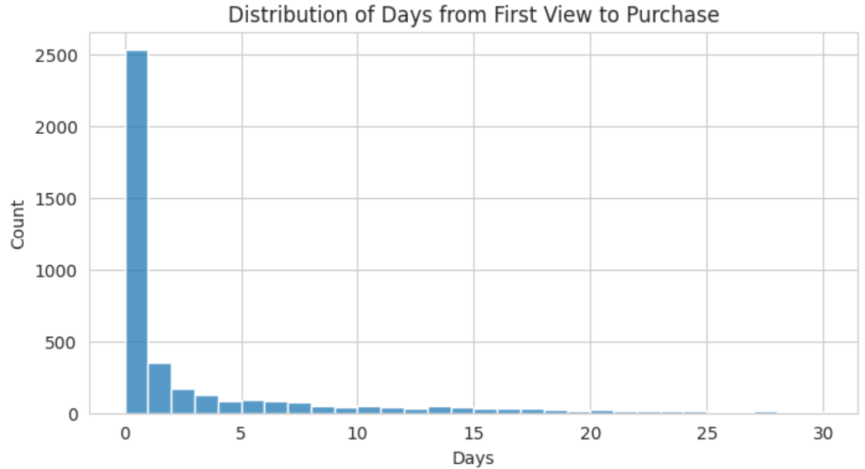
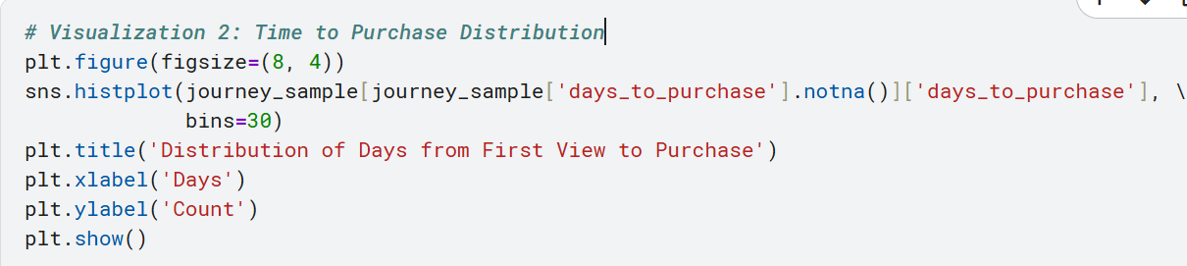
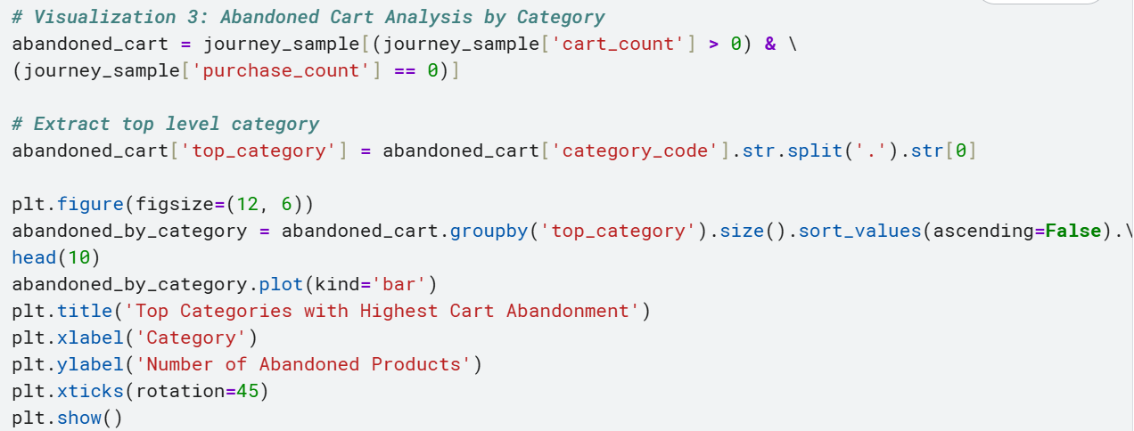
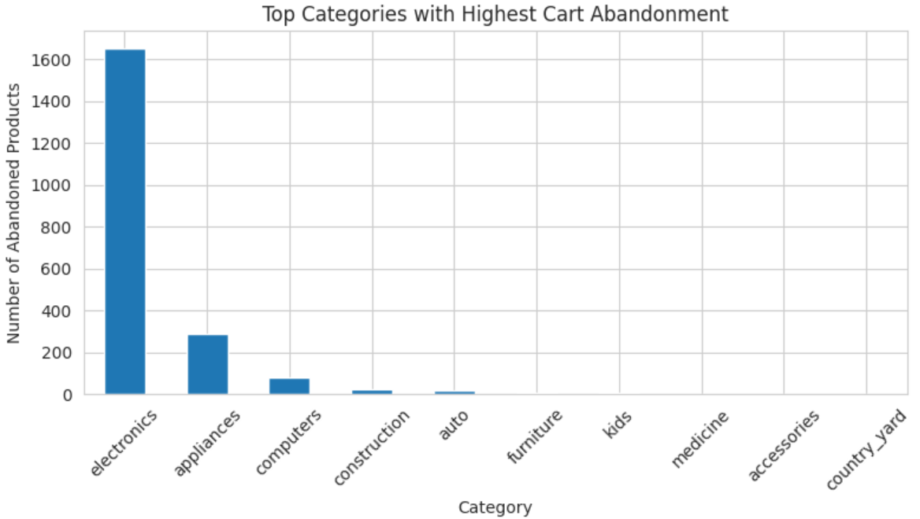
Customer journey from first view to purchase, abandoned cart analysis

Slide 9
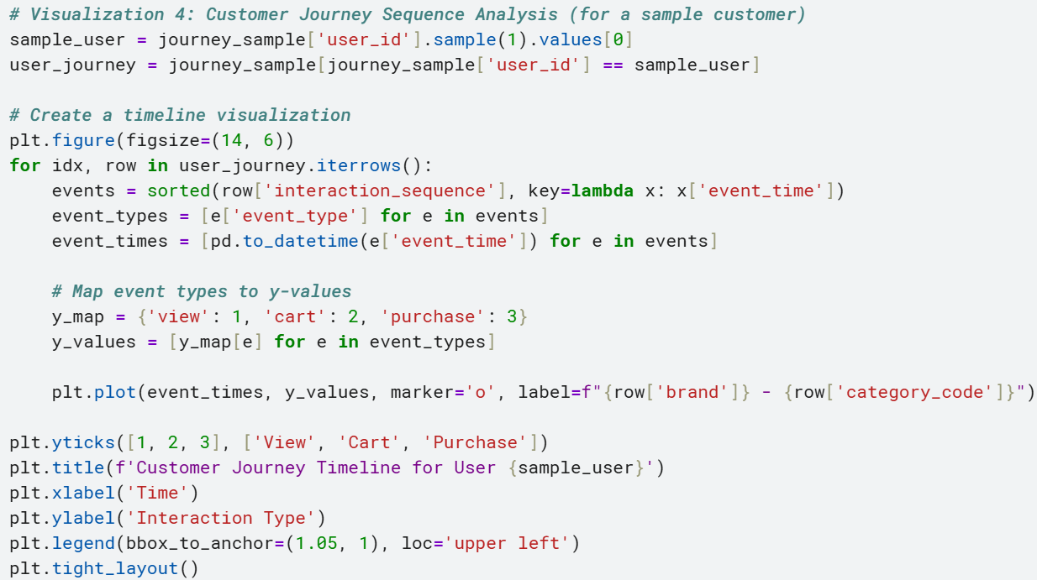
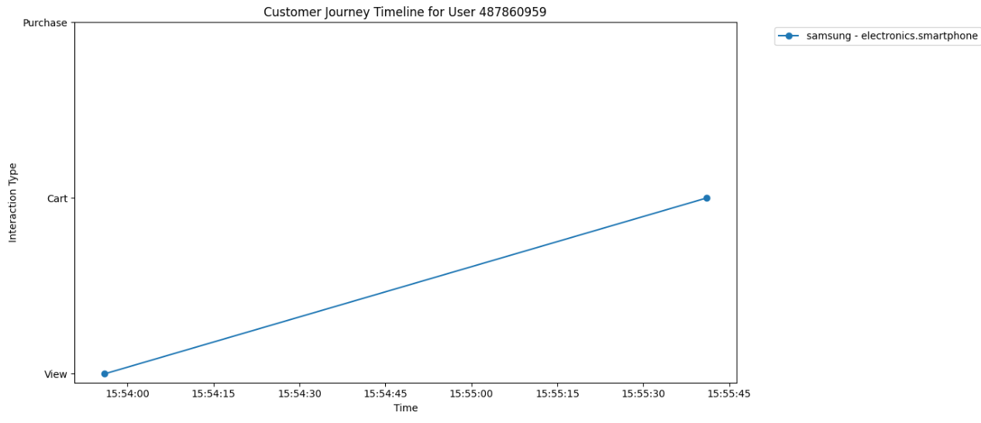
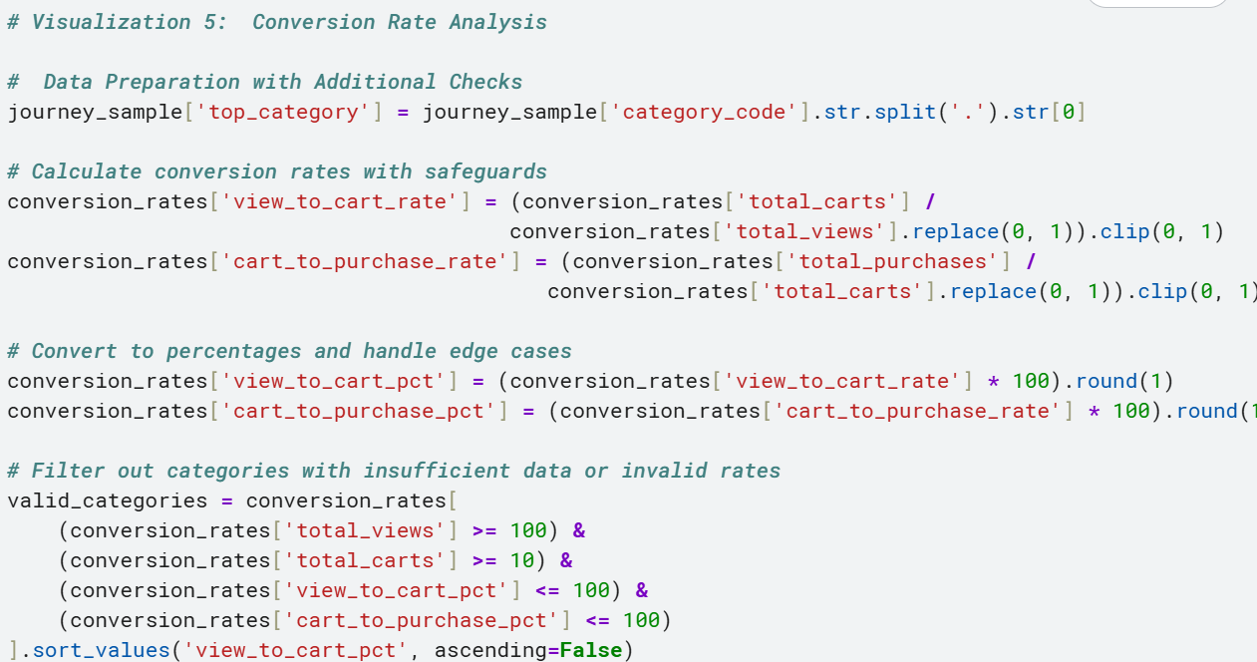
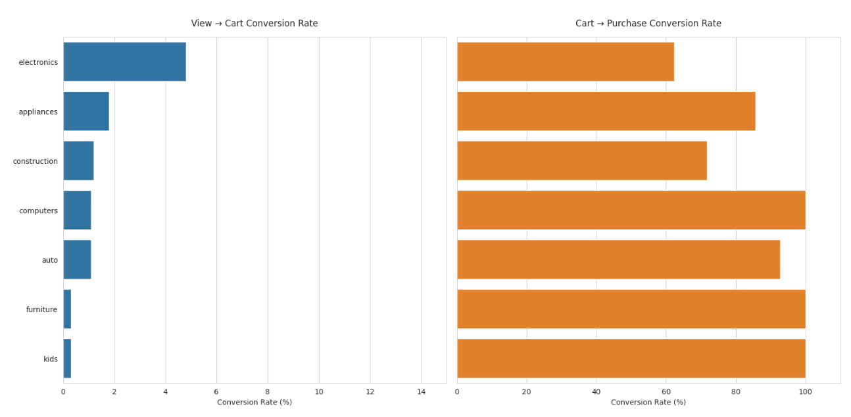

Slide 10
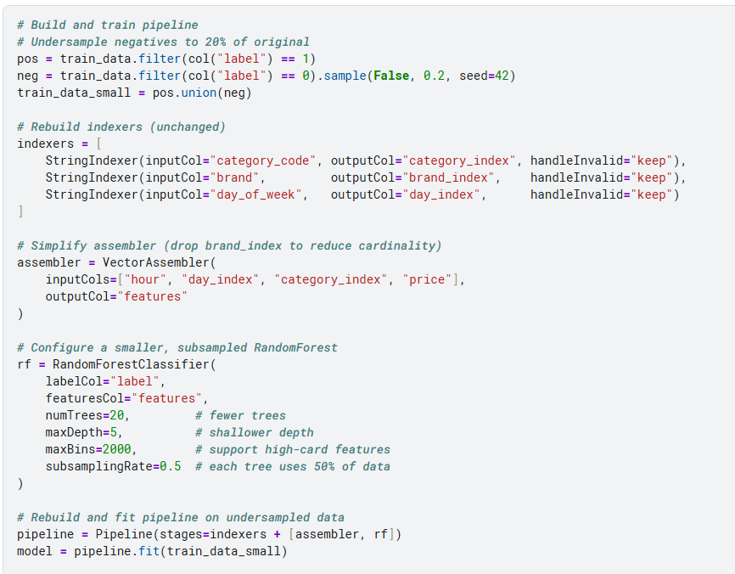
Time sensitive recommendation system
Build a time-aware recommender to predict which products users will buy at each hour and day.
Label real “cart/purchase” events as positives and views as negatives for supervised learning.
Split by product to avoid train/test leakage and under-sample negatives for balance.
Train a lightweight Random Forest on [hour, day, category, price] features for scalable prediction.

Slide 11
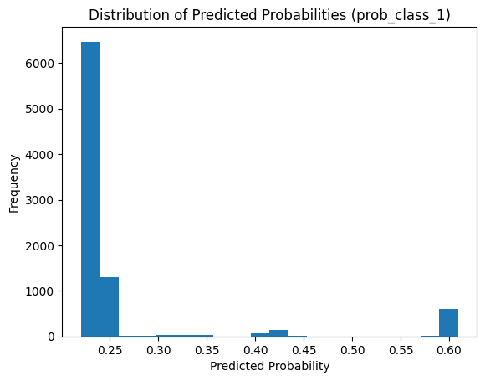
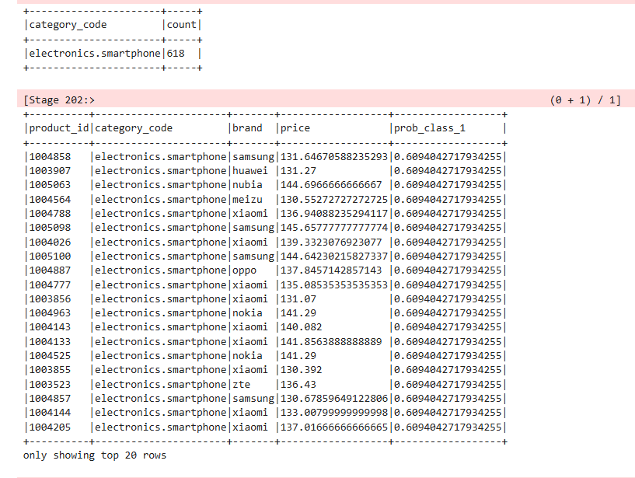
Results & Inference
Inference 1: Most products score low (∼0.25) while a select few peak around ∼0.60, highlighting top recommendations.
Inference 2: Categories with highest max probability—electronics.smartphone, apparel.shoes, etc.—are prime for time-sensitive promotion.
Evaluation: ROC AUC 0.72, F1-score 0.90

Slide 12
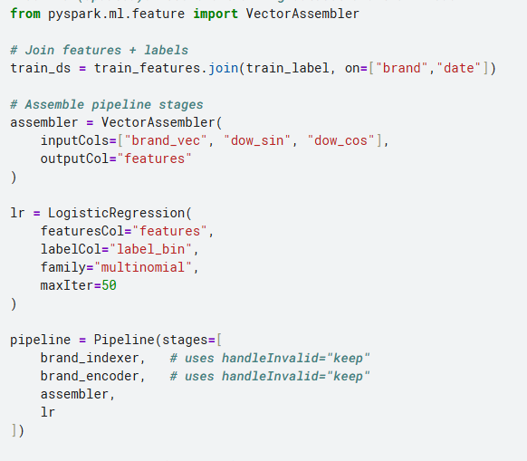
Optimal timing purchase predictor
Identify, for each brand, the 2-hour window when its price typically dips lowest
Each brand–day labeled by the 2-hr bin with its lowest observed price
Features:
Brand identity (one-hot encoding)
Column identity (one-hot encoding)
Day-of-week signal (cyclical sine/cosine)
Model: Multinomial Logistic Regression predicting bin ∈ {0–2, 2–4, …, 22–24}

Slide 13
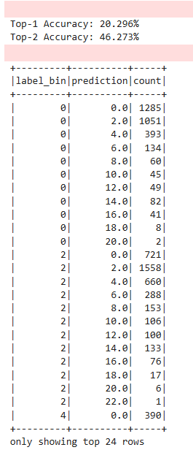
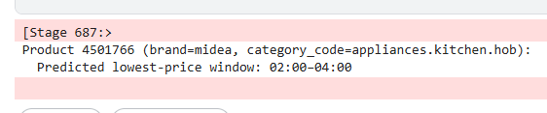
Exact Match Rate: The model correctly identifies the precise 2-hour window about 20% of the time
Near-Miss Rate: If we allow a one-slot margin (±2 hours), accuracy jumps to 45%
The confusion matrix shows a strong diagonal for bins close to the true label, but predictions fall off sharply for bins more than one slot away.

