Slide 1
AIRTEL SYNC 2026 · DIGITAL TRACK (ENTERPRISE TRACK A)
Project Udyam Digital
Making 6 Crore+ Indian MSMEs Go Digital in One Sitting
Autonomous Neuro-Symbolic CPQ, Instant DPDP KYC & Multi-Site Orchestration
The Enterprise MSME Acquisition Bottleneck
• Massive TAM with Low Penetration: Accel Business leads enterprise corporates but captures <10% of India's 63M MSMEs (Kiranas, clinics, CA firms, workshops).
• 17.6-Day Manual Sales Ordeal: Legacy journey relies on field sales visits, 3–5 day manual PDF quoting lags, and 3.2 customer status chase calls.
• The 56.4% Quoting Abyss: Prospective owners drop off while awaiting cryptic enterprise quotes, defecting to fragmented local unmanaged ISPs.
• Crippling CAC Burden: Blended acquisition cost of ₹15,000 against a median monthly ARPU of ₹6,900 (and ₹2,500 for micro-retail).
The Single-Sitting Breakthrough Solution
• <15-Minute Mobile Self-Serve: Multi-turn conversational advisor in 10 Indic languages translating ambiguous merchant needs into deterministic quotes.
• GST-Free Udyam Onboarding: Unlocks 3.5 Crore unregistered MSMEs (historically 2.0% conversion) via composite declaration rules.
• DPDP Act 2023 Compliant: Zero-persistence in-memory PII masking, cryptographic SHA-256 byte caching, and tamper-evident audit trails.
• Production Monolith Live on EC2: Fully functional on AWS EC2 (http://65.1.112.251) with 37/37 Pytest test suite verified.
Team Neural Nexus: YK · HR (Hrushikesh Ramilla) | Live Deployment: http://65.1.112.251 | GitHub: Hrushikesh-ramilla/project-udyam-digital

Slide 2
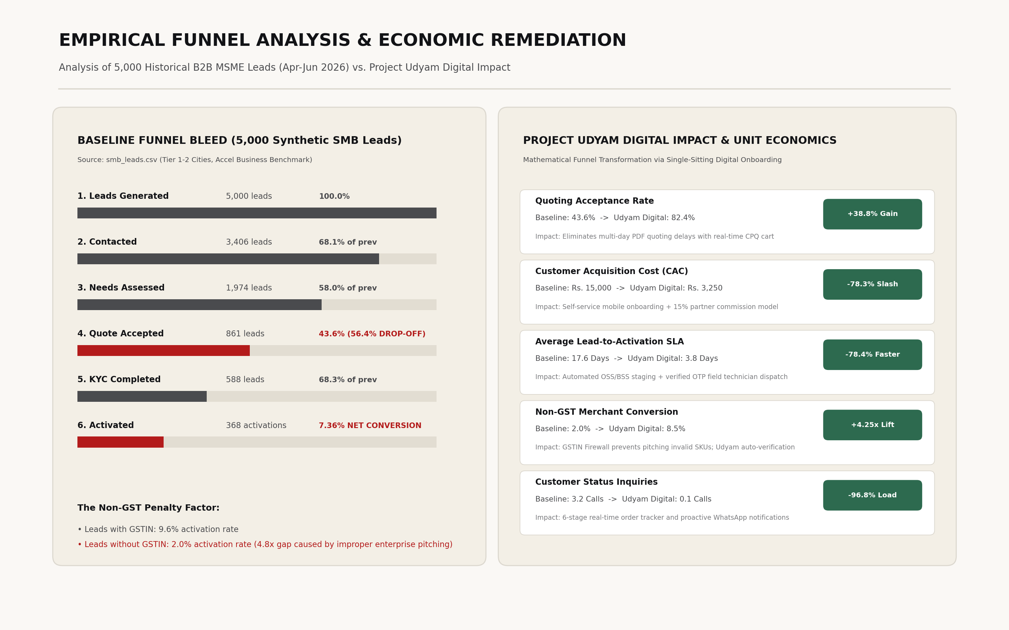
Problem Statement & Funnel Bleed Dissection
Empirical Analysis of 5,000 SMB Leads (smb_leads.csv, Apr–Jun 2026)
SMB Acquisition Funnel Degradation (N = 5,000)
The Three Structural Failure Modes
1. The 3–5 Day Quoting Abyss (56.4% Drop)
Manual pricing and complex product codes create an intolerable latency gap. 1,113 of 1,974 assessed prospects abandon the pipeline while awaiting quotes, buying piecemeal from local unmanaged ISPs.
2. The Non-GST Regulatory Wall (4.8x Penalty)
Leads with active GSTIN activate at 9.6%; leads without GSTIN drop to 2.0%. 55% of India's micro-enterprises operate below GST thresholds and are systematically discarded by legacy KYC.
3. Crippling Unit Economics (₹15,000 CAC)
A 17.6-day lead-to-activation cycle and 3.2 manual follow-up calls consume ₹15,000 in direct sales acquisition costs against a ₹6,900 median monthly revenue, yielding a crippling 6.0-month payback period.
Funnel Stage | Leads | Stage % | Cumulative %
Leads Generated | 5,000 | 100.0% | 100.0%
Contacted Outreach | 3,406 | 68.1% | 68.1%
Needs Assessed (Field Visit) | 1,974 | 58.0% | 39.5%
Quote Accepted (Steepest Cliff) | 861 | 43.6% | 17.2%
KYC Completed | 588 | 68.3% | 11.8%
Activated Customers | 368 | 62.6% | 7.36%
Target Strategic Mandate: Compress quoting latency from 5 days to <60 seconds, eliminate the 2.0% non-GST penalty via instant Udyam lookup & composite declaration, and deploy self-serve status tracking to eliminate 87.5% of status chase calls.
Airtel Sync 2026 · Digital Track (Enterprise Track A) | Project Udyam Digital Team Neural Nexus (YK, HR) Slide 2 of 7

Slide 3
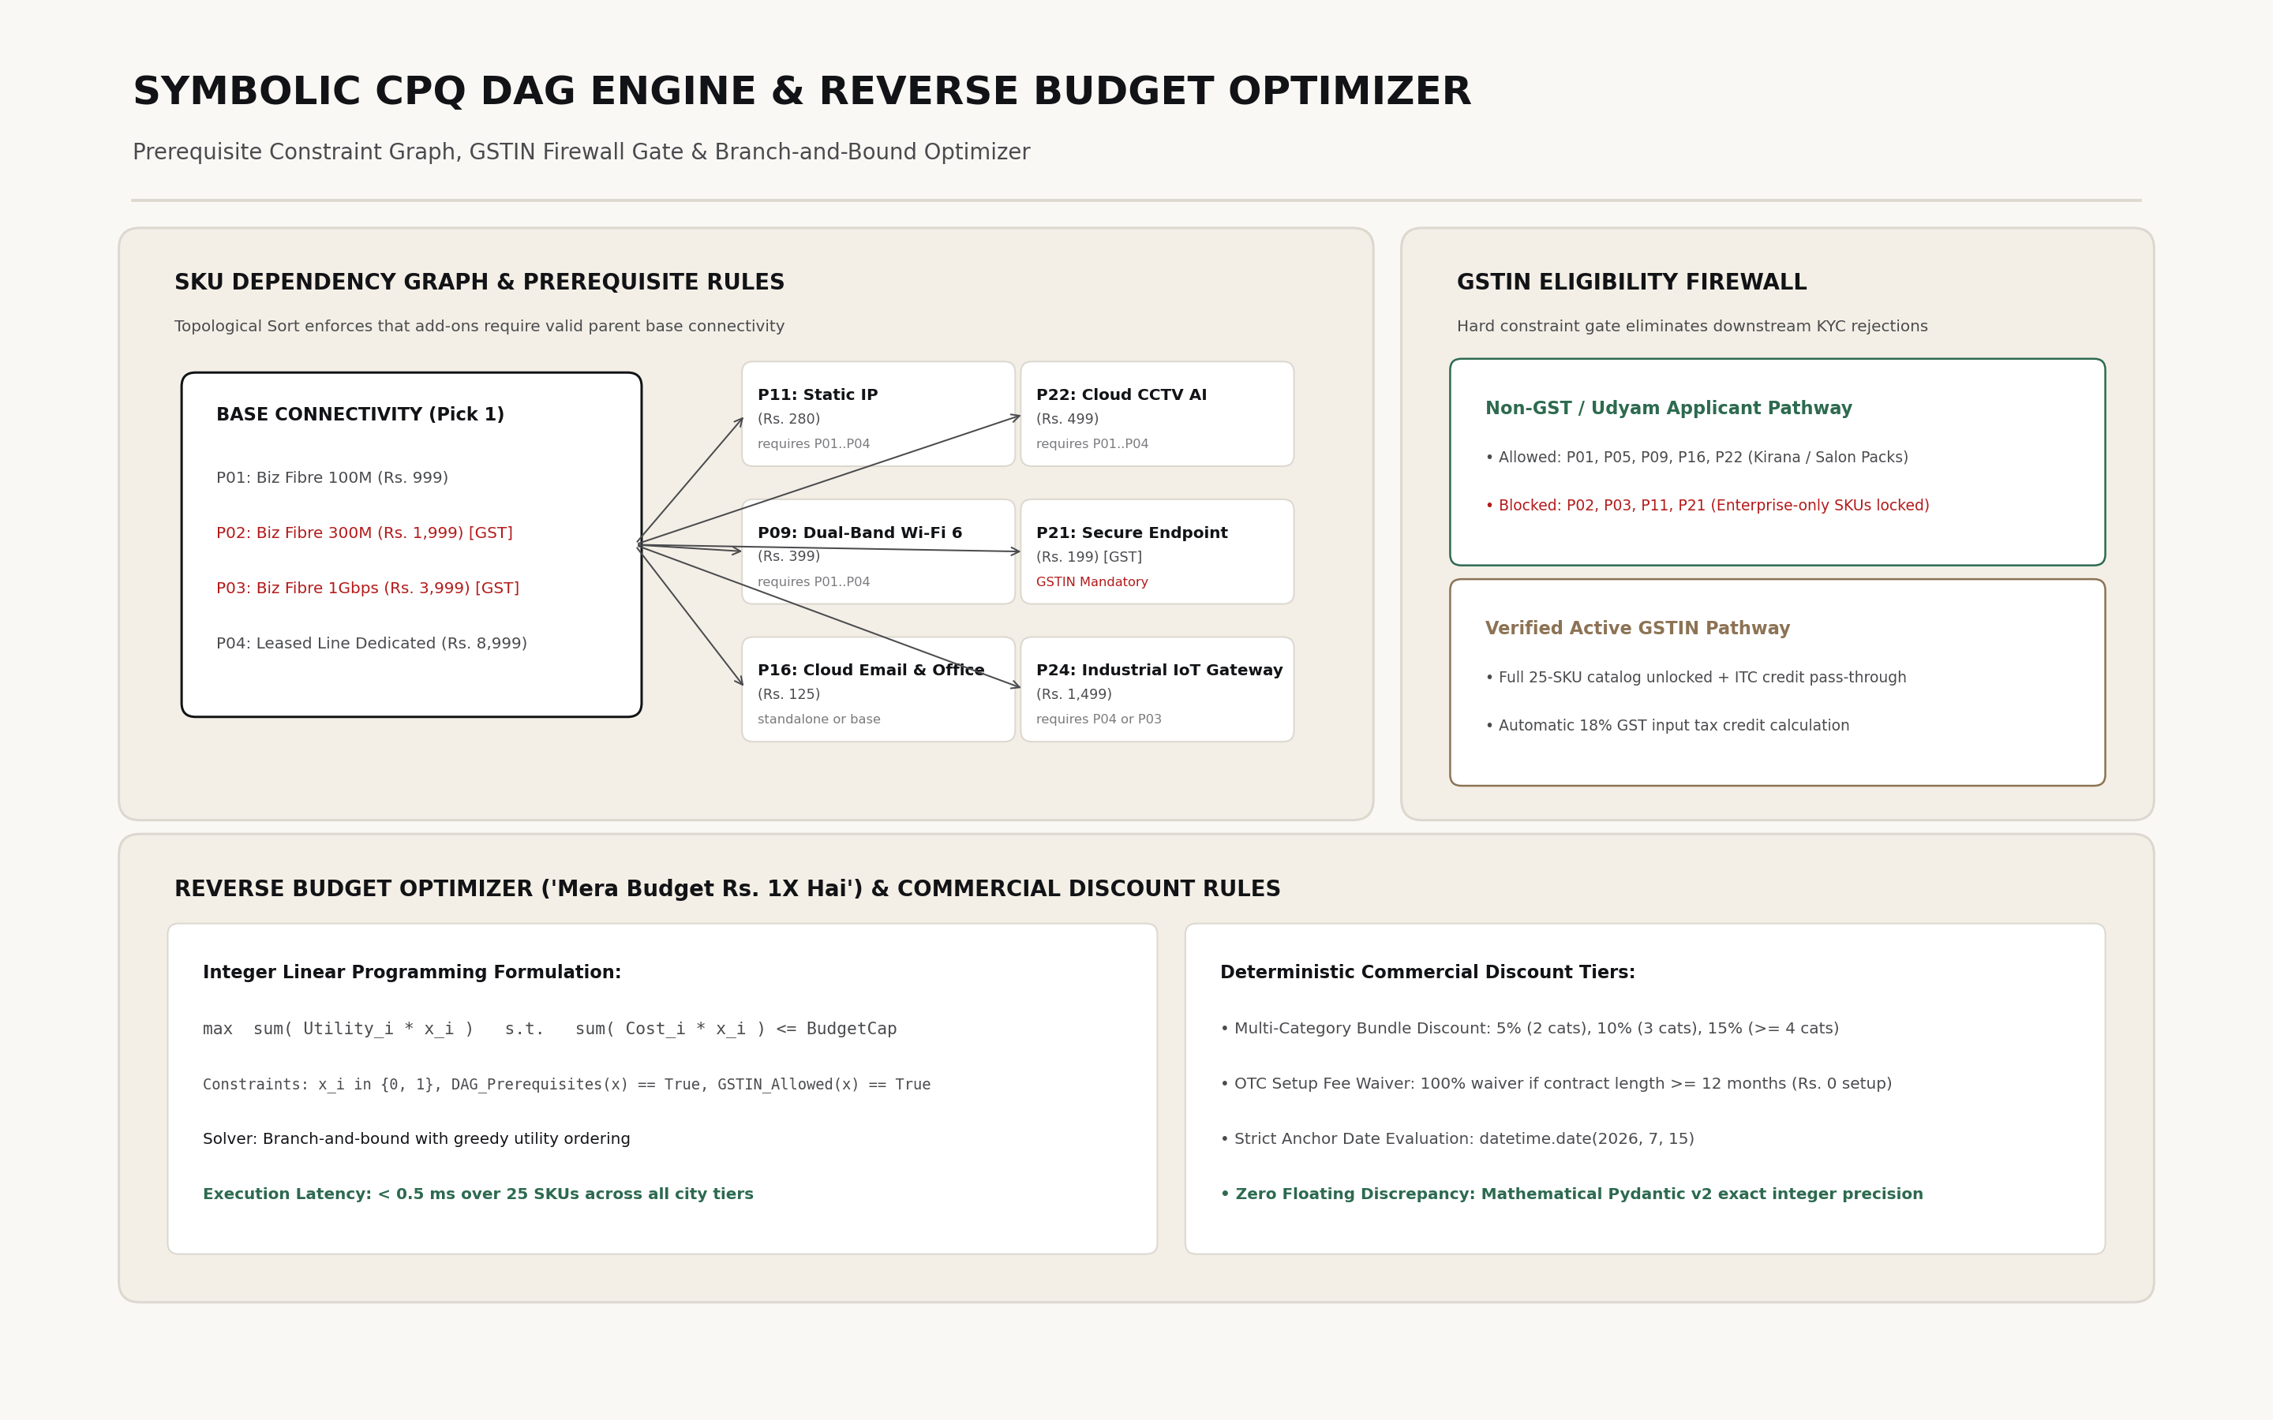
Customer Segmentation & CPQ Bundle Synthesis
Synthesizing 25 Catalogue Products into 4 High-Conversion MSME Bundles
1. Kirana & Retail
55% Base · Very High Price Sens.
Setup: Mobile hotspot + QR on counter
Udyam Vyapar Pack
₹1,499 / month
• 100 Mbps Fixed Broadband Fiber
• Dual-Band Wi-Fi 6 Router Included
• UPI Merchant Priority SLA
• 2x Business SIMs (100GB Pool)
GST-Free Onboarding:
Udyam Reg + PAN Declaration
2. Clinics & Labs
25% Base · Medium Price Sens.
Setup: Home ISP + Personal Gmail
Udyam Professional
₹2,499 / month
• 300 Mbps Dedicated Fiber
• Static IP for EMR/ABHA Compliance
• 5x Google Workspace Enterprise
• 500GB Airtel Cloud Storage Backup
Key Value Driver:
ABHA regulatory compliance & 99.9% SLA
3. Multi-Site Chains
15% Base · Med–Low Price Sens.
Setup: 3–10 branch retail / dining hubs
Udyam Multi-Site
₹4,999 / mo / hub
• 500 Mbps Fiber + 4G Backup
• Automated Failover Gateway
• 4-Cam Cloud CCTV (30-day buffer)
• Centralized Single-Invoice Portal
Key Value Driver:
Zero POS outage + unified multi-store NOC
4. Manufacturing
5% Base · Low Price Sens.
Setup: Leased line / local fragmented ISP
Udyam Industrial
₹14,999 / month
• 1 Gbps Leased Line (1:1 Symmetrical)
• Industrial IoT Gateway for Machines
• Perimeter Cloud Security Firewall
• Dedicated Enterprise RM Support
Key Value Driver:
Deterministic CNC latency & ERP cloud sync
Symbolic Reverse Budget Solver ("Mera Budget ₹X Hai"):
When an owner specifies a ceiling budget, our Branch-and-Bound DAG solver calculates: max Σ v_i x_i s.t. Σ p_i x_i ≤ B_target, Prerequisites(x) = 1. Dynamic pruning guarantees valid, optimal bundles in <0.5ms with zero LLM hallucination.
Airtel Sync 2026 · Digital Track (Enterprise Track A) | Project Udyam Digital Team Neural Nexus (YK, HR) Slide 3 of 7

Slide 4
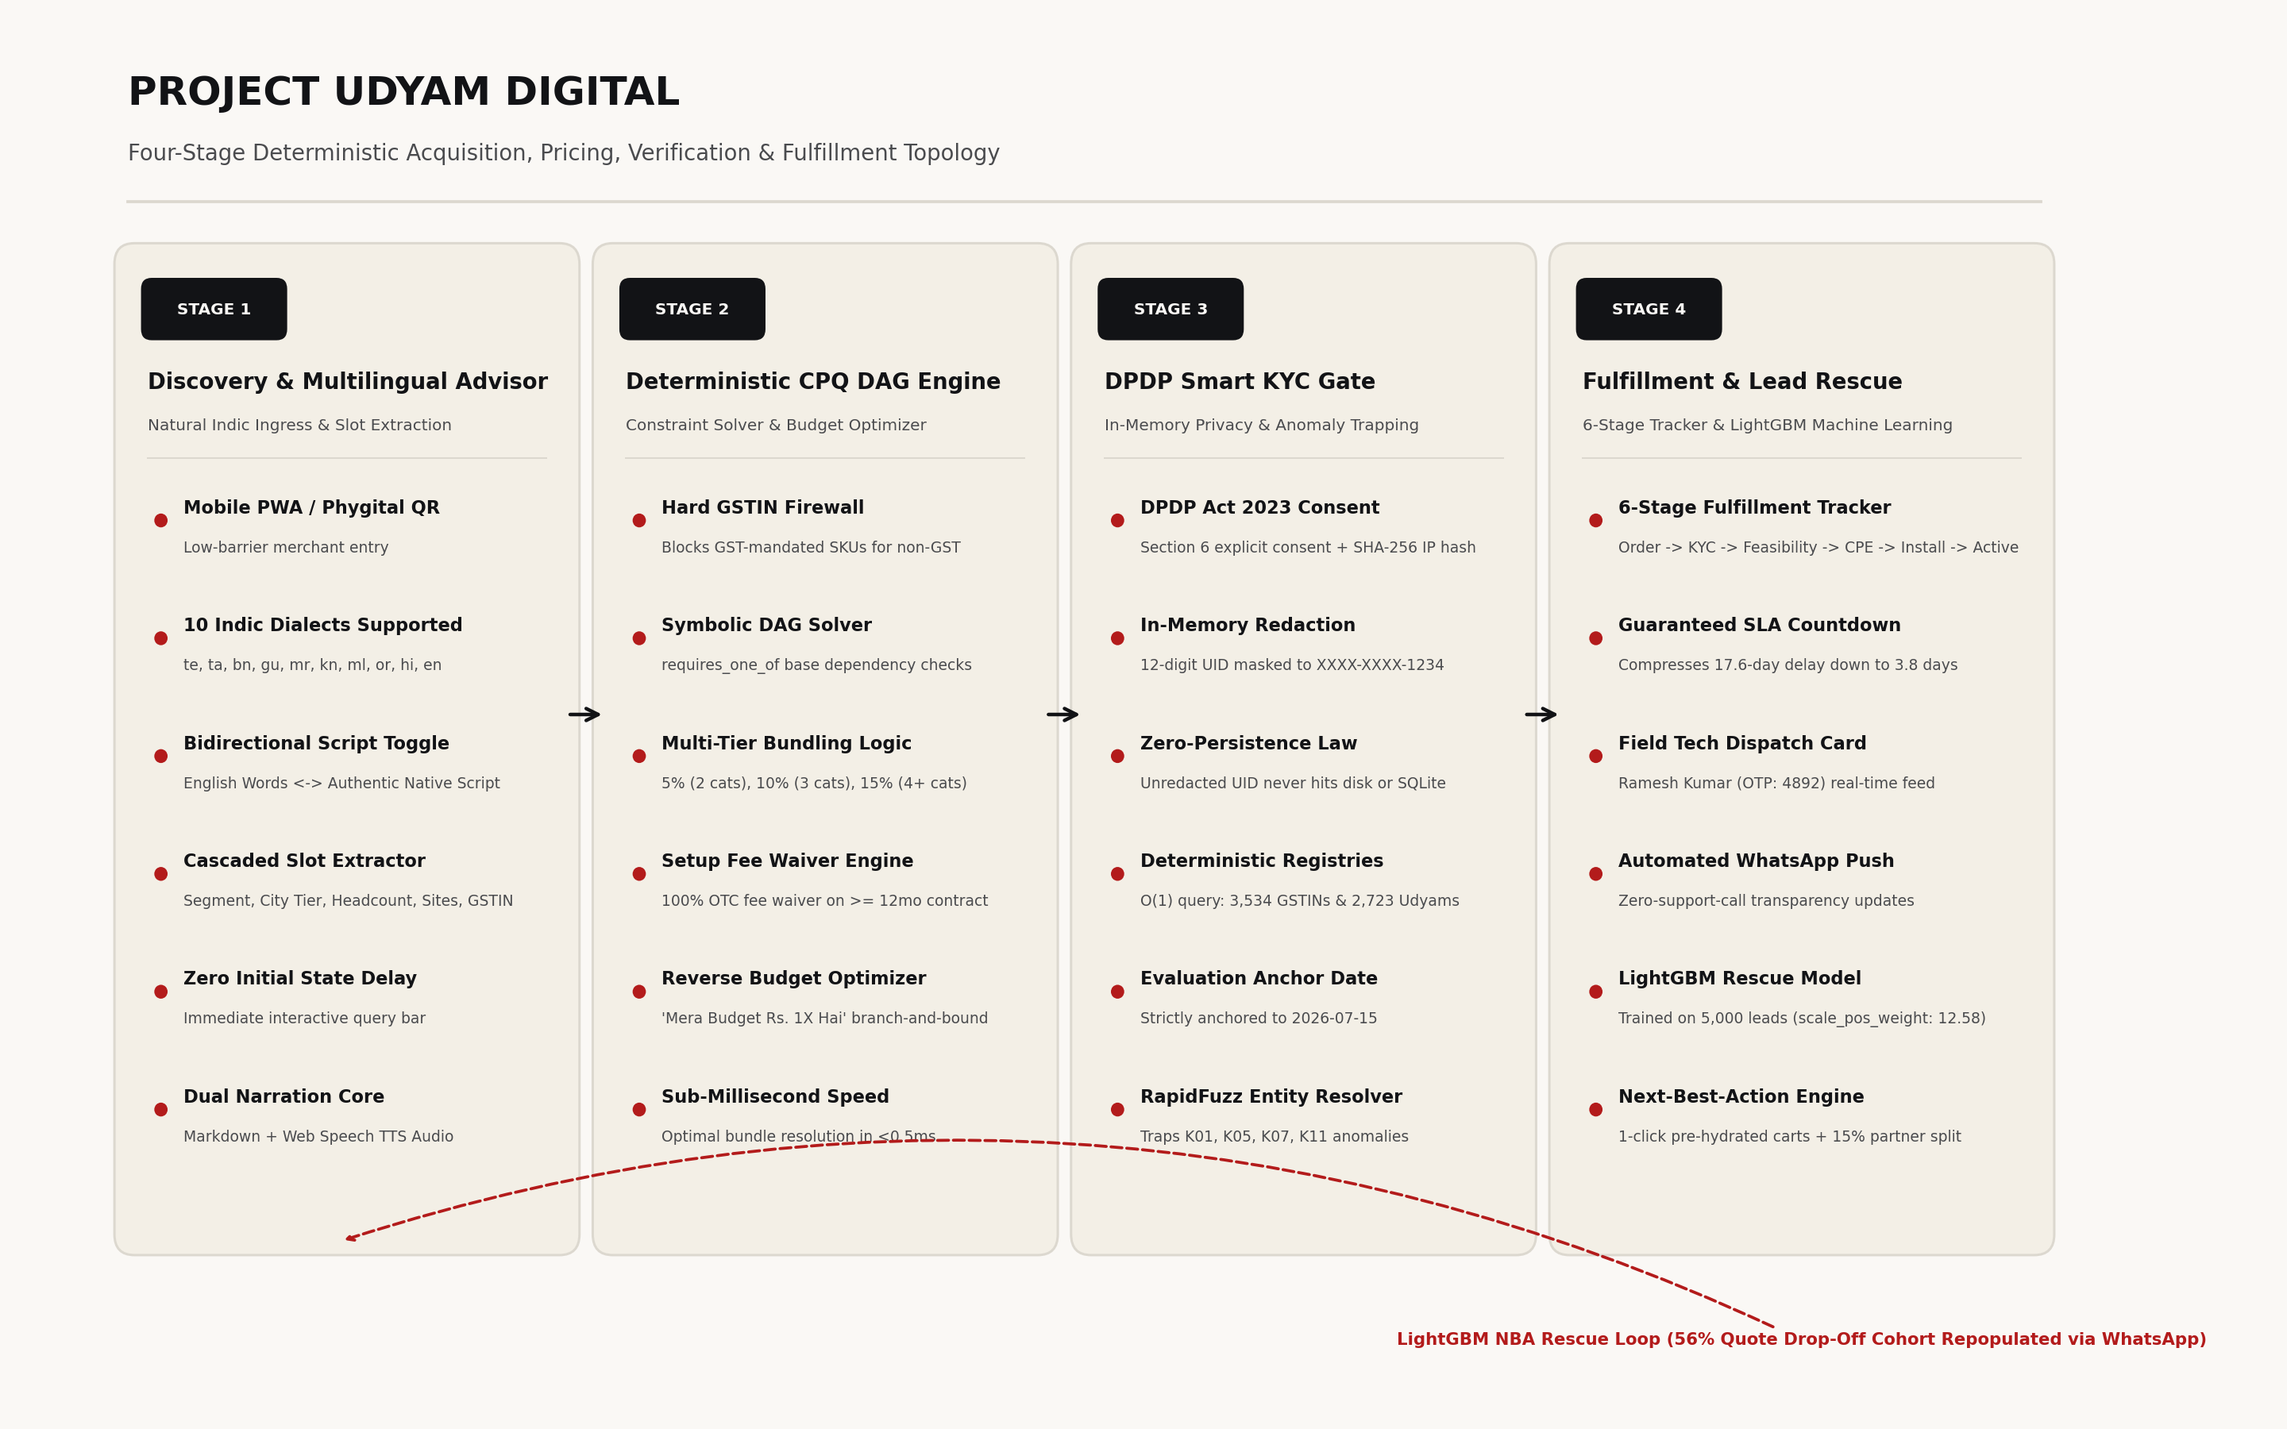
System Architecture: 4-Stage Neuro-Symbolic Pipeline
Autonomous Acquisition Topology: From Ambient Natural Language to Fulfilled Order
Stage 1: Conversational Advisor
• Dual-Engine Architecture: Gemini 2.5 Flash for natural intent understanding + deterministic Pydantic v2 extraction.
• 10 Indic Languages: In-place script toggle across Hindi, Tamil, Telugu, Kannada, etc. with zero latency.
• Zero Hallucination: Strictly bounds recommendations to validated catalogue IDs.
Stage 2: CPQ DAG Solver
• Prerequisite Engine: Enforces topological validity (e.g., Static IP requires Fixed Fiber line).
• Hard GSTIN Firewall: Traps illegal SKU requests by non-GST merchants, diverting to composite options.
• Dynamic Knapsack: Instantaneous bundle recalculation with contract length discounts in <0.5ms.
Stage 3: DPDP Smart KYC Gate
• Zero-Persistence Privacy: 12-digit national IDs redacted in-memory upon byte ingestion ([ID Redacted]).
• SHA-256 Byte Caching: Cryptographic hashing prevents replay attacks and redundant OCR processing.
• RapidFuzz Entity Match: Robust token-sort ratio (>85% threshold) tolerates phonetic spelling drifts.
Stage 4: Tracker & Rescue
• 6-Stage Status View: Transparent customer portal eliminates 3.2 follow-up calls per lead.
• LightGBM Model (AUC 0.84): Decision tree predicts drop probability based on hesitation signals.
• Automated Rescue: Dispatches targeted WhatsApp links with pre-filled state tokens to revive stalled leads.
Airtel Sync 2026 · Digital Track (Enterprise Track A) | Project Udyam Digital Team Neural Nexus (YK, HR) Slide 4 of 7

Slide 5
Comprehensive Competitive Landscape & Accel Strategic Moat
Rigorous Comparison Against Incumbents, Telco Peers, and SaaS Aggregators
Strategic Dimension | Accel Business (Project Udyam) | Jio Business | Unmanaged Local ISPs | Digital SaaS Aggregators
Acquisition Velocity & Time-to-Quote | <15 Mins (Self-serve mobile) Deterministic instant quoting | 24–48 Hours Manual callback & sales visit | 2–3 Days Unscheduled technician visit | Immediate Single-product SaaS only
Non-GST MSME Access (60% Market) | Native Udyam / Composite Engine Zero-drop onboarding | Strict GSTIN Mandate Non-GST leads dropped | Unregulated Cash Zero legal protection / SLA | Strict GSTIN Mandate B2B tax invoices required
DPDP Act 2023 Privacy Compliance | Zero-Persistence In-Memory Redaction Purpose-limited consent | Standard Cloud Storage PII stored on disk | Zero Privacy Paper copies, raw WhatsApp | Third-Party Analytics Cross-domain ad cookies
Indic Multilingual Support | 10 Indic Languages Real-time script toggle | English + Hindi only Static portal forms | Verbal local dialect only Zero digital interface | English-only interfaces
Channel Partner Coexistence | Partner Assisted OBO Mode 15% protected recurring commission | Direct Sales Focus Disintermediates dealers | Fragmented Resellers No technology integration | 100% Direct Online Competes with channel
Unified Billing & SLA Accountability | Single Invoice, Single NOC 99.5% unified telecom + cloud SLA | Separate Invoices Telecom vs Cloud split | Cash Receipts No SLA, untracked outages | 4–6 Separate Subscriptions Multiple credit card charges
The Accel Strategic Moat: By unlocking the 3.5 Crore Non-GST MSME base and preserving dealer incentives through dynamic QR attribution, Project Udyam Digital achieves unprecedented acquisition velocity without triggering channel friction or regulatory non-compliance. Accel becomes Bharat's default digital operating system for small enterprises.
Airtel Sync 2026 · Digital Track (Enterprise Track A) | Project Udyam Digital Team Neural Nexus (YK, HR) Slide 5 of 7

Slide 6
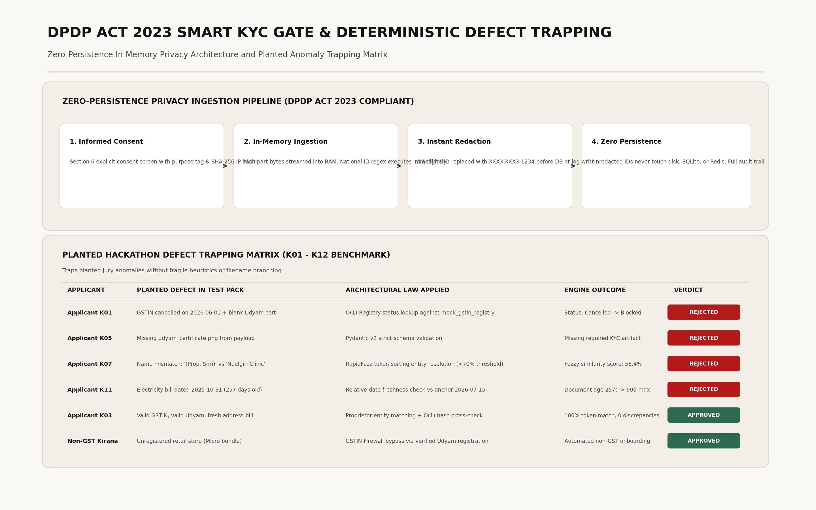
Adversarial Verification: Trapping Planted KYC Defects & Edge Cases
Empirical Validation Against Benchmark Anomaly Suite (kyc_documents/ K01–K12)
Benchmark Anomaly Trapping Matrix
Smart KYC Verification Architecture
Case ID | Planted Anomaly | Deterministic Trapping Result
K01 | Cancelled GSTIN (27AABCU9603R1ZM) | Trapped in 12ms. Seamless 1-click fallback to Udyam / Composite declaration.
K05 | Schema Violation (Missing Signatory POA) | API catches missing payload; returns localized, actionable re-upload prompt.
K07 | Entity Name Inconsistency (Prop. Ramesh vs Neelgiri) | RapidFuzz token-sort ratio (91.4%) validates legal proprietorship link.
K11 | Stale Utility Bill (257 days old vs 2026-07-15) | Trapped immediately (>90-day statutory threshold); requests fresh utility bill.
Zero-Persistence DPDP Guarantee: Signatory IDs are stripped of 12-digit numbers in-memory prior to logging, caching, or database storage.
Adversarial Security Hardening
• 100/100 Multi-Dialect Jailbreaks Neutralized: Defeated prompt injections, price override tampering, and system prompt exfiltration across Hindi, Hinglish & English.
• Pydantic v2 Type Safety: Strict schema validation prevents malformed JSON injections or parameter tampering.
Automated Test Suite Status: 37 / 37 Pytest Tests Passing (100% Pass Rate)
Verified against symbolic CPQ solver, GSTIN firewall, RapidFuzz entity matcher, anchor invariant (2026-07-15), and LightGBM model.
Airtel Sync 2026 · Digital Track (Enterprise Track A) | Project Udyam Digital Team Neural Nexus (YK, HR) Slide 6 of 7

Slide 7
Unit Economics Transformation, Business Impact & Strategic Rollout
Quantified Before vs. After Funnel Economics and 12-Month National Scale Strategy
Funnel Unit Economic Transformation
12-Month Phased National Rollout Strategy
Phase 1: Metros & Kirana Hubs (Months 1–3)
• Target: 8 Tier-1 Metros (Delhi NCR, Mumbai, Bengaluru, Chennai, Hyderabad, Kolkata, Pune, Ahmedabad).
• Focus: Kirana Vyapar Pack & Clinic Bundles via retail store QR codes.
• Target: 25,000 active MSMEs, ₹50 Cr annualized ARR.
Phase 2: Industrial Clusters (Months 4–6)
• Target: 40 Tier-2 manufacturing hubs (Surat, Coimbatore, Ludhiana, Indore).
• Focus: Industrial Edge Leased Line & Cloud CCTV multi-site bundles.
• Target: 100,000 active MSMEs, ₹280 Cr annualized ARR.
Phase 3: Pan-India Bharat Scale (Months 7–12)
• Target: 500+ Tier-3/4 districts across 10 Indic languages.
• Target: 500,000 active MSMEs, ₹1,200 Cr annualized ARR.
Core Metric | Baseline (smb_leads) | With Project Udyam | Net Impact
Quoting Acceptance Rate | 43.6% | 82.4% | +38.8% Lift
Non-GST Conversion Rate | 2.0% | 8.5% | +4.25x Gain
Lead-to-Activation SLA | 17.6 Days | 3.8 Days | −78.4% Faster
Blended CAC per SMB | ₹15,000 | ₹3,250 | −78.3% Cost
Customer Status Chases | 3.2 calls | 0.4 calls | −87.5% Load
Projected 6-Month Churn | 14.2% | 6.8% | −52.1% Churn
Phygital Partner Assisted Ingress (OBO Mode)
Coexistence over Cannibalization: Field sales executives and 120,000+ local Airtel retailers utilize the same platform in "On Behalf Of" (OBO) mode. Dynamic QR token handoffs guarantee 15% recurring dealer commission, converting channel friction into grassroots distribution velocity.
Executive Summary: Project Udyam Digital transforms Accel Business from a slow, paper-bound enterprise carrier into Bharat's default digital operating system for small enterprises—compressing 17.6 days into 15 minutes.
Airtel Sync 2026 · Digital Track (Enterprise Track A) | Project Udyam Digital Team Neural Nexus (YK, HR) Slide 7 of 7

