Slide 1
Predict CLTV of a customer
Hrushikesh H D

Slide 2
AGENDA
Problem Statement
Objective
Approach
Feature Engineering
Model Selection using Hyperparameter Tuning and Cross Validation
Predictions and Evaluation
​Summary

Slide 3
Problem Statement
The VahanBima insurance company wants to launch personalized programs for its customers. To do this, they want to predict the CLTV of customers based on their activity and interaction with the platform. The task is to build a high-performance and interpretable machine learning model. The model will be used to segment customers into different tiers. The interpretability will help to understand the reasoning behind the model's predictions.

Slide 4
objective
To build a high performance and interpretable machine learning model to predict the CLTV based on the user and policy data.

Slide 5
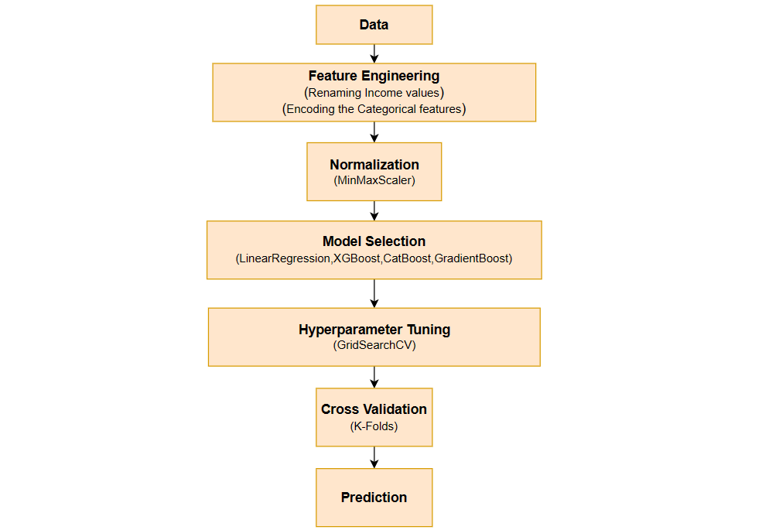
Approach

Slide 6
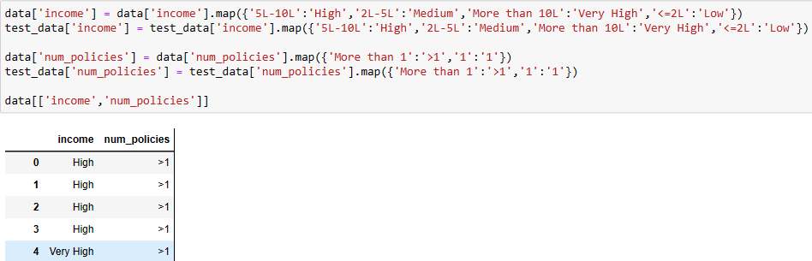
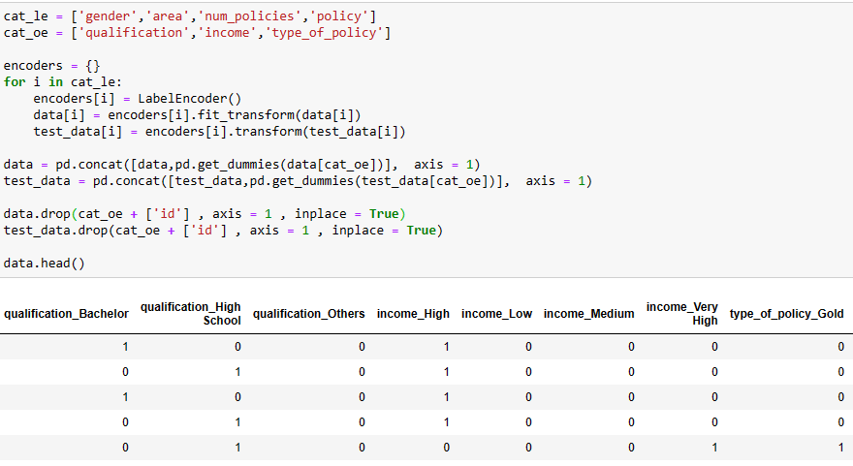
Feature engineering
In Feature Engineering,
In Income and number of policy column,
Renaming of values has been done to map values easily to which category they belong to.
Encoding is done for categorical variables using LabelEncoder and OneHotEncoder.

Slide 7
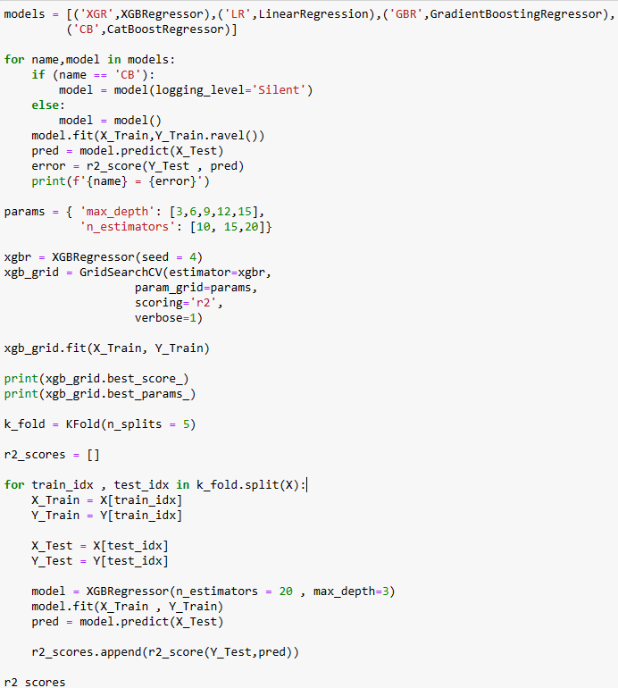
Model Selection using HyperparameterTuning and Cross Validation
After going through five-six types of model, I have finalized three models, from which I will be choosing one.
LinearRegression
XGBoostRegressor
CatBoostRegressor
For which I'll check the r2 score then hyperparameter tuning all three models and then cross validation to get the mean r2 score for all three models.
Here I have shown an image example for XGBoostRegressor

Slide 8

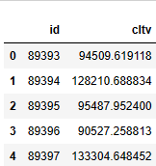
Prediction & Evaluation
After going through the results of r2 scores for models,
I have finalized the CatBoostRegressor model with 75 estimators.
Below

Slide 9
SUMMARY
After analyzing , cleaning and feature extraction of the given data.
A model was selected from chosen set of three models by using hyperparameter tuning and cross validation based on the r2 score.
CatBoostRegressor with 75 estimators which gave a mean r2 score of 0.174834769486781 after 5-folds cross validation was selected and used to build a high performance and interpretable machine learning model to predict the CLTV based on the user and policy data.

Slide 10

THANK YOU
Hrushikesh H D

