Slide 1

Zomato Restaurant Dataset
Exploratory Data Analysis

Slide 2
Why Analyze Zomato Data?
Market Trends
Optimize Operations
Understand consumer behavior.
Extract meaningful insights.

Slide 3
Project Objectives
01
02
03
Understand Data
Clean & Preprocess
Analyze Trends
Structure & characteristics.
Prepare data for analysis.
Ratings, cost, cuisines, delivery.
04
05
Visualize Patterns
Derive Insights
Relationships between features.
Business-oriented conclusions.

Slide 4

Dataset Overview
Key Attributes
Restaurant Name
City / Location
Cuisines
Average Cost for Two
Aggregate Rating
Online Delivery
Table Booking
Thousands of records across cities.

Slide 5

Tools & Methodology
Programming
Python
Libraries
Pandas
NumPy
Matplotlib
Seaborn

Slide 6


Data Preparation
Data Loading
Cleaning & Preprocessing
Pandas, initial inspection.
Missing values, numeric conversion, consistency.

Slide 7
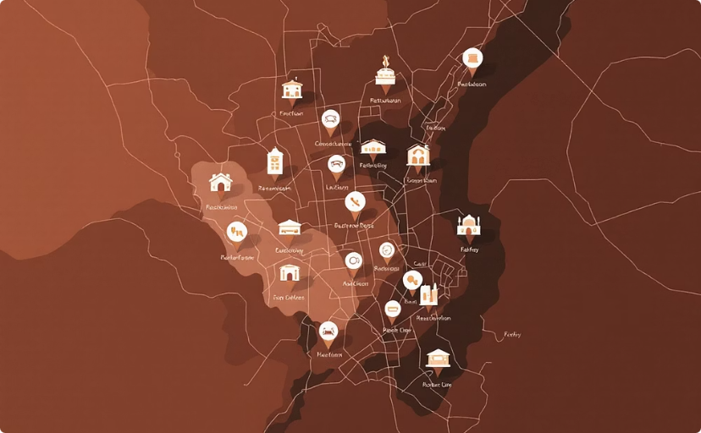
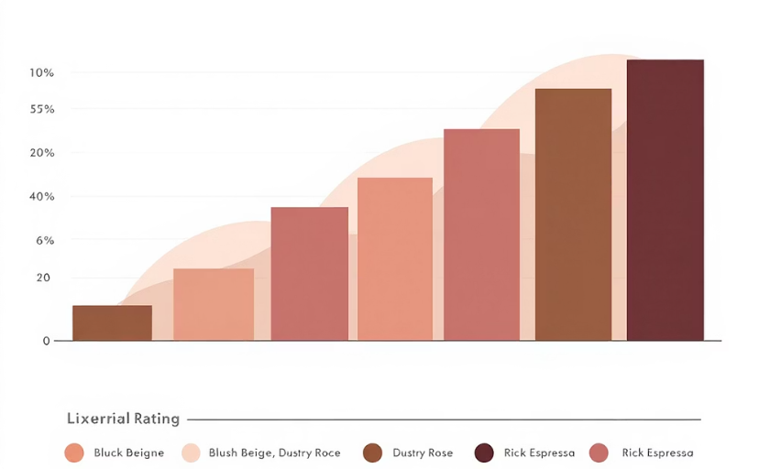
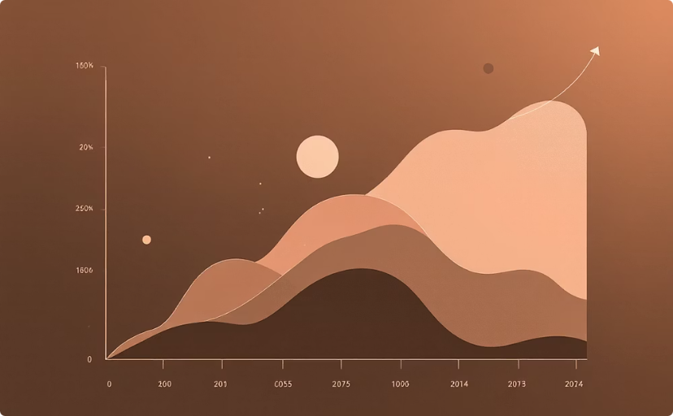
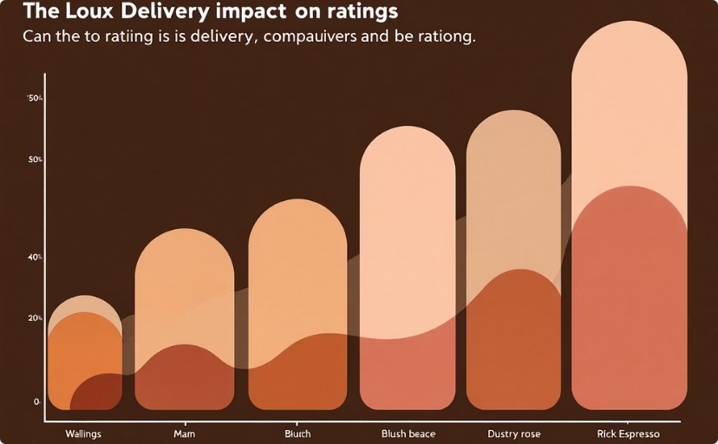
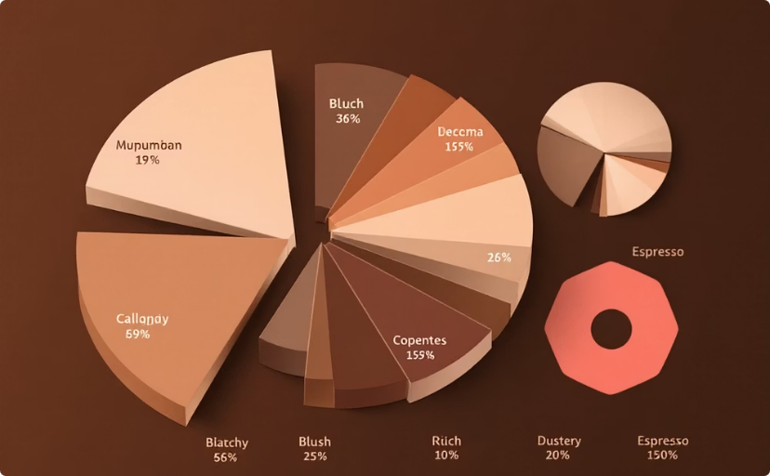
Exploratory Analysis
Restaurant Distribution
Ratings Analysis
Cost for Two
Online Delivery Impact
Density across cities.
Common ranges, mid-to-high.
Pricing ranges, outliers.
Higher ratings with delivery.
Cuisine Analysis
Popularity, average ratings.

Slide 8
Key Insights
Mid-Price Range
Online Delivery Boosts Ratings
Majority of restaurants.
Positive influence.
Cuisine Popularity
Uneven Distribution
Certain cuisines better rated.
Restaurants across cities.

Slide 9

Conclusion
EDA provides valuable insights into Zomato restaurant trends and customer preferences.
Helps owners and platforms make informed decisions on pricing, services, and market expansion.

Slide 10

Future Scope
Predict Ratings
Sentiment Analysis
Apply ML models.
Customer reviews.
Interactive Dashboards
City-Specific Deep Dive
Power BI, Tableau.
Targeted analysis.

