Slide 1

GoShop - Grocery delivery app
Team-14
Hrushikesh Vasista
Prashanth Molakala
Praveen Kumar Selvan
Vasudev Gawde

Slide 2
Features
Saves hours every week - not standing in line and driving to the supermarket!
One time User Registration
Payment through PayPal gateway
View Order History
Invite friends through SMS, email, WhatsApp
Supports Google and Facebook Sign-in
Keep a list of favorite items that you love to order
Edit Details ( Name, Phone Number, Address)
Multi-Language Support (English, German)
Leave feedback
Get Directions

Slide 3
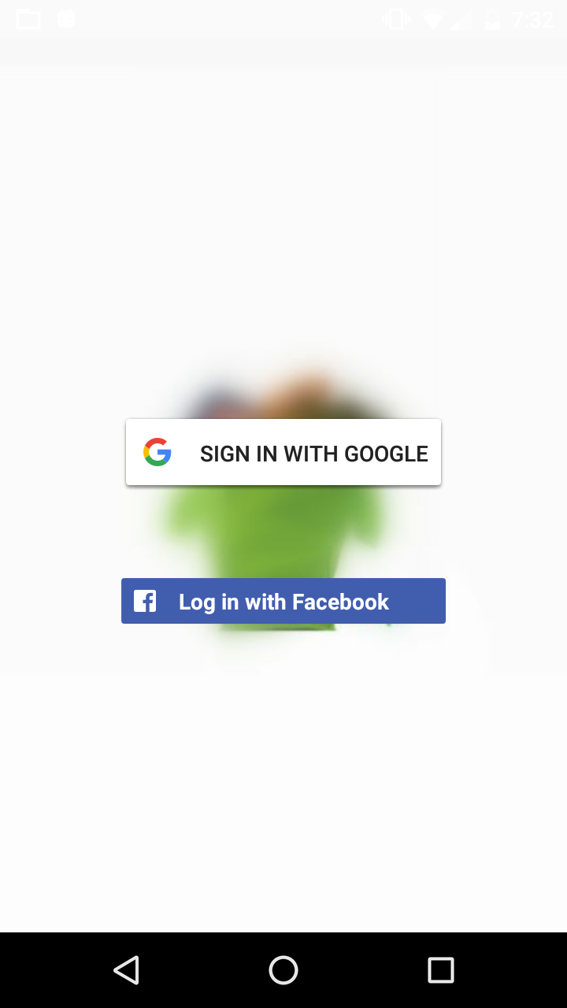
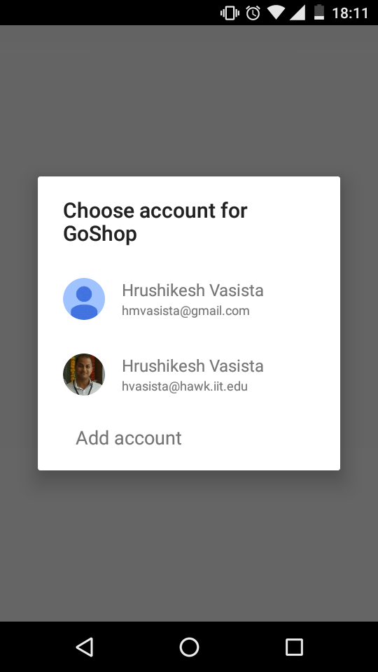
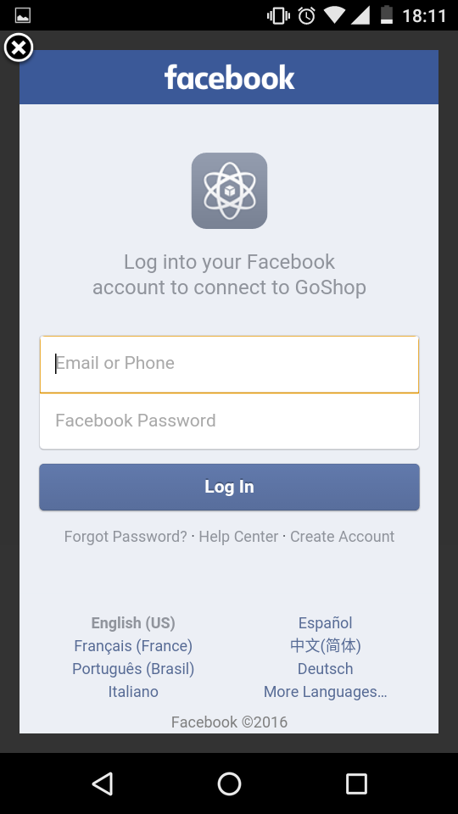
Login
Google Sign In
Google client API used for Logging in
Facebook Login
Facebook SDK used for Logging in
Silent /Auto Login
Automatic Login until user has logged out

Slide 4
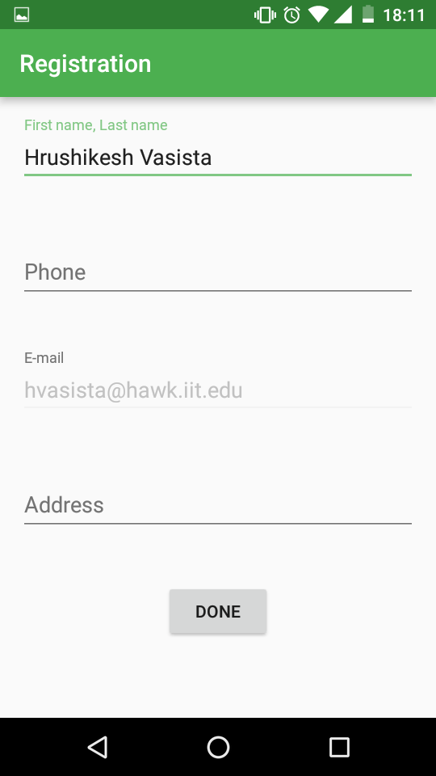
Registration
One Time User Registration
Registration Details
Name
Phone Number
Address

Slide 5
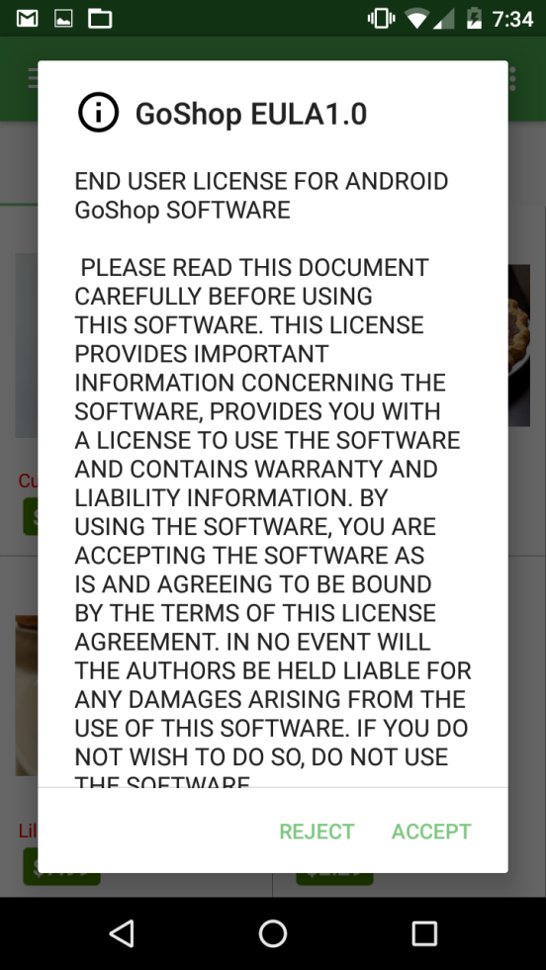
End User License Agreement(EULA)
Legal contract between the App Developers and the end user of an application.
Specifies
Term of License
Restrictions on use
Proprietary Markings
Disclaimer of Warranties and Technical Support

Slide 6
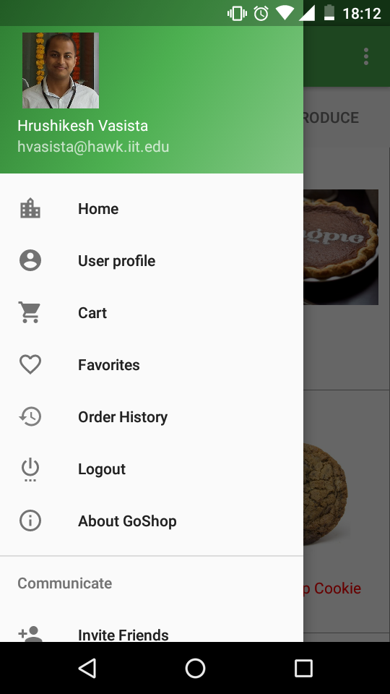
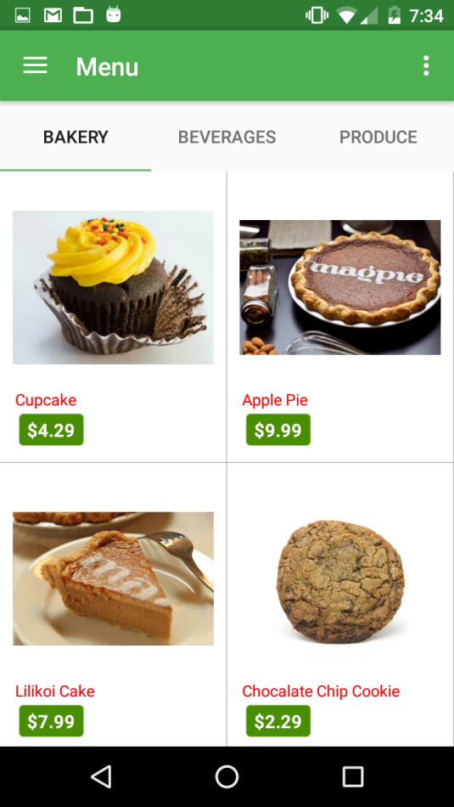
Home Page
Consist of Items which are categorized under different tabs
Display Item’s Image , price and name
Switch between tabs to view different categories of items

Slide 7
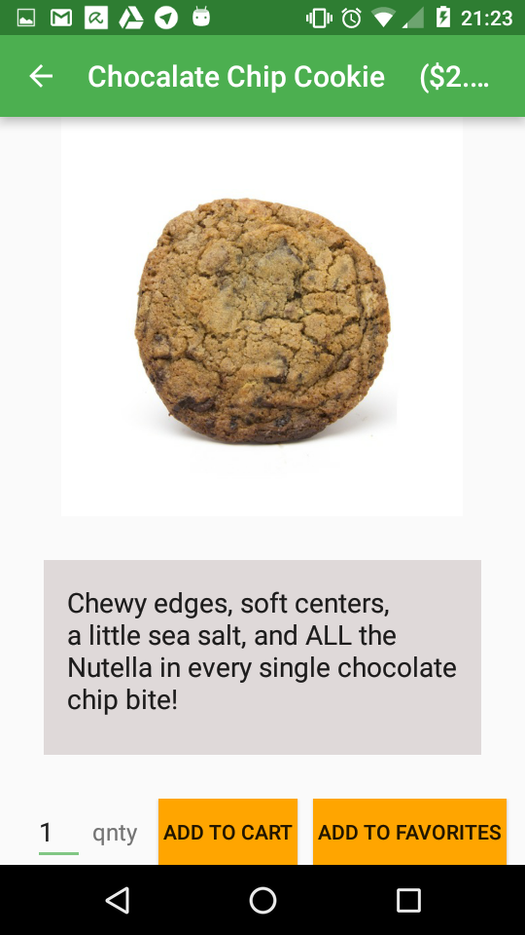
Item Detail Page
Select Items to view Item Detail Page
Item Detail Page
Item Name
Item Price
Item Image
Item Description
Enter Quantity
Add to Cart Button
Add to Favorites

Slide 8
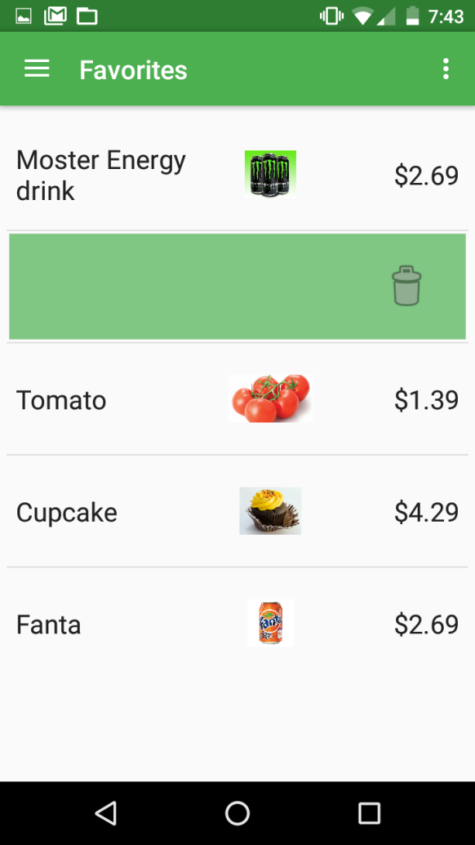
Favorites Page
Keep a list of favorite items that you love to order
User can Add Items into Favorites upon clicking on the Add to Favorites button
To remove the favorites item Swipe left and click the delete icon

Slide 9
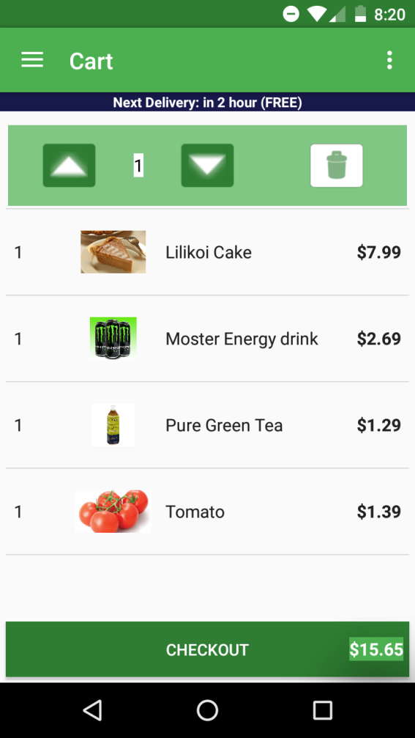
Cart Page
Keep a list of items added to cart and displays the subtotals of each item as well as the total amount of the cart and a Checkout button
User can Add Items into Cart by entering a quantity and clicking on the Add to Cart button for the item
To Update the quantity of the item swipe left and click on up or down arrow to increment or decrement the quantity respectively
To remove the cart item Swipe left and click the delete icon

Slide 10
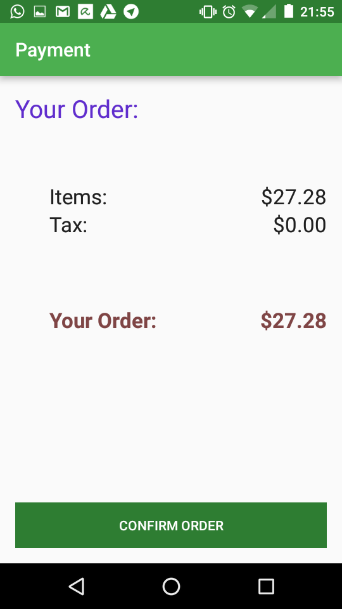
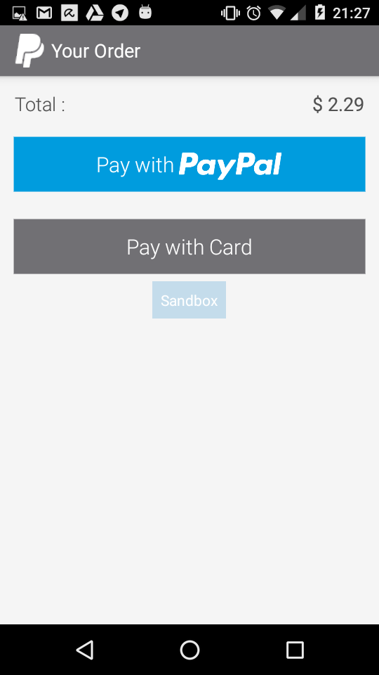
Payment Page
When the user clicks the Checkout button he / she will be redirected to the payment page
The payment is being done using PayPal Gateway
Multiple payment options using PayPal account or debit or credit cards
Once the payment is successful user is notified

Slide 11
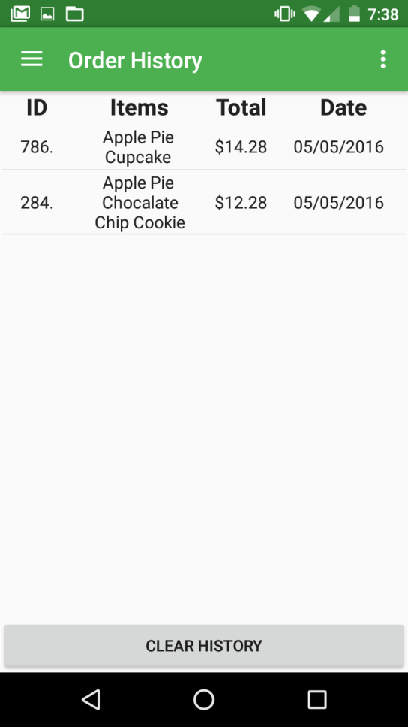
Order History Page
Display the list of ordered items with their order total, order ID and order date
User can clear the order history by clicking on Clear Orders button

Slide 12
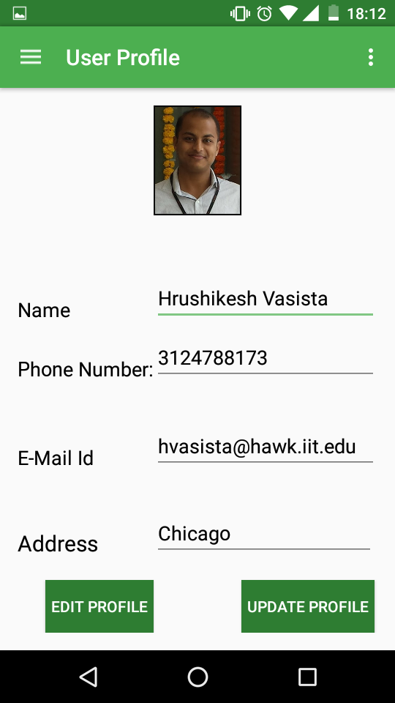
User Profile Page
Displays the details of the user which he / she entered during registration
Displays details
Profile picture
Name
Email id
Phone number
Address
User can edit and update his / her details

Slide 13
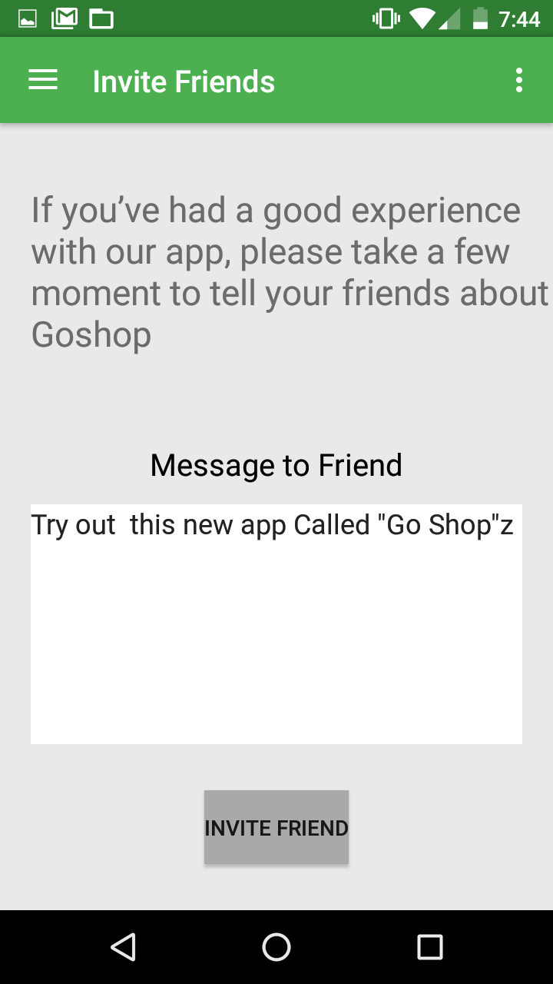
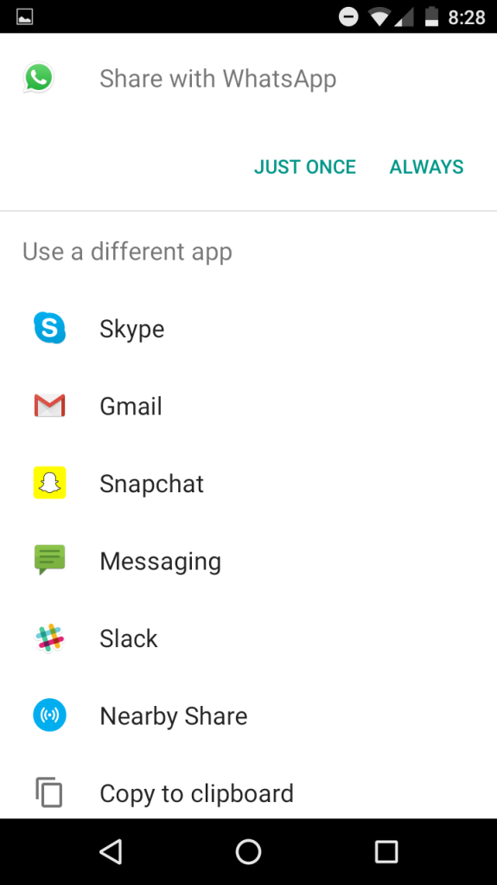
Invite Friends Page
Allows you to invite friends to try out the app
Send invite through
SMS
WhatsApp
Gmail
Telegram etc

Slide 14
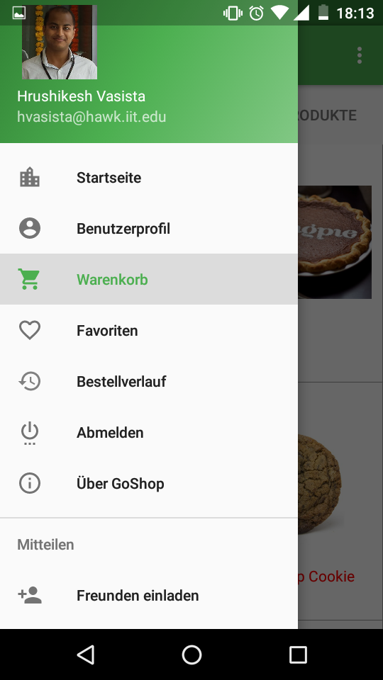
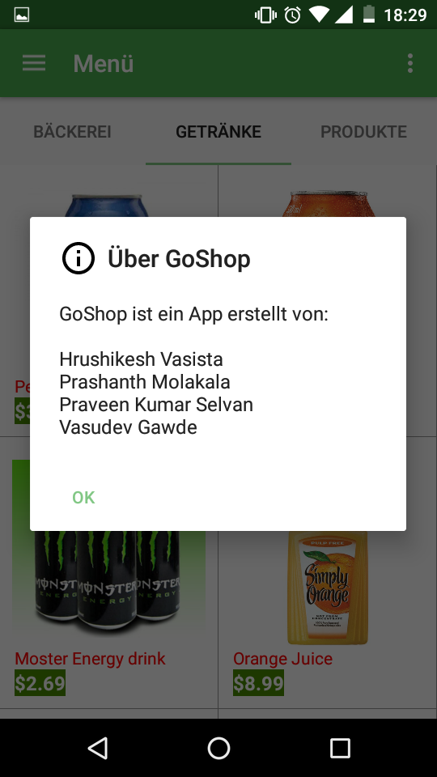
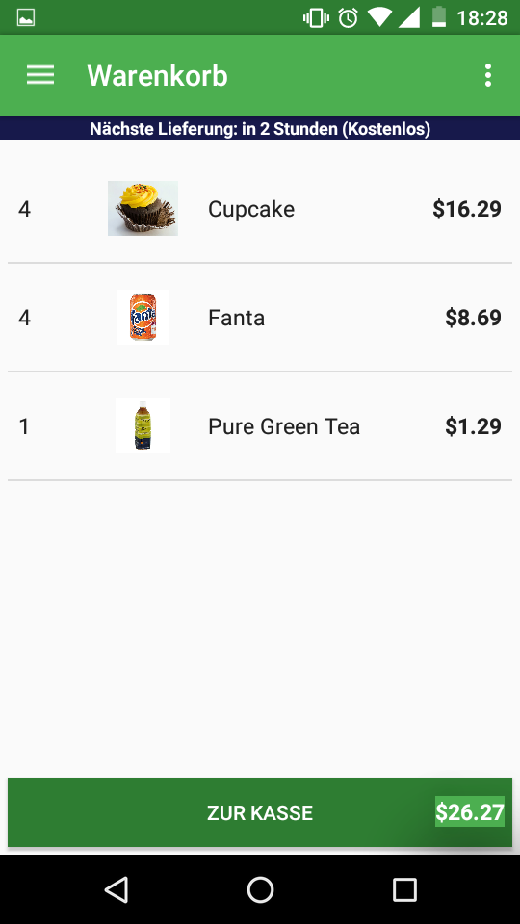
MULTI language support

Slide 15
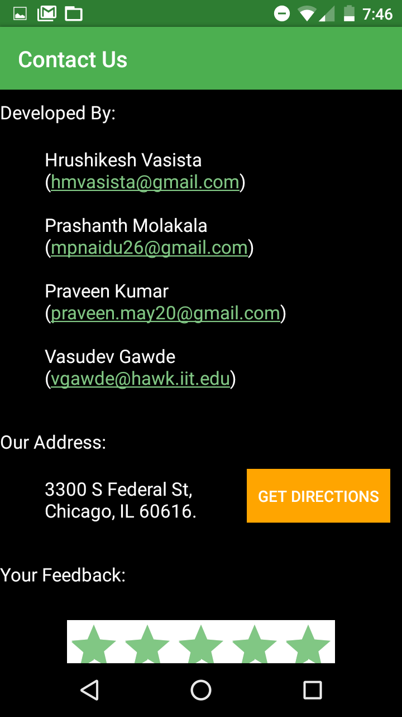
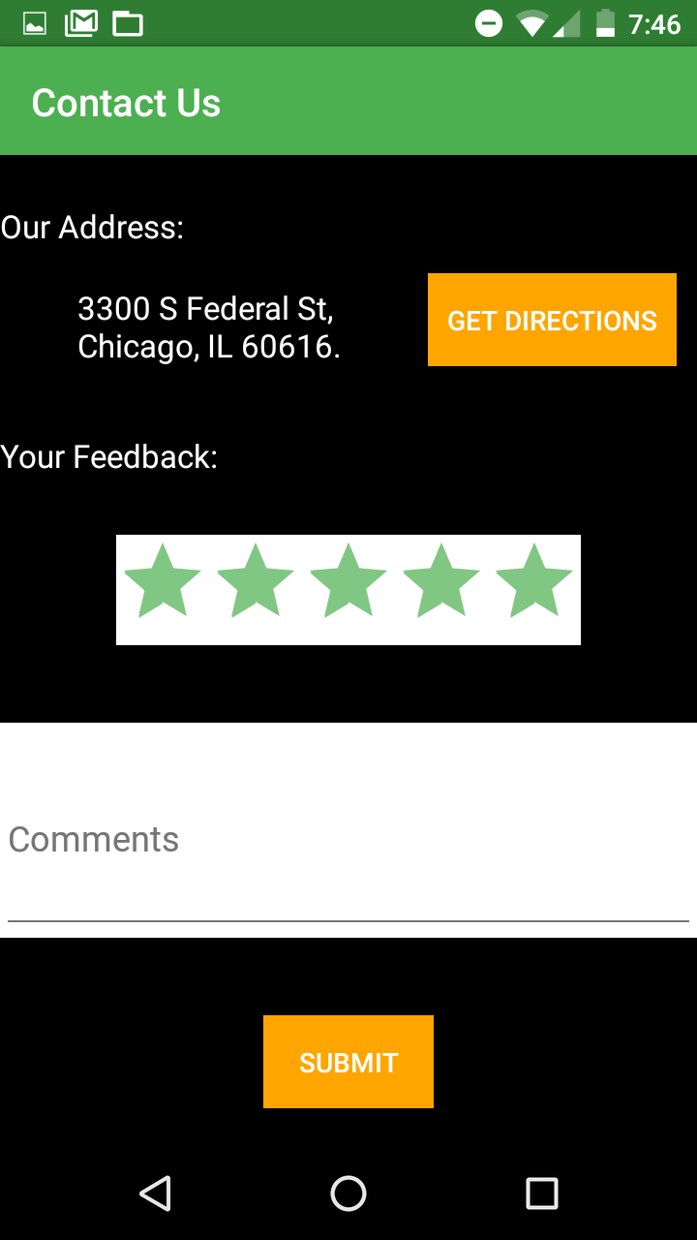
Contact Us Page
Displays the contact information
Get directions to the address by invoking inbuilt google maps
Feedback
Rating
Comments

Slide 16
Thank you

