Slide 1
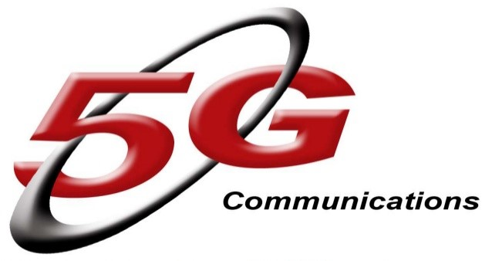
Presented by:
G.Hrushitha.
G.Shiny

Slide 2



Contents….
Introduction to 5G
Evolution from 1G to 5G
Architecture
Hardware & Software of 5G
Conclusion

Slide 3
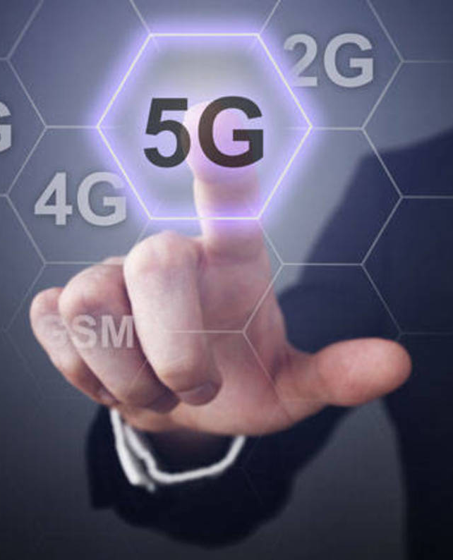



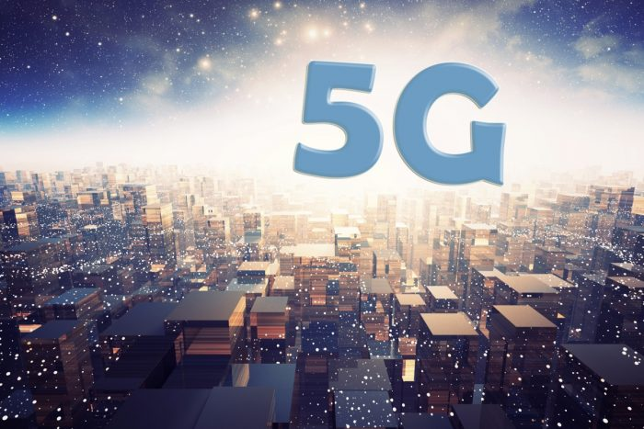
Introduction to 5G

Slide 4

What is 5G?
5G Wireless:-
5th generation wireless technology.
Complete wireless communication with
almost no limitations.
It is incredible transmission speed. Concept is only theory
Not real.

Slide 5
Evolution from 1G TO 5G
1G
2G
3G
4G
5G

Slide 6
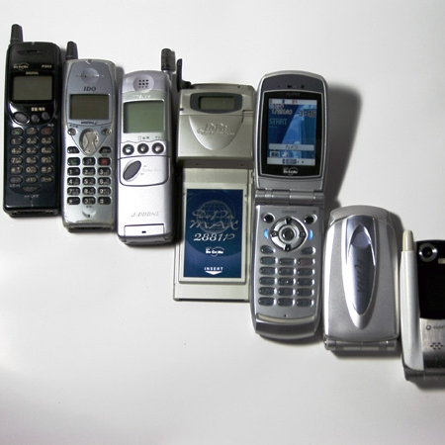
1G Wireless Technology
Developed in 1980s & completed in early 1990s.
Allows user to make voice calls in 1 country.
Based on analog system.
Speed up to 2.4 kbps.
This Photo by Unknown Author is licensed under CC BY-SA

Slide 7

2G Wireless Technology
Developed in late 1980s & completed in late 1990s.
Services such are digital voice & SMS with more clarity.
Based on digital system.
Speed up to 64 kpbs

Slide 8
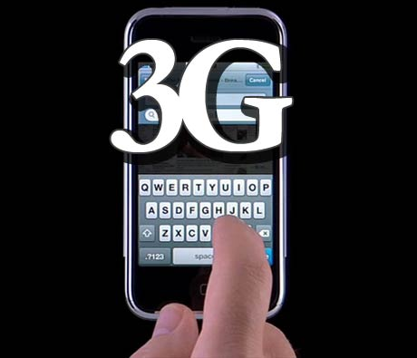
3G Wireless Technology
Developed between late 1990s & early 2000s.
Transmission speed from 125 kbps to 2 Mbps.
Good clarity in video conference.
Use E-mail, shopping & banking.

Slide 9
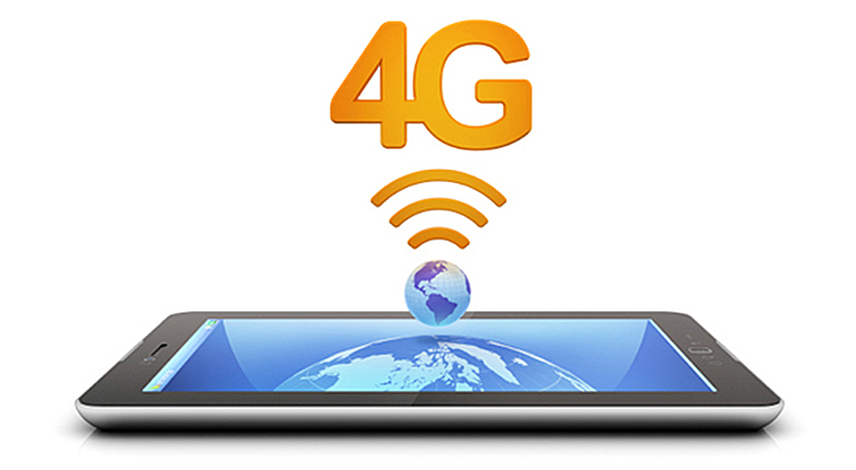
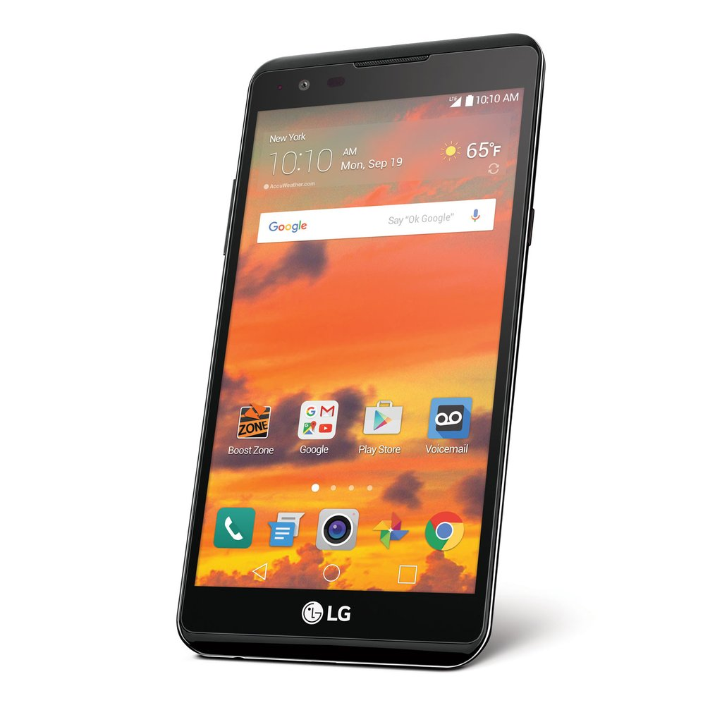
4G Wireless Technology
Developed in 2010.
Faster & more reliable.
Speed up to 100 Mbps.
High performance.
This Photo by Unknown Author is licensed under CC BY-SA
This Photo by Unknown Author is licensed under CC BY-SA

Slide 10
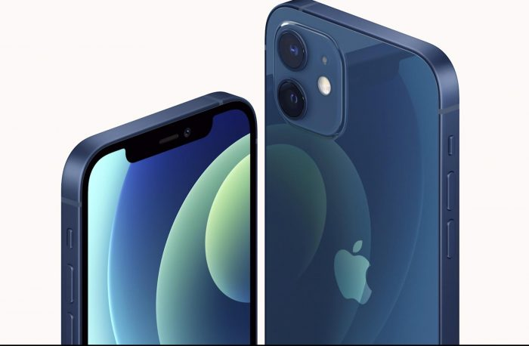
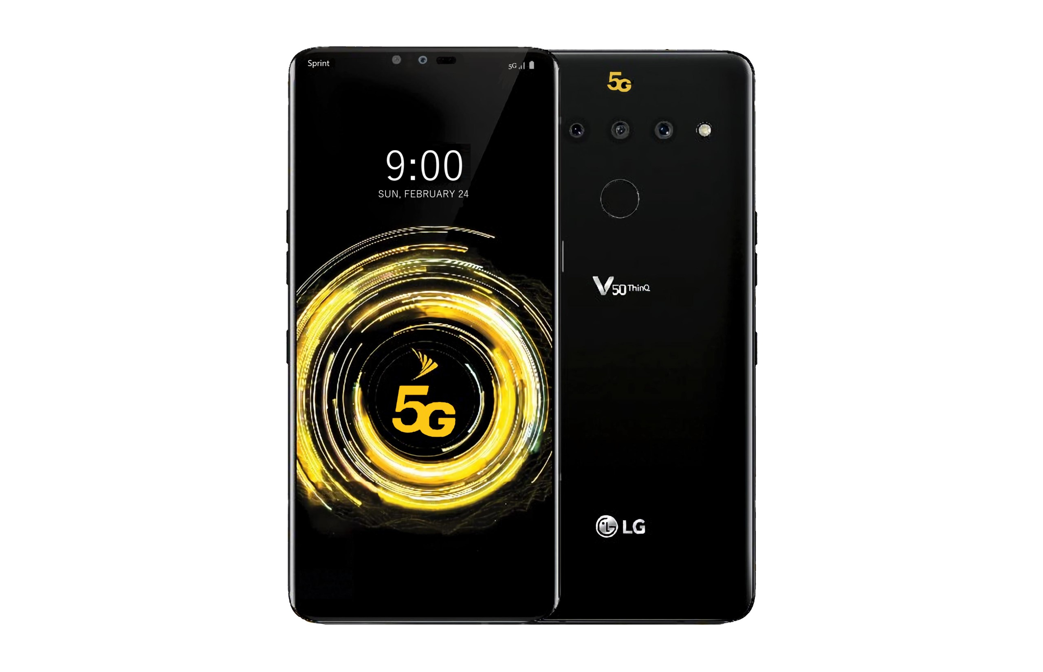
5G Wireless Technology
Next major phase of mobile telecommunication & wireless system.
10 times more capacity than others.
Expected speed up to 1 Gbps.
More faster & reliable than 4G.
This Photo by Unknown Author is licensed under CC BY-SA

Slide 11
5G Hardware
5G Software
Uses UWB (Ultra Wide Band) networks with higher Bandwidth at low energy levels.
Bandwidth is of 4000 Mbps, which is 400 times faster than today’s wireless networks.
Uses smart antenna.
Uses CDMA (Code Division Multiple Access).
5G will be single unified standard of different wireless networks.
Including LAN/WAN technologies, and WWWW- Word Wide Wireless Web.
Unified IP & seamless combination of broadband.
Software defined radio, encryption, flexibility, Anti-Virus.

Slide 12

Conclusion
3G- Operator Centric,4G- Service Centric whereas 5G- User Centric.
We have proposed 5G wireless concept designed as an open platform on different layers.
The new coming 5G technology will be available in the market at a affordable rates.

Slide 13


Thank You
G.Hrushitha.
G.Shiny

