Slide 1

Presentation on Cricket Management System
Submitted by
Gelle Hruthesh Reddy(20BCB7031)
Guided by
Prof.Hussain Ahmed Choudary
Asst.Prof.Vamshi Krishna
VIT-AP UNIVERSITY
AMARAVATI
ANDHRA PRADESH, INDIA
2021

Slide 2
Contents
1.Abstract
2.Introduction
3.Motivation
4.Literature Survey
5.Problem Statement
6.Objective
7.Software and Hardware Requirement
8.Functional and Non-Functional Requirements
9.Algorithm,Flowchart,Architecture
10.Result
11.Conclusion and Future work
12.Reference

Slide 3
1.Abstract
In present days we encounter so many problems like many people cannot watch the live score of current matches and it requires high quality network and consumes more time to load. We can also see the advertisements more often than the information needed in time. As we can see there so many server errors in giving the required information to the user and this cause more time to load the information. So, we want to develop a software which minimize unrelated matter and make it easy for every user to use the website.

Slide 4
2.Introduction
The aim of the project is to provide the complete information of the National and International statistics. The information is available country wise and player wise. By entering the data of each match, we can get all type of reports instantly, which will be useful to call back history of each player. Also, the team performance in each match can be obtained. We can get a report on number of matches, wins and lost.

Slide 5
3.Motivation
In many online websites the score updates are delayed, and many unrelated advertisements were shown, this is where we thought of making a software which do not waste time. We want to create a website where user can easily access data with minimal number of advertisements.
So, we want to make,
This website can be easily accessible by the users
And no need of high-quality internet

Slide 6
4.Literature Survey
We have researched and taken the problems of many examples like most of the software will show the results very late and show unrelatable matter like advertisements. There are some errors in which the servers are down and many other problems. So , we wanted to make a website which gives the result quickly than other website

Slide 7
5.Problem Statement
We had encounter so many problems like most of the website requires high quality network. We can also see the advertisements more often than the information needed in time which wastes more time than searching for the required information. As we can see there so many errors or False information giving to the user and the live updates of ongoing matches are not showing up the information quickly.

Slide 8
6.Objective
To create easy for the user to use the software.
Two reduce the time to get results of the data provided.
To make it run-in Low-end device and to make it run in any type of internet connection.
To let people, know the information of players, teams and giving updates every day.
To provide the correct data and provide an authentication for completing tasks safely.

Slide 9
7.Software and Hardware Requirement
Software requirements
The CMS will work properly on any device with internet connection.
The device should at least have a web browser and internet connection.
Hardware requirements
Device should have at least 256mb or higher RAM.

Slide 10
8.Fundamental and Non-Functional Requirements
Functional requirements
The view option given to user to view both the personal and professional data of the player or team required.
Retrieve function lets the user can download the data of players or matches.
Non -Functional requirements
Both user and admin need to login to access the data of players and matches.
The system can handle multiple users at a time, giving better performance.
The system is highly flexible as it can be accessed by anyone.
The information is stored in the database which contain the information players, teams, etc.

Slide 11
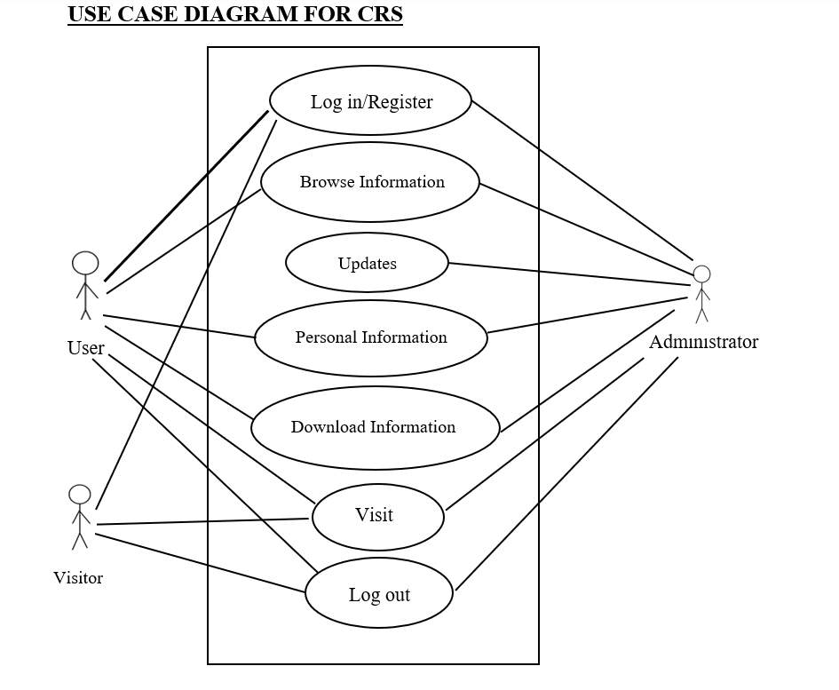
9.Methodology,Flowchart,Architecture
Fig 9.1 Use Case Diagram

Slide 12
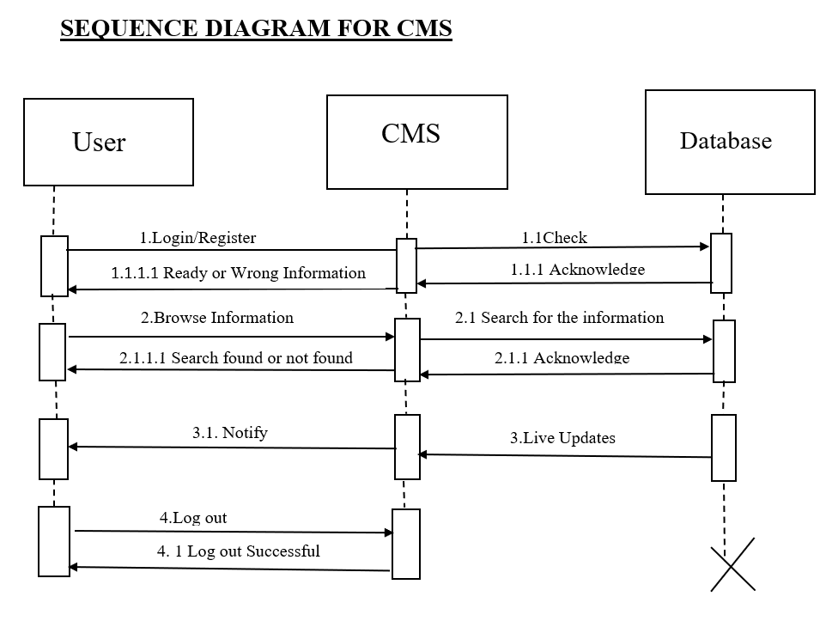
Fig 9.2 Sequence Diagram

Slide 13
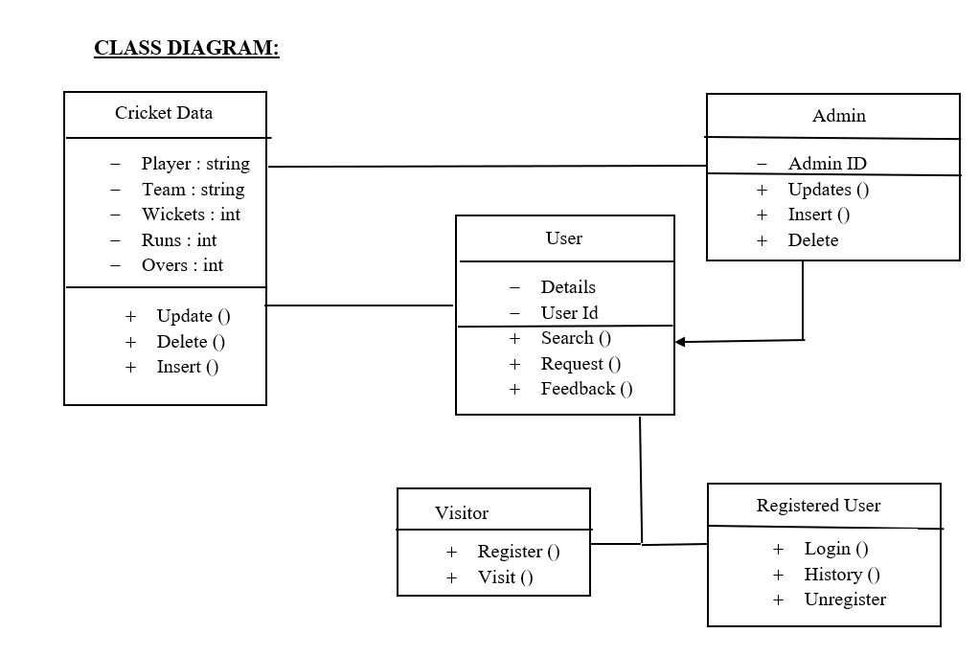
Fig 9.3 Class Diagram

Slide 14
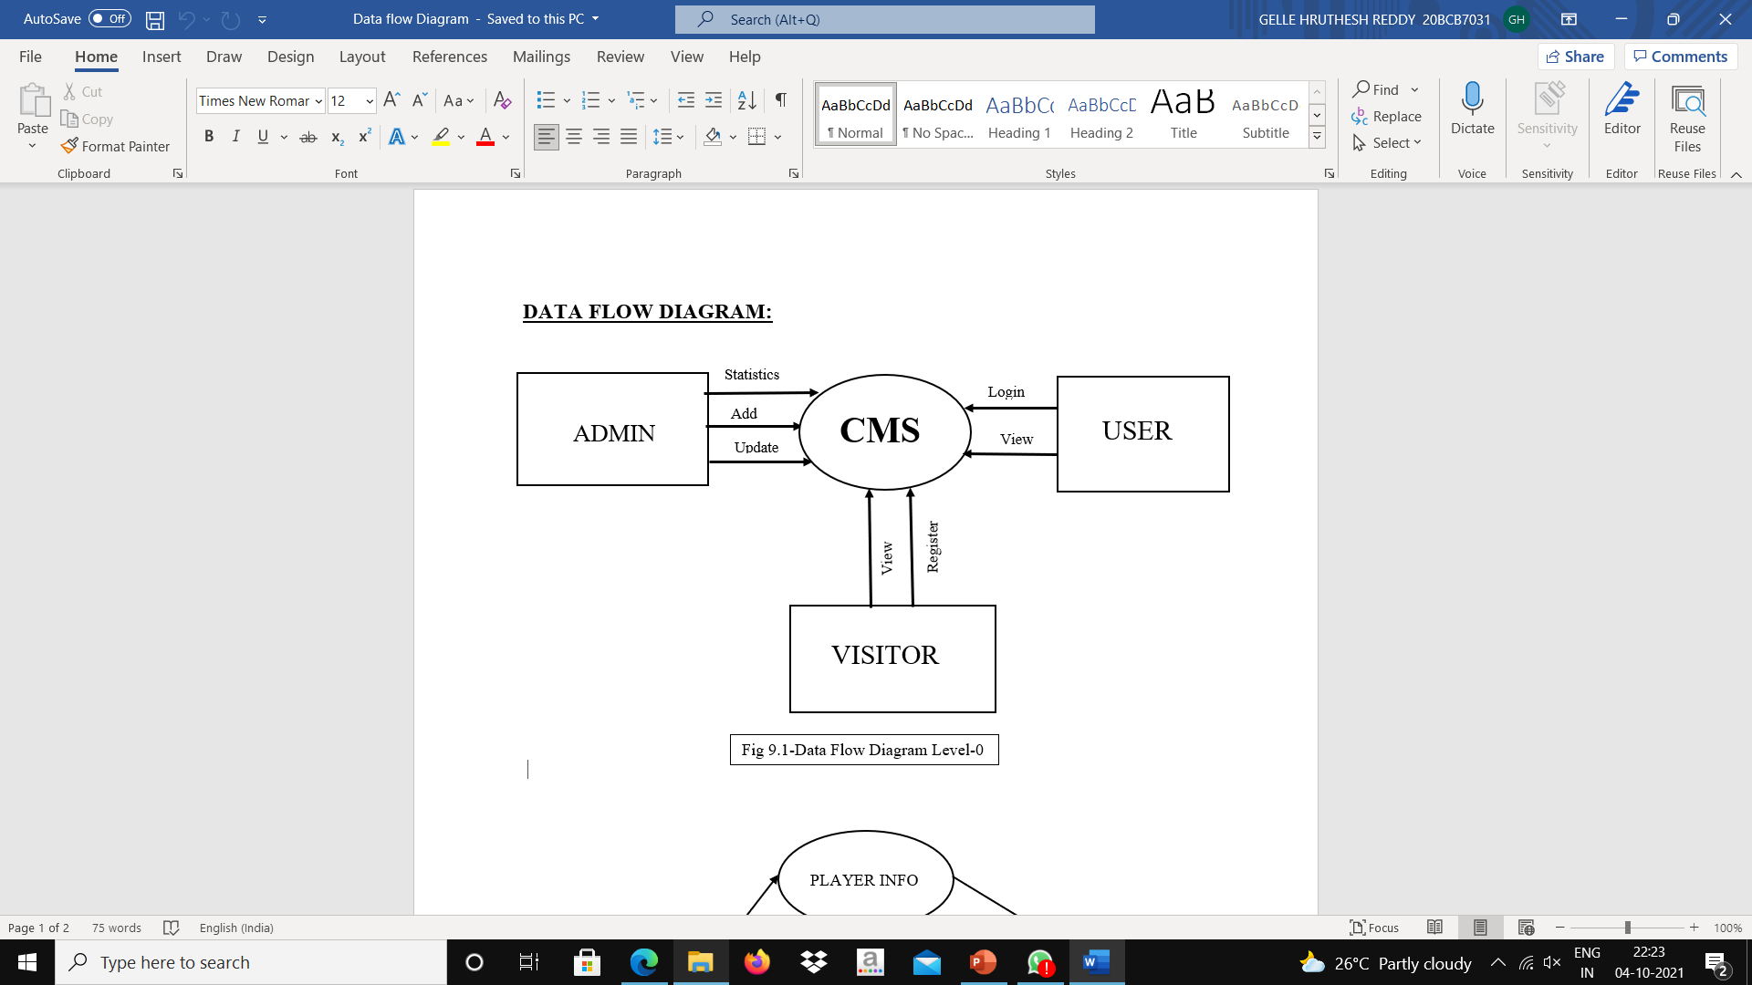
Fig 9.4 DFD Level 0

Slide 15
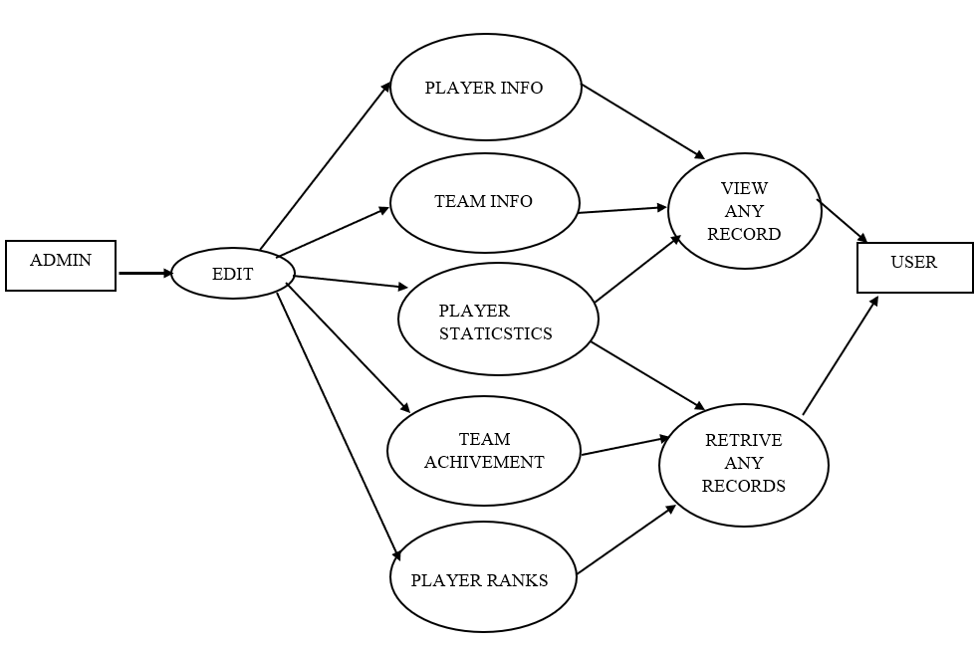
Fig 9.5 DFD Level 1

Slide 16
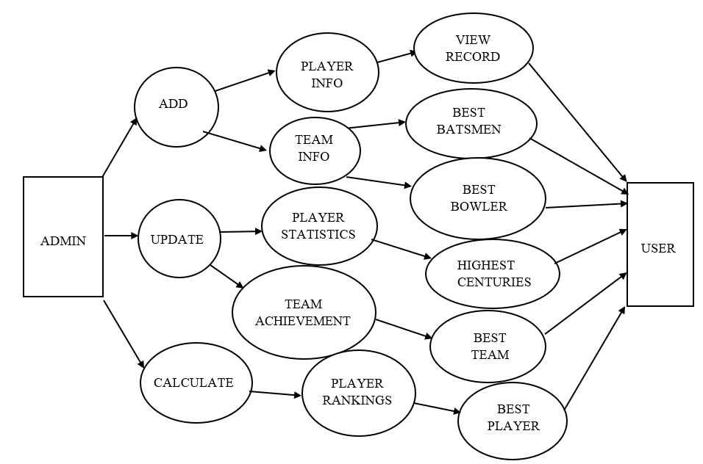
Fig 9.6 DFD Level 2

Slide 17
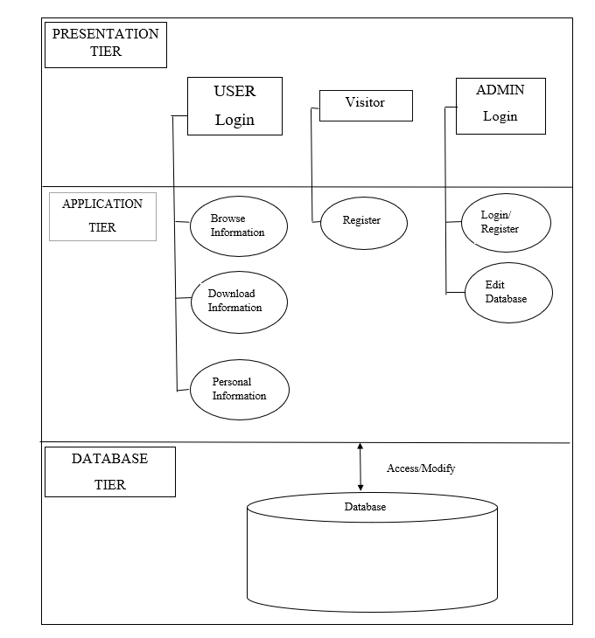
Architecture:
Fig 9.7 Architecture

Slide 18
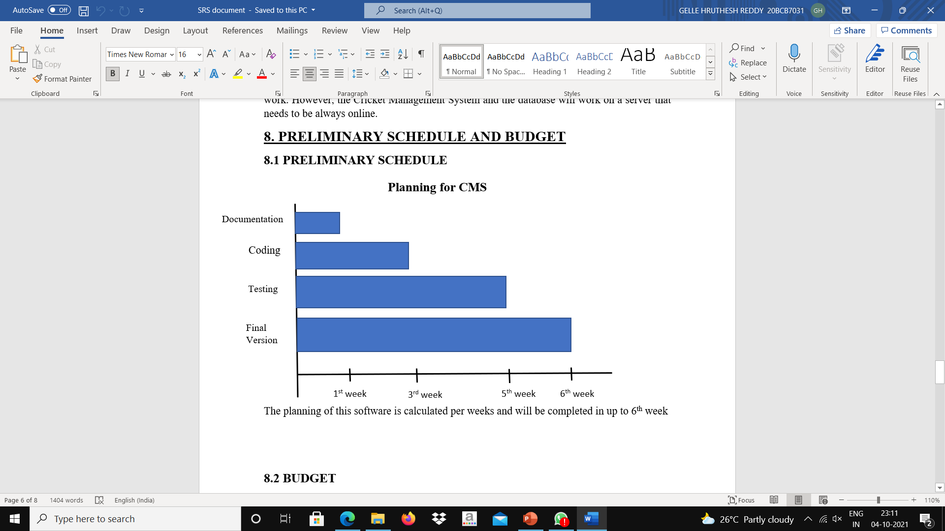
Fig 9.8 Planning for CMS

Slide 19
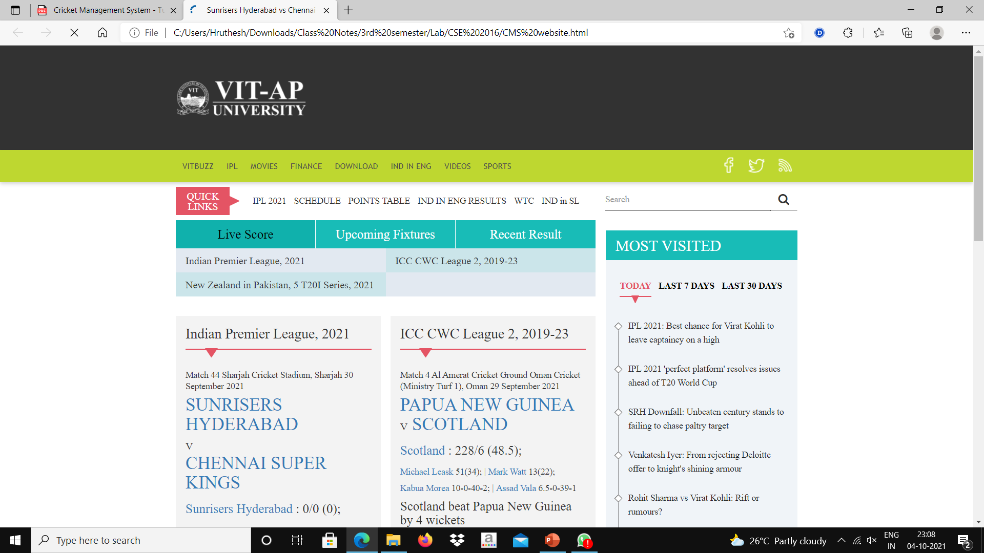
10.Result

Slide 20
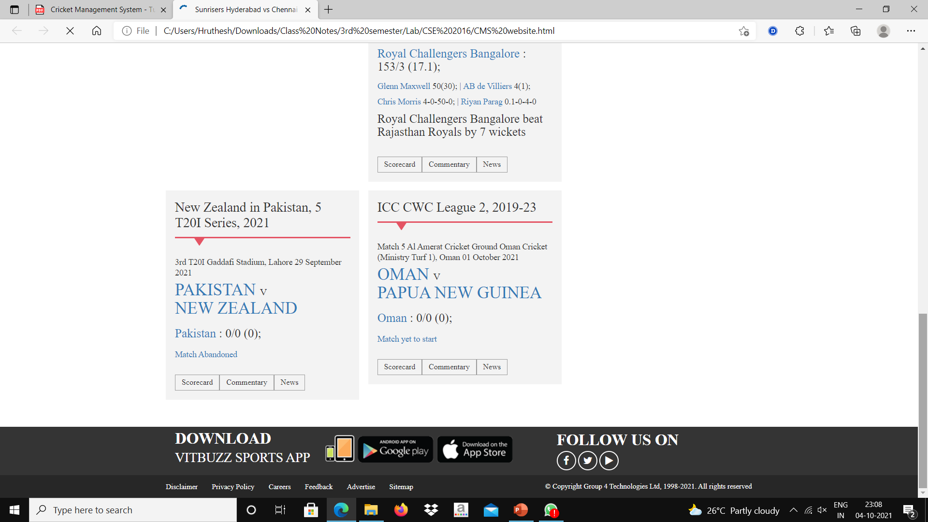

Slide 21
11.Conclusion
We can conclude that the Cricket Management System can be used by people all across the world to access the information of various players and teams.
It can help in accessing new data and news about favourite players and teams.
It is a modern approach to fetch data of players and teams, along with live scores.
It is compatible with any device with internet connection.

Slide 22
12.Reference
Software Engineering: A Practitioners Approach by Roger S.Pressman
Software Engineering by K.K.Aggarwal

