Slide 1







International Conference on Data Processing and Networking
(ICDPN-2026)
25th - 26th September, 2026
AI-Driven Groundwater Depletion Prediction and Sustainable Extraction Optimization System
Sandhya N, Anoop S Sonagoji, Driti S, Hruthik C P, Tejashwini M Bevingidad
Department of Artificial Intelligence and Machine Learning
Dayananda Sagar Academy of Technology and Management, Bangalore, India

Slide 2
INDEX:
2. Abstract
3. Introduction
4. Literature Review
5. Research Gaps
6. Proposed Methodology
7. Results & Discussion
8. Comparative Analysis
9. Conclusion & Future Work
10. References

Slide 3
2. ABSTRACT:
Groundwater depletion threatens food security and water supply, while sustainable management is challenged by differences in spatial scale, vadose-zone delays, and non-convex extraction control.
A Scientific Machine Learning (SciML) and robust control framework is proposed for basin-level groundwater forecasting and extraction scheduling.
A four-step spatial downscaling approach with mass balance is used to derive Groundwater Level Anomalies (GWLA), with vadose-zone delays modelled using a Gamma convolution kernel.
GNN-LSTM, 2D Dupuit-Boussinesq PINN, and 2D Fourier Neural Operator (FNO) models are benchmarked for field evolution, while Split Conformal Prediction provides non-parametric safety guarantees.
Extraction is optimized using Two-Loop Sequential Convex Programming (SCP) with Chance-Constrained Model Predictive Control (CCMPC).
RMSE = 2.663 m | Error Reduction = 84.7% | CVR = 0.0%

Slide 4
3. INTRODUCTION:
Groundwater Context
Groundwater is an important buffer against climate variations affecting agriculture, industries, and urban water needs. Increasing utilization has caused extensive aquifer depletion.
Key Challenges
Spatial Scale Mismatch
GRACE data: ~300 km → Watershed scale: ~4 km
Vadose-Zone Nonlinearity
Surface infiltration and recharge involve nonlinear vadose-zone dynamics.
Non-Convex Stochastic Control
Groundwater extraction involves a non-convex control problem under climate uncertainty.
Proposed Framework
Scientific Computing + Optimal Control
GRACE Downscaling → Gamma-Kernel Vadose Dynamics → SciML Surrogates → Conformal Prediction → Sequential Convex Programming

Slide 5
4. LITERATURE REVIEW :
Research Area | Existing Approaches | Key Limitation | Approach in This Work
GRACE Spatial Downscaling | Statistical regression, CNNs, Random Forests, Gradient Boosting | Coarse resolution and spatial distortion | Four-step mass-conserving downscaling
Groundwater Numerical Modeling | MODFLOW / FEFLOW | Fine grids and long computation times | Scientific ML surrogate models
Physics-Informed Learning | PINNs for groundwater-flow equations | Computational cost of conventional numerical solvers | Dupuit-Boussinesq PINN
Fourier Neural Operators | Spectral learning of spatial operators | Requires comparison with other surrogate representations | 2D FNO
Graph Neural Networks | Graph-based message passing between wells | Spatial relationships require appropriate modelling | GNN-LSTM
Safe Optimal Control | Chance-Constrained MPC | Distributional assumptions on disturbances | Split Conformal Prediction + SCP-CCMPC

Slide 6
5. RESEARCH GAPS :
1. Spatial Resolution Gap
GRACE observations are too coarse for watershed-scale groundwater analysis.
2. Mass Conservation Gap
Spatial downscaling can introduce spatial distortion and mass-conservation issues.
3. Vadose-Zone Modelling Gap
Groundwater recharge involves delayed and nonlinear vadose-zone dynamics.
4. Computational Gap
Conventional groundwater models require fine grids and long computation times.
5. Uncertainty Quantification Gap
Chance-constrained control relies on assumptions about disturbance distributions.
6. Integrated Prediction–Control Gap
Prediction, uncertainty quantification, and extraction optimization need to be integrated into a unified framework.

Slide 7
6. PROPOSED METHODOLOGY :
DATA INPUT
GRACE/GRACE-FO
+ Hydroclimatic Data
SPATIAL DOWNSCALING
300 km → 4 km
Mass-Balance Correction
VADOSE-ZONE DELAY
Gamma-Kernel Convolution
EXTRACTION OPTIMIZATION
SCP + CCMPC
Sustainable Pumping Schedule
UNCERTAINTY & SAFETY
Split Conformal
Prediction
SciML PREDICTION
GNN-LSTM | PINN | FNO

Slide 8
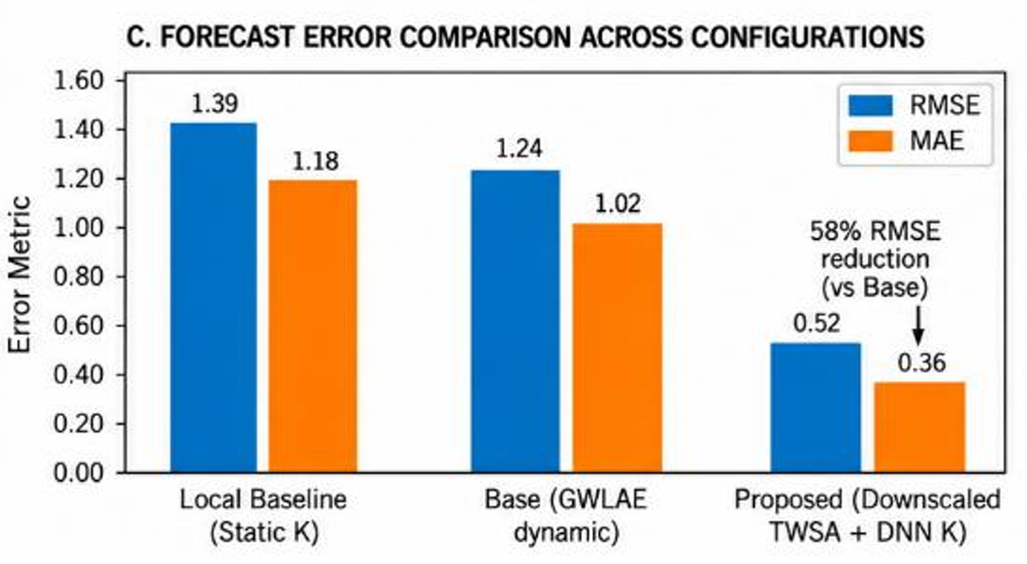
7. RESULTS & DISCUSSION:
NNNNNN RESULTS TABLE
JJJJJ
Configuration | RMSE (m) | MAE (m)
Local Baseline | 2.6762 | 2.1614
Raw Coarse GRACE | 17.4156 | 15.1568
Proposed Fusion | 2.6635 | 2.1596
84.7%
ERROR REDUCTION
95.4%
TEST COVERAGE
0.0%
CONTROL VIOLATION RATE

Slide 9
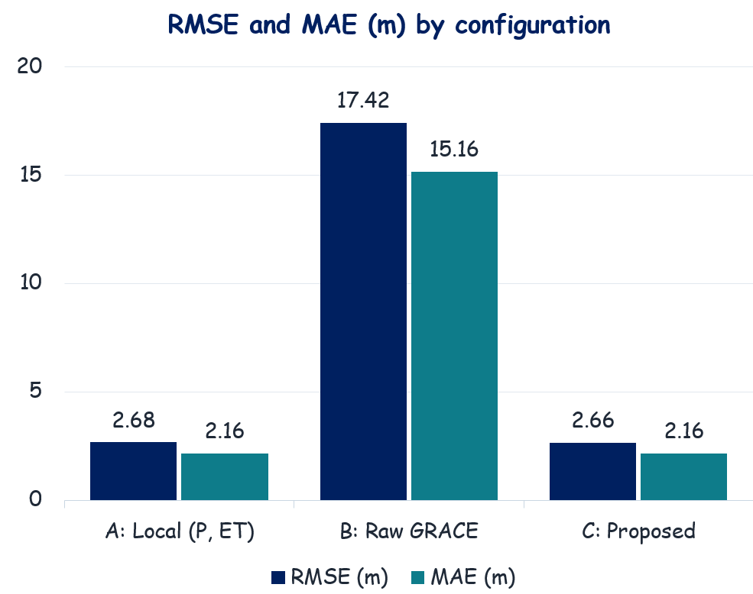
8. COMPARATIVE ANALYSIS:
Configuration | RMSE | MAE
A: Local (P, ET) | 2.6762 | 2.1614
B: Raw GRACE | 17.4156 | 15.1568
C: Proposed | 2.6635 | 2.1596
Lower RMSE than raw GRACE
(17.4156 → 2.6635 m)
Proposed fusion also achieves
the lowest MAE with CVR = 0.0%.
84.7%

Slide 10
9. CONCLUSION & FUTURE WORK :
CONCLUSION FUTURE WORK
A unified SciML + chance-constrained control framework for satellite-enhanced groundwater forecasting and extraction.
Mass-conserving four-phase GRACE downscaling and a Gamma-kernel vadose delay feed GNN-LSTM, PINN and FNO surrogates.
A split-conformal margin (q̂ = 0.4926 m) inside two-loop SCP-CCMPC gives RMSE 2.6635 m and CVR = 0.0%.
Delivered as a FastAPI service with dashboard, 3D subsurface view, depletion alerts, pumping quotas and auto-reports.
1. Differentiable MODFLOW-6 + adaptive conformal prediction
Multilayer aquifers; uncertainty under a changing hydroclimate
2. IoT-based real-time pumping data
LoRaWAN and cellular flow meters
3. Decentralised control & field validation
Transboundary aquifers; monitoring wells and pumping telemetry

Slide 11
10. REFERENCES :
[8] A. Borzì, The Formulation and Numerical Solution of Quantum Control Problems. Philadelphia, PA, USA: SIAM, 2019.
[9] B. Groom, C. Koundouri, and P. Pappas, "Managing groundwater depletion under climate uncertainty: A chance-constrained programming approach," Water Resour. Econ., vol. 38, p. 100198, 2022.
[10] B. D. Tapley et al., "Contributions of GRACE to understanding climate change," Nat. Clim. Chang., vol. 9, no. 5, pp. 358–369, 2019.
[11] J. Chen, J. S. Famiglietti, B. R. Scanlon, and M. Rodell, "Groundwater storage changes: Present status from GRACE observations," Surv. Geophys., vol. 37, no. 2, pp. 397–417, 2016.
[12] M. Rodell et al., "The global land data assimilation system," Bull. Amer. Meteor. Soc., vol. 85, no. 3, pp. 381–394, 2004.
[13] R. Houborg, M. Rodell, B. Li, R. Reichle, and B. F. Zaitchik, "Joint assimilation of GRACE terrestrial water storage and MODIS active fire data into the Noah land surface model," Remote Sens. Environ., vol. 126, pp. 282–297, 2012.
[1] J. S. Famiglietti, "The global groundwater crisis," Nat. Clim. Chang., vol. 4, no. 11, pp. 945–948, 2014.
[2] M. Rodell et al., "Emerging trends in global freshwater availability," Nature, vol. 557, no. 7707, pp. 651–659, 2018.
[3] B. R. Scanlon et al., "Groundwater depletion and sustainability of irrigation in the US High Plains and Central Valley," Proc. Natl. Acad. Sci. U.S.A., vol. 109, no. 24, pp. 9320–9325, 2012.
[4] A. Asoka, T. Gleeson, M. Wada, and V. Mishra, "Relative contribution of monsoon precipitation and pumping to changes in groundwater storage in India," Nat. Geosci., vol. 10, no. 2, pp. 109–117, 2017.
[5] H. Save, S. Bettadpur, and B. D. Tapley, "High-resolution CSR GRACE RL05 mascons," J. Geophys. Res. Solid Earth, vol. 121, no. 10, pp. 7547–7569, 2016.
[6] A. Y. Sun, "Predicting groundwater level changes using GRACE data with machine learning," Water Resour. Res., vol. 49, no. 12, pp. 7900–7912, 2013.
[7] K. R. Rushton, Groundwater Hydrology: Conceptual and Computational Models. Chichester, U.K.: Wiley, 2003.

Slide 12
10. REFERENCES (CONTD.) :
[14] W. Yin et al., "Downscaling GRACE-derived terrestrial water storage anomalies using machine learning techniques: A case study in the North China Plain," J. Hydrol., vol. 574, pp. 1111–1124, 2019.
[15] S. Ali, S. Liu, and X. Mo, "Machine learning based spatial downscaling of GRACE terrestrial water storage anomalies over the Indus Basin," Remote Sens., vol. 15, no. 4, Art. 982, 2023.
[16] M. Raissi, P. Perdikaris, and G. E. Karniadakis, "Physics-informed neural networks: A deep learning framework for solving forward and inverse problems involving nonlinear partial differential equations," J. Comput. Phys., vol. 378, pp. 686–707, 2019.
[17] A. M. Tartakovsky et al., "Physics-informed deep neural networks for learning parameters and solutions of Darcy flow," Water Resour. Res., vol. 56, no. 5, e2019WR026731, 2020.
[18] Z. Li et al., "Fourier neural operator for parametric partial differential equations," arXiv:2010.08895, 2020.
[19] G. Wen, Z. Li, K. Azizzadenesheli, A. Anandkumar, and S. M. Benson, "U-FNO—An enhanced Fourier neural operator-based provider for multiphase flow in porous media," Comput. Methods Appl. Mech. Eng., vol. 399, Art. 115188, 2022.
[20] T. N. Kipf and M. Welling, "Semi-supervised classification with graph convolutional networks," in Proc. ICLR, Toulon, France, 2017, pp. 1–14.
[21] A. Y. Sun, P. Scanlon, Z. Zhang, and K. Bao, "Spatio-temporal graph neural networks for regional groundwater level forecasting," Hydrol. Earth Syst. Sci., vol. 25, no. 8, pp. 4821–4837, 2021.
[22] L. Hewing, K. P. Wabersich, M. Menner, and M. N. Zeilinger, "Learning-based model predictive control: Toward safe learning in control," Annu. Rev. Control Robot. Auton. Syst., vol. 3, pp. 269–296, 2020.
[23] M. Farina, L. Giulioni, and R. Scattolini, "Stochastic linear model predictive control with chance constraints: A review," J. Process Control, vol. 44, pp. 53–67, 2016.
[24] V. Vovk, A. Gammerman, and G. Shafer, Algorithmic Learning in a Random World. Boston, MA, USA: Springer, 2005.
[25] A. N. Angelopoulos and S. G. Bates, "A gentle introduction to conformal prediction and distribution-free uncertainty quantification," arXiv:2107.07511, 2021.

