Slide 1

Project Defense

Slide 2
Crime Classification Analysis
DATA 228 - Big Data Technologies and Applications
Hruthik Vinnakota
Jugal Kishore Ruvva
Rajeev Yenugula
Shilpa Bai Udaya Singh
Department of Data Analytics
San Jose State University
Professor: Dr Ming - Hwa Wang

Slide 3
Agenda
Project Overview
Implementation
Design Document
Data Analysis
Results and discussion
Conclusion and Future Scope
Code Walkthrough and Demo

Slide 4
Project Overview
Data collected from Police Department Incident Reports: Historical 2003 to May 2018
https://data.sfgov.org/Public-Safety
More than 2M records present in the dataset.
The project will use big data techniques to analyze the vast amount of crime data
and will be preprocessed and used to train the ML algorithms to accurately classify the
crime description into different categories
The system would accept a crime description as input and employ
machine learning algorithms to evaluate the text in order to find
specific keywords, terms and tendencies that can be used to categorize the crime.

Slide 5
Implementation
Python programming language.
PySpark and associated machine learning libraries.
Databricks for coding and visualization.
Feature extractors and transformers.
Pipelines, Classifiers and Evaluation metrics.

Slide 6
Feature transformers
String Indexer, Tokenizer and StopWordsRemover.
String Indexer– Label the string column.
- Crime Category
Tokenizer breaks the crime description into array of words.
StopWordsRemover excludes the words that do not carry any meaning.

Slide 7
Feature extractors
TF-IDF and Count Vectorizer.
NLP methods to vectorize the text.
Count Vectorizer converts text into vector of token counts.
TF-IDF consider how important the word is in the document during the conversion.

Slide 8
Data Preparation
Split data into training and testing data sets.
70% of data used for training.
30% for testing.

Slide 9
Machine Learning Models
Multi Class classification – 36 Categories
Logistic Regression and Naïve Bayes.
Creating Pipelines with 4 stages.
Tokenizer
Stop Words Remover
Count Vectorizer/TF-IDF
Logistic Regression/Naïve Bayes

Slide 10
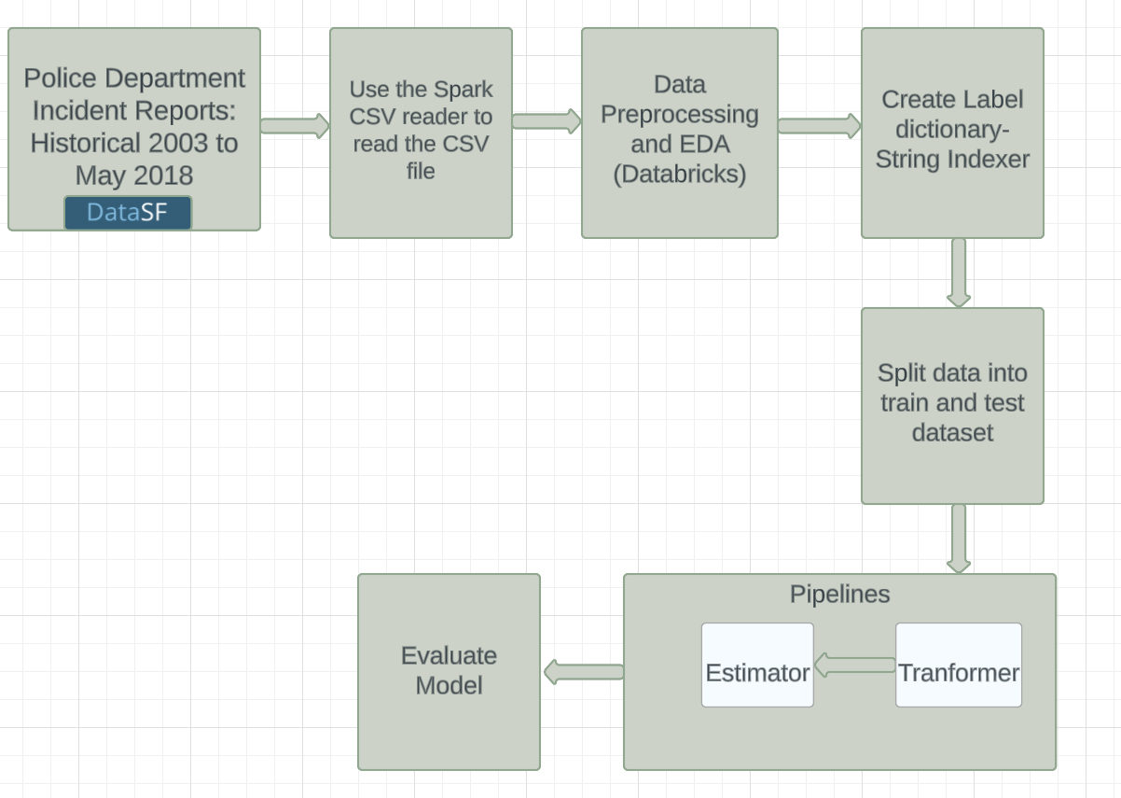
Data Flow Design

Slide 11
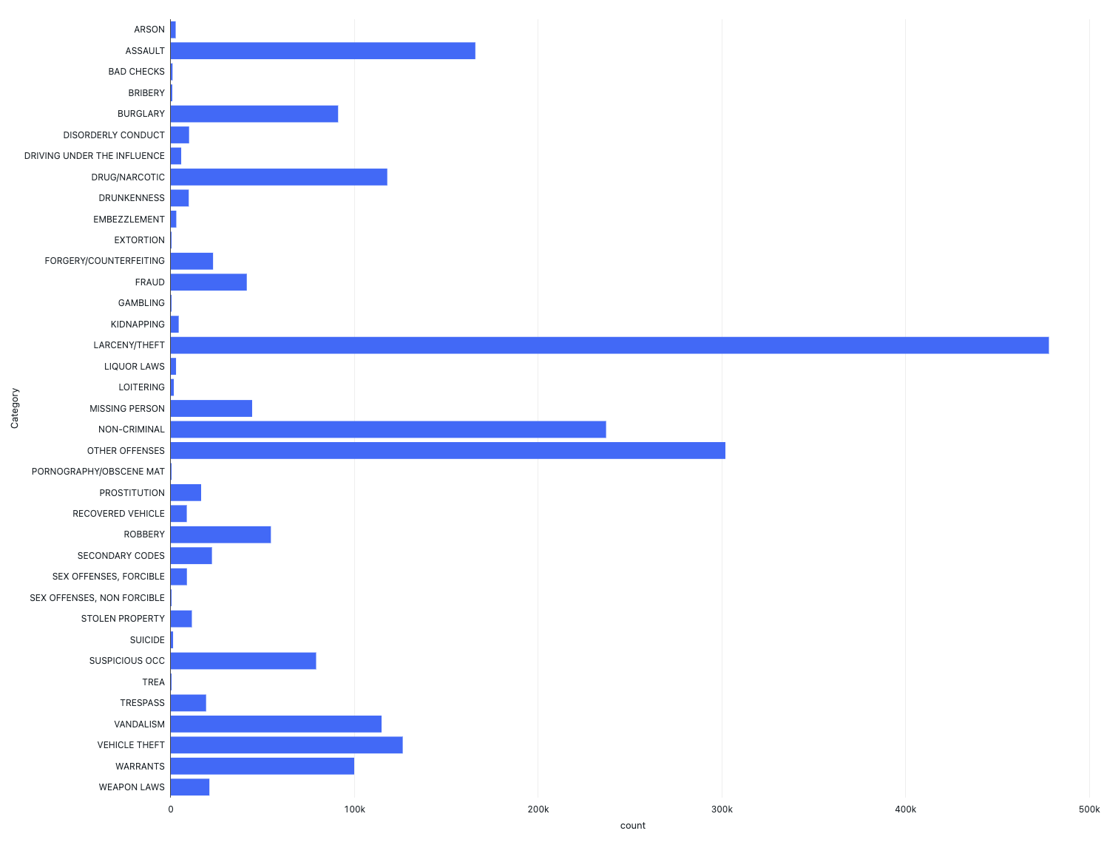
Data Analysis
Crime category with maximum number of incidents were Theft, followed by others and non-criminal category.
Count of different crime categories

Slide 12
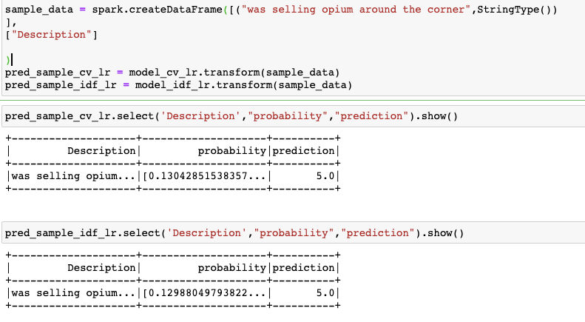
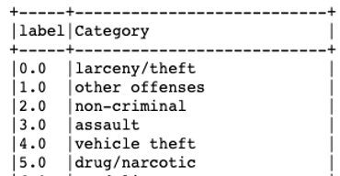
Output generation and Analysis
The final output is to produce expected class labels
Model was tested on new data sample.
Description : “selling opium around the corner
Model predicted label accurately as ‘5’ as drug/narcotic category

Slide 13
Model Evaluation
Multi Class Evaluation Metrics
- Accuracy
- Precision
- Recall
- F1 score
Logistic Regression performed well 95% accuracy
Naïve Bayes outperformed with 99% accuracy.

Slide 14
Results and discussion
Model | Accuracy | Precision | F1 | Recall
Logistic Regression with Count Vectorizer | 0.958 | 0.9562 | 0.9463 | 0.958
Logistic Regression with TF-IDF | 0.9575 | 0.9557 | 0.9457 | 0.9575
Naïve Bayes with Count Vectorizer | 0.9946 | 0.9958 | 0.995 | 0.9946
Naïve Bayes with TF-IDF | 0.9946 | 0.9955 | 0.9939 | 0.993

Slide 15
Compare Output against Hypothesis
The proposed hypothesis was to give accurate results when Classifiers are used with different feature extractors.
Hypothesis was validated based on the results and findings.

Slide 16
Conclusion
Overall, the project successfully demonstrated the effectiveness of logistic regression and Naive Bayes models in classifying crime categories based on description.
It emphasizes the significance of preprocessing techniques and highlights the need for data quality assurance.
By considering these factors and further refining the models, this project has the potential to contribute to real-world crime prediction and prevention efforts.

Slide 17
Future Scope
To further enhance the project, more advanced techniques like word embeddings or deep learning models could be explored to potentially improve the accuracy and overall performance.
Since some of the time components are extracted and analyzed during the EDA, more detailed analysis including seasonal pattern can be studied.
Time Series Forecasting can be performed as a future scope using ARIMA, LSTM and other time series model.

Slide 18

Code Walkthrough and Demo

Slide 19


