Slide 1

Nova Mart
Home
About
Content
Others
Campaign Performance Analysis
https://www.linkedin.com/in/hruthik-gajjala/
CodeBasics.io
-

Slide 2
Nova Mart
Home
About
Content
Others
About Company
Nova Mart is a modern retail store that offers a wide range of products — from groceries and household essentials to fashion and electronics — all under one roof. It focuses on providing customers with quality products at affordable prices, ensuring a convenient and satisfying shopping experience. Nova Mart combines technology-driven services with excellent customer support to make everyday shopping simple, smart, and efficient.
Datasets :
1. dim_campaigns
2. dim_products
3. dim_stores
4. fact_events

Slide 3
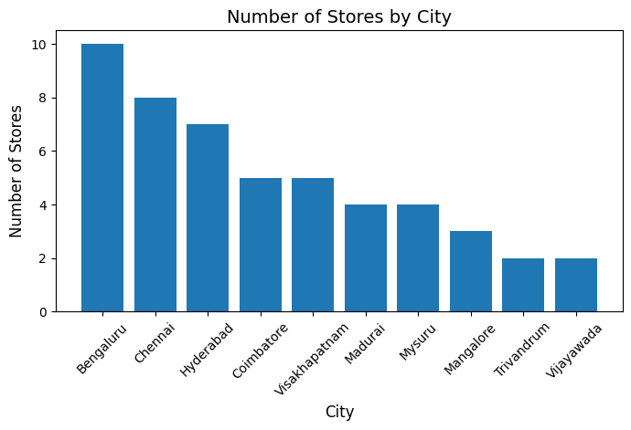
Nova Mart
Home
About
Content
Others
1. Visualize the number of stores in each city. Identify the city with the most stores and explain the distribution of stores across other cities. How does the number of stores in Bengaluru compare with those in Hyderabad and Chennai?
Key Insights
Dominance: Bengaluru, Chennai, and Hyderabad collectively hold exactly half of the total store count.
Plateau: Four mid-tier cities are clustered uniformly, stalled at 4-5 stores each.
Low Entry: Trivandrum and Vijayawada represent the lowest market investment with only 2 stores.
Recommendations:
Prioritize: Target Coimbatore and Visakhapatnam for immediate expansion to Grater than or equal to 7 stores.
Evaluate: Review the performance of the 2-store cities before committing to further scaling.
Conclusion: The strategy relies heavily on major metros and must tactically accelerate growth in successful mid-tier markets.

Slide 4
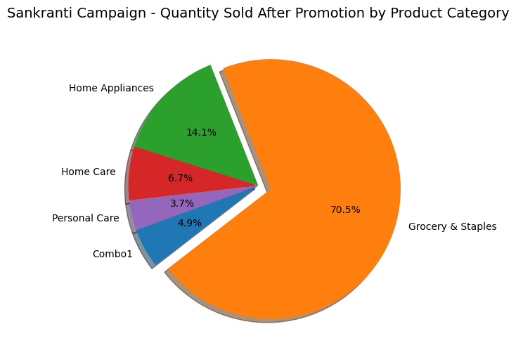
Nova Mart
Home
About
Content
Others
2. Analyze the total quantity sold after promotion for the Sankranti campaign across different product categories. What percentage does each category contribute to the overall sales, and what insights can be drawn from these contributions?
Key Insights
Dominant Performer: Grocery & Staples accounts for a massive $70.5% of the total quantity sold during the promotion.
Clear Second: Home Appliances is the distant runner-up with $14.1%, showing moderate success outside the core food items.
Marginal Impact: The remaining three categories (Home Care, Personal Care, and Combo1) collectively contribute less than 16% to the overall sales quantity.
Recommendations
Maximize Grocery: Continue heavily promoting Grocery & Staples as it drives the vast majority of promotional volume.
Investigate Smallest Categories: Analyze promotional mechanics for Personal Care and Combo1 to identify reasons for their minimal contribution.
Conclusion: The Sankranti Campaign was overwhelmingly successful only for Grocery & Staples, indicating the promotion failed to significantly lift sales across other product categories.

Slide 5
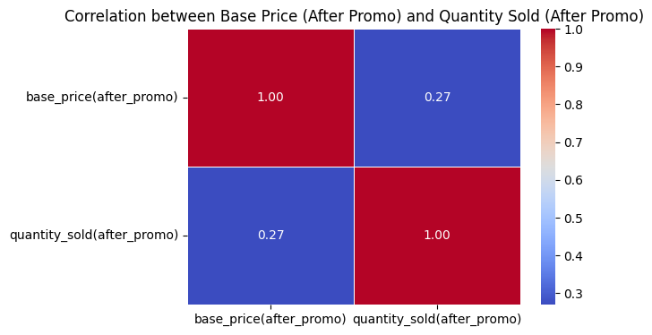
Nova Mart
Home
About
Content
Others
3. Examine the correlation between base price (after the promotion) and sales quantities (after the promotion). What insights can be drawn regarding the relationship between base price and sales quantities after the promotion?
Key Insights
Weak Positive Correlation: The correlation between the final price and the quantity sold is weakly positive (+0.27).
Unexpected Relationship: Typically, price and quantity sold have a negative correlation (as price increases, quantity sold decreases). The positive result suggests an inelastic, status-driven, or bulk purchase pattern.
Low Predictive Power: Since the correlation is close to zero, the base price after the promotion is not a strong predictor of the final quantity sold.
Recommendations
Investigate Correlation Drivers: Deep dive into specific product segments to understand why higher prices are weakly correlated with higher sales (e.g., luxury segment, large commercial orders).
Focus on Non-Price Factors: Shift sales strategy focus toward non-price drivers like marketing spend, visibility, and product placement, as price is not a primary constraint.
Conclusion: The promotional base price has a weak, unexpected positive relationship with quantity sold, indicating that price is not the dominant factor influencing customer purchase decisions.

Slide 6
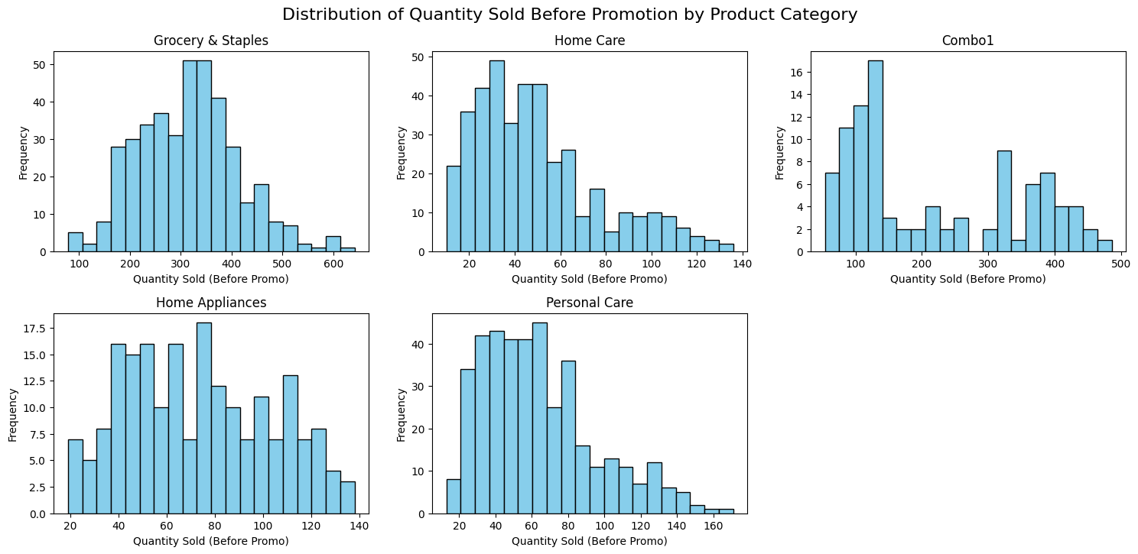
Nova Mart
Home
About
Content
Others
4. Analyze the distribution of quantity sold before the promotion for each product category (Grocery & Staples, Home Care, Personal Care, Home Appliances, etc.). What patterns or trends do you observe across these categories, and how could these insights inform future promotional strategies?
Key Insights
Grocery Dominates Volume: Grocery & Staples operates at a much higher scale (quantities up to 600) compared to all other categories (most cap around 150), reinforcing its role as the primary volume driver.
Right Skew/Lower Volume in Key Categories: Home Care and Personal Care distributions are heavily right-skewed, meaning most pre-promotion sales are low volume transactions (below 50 units).
Bimodal/Complex Patterns in Appliances/Combo: Home Appliances and Combo1 show flatter or multi-modal (bimodal) distributions, suggesting these categories have distinct purchasing groups or two common order sizes (low volume and high volume).
Recommendations
Tailor Promotional Price Points: Develop promotions for Home Care and Personal Care that specifically target the high frequency of low-volume transactions (e.g., "buy one, get one at 50%").
Segment Appliances/Combo: Investigate the two primary modes (peaks) in the Home Appliances and Combo1 distributions to define two distinct customer segments and market to them separately.
Conclusion: The pre-promotion sales volume and distribution shape vary significantly across categories, necessitating highly customized inventory and marketing strategies for each product group.

Slide 7
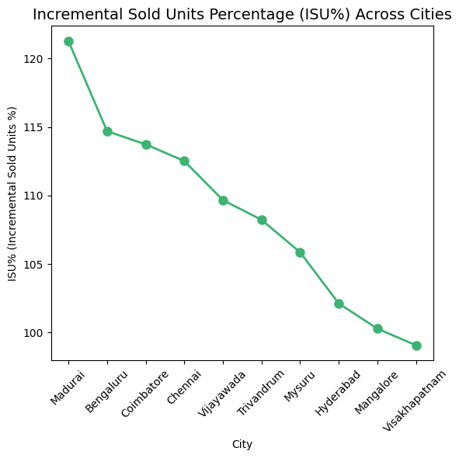
Nova Mart
Home
About
Content
Others
5. Analyze the incremental sold Units percentage (ISU%) across various cities. Identify the city with the highest ISU% after the promotion and the city with the smallest change. What trends can be observed about the effectiveness of promotions in driving sales across these cities?
Key Insights
High-Impact Leader: Madurai has the highest promotional effectiveness, driving over 122% in incremental sold units, significantly outperforming all other cities.
Clear Declining Trend: There is a distinct, monotonic downward trend in ISU% from Madurai to the bottom city, suggesting campaign effectiveness is not uniform and decreases predictably across the city ranking.
Below-Average Performers: Hyderabad, Mangalore, and Visakhapatnam are clustered at the bottom, achieving very low incremental gains (close to 100%, meaning almost no increase, or slightly above).
Recommendations
Model Madurai Success: Conduct a detailed study on the promotional execution and local factors in Madurai to replicate its high ISU% in other cities.
Revise Strategy for Bottom Cities: Immediately revise the campaign strategy or allocation of promotional resources for Hyderabad, Mangalore, and Visakhapatnam where the current approach is failing to drive meaningful incremental sales.
Conclusion: Promotional effectiveness, measured by ISU%, varies drastically across cities, requiring replication of the high-impact Madurai model and immediate intervention in the lowest-performing markets.

Slide 8
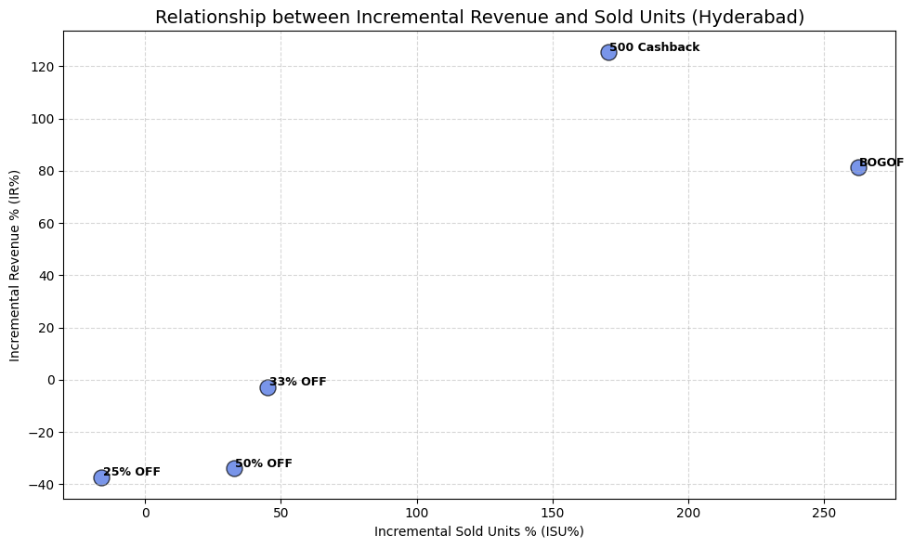
Nova Mart
Home
About
Content
Others
6. Analyze the relationship between incremental revenue and incremental sold units for different promotion types in Hyderabad. Which promotion type led to the highest incremental sold units, and which one generated the highest incremental revenue? What insights can you draw from the balance between the two metrics for this city?
Key Insights
Cashback Drives Profit: The ₹500 Cashback scheme generates the highest Incremental Revenue (>120%), making it the most profitable promotion.
BOGOF Drives Volume: The BOGOF (Buy One Get One Free) scheme achieves the highest Incremental Sold Units (>250%), prioritizing volume over revenue efficiency.
Deep Discounts Fail Revenue: Both the 50% OFF and 25% OFF schemes result in negative Incremental Revenue, indicating significant profit erosion despite some sales lift.
Recommendations
Prioritize Cashback: Make the ₹500 Cashback promotion the primary strategic push to maximize profitable growth in Hyderabad.
Eliminate Low Discounts: Discontinue or drastically revise the 25% OFF and 50% OFF schemes immediately due to their severely negative impact on incremental revenue.
Conclusion: In Hyderabad, fixed-value incentives (Cashback) and high-volume mechanics (BOGOF) successfully drive growth, while traditional percentage-off discounts severely erode incremental profitability.

Slide 9
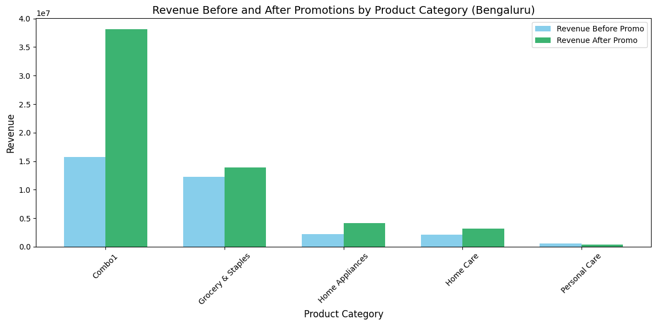
Nova Mart
Home
About
Content
Others
7. Analyze the revenue before and after promotions across different product categories in Bengaluru. What trends can be identified in the performance of each category, and how did promotions impact overall revenue in the city?
Key Insights
Combo1 is the Revenue Leader: The Combo1 category shows the most dramatic revenue increase, with a post-promo revenue of approx 3.9 crore, making it the highest revenue driver by a large margin.
Strategic Focus on Combo1 and Grocery: Only Combo1 and Grocery & Staples show a significant revenue lift post-promotion; all other categories have marginal or negligible increases.
Ineffective Personal Care Promo: The Personal Care category shows almost no change in revenue, indicating the promotion had virtually no impact on sales or profitability in this segment.
Recommendations
Replicate Combo1 Success: Analyze the specific promotional mechanics used for Combo1 and attempt to apply them to other low-performing categories to achieve similar explosive growth.
Review Marginal Segments: Immediately review the promotional strategy for Home Appliances, Home Care, and Personal Care to reallocate budget or eliminate ineffective discount models that yield low incremental revenue.
Conclusion: Promotions in Bengaluru are highly effective only for the Combo1 category, demonstrating a targeted success that must be leveraged and replicated across marginal product segments.

Slide 10
Nova Mart
Home
About
Content
Others
Thank you
https://www.linkedin.com/in/hruthik-gajjala/
CodeBasics.io
-

