Slide 1
IMDB MOVIES
Hruthik SH
PRSQL-01
PTID CDA DEC 25 1098
.

Slide 2
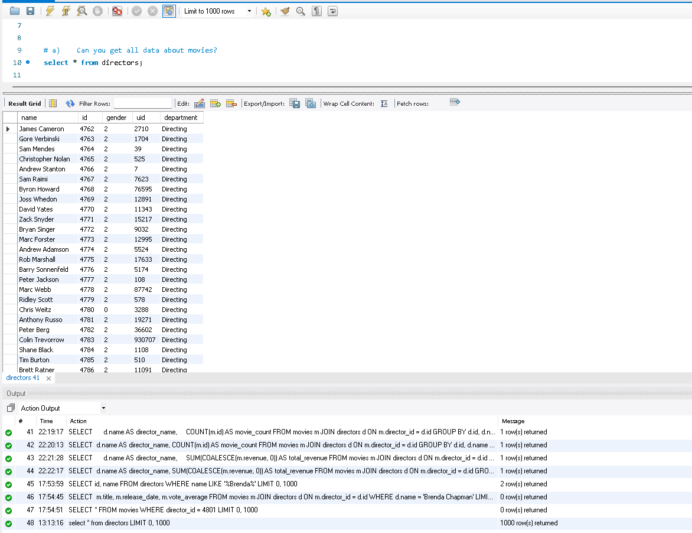
A) Can you get all data about movies?
This query extracts the complete set of movie records from the IMDB movies table, allowing a full view of all available attributes such as titles, release dates, popularity, revenue, and ratings. The output provides a comprehensive foundation for analysis and helps validate data completeness before performing any transformations or aggregations. It is mainly used for initial data exploration and understanding the dataset structure.

Slide 3
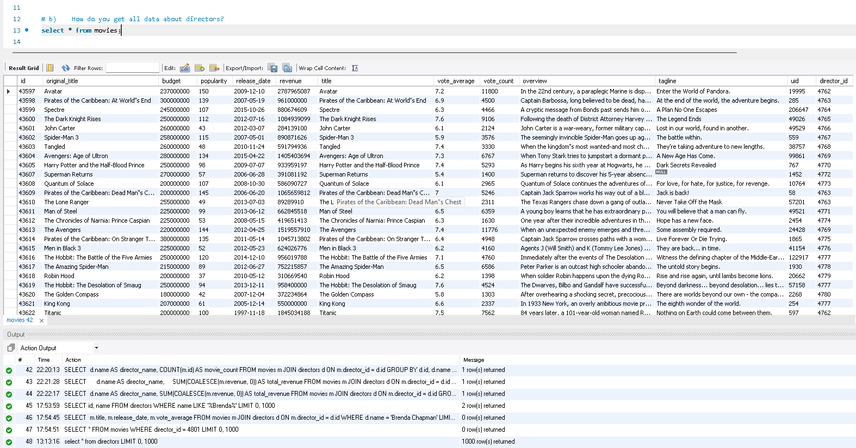
B) How do you get all data about directors?
This query fetches all records from the directors table, presenting complete information about each director in the dataset. The output includes identifiers, names, and gender details, which are essential for linking directors with their respective movies. This step supports relationship analysis and enables accurate joins between movies and directors

Slide 4
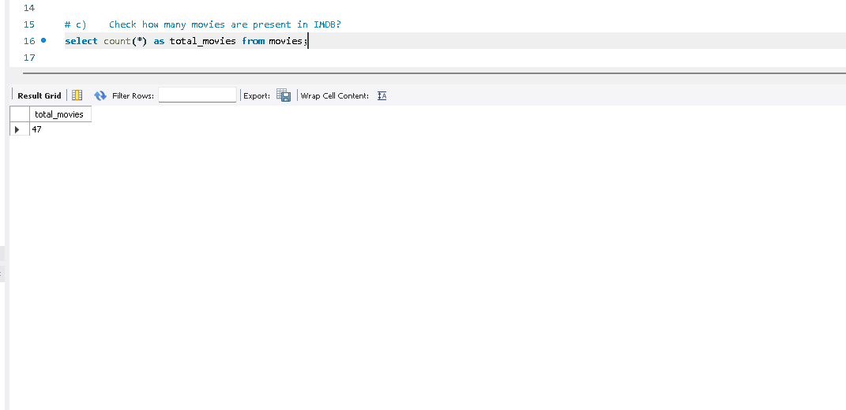
C) Check how many movies are present in IMDB?
This query calculates the total count of movies stored in the database. The output returns a single numeric value representing the size of the dataset, which helps in understanding the scale of analysis and verifying whether all expected records are present. It is commonly used as a validation metric in reporting.

Slide 5
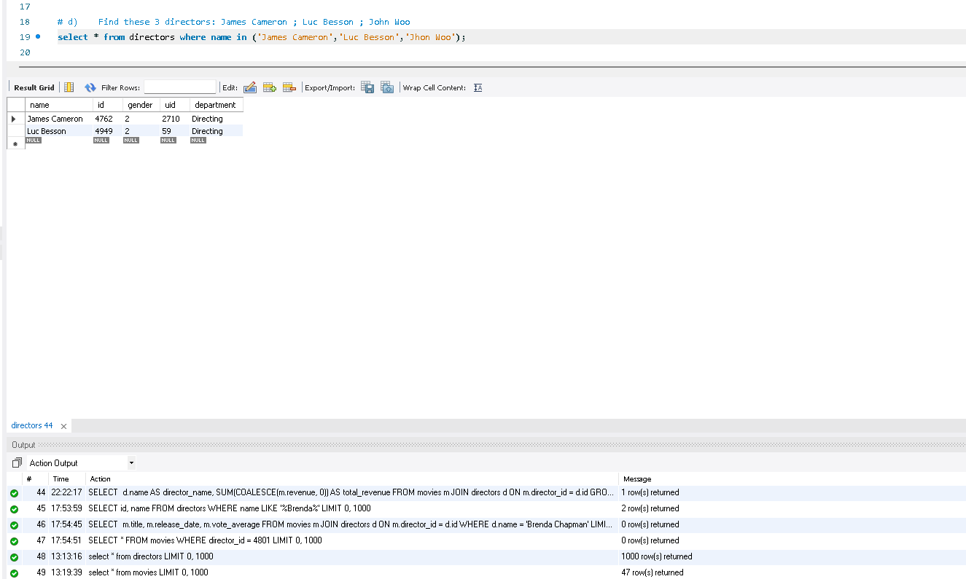
D) Find these 3 directors: James Cameron ; Luc Besson ; John Woo
This query filters the directors table to return records for James Cameron, Luc Besson, and John Woo. The output displays only the matching directors, enabling focused analysis on well-known filmmakers. This is useful when performing director-specific insights or verifying the presence of key industry figures in the dataset

Slide 6
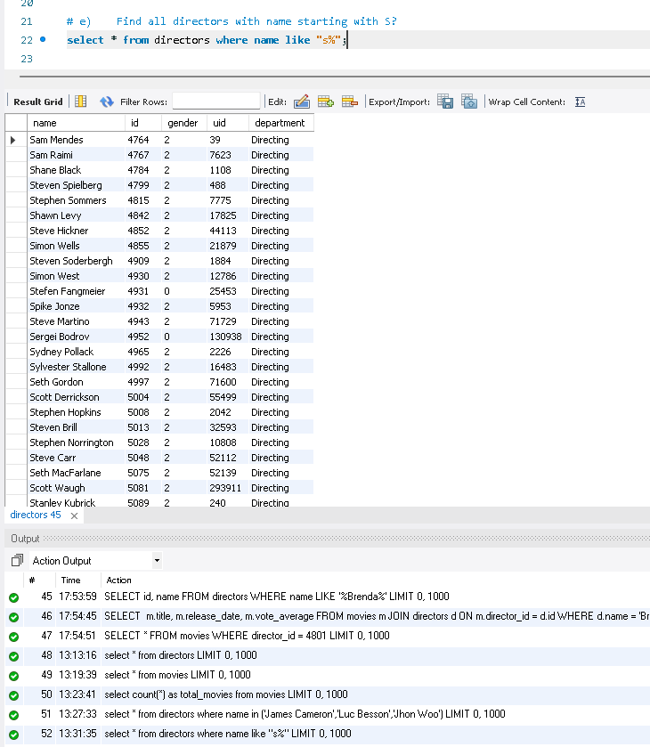
E) Find all directors with name starting with S?
This query identifies directors whose names begin with the letter “S” using pattern matching. The output lists only those directors, supporting alphabetical categorization and name-based filtering. Such queries are useful in data profiling and exploratory analysis.

Slide 7
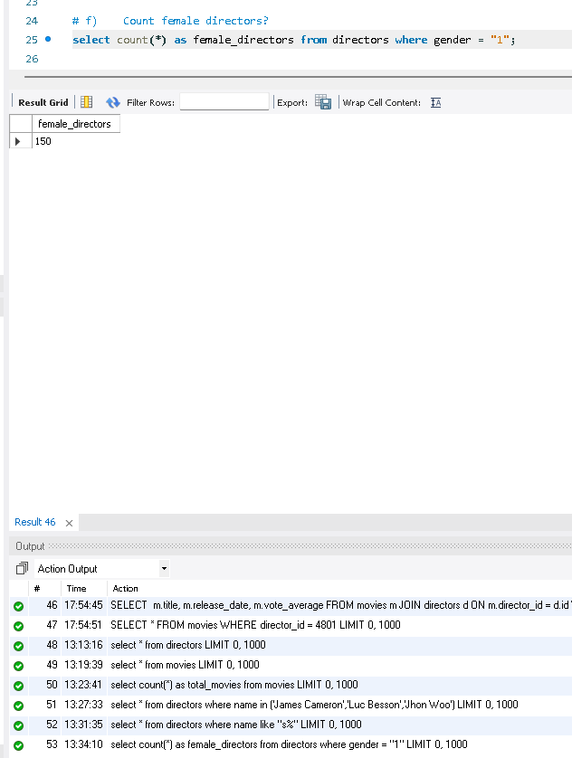
F) Count female directors?.
This query counts all directors identified as female based on the gender indicator. The output provides a single value that reflects gender representation within the dataset. This insight is useful for diversity analysis and high-level demographic reporting in the film industry

Slide 8
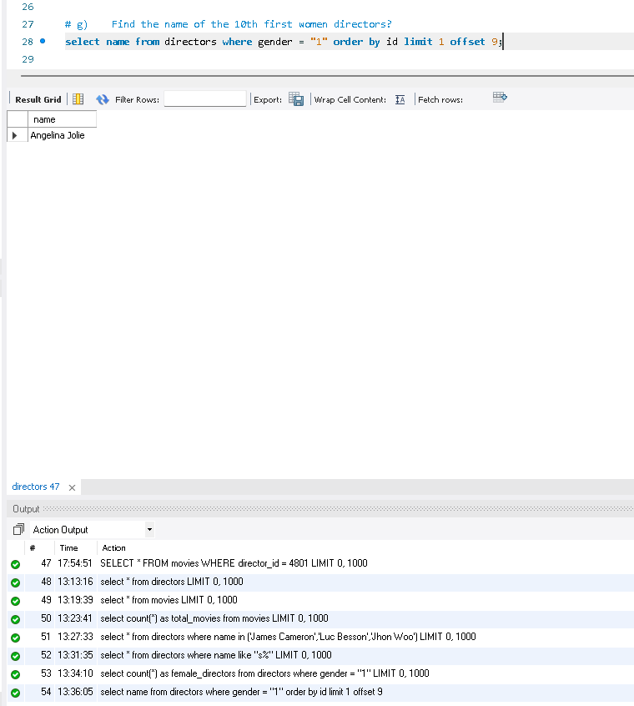
G) Find the name of the 10th first women directors?
This query retrieves the name of the 10th female director based on ascending order of director ID. The output highlights positional ranking within filtered data, demonstrating the use of ordering and pagination logic. It showcases advanced SQL control using LIMIT and OFFSET.

Slide 9
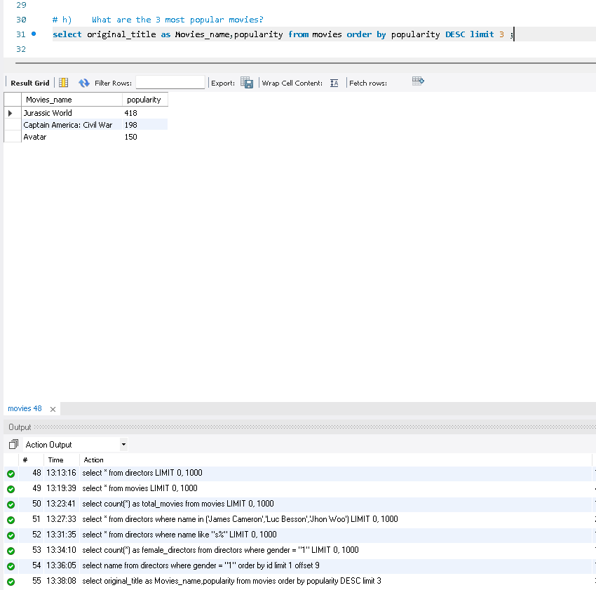
H) What are the 3 most popular movies?
This query ranks movies by popularity score in descending order and returns the top three results. The output highlights the most widely recognized and audience-favored movies in the dataset. This analysis helps identify trending content and viewer preferences.

Slide 10
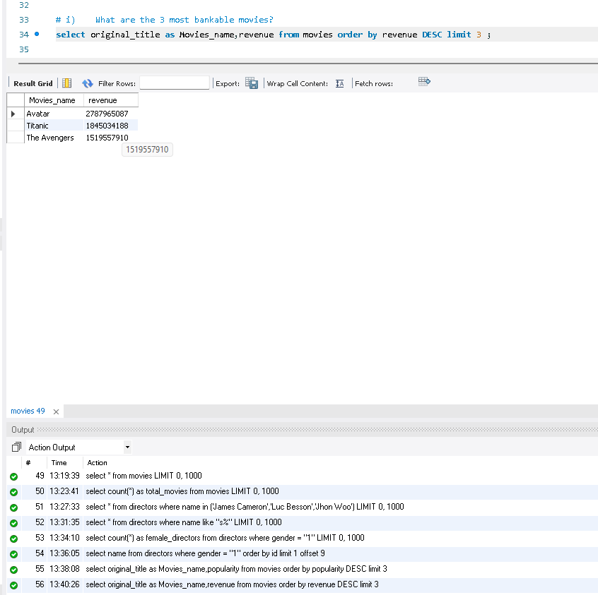
I) What are the 3 most bankable movies?
This query ranks movies based on total revenue earned and extracts the top three highest-grossing films. The output directly reflects commercial success and financial performance, making it valuable for business-oriented insights and profitability analysis.

Slide 11
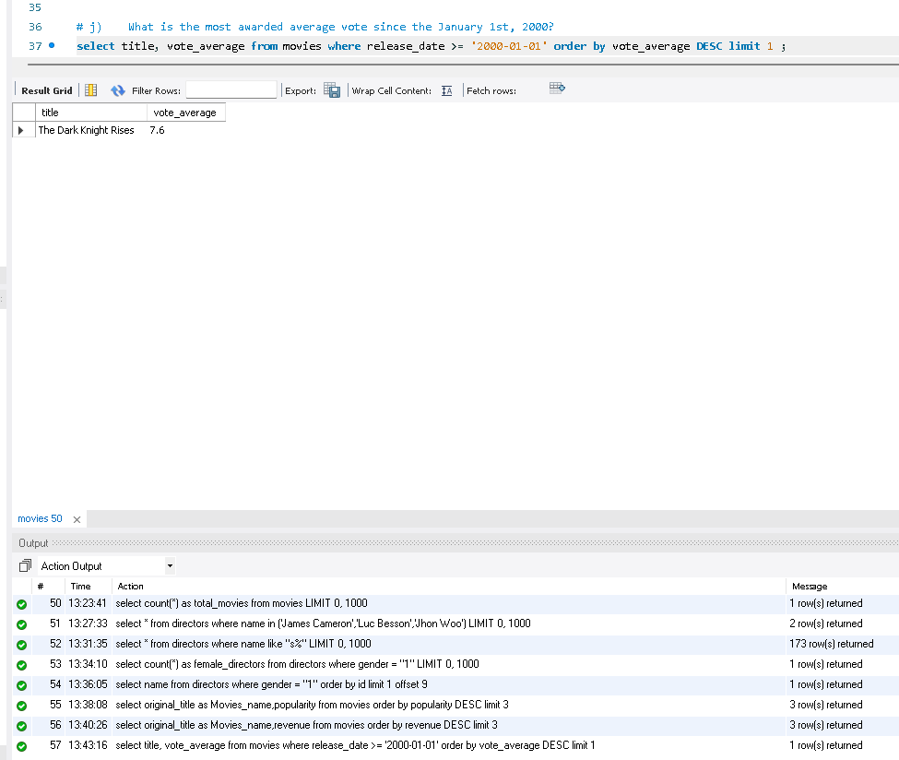
J) What is the most awarded average vote since the January 1st, 2000?
This query filters movies released from the year 2000 onward and identifies the one with the highest average vote. The output highlights the most critically acclaimed modern movie, enabling quality-based evaluation while excluding older releases.

Slide 12
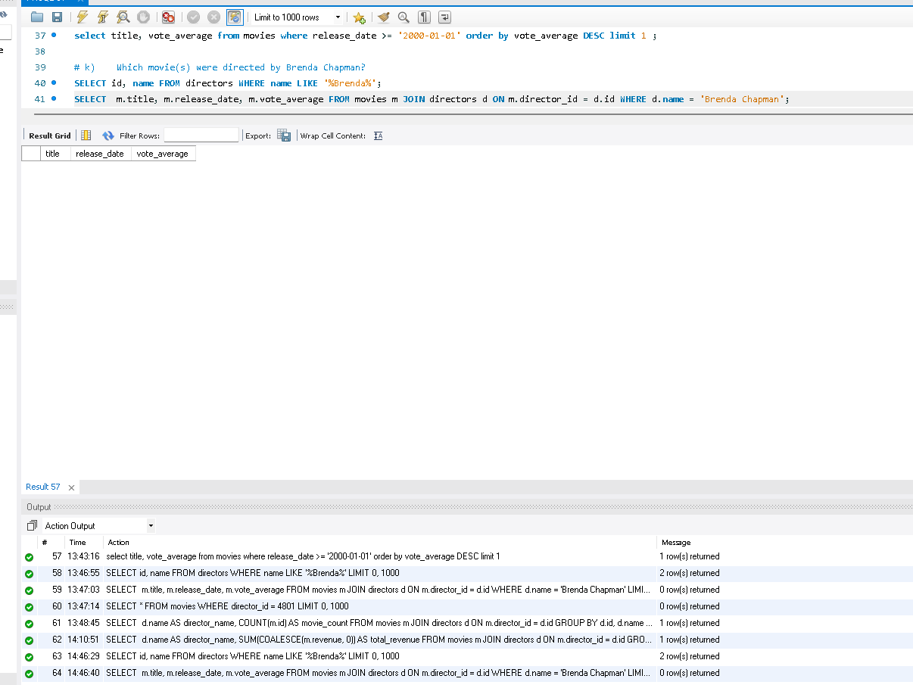
K) Which movies were directed by Brenda Chapman?
This query joins the movies and directors tables to retrieve all films directed by Brenda Chapman. The output lists her movies along with release dates and ratings, providing a focused view of her filmography. This demonstrates effective use of table relationships for director-level analysis

Slide 13
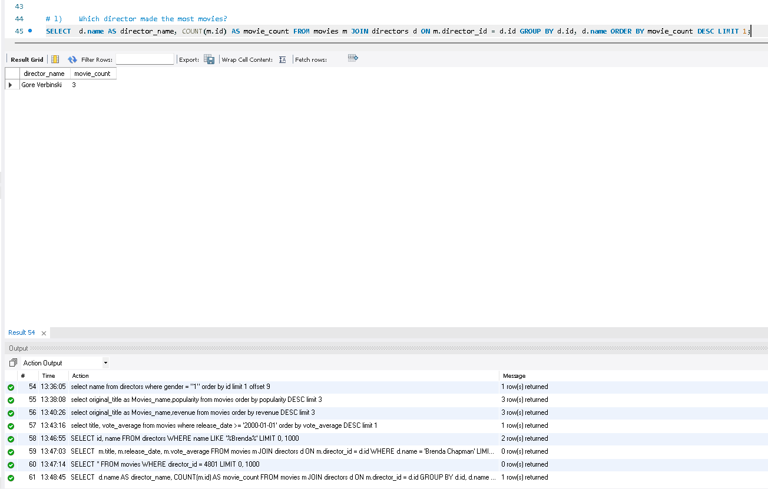
L) Which director made the most movies?
This query aggregates movie counts per director and identifies the one with the maximum number of films. The output reveals the most prolific director in the dataset, offering insight into productivity and career volume within the industry.

Slide 14
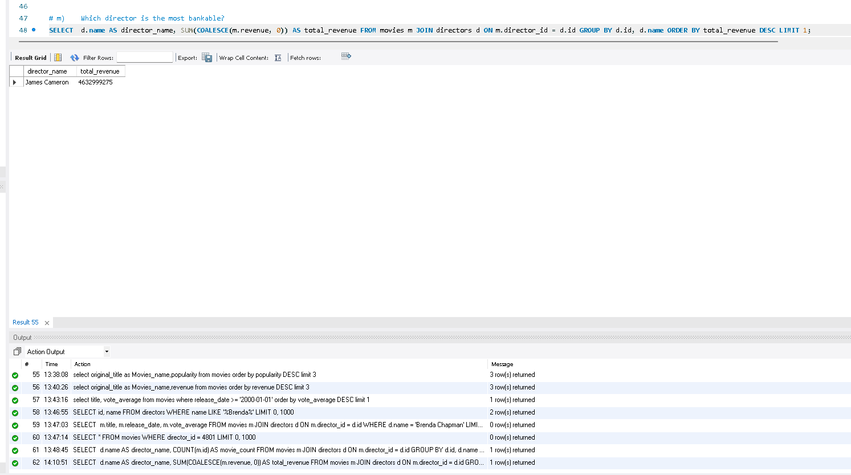
M) Which director is the most bankable?
This query calculates the total revenue generated by each director’s movies and identifies the top performer. The output highlights the director with the highest cumulative box-office revenue, representing strong commercial impact and financial success in filmmaking.

Slide 15
THANK YOU

