Slide 1
RELIABLE MODELS FOR DETERMINING THE PRESSURE-VOLUME-TEMPERATURE PVT PROPERTIES USING MACHINE LEARNING TECHNIQUES
Under the guidance of
Dr . Mohamed Ibrahim
Name | UH ID
N.SATHYA LAHARI | 2200736
J.HRUTHIKA | 2151639
D.CHARAN | 2215421
A.V. SAMPATH | 2199279
MUSA AHMED | 2034065

Slide 2
CONTENTS
Objective
Introduction
Literature Review
Problem Statement
Impact and Value
Data
Methodology
Results
Conclusion
References

Slide 3
OBJECTIVE
Develop reliable models for Pressure-Volume-Temperature (PVT Properites) prediction.
Figure out best machine learning model compared to other methods, like popular PVT correlation and other regression methods.
Calculating average absolute percentage error (AAPE) and coefficient of determination (R-value) to check the model accuracy.

Slide 4
INTRODUCTION
PVT properties are important in the oil and gas industry for reservoir modeling and production optimization.
Traditionally, PVT properties are determined through laboratory experiments which can be time-consuming and expensive.
Laboratory measurements and numerous correlations equations show significant deviations between the actual values and the predicted results.
PVT properties determination using Machine Learning Techniques can greatly benefit these industries by providing more accurate and efficient methods of analysis.

Slide 5
LITERATURE REVIEW
Several studies have investigated the use of ensemble models for predicting PVT properties, including combinations of neural networks, support vector regression, and decision trees.
A study used a combination of neural networks and support vector regression to achieve higher accuracy in predicting PVT properties compared to individual models.
While ensemble models have shown promise in improving prediction accuracy and generalizability, challenges such as model complexity and interpretability need to be addressed for these models to be widely adopted.

Slide 6
PROBLEM STATEMENT
Develop accurate and reliable models for predicting PVT properties with limited and noisy data, and how to effectively integrate these models into the decision-making process for optimizing production and maximizing profits.

Slide 7

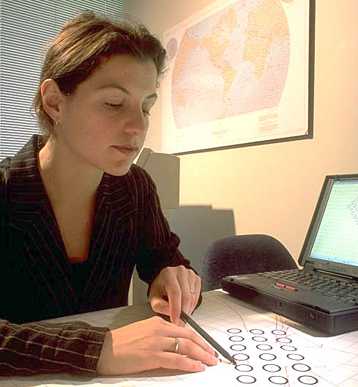
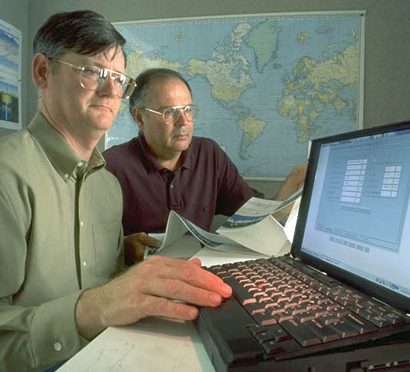
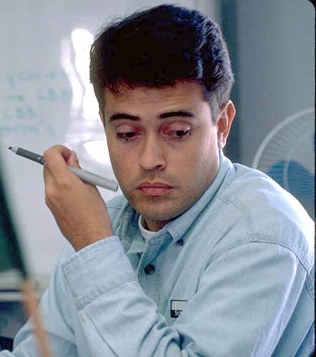
IMPACT AND VALUE
Reliable PVT property models can lead to improved well performance, reduced operational costs, and increased efficiency in production processes.
These models can also aid in environmental monitoring and help reduce the environmental impact of production processes.
Overall, developing reliable PVT property models using machine learning techniques can have significant economic, environmental, and societal impacts.
Production
Engineer
Facilities/Flow
Assurance Engineer
Fluid Data
Geologist
Reservoir Engineer

Slide 8
DATA BACKGROUND AND QUALITY
Data were collected from 6 oil fields from south sudan and sudan.
PVT properties were measured using standard laboratory procedures and applied several correlation methods(Glaso, Standing, Vasquez-Beggs, Almarhoun, kartoatmodjo) to evaluate the performance of the existing methods.
Target Variable | Input Parameters | Data Size
Formation Volume Factor(Bo) | 5 –(Temperature, Solution Gas-Oil Ratio, Gas Gravity, Density, and API Gravity) | 224
Bubble Point Pressure(Pb) | 5-(Pressure (Pb), temperature (T), stock-tank oil gravity (Rsb), gas gravity, density, and API gravity) | 59
Solution Gas–Oil Ratio(Rs) | 6-Temperature (T), density, API gravity, gas gravity, bubble point pressure (Pb), and pressure (P) | 222

Slide 9
DATA PROCESSING,WRANGLING AND EDA
Dataset contains no duplicate or missing values but there are some outliers ,filtered to remove values outside of the lower and upper boundaries for each column using box plot.
Visualized through distplot, pairplot ,correlation matrix and each parameter's distribution looks to be normal. P and Pb have the highest correlation with RsActual, as well as Rsb has highest correaltion with Pb and Bo has a weak correlation with all of the variables.
Finally, we have a dataset free of outliers, duplicate values, and null values.

Slide 10
METHODOLOGY
Data Collection: Collected and obtained data from various sources
Data Preparation: Remove outliers, split the data(7:3) and normalize through Min Max Scaling
Feature Engineering: Selected relevant features using Correlation Matrix, Bidirectional elimiation
Model Evaluation: Evaluate on test dataset using appropriate performance metrics such as AAPE, R-value and compared results with existing methods
Model Training: Train the models on the data and tune the hyperparameter using Randomized Search CV,Grid Search CV
Model Building : Lasso Regression, KNN, Random Forest, ANN, SVM, and Gradient Boosting, Ensembling Modelling

Slide 11
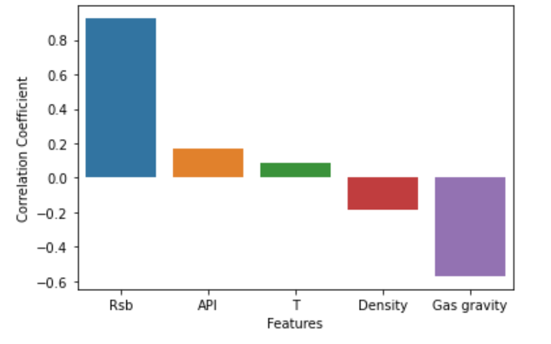
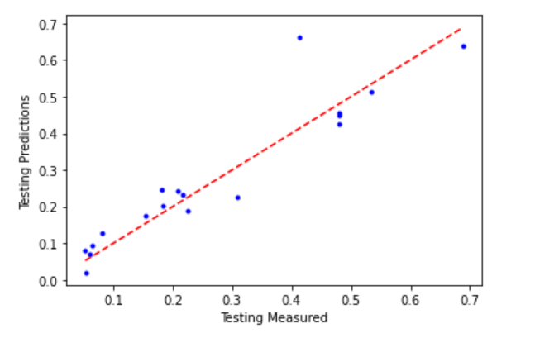
bubble point pressure –Pb
RESULTS

Slide 12
Author | Average Absolute Error % | Sum of Squared Residuals (RB/STB) | Variance (RB/STB)² | Standard Deviation (RB/STB)² | R Squared
Glaso | 7.91 | 5.14 | 0.05 | 0.224 | -0.055
Standing | 6.87 | 4.642 | 0.0455 | 0.213 | 0.047
Vasquez-Beggs | 7.37 | 4.657 | 0.0456 | 0.214 | 0.044
Petrosky & Farshad | 7.45 | 4.719 | 0.0462 | 0.215 | 0.031
Farshad & Leblanc | 6.99 | 4.611 | 0.0452 | 0.213 | 0.053
Almarhoun-1 | 6.64 | 4.422 | 0.0433 | 0.208 | 0.092
Almarhoun-2 | 6.76 | 4.481 | 0.0439 | 0.21 | 0.08
Kartoatmodjo and Schmidt | 6.59 | 4.418 | 0.0433 | 0.208 | 0.093
Almedhaideb | 9.85 | 4.115 | 0.0399 | 0.2 | 0.155
This study | 26.8 | 1.17 | 0.029 | 0.171 | 0.85

Slide 13
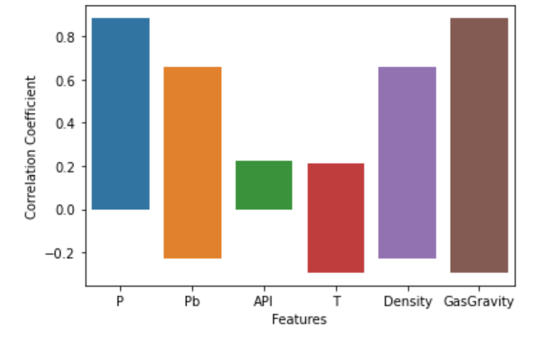
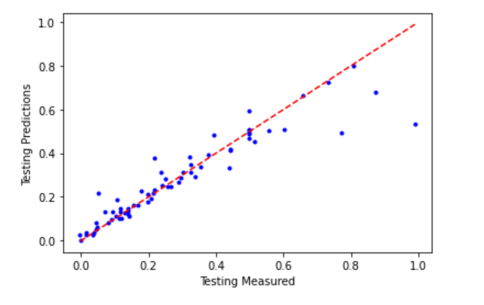
SOLUTION GAS-OIL RATIO –(Rs)
Author | Average Absolute Error % | Sum of Squared Residuals*10⁴ (scf/STB)² | Variance*10² (scf/STB)² | Standard Deviation (scf/STB) | R Squared
Standing | 24.98 | 23.32 | 30.28 | 55 | 0.8381
Vasquez-Beggs | 31.88 | 19.37 | 25.16 | 50.2 | 0.8655
Glaso | 64.12 | 19.17 | 24.9 | 49.9 | 0.8669
Almarhoun | 38.14 | 51.68 | 67.11 | 81.9 | 0.6412
kartoatmodjo | 40.62 | 20.19 | 26.22 | 51.2 | 0.8598
This Study | 25.4 | 4.58 | 3.6 | 19.1 | 0.87

Slide 14
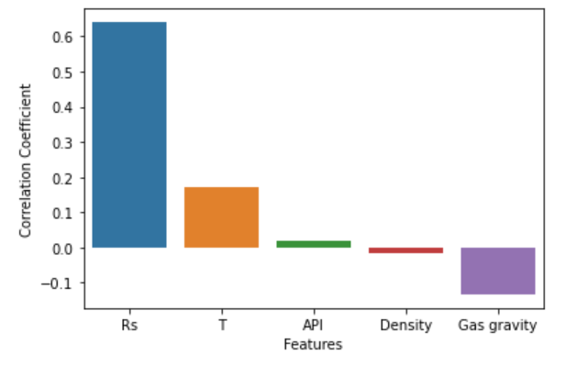
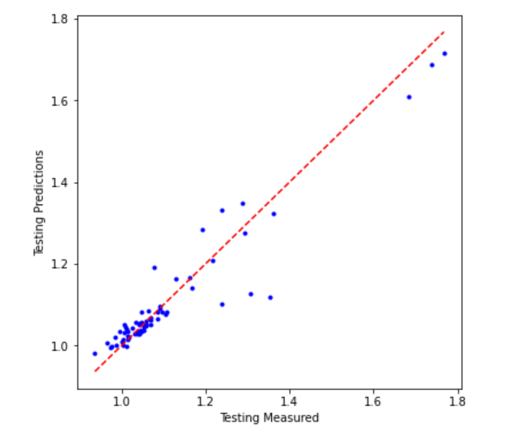
oil formation volume factor –Bo:

Slide 15
Author | Average Absolute Error % | Standard Deviation (psia) | Sum of Squared Residuals*10⁴ (psia)² | Variance*10³ (psia)² | R Squared
Glaso | 37.4 | 145.7 | 42.48 | 21.24 | 0.938
Standing | 23.100 | 152.200 | 46.32 | 23.16 | 0.932
Vasquez-Beggs | 20 | 139 | 38.76 | 19.38 | 0.943
Almarhoun | 25 | 184.2 | 67.86 | 33.93 | 0.901
Farshad-Leblanc | 11.4 | 98.000 | 19.19 | 9.6 | 0.971
Kartoatmodjo-Schmidt | 32 | 188 | 70.42 | 35.21 | 0.897
Valkó & McCain | 16.600 | 136.700 | 37.37 | 18.68 | 0.945
Velarde, Blasingame, & McCain | 25.200 | 160.100 | 51.26 | 25.63 | 0.925
Al-shammasi | 13 | 117 | 27.29 | 13.65 | 0.96
This study | 2.28 | 14.4 | 12.3 | 2.1 | 0.95

Slide 16
COMPARSION ANALYSIS:
Determination Approach |  |  | Formation Volume Factor | Bubble Point Pressure | Solution Gas Oil Ratio
1 | Famous Correlations | Standing (1947) | 6.9% | 23.1% | 24.9%
 |  | Vasquez-Beggs (1977) | 7.4% | 20.0% | 31.9%
 |  | Almarhoun (1988) | 6.6% | 25% | 38.1%
2 | SPSS(Nonlinear Regression) | Mohamed et al (2018) | 5.06% | 9.1% | 19.54%
3 | ANN | Amjed et al (2019) | 2.59% | 11.39% | 10.31%
4 | Ensemble Model | This study (2023) | 2.28% | 26.8% | 25.4%

Slide 17
CONCLUSION
By merging the results of the Lasso Regression, KNN, Random Forest, ANN, SVM, and Gradient Boosting models, we were able to create reliable ensemble models.
The developed new model surpassed the most popular PVT correlations as well as the AI models in predicting the oil formation volume factor with average absolute error of only 2.3 % .
Furthermore, the ensemble model has predicted the bubble point pressure and solution gas oil ratio with almost same accuracy of the famous PVT equations.
The newly developed model are easy to use and has good accuracy to predict the PVT properties when we do not have laboratory results.
The finding of the study are important to reservoir engineers, flow assurance engineers , production engineers and geologist for production optimization and reserve estimations.

Slide 18
REFERENCES
[1] Evaluation of Empirically Derived PVT Properties for Middle East Crude Oils M.N.Hemmati And R.Kharrat.
[2] Reservoir Engineering Handbook / Edition 3 By Tarek Ahmed, PhD, PE
[3] Herriot watt uni­versity reservo­ir engineering
[4] Correlation of Black Oil Properties at Pressure below Bubble-point A Thesis By JORGE JAVIER VELARDE PEREIRA Submitted to Texas A&M University in partial Fulfillment of the requirements for the degree of Master of Science.
[5] Correlations for predicting solution gas-oil ratio, bubble-point pressure and oil formation volume factor at bubble-point of Iran crude oils M.Taghizadeh Mazandarani , S. Mohammad Asghari. European Congress of Chemical Engineering (ECCE-6) Copenhagen, 16-20 September 2007.
[6] IMPROVED PVT CORRELATIONS FOR UAE CRUDE OILS. R.A. Almedhaideb, UAE university, SPE member.
[7] Introduction to PVT (PETROTEC – November 2005) lectures slide
[8] PVT course lectures (slides)-Schlumberger

Slide 19
Thank You !

