Slide 1
ADAFACE: QUALITY ADAPTIVE MARGIN FOR FACE RECOGNITION
Authors
Minchul kim, Anil k. Jain, xiaoming liu
Michigan State University
Presented by
J.HRUTHIKA
Department of Engineering Data Science,
University of Houston.

Slide 2
CONTENTS
Objective
Introduction
Literature Review
Problem Statement
Methodology
Test Datasets
Results
Limitations
Conclusion
References

Slide 3
OBJECTIVE
To improve face recognition performance in low quality face datasets by introducing adaptiveness in the loss function based on image quality.
The goal is to emphasize hard samples for high quality images and easy samples for low quality images, thereby improving recognition performance .
The authors propose AdaFace, a novel loss function adapting to image quality and assigning varying importance to samples based on difficulty. It avoids emphasizing unidentifiable images and prioritizes hard but recognizable samples.

Slide 4
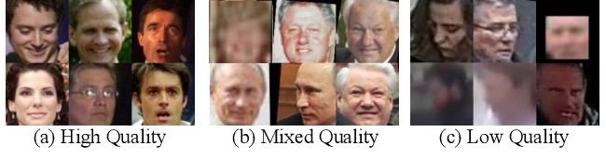
INTRODUCTION
Factors affecting Image Quality:
Capture Conditions
Image Resolution and Scale
Environmental Factors
Facial Expression and Emotion
Image Preprocessing and Enhancement
Face Pose and Alignment etc.. make the recognition task difficult.
Easy to Recognize
Hard to Recognize

Slide 5
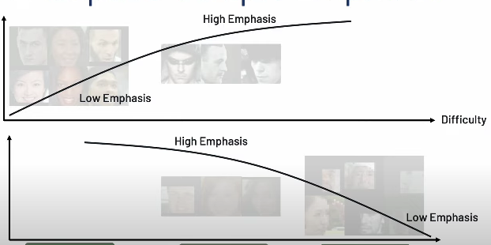
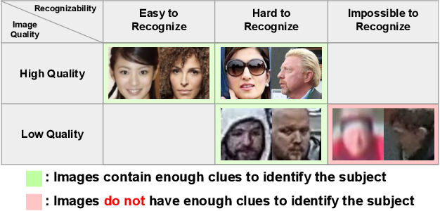
Are all images equally important ?
High
Quality
Low
Quality
Fig. Examples of face images with different qualities and recognizabilities
Easy to
Recognize
Hard to
Recognize
Impossible to Recognize

Slide 6
LITERATURE REVIEW
Face Recognition with Low Quality Images: Addresses the challenge of face recognition in unconstrained scenarios, such as surveillance or low-quality videos, where images may lack identity cues.
Margin Based Loss Function: Discusses the use of margin-based soft max loss functions in face recognition, which add a margin to the soft max loss to learn discriminative features.
Compares approach with Curricular Face and Mag Face emphasizing adaptively changing loss function.
Performance evaluation on diverse datasets shows improved recognition on low-quality images while maintaining high-quality performance.

Slide 7
PROBLEM STATEMENT
Aims to design a novel loss function that can adaptively changes the margin function to emphasize different sample difficulty levels based on its image quality, giving more importance to challenging samples in the case of high-quality images and prioritizing easier samples for low-quality images(hard yet recognizable samples).

Slide 8
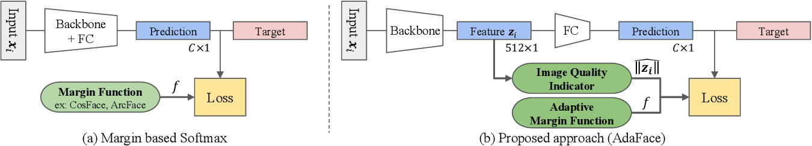
Methodology
Adaptive Margin Function : A way to change emphasis of different difficulty of samples.
2) Image Quality Indicator : A way to estimate image quality of a sample.

Slide 9
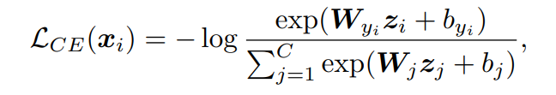
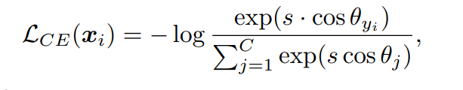
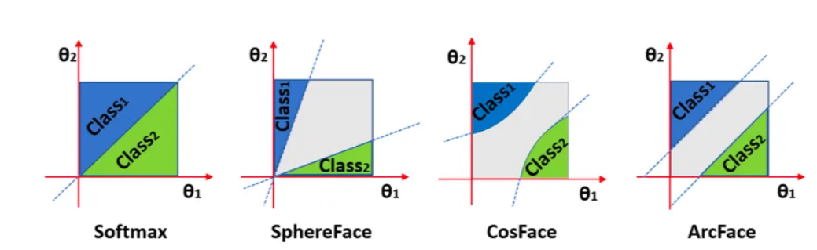
Loss Function for Face Recognition:
1)Adaptive Margin Function
Fig. Margin based Softmax
Cross entropy softmax loss:
Normalized softmax loss:
Fig:Decision margins of different loss functions under bi- nary classification case. The dashed line represents the decision boundary, and the grey areas are the decision margins.

Slide 10
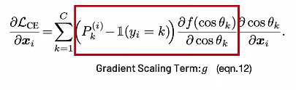
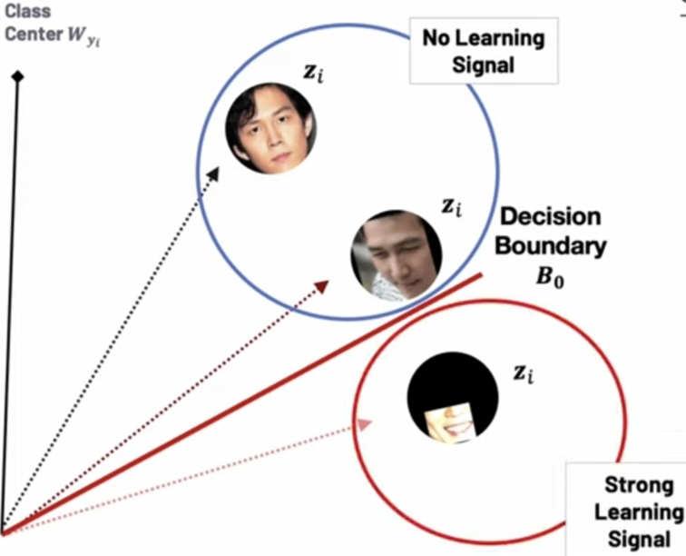
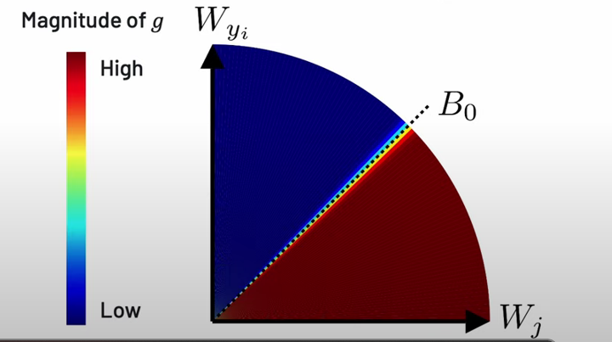
Effect of without margin on Gradient :
1)Adaptive Margin Function
Fig: Gradient Scale Term Plot without margin

Slide 11
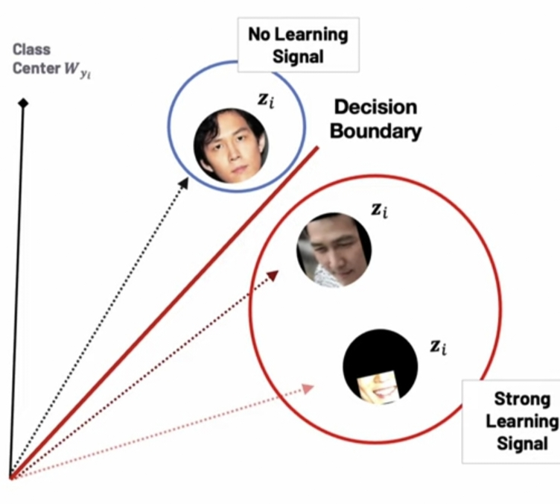
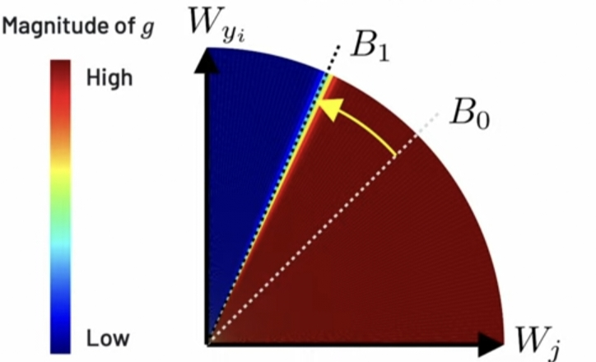
Effect of Additive Margin on Gradient :
1)Adaptive Margin Function
Fig:Gradient Scale Term Plot with additive margin

Slide 12
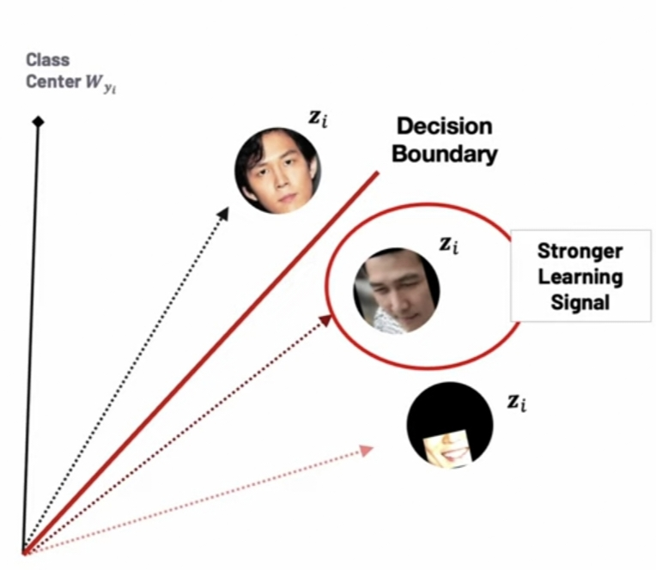
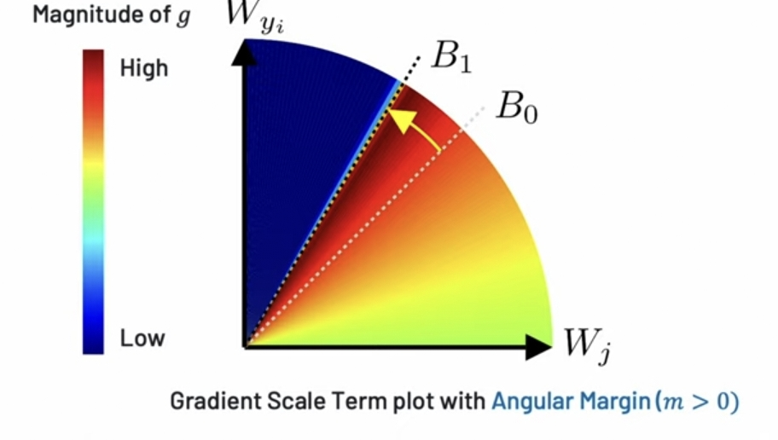
1)Adaptive Margin Function
Effect of Angular Margin on Gradient :

Slide 13
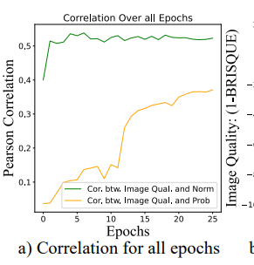
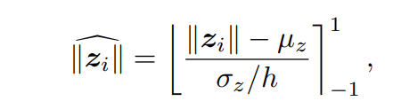
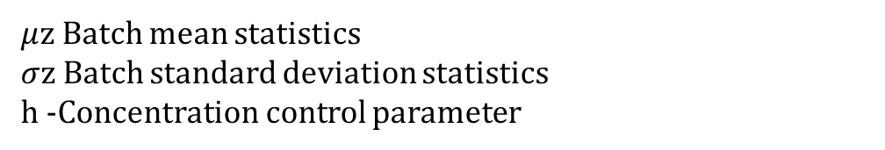
2)Image Quality Indicator
$μ$z Batch mean statistics $σ$z Batch standard deviation statistics h -Concentration control parameter
Feature norm can be a good proxy for the image quality, and

Slide 14
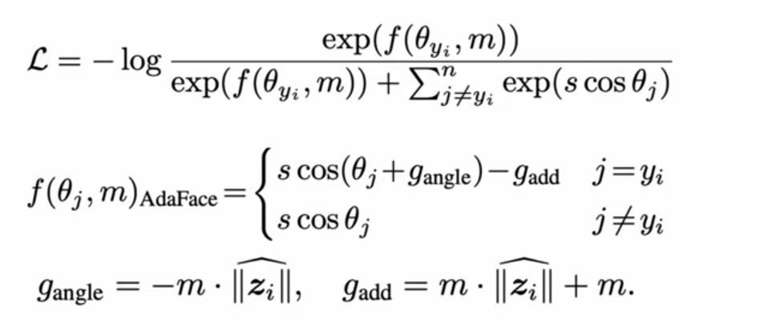
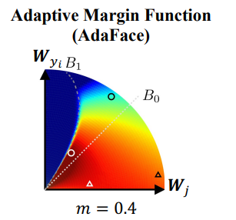


AdaFace Objective:
Easier Sample, Low Norm Harder Sample, Low Norm
Easier Sample, High Norm Harder Sample, High Norm
Combine different margin functions to emphasize samples of different difficulty based on the image quality.

Slide 15
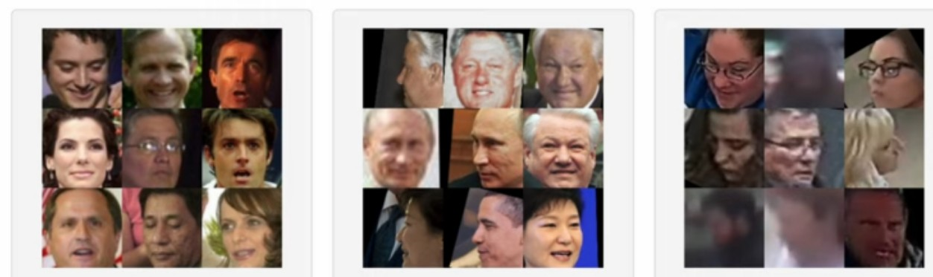
Test Datasets
High Quality Datasets LFW, CFP-FP, CPLFW, AGEDB. CALFW
Mixed Quality Datasets IJB-B, IJB-C
Low Quality Datasets IJB-S, TinyFace

Slide 16
results
Achieves state-of-the-art performance on mixed and low-quality face datasets.
Adapts the loss function based on image quality, leading to improved recognition accuracy. Assigns higher importance to difficult samples of high quality, improving performance on challenging datasets.
Shows a high correlation between feature norm and image quality, supporting its use as a proxy for image quality.
Combines different margin functions to emphasize hard samples when necessary.
Outperforms ArcFace in identifying subjects in the IJB-C dataset where ArcFace fails.

Slide 17
limitations
Does not address mislabeled samples in large-scale facial training datasets.
Adaptive loss function may wrongly emphasize high-quality mislabeled images.
Suggests future works should handle unidentifiability and label noise simultaneously.

Slide 18
CONCLUSION
By incorporating image quality into the loss function, AdaFace improves face recognition performance in low-quality datasets.
This approach may enhance robustness to varying image quality, inspire advancements in loss functions for computer vision tasks, set new benchmarks in face recognition datasets, and have practical applications in identity verification, surveillance, access control, and biometric authentication.
Demonstrates AdaFace's efficiency in improving face recognition on low-quality datasets while maintaining high-quality performance.
Highlights the importance of collecting human data with informed consent..
Emphasizes minimizing negative societal impact in Computer Vision.
Encourages using new datasets for future research.

Slide 19
REFERENCES
[1] Yoshua Bengio, Jer´ome Louradour, Ronan Collobert, and Jason Weston. "Curriculum learning." In Proceedings of the 26th Annual International Conference on Machine Learning, pages 41–48, 2009.
[2] Jie Chang, Zhonghao Lan, Changmao Cheng, and Yichen Wei. "Data uncertainty learning in face recognition." In Proceedings of the IEEE/CVF Conference on Computer Vision and Pattern Recognition, pages 5710–5719, 2020.
[3] Zhiyi Cheng, Xiatian Zhu, and Shaogang Gong. "Low-resolution face recognition." In Asian Conference on Computer Vision, pages 605–621, 2018.
[4] Jiankang Deng, Jia Guo, Niannan Xue, and Stefanos Zafeiriou. "ArcFace: Additive angular margin loss for deep face recognition." In Proceedings of the IEEE/CVF Conference on Computer Vision and Pattern Recognition, pages 4690–4699, 2019.
[5] Jiankang Deng, Jia Guo, Jing Yang, Alexandros Lattas, and Stefanos Zafeiriou. "Variational prototype learning for deep face recognition." In Proceedings of the IEEE/CVF Conference on Computer Vision and Pattern Recognition, pages 11906–11915, 2021.
[6] Jiankang Deng, Jia Guo, Debing Zhang, Yafeng Deng, Xiangju Lu, and Song Shi. "Lightweight face recognition challenge." In Proceedings of the IEEE/CVF International Conference on Computer Vision, 2021.

Slide 20
Thank You !

