Slide 1

Students' Perceptions of AI in Education
Group 9: Charan Devapatla – 2215421
Hruthika Jinna – 2151639
Leela Prasad Boddu – 2214707
Nikhitha Reddy Kadapakonda – 2162999
Veera Sampath Reddy Alavalapati - 2199279

Slide 2
DATASET INTRODUCTION & DESCRIPTION
Source : https://www.kaggle.com/datasets/gianinamariapetrascu/survey-on-students-perceptions-of-ai-in-education?resource=download
Data Collection :
Surveys or interviews with students includes information on students' attitudes, perceptions, and experiences with AI in education on 2nd and 3 rd year students at the Faculty of Cybernetics,Statistics Informatics.
Consists of 16 questions ,covering topics such as
Students' level of AI knowledge, Sources of information, Impact of AI on society
Advantages and disadvantages of using AI in education
Demographic information such as gender, year of study, major, and academic performance.
Target Variable – Utility grade –
0 :perception of low usefulness (rating between 0-5)
1: perception of high usefulness (rating between 6-10)
Input Features – Education, GPA, Feelings, Economic growth etc.

Slide 3
PROBLEM STATEMENT & OBJECTIVE
Aim: To gather insights into students' perceptions of the role of artificial intelligence in education.
To better understand the factors that contribute to students' perceptions of the utility of ai in education by building predictive model.
To develop a machine learning model that can accurately predict the utility grade of ai in education from the perspective of students based on their responses to survey questions.

Slide 4
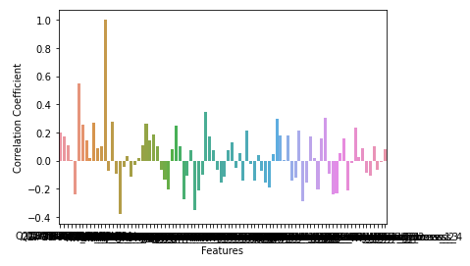
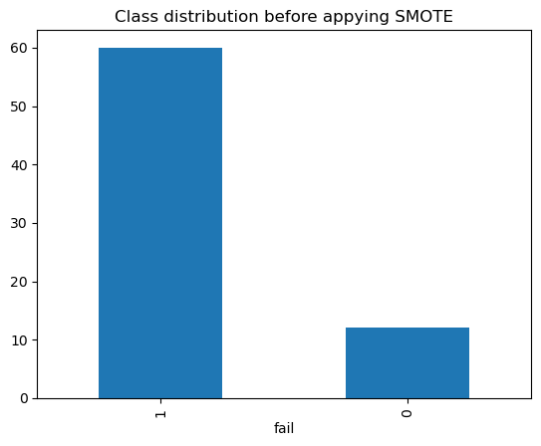
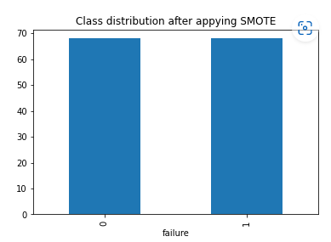
PREPROCESSING OF DATA
No missing and duplicate values
Correlation - target variable with remaining features
Label encoded the columns using function “multilabelbinarizer” , one hot encoding using “get dummies” and dropped the unnecessary columns
Train and test split (80:20)
SMOTE – To handle Imbalance data points in the target variable

Slide 5
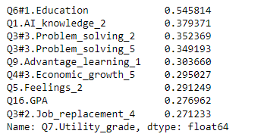
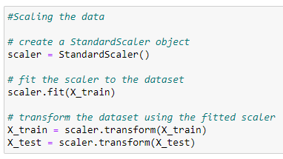
PREPROCESSING OF DATA
Feature selection : selected best 10 features from the data using correlation
Perform scaling on data using standard scaler

Slide 6
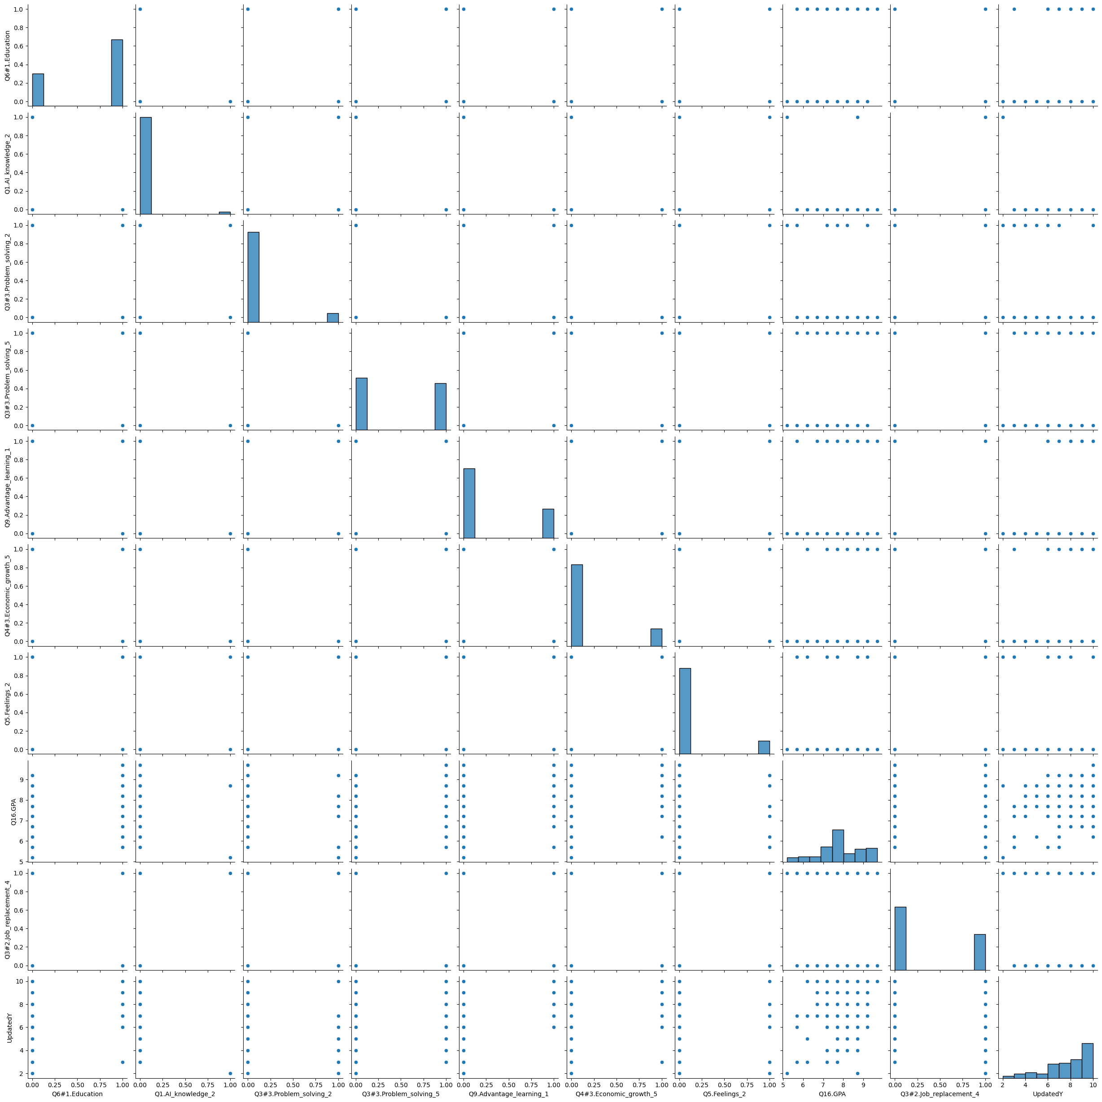
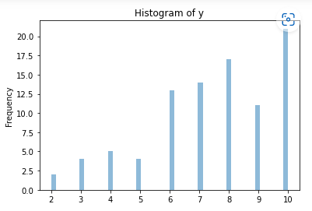
Visualization-EDA
Plot the histogram of target variable
Pair plot on the selected features

Slide 7
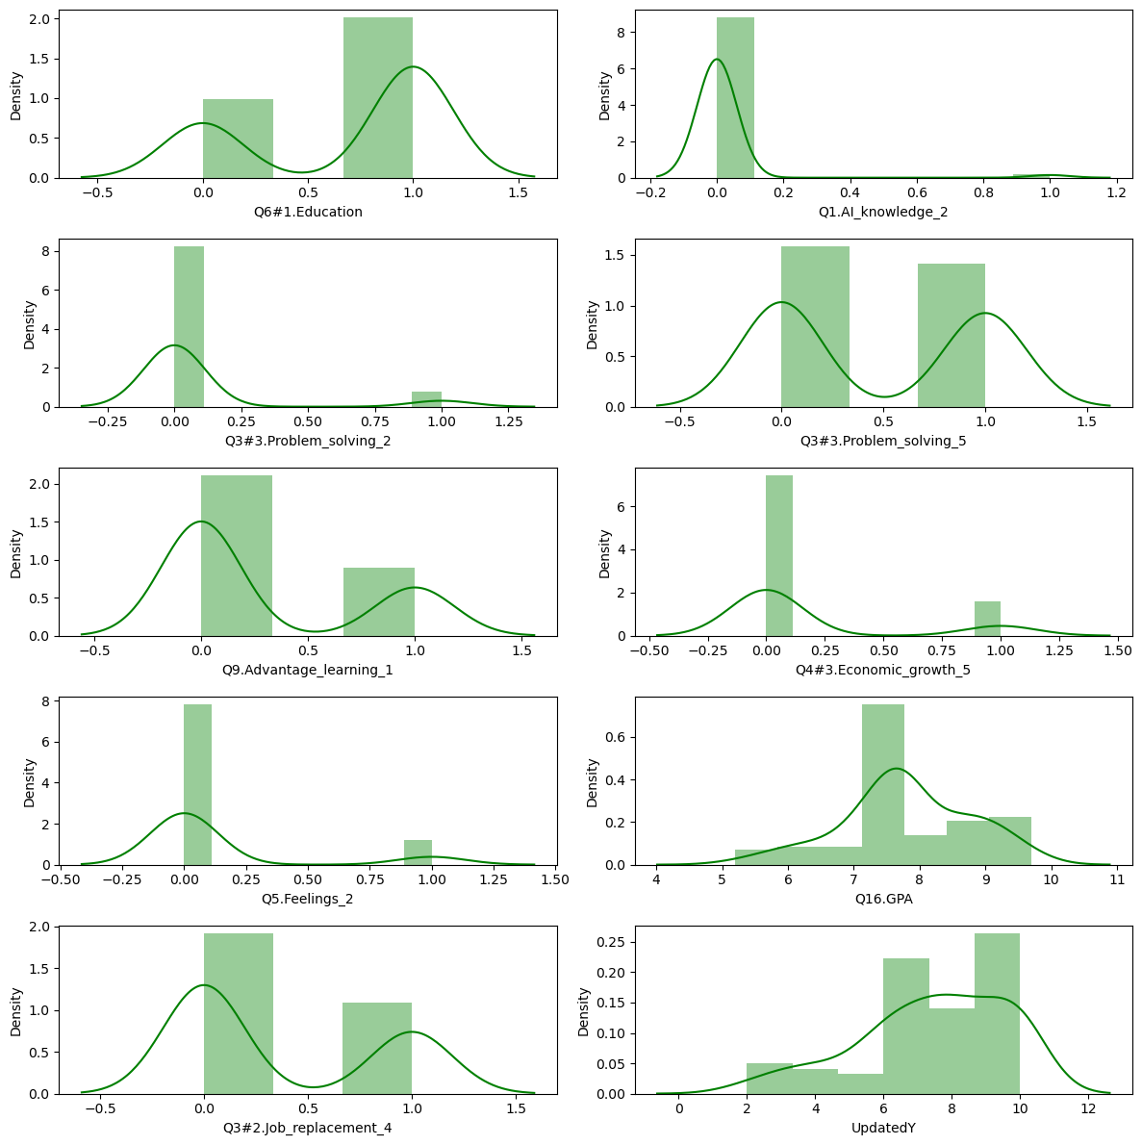
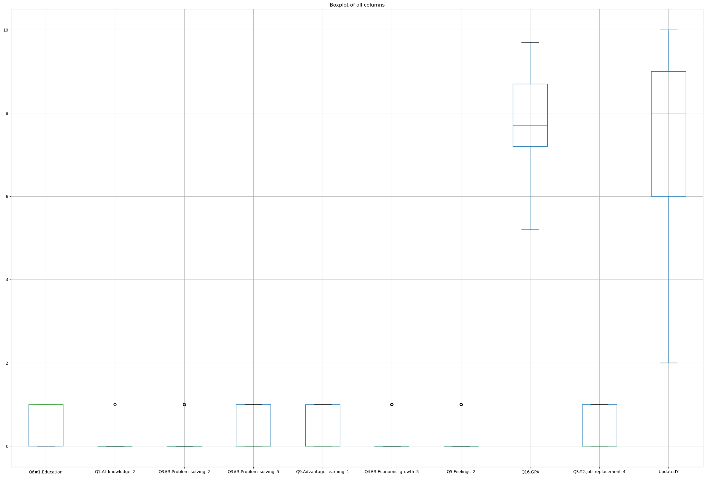
Visualization-EDA
Displot ,box plot on the selected features
Outliers : checked for outliers, no need to handle outliers.

Slide 8
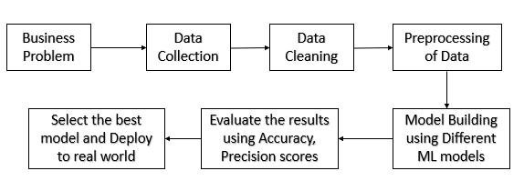
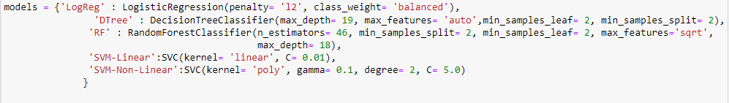
Methodology
Models:

Slide 9
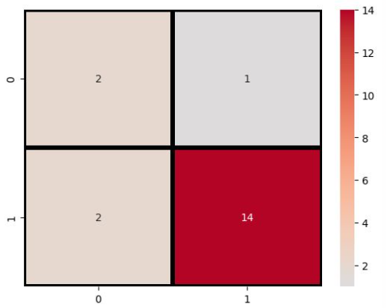
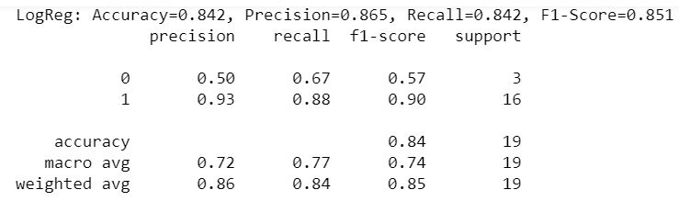
MODEL BUILDING
1.Logistic Regression:
Supervised machine learning algorithm used for Classification problems
The main aim is to predict the probability of given instance belongs to that class or not
It transforms the continuous value output of linear regression to categorical value output using Sigmoid Function
Accuracy score – 0.84 ( using selected features from correlation) and 0.79(using grid search)
Hyper params : { 'penalty': ['l1', 'l2'],'C': [0.1, 1] }
Best parameters : {'C': 0.1, 'penalty': 'l2'}

Slide 10
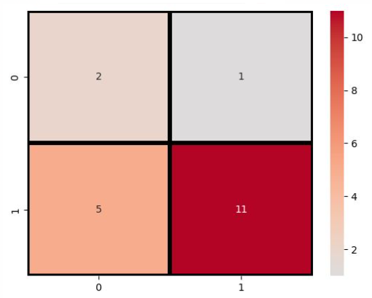
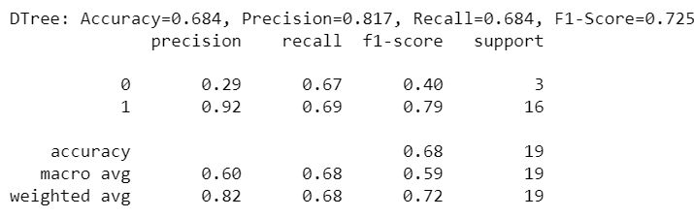
MODEL BUILDING
2. Decision Tree:
It is a flowchart like tree structure, uses set of rules to make decisions similar to how humans make decisions.
Here source set divides based on the attribute value test and the process repeats until subset at a node all has the same values.
Here each internal node – attribute, Branch - outcome from the test and leaf node- class label
Accuracy score – 0.68 ( using selected features from correlation) and 0.74(using grid search)
Hyper params : {'max_depth': [1,2,5],'min_samples_leaf': [2,4,5]}
Best params : {'max_depth': 2, 'min_samples_leaf': 2}

Slide 11
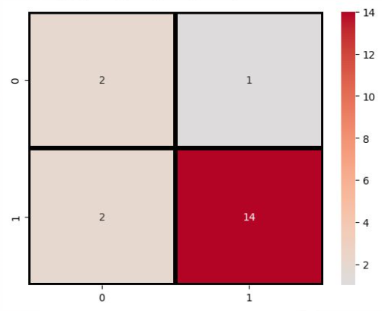
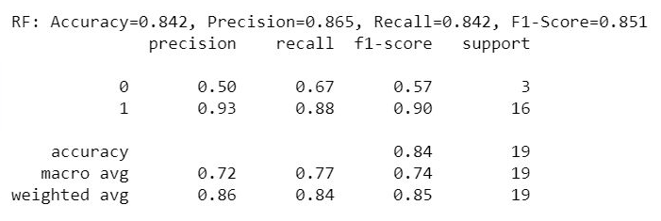
MODEL BUILDING
Random Forest:
It takes number of decision tree classifiers on various sub sample of the dataset and uses average to improve accuracy
Used for both classification and Regression
Uses technique called Bootstrap and Aggregation, known as Bagging
Accuracy score – 0.84 ( using selected features from correlation) and 0.79(using grid search)
Hyper params : {'n_estimators': [10,75,100,150],'max_depth': [2,3, 5],'min_samples_split': [1,2, 5]}
Best params : {'max_depth': 2, 'min_samples_split': 2, 'n_estimators': 150}

Slide 12
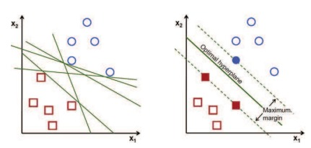
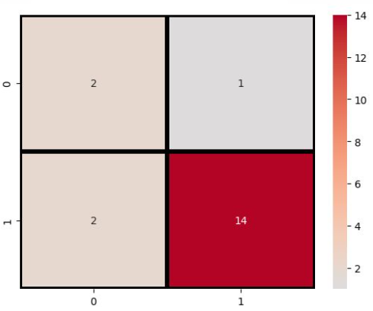
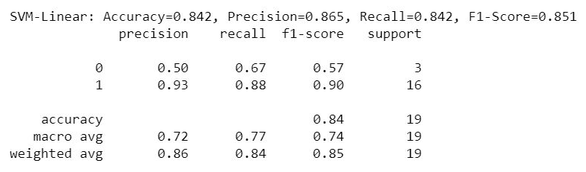
MODEL BUILDING
4. SVM :
Mainly used for classification of complex, small and medium size data. eg – Face detection, image classification
By using SVM we can separate the classes with best possible approach using maximal margin concept.
Accuracy score – 0.84 ( using selected features from correlation) and 0.84(using grid search)
Hyper params : {'kernel': ['linear', 'rbf'],'C': [0.001,0.01,0.1, 1],'gamma': [ 1, 10]}
Best params : {'C': 0.1, 'gamma': 1, 'kernel': 'linear'}

Slide 13
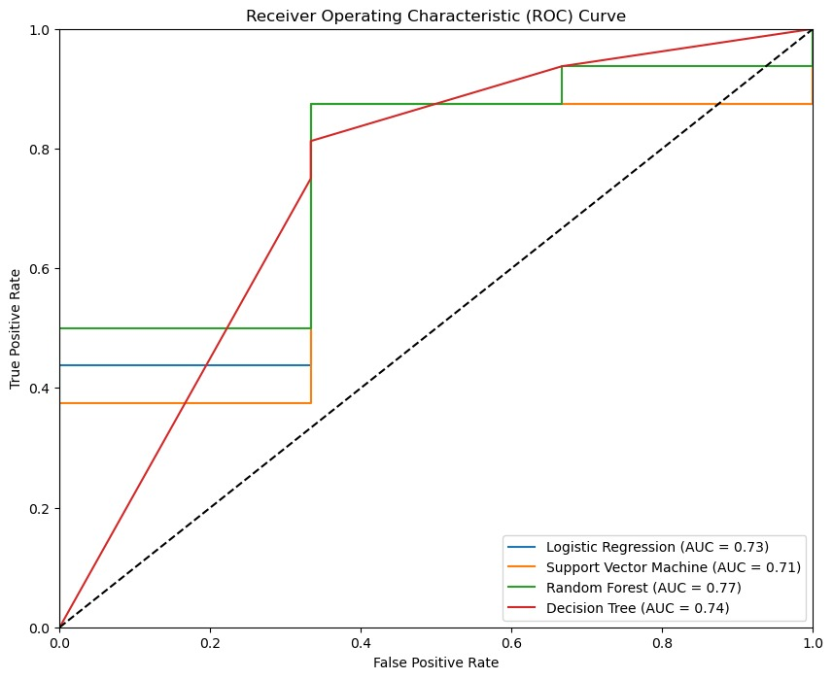
RESULTS
From ROC plot, Random forest is the best model among all.
Model accuracy is 84%.

Slide 14
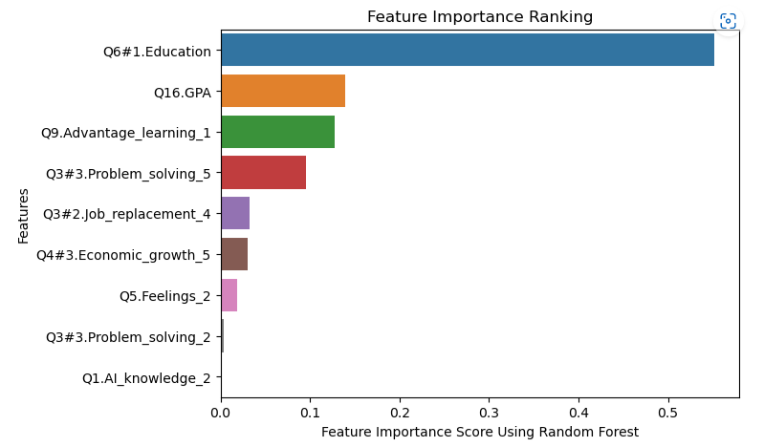

CONCLUSIONS AND CHALLENGES
Conclusions:
Among all the selected features Question6 #1 Education is most important in classifying the target utility.
AI Knowledge is least significant one in predicting AI usefulness in Education.
CHALLENGES :
Insufficient data availability.
Survey questions may not fully capture the complexity of students' perceptions of AI in education.

Slide 15

Q&A

