Slide 1
NECTAR
Intelligent Facilities Platform
Data Scientist Challenge — IoT Analytics for Predictive Maintenance,
Energy Forecasting, Anomaly Detection & Asset Connectivity
51
73,440
5
60
Connected Assets
Telemetry Readings
ML Capabilities Built
Days of Data
Prepared for Team Nectar • Submission covers Tasks 1–5 of the challenge brief

Slide 2
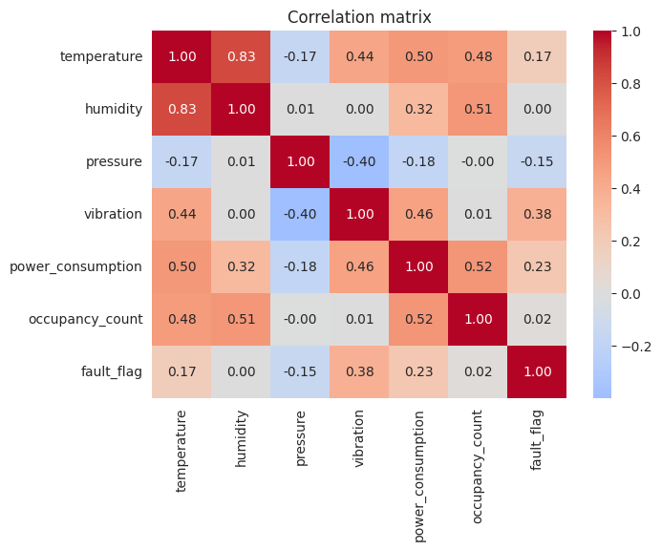
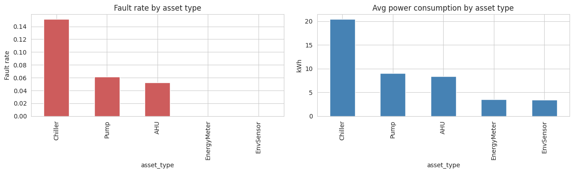
Data Overview & Key EDA Findings
Task 1 — Exploratory Data Analysis
Fault rate and average power draw by asset type
No dataset shipped with the brief — a schema-faithful synthetic dataset was generated with realistic degradation trajectories, occupancy cycles, and planted anomalies / data-quality issues, so every downstream task has real signal to recover.
Correlation matrix — sensor readings
Power consumption tracks occupancy and business-hours scheduling closely — the clearest energy-optimization lever is off-hours setbacks.
Vibration is the strongest correlate of fault_flag of any sensor — the core signal behind Task 2's model.
Chillers show the highest fault rate and power draw of any asset type — the priority target for predictive maintenance.
Nectar Data Scientist Challenge | Intelligent Facilities Platform
2

Slide 3
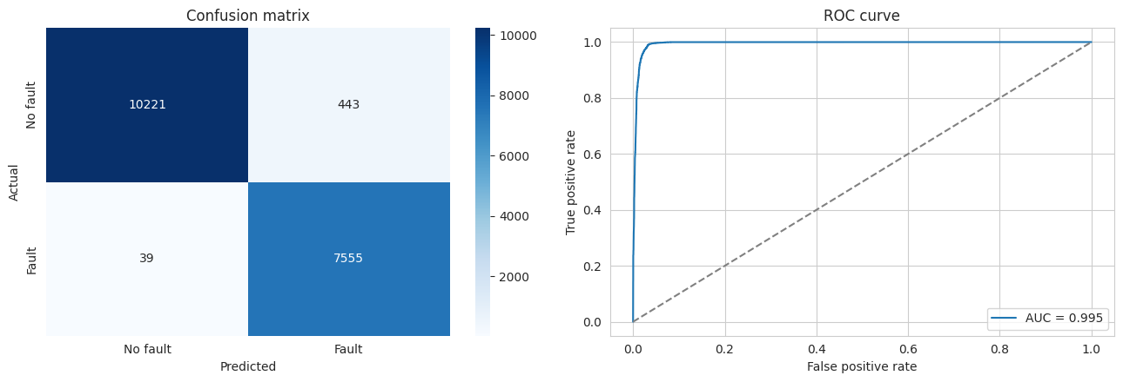
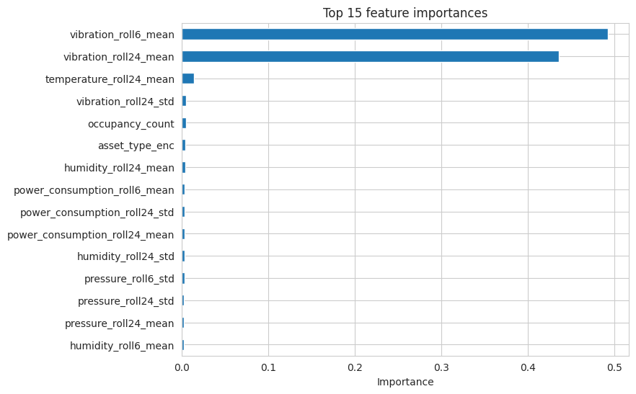
Predictive Maintenance
Task 2 — Will an asset fail within the next 24 hours?
Confusion matrix & ROC curve — held-out (time-based) test set
0.945
0.995
0.969
0.995
Precision
Recall
F1 Score
ROC-AUC
XGBoost on rolling 6h/24h window features (mean, std) plus short-term trend, per asset — handles class imbalance via scale_pos_weight, non-linear interactions, no scaling required.
Label is strictly forward-looking (any fault in the next 24h), with a time-based train/test split so no future information leaks into training.
Top features: rolling vibration mean/std and the vibration trend — matches the EDA's pre-fault signature.
Top 15 feature importances
Beats a Random Forest baseline (F1 0.964, ROC-AUC 0.993) on every metric.
Nectar Data Scientist Challenge | Intelligent Facilities Platform
3

Slide 4
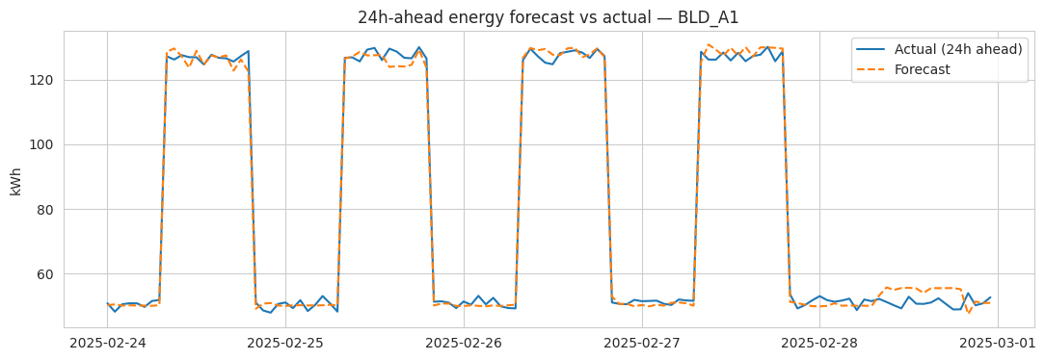
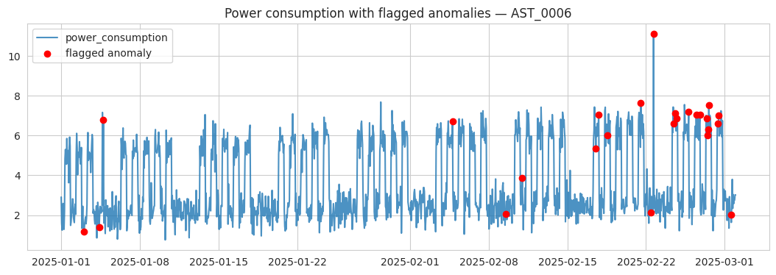
Energy Forecasting & Anomaly Detection
Task 3 — Building-level 24h energy forecast · Task 4 — Spikes, drift & degradation
24h-ahead energy forecast vs. actual, one building
Power consumption with flagged anomalies, one asset
2.53 kWh
4.27 kWh
2.76%
Anomaly detection combines Isolation Forest (per asset type, multivariate) with a rolling z-score check and a dedicated sensor-drift detector — each flags a different failure signature.
MAE
RMSE
MAPE
Forecasting: XGBoost regressor with lag (1h/24h/168h) and calendar features, per building. Same-hour-yesterday and same-hour-last-week lags dominate importance — buildings are highly routine.
Nectar Data Scientist Challenge | Intelligent Facilities Platform
4

Slide 5
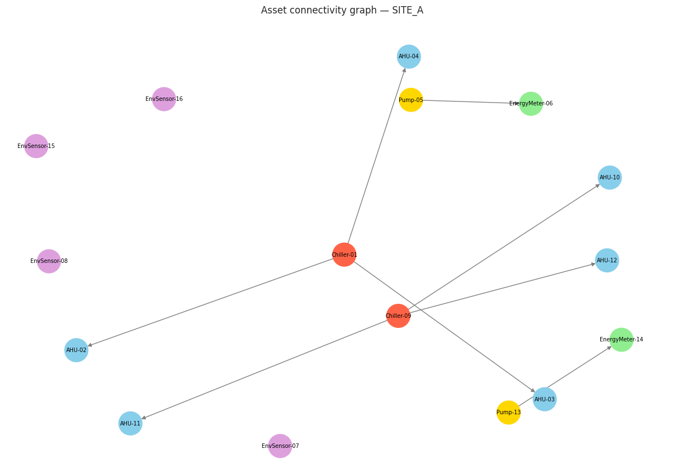
Asset Connectivity & Business Recommendations
Task 5 — Hierarchy, failure-impact propagation & data quality
Recommendations
Chiller failures have the largest blast radius (cascade to every downstream AHU) — prioritize these assets for the tightest monitoring and, where feasible, N+1 redundancy.
Enforce foreign-key constraints on parent_asset_id and uniqueness on connectivity edges at ingestion — this run's audit found a duplicate edge and one invalid parent reference.
Route assets flagged by both the anomaly detector and the maintenance model first, to cut false-alarm fatigue for the operations team.
A Pump failure cascades to its downstream Energy Meter, which then reads as a flatlined "stuck sensor" — the connectivity graph and anomaly detector corroborate each other here.
Directed asset graph (NetworkX) — Site A hierarchy
Full analysis, code, and a reproducible pipeline are in Nectar_Data_Scientist_Challenge.ipynb.
Nectar Data Scientist Challenge | Intelligent Facilities Platform
5

