Slide 1

CASE STUDY 3: GROSS ANNUAL INCOME ESTIMATION​
MS984: Data Analytics in Practice | Group 4​
Le Phuong Linh | Shrishti Sridhar Manja |Hrutuja Mangesh Patkar | Blaise Marvin Rusoke | Liyi Tan​

Slide 2
AGENDA
​Methodology​
Results​
Limitations​
Future Work

Slide 3
METHODOLOGY
Formulate
Formulate function to convert gross to net income​
Determine
Determine the bracket for net income​
Upper Gross is created from combining tax threshold and insurance threshold ​
Upper Net = Upper Gross - Income Tax - National Insurance - Personal Allowance Taper
Set up
Set up formula to convert net to gross by reversing the formula from gross to net
Gross to Net​
Net to Gross​

Slide 4
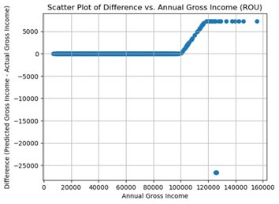
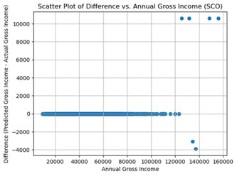
RESULTS
Overall margin error: 0.23%​
ROU: Margin error: 0.26% More accurate for gross below 100,000
Sco: Margin error: 0.11% More accurate for gross below 125,140

Slide 5
LIMITATIONS
Updates in Tax Brackets can cause tedious work to update static math in the function.
How to solve? Using advance models that find trends from data through initial training.
Deductions - pension payments ,student loans, dividend not considered.
How to solve? Utilizing richer data from individuals’ daily bank transactions over time
Unique sets of individuals such as Self-employed persons into consideration.
How to solve? More attributes to consider while analyzing and training.

Slide 6
FUTURE WORK
Utilise clustering machine learning algorithms on transactions data to foster the identification of distinct groups individuals in the dataset.
Develop a more robust and reusable solution that makes use of ML linear regression techniques to understand the underlying patterns in the data and make more accurate predictions using intricate features.

Slide 7

Thank you, we’re happy to address your questions!

