Slide 1
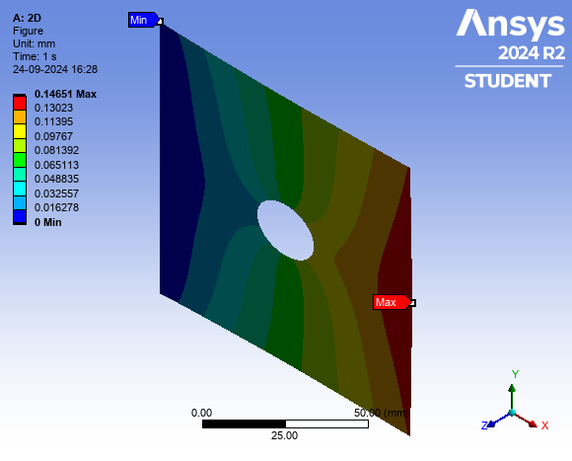
Stress and Deformation Report
Input Features | Values
Thickness (mm) | 5.0
Diameter (mm) | 20.0
Force (N) | 50000.0
Material | Aluminium
Max Stress (MPa) | 13.56
Min Stress (MPa) | 329.98
Max Deformation (mm) | 0.06

