Slide 1
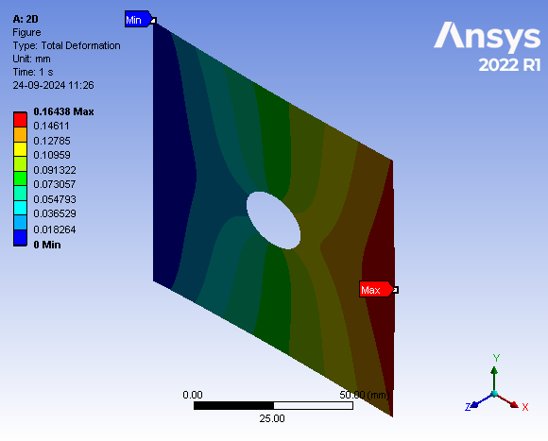
Stress and Deformation Report
Features | Values
Thickness (mm) | 5
Diameter (mm) | 20
Force (N) | 51000
Material | Aluminum
Max Stress (MPa) | 13.56
Min Stress (MPa) | 329.98
Max Deformation (mm) | 0.06

