Slide 1
AJAX
by Anton Hryshko

Slide 2
What is AJAX?
AJAX = Asynchronous JavaScript And XML.
AJAX is not a programming language.
AJAX just uses a combination of:
A browser built-in XMLHttpRequest object (to request data from a web server)
JavaScript and HTML DOM (to display or use the data)

Slide 3
Purpose
AJAX allows web pages to be updated asynchronously by exchanging data with a web server behind the scenes. This means that it is possible to update parts of a web page, without reloading the whole page.

Slide 4
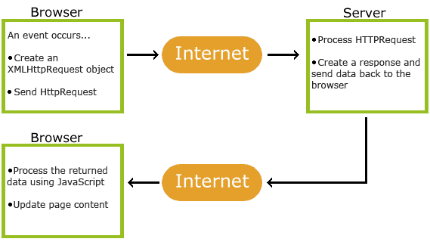
How AJAX Works

Slide 5
Purpose
1. An event occurs in a web page (the page is loaded, a button is clicked)
2. An XMLHttpRequest object is created by JavaScript
3. The XMLHttpRequest object sends a request to a web server
4. The server processes the request
5. The server sends a response back to the web page
6. The response is read by JavaScript
7. Proper action (like page update) is performed by JavaScript

Slide 6
The XMLHttpRequest Object
The keystone of AJAX is the XMLHttpRequest object.
All modern browsers support the XMLHttpRequest object.
The XMLHttpRequest object can be used to exchange data with a web server behind the scenes. This means that it is possible to update parts of a web page, without reloading the whole page.

Slide 7
Create an XMLHttpRequest Object
All modern browsers (Chrome, Firefox, IE7+, Edge, Safari, Opera) have a built-in XMLHttpRequest object.
Syntax for creating an XMLHttpRequest object:
var xhttp = new XMLHttpRequest();

Slide 8
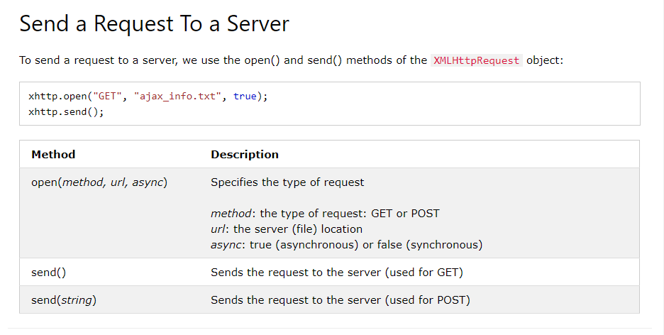
AJAX - Send a Request To a Server
The XMLHttpRequest object is used to exchange data with a server.

Slide 9
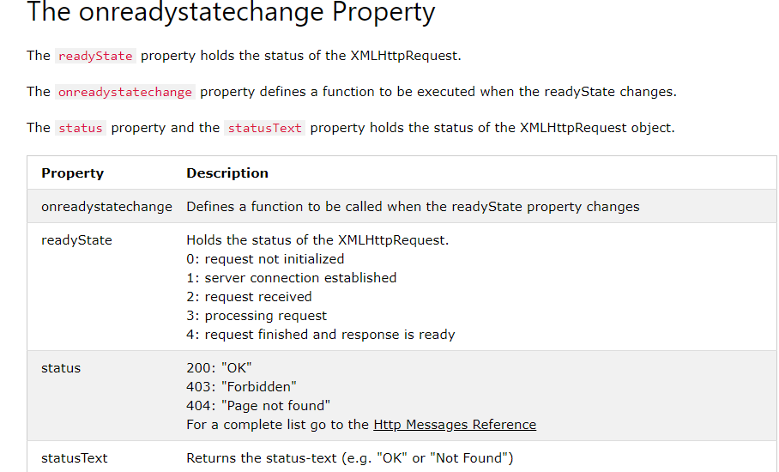
AJAX - Server Response

Slide 10
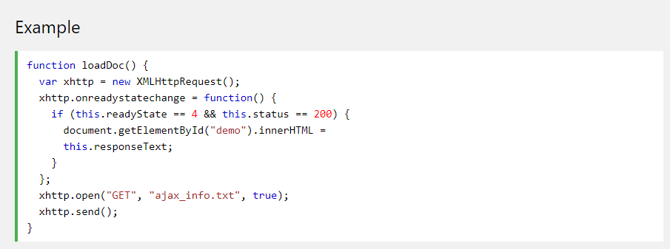
Example

Slide 11
Fetch
The fetch() method is modern and versatile, so we’ll start with it. It’s not supported by old browsers (can be polyfilled), but very well supported among the modern ones.
The basic syntax is:
let promise = fetch(url, [options])
url – the URL to access.
options – optional parameters: method, headers etc.

Slide 12
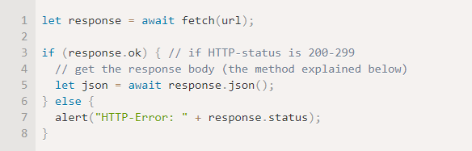
Fetch

Slide 13


