Slide 1

PROCODERS
S
TEAM LEADER : HARSH VERMA
TEAMMATES : CHAITANYA GUPTA | CHAITANY RAGHAV | DHAIRIYA MODI

Slide 2







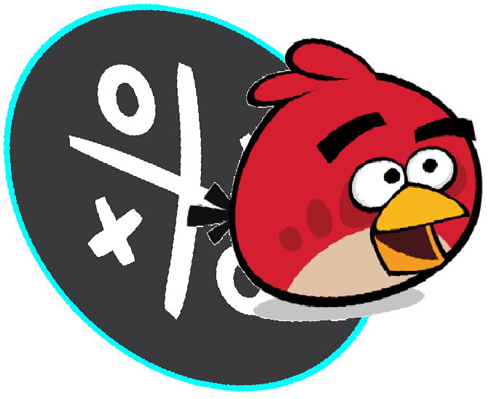
ARCADEERS
DOTS & BOXES
S PAC-MAN
TANK MAZE
SNAKES
R SUDOKU
TANKS
ANGRY TICTACTOE

Slide 3

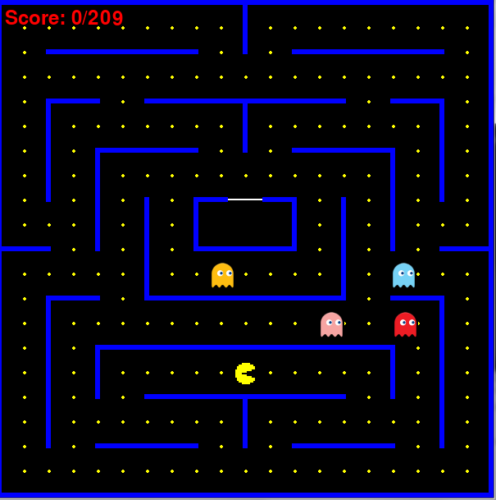
PAC-MAN
Pac-man, our hero, munches his way around the room , eating all the pacdots .
There are ghosts roaming in the same room.
Pac-man needs not to get touched by these ghosts.

Slide 4
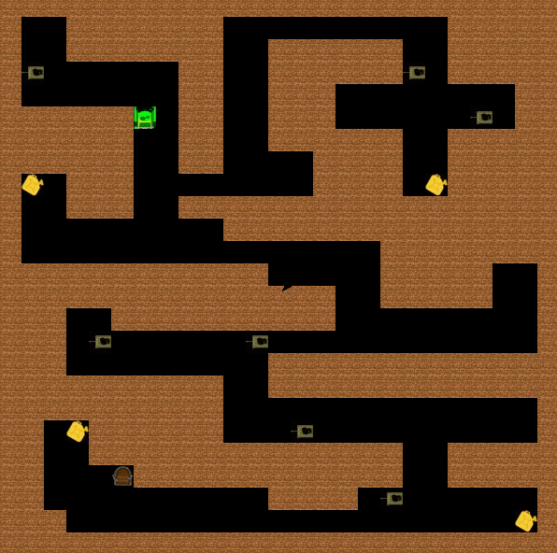
TANK MAZE
Don’t get touched enemy tanks , this would lead to decrease your tank’s health.
There are various fuel tanks that would increase your tank’s heath.
You are supposed to reach final door to complete the level.

Slide 5
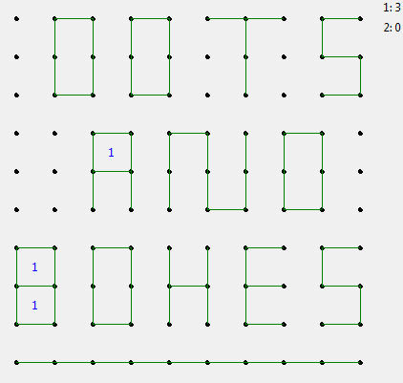
DOTS $ BOXES
On each turn, click between two horizontally or vertically adjacent dots to draw a line.
Drawing the 4th wall of a box wins it, earning you a point and gives another chance to move again.
Lines are drawn until ll squares are claimed. The player wins with most claimed square wins

Slide 6
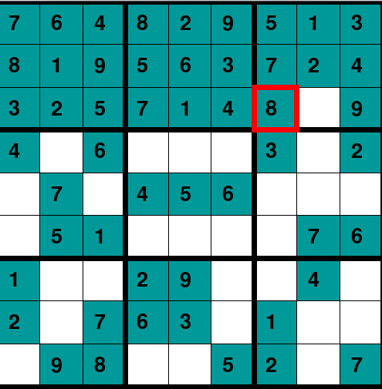
SUDOKU
Only use the number 0 to 9.
Only use each number once in each row, column and grid.
Use the process of elimination as a tactic.
Completion of all grids leads to game win.

Slide 7

ANGRY TIC TAC TOE
The game is played in 3X3 grid .
You and your friend are given two different angry birds . Each player take their turn to fill empty grids.
The first player to get 3 of his marks in a row(horizontally , vertically or diagonally)will win .

Slide 8
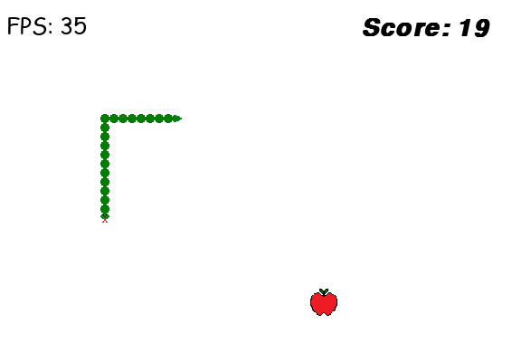
SNAKES
Snake moves at a constant speed and is allowed to move in only East, West, North and South.
Snake eats an apple and gets longer
Game continues until snake dies.
Snake dies by either , running into the edge of the board , or , running into it’s own tail.

Slide 9
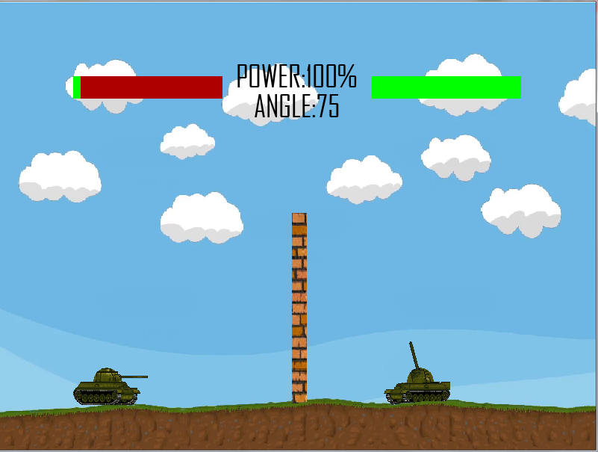
TANKS
Its time for a death battle! Though the wall may part you two the projectiles can still hit the other.
Use your knowledge of projectiles to get the perfect power, angle and position and attack your enemy.
Because of obvious reasons, the one to die first loses. (You better survive!)

Slide 10

LIBRARIES/MODULES USED IN THE PROJECT
Time
Random
Copy
SqLite3
Math
PyGame
Turtle
Tkinter
_thread
os
Programming Language:
PYTHON

Slide 11

THANK YOU

