Slide 1

University Students Struggle to Find Internships and Jobs.
A problem we are all familiar with

Slide 2
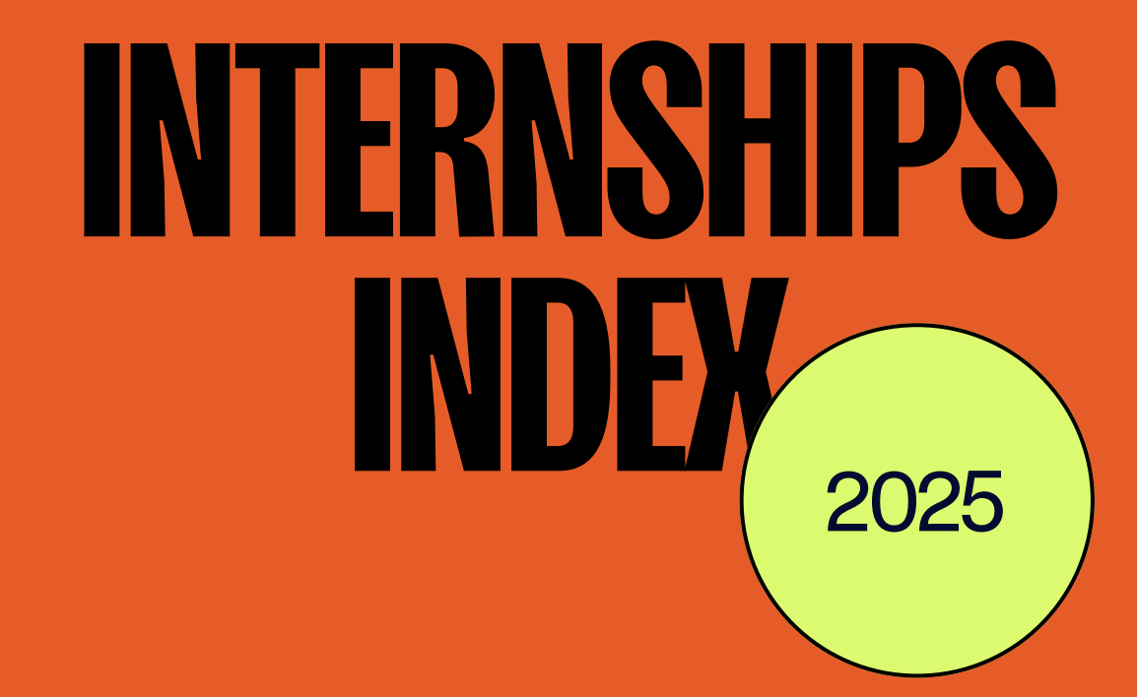
The 2025 Handshake Internship Index.
Internship and job search website Handshake created a comprehensive report pulling from over 6,400 students with user data of over 15 million students and 900,000 employees.
Research Found…

Slide 3
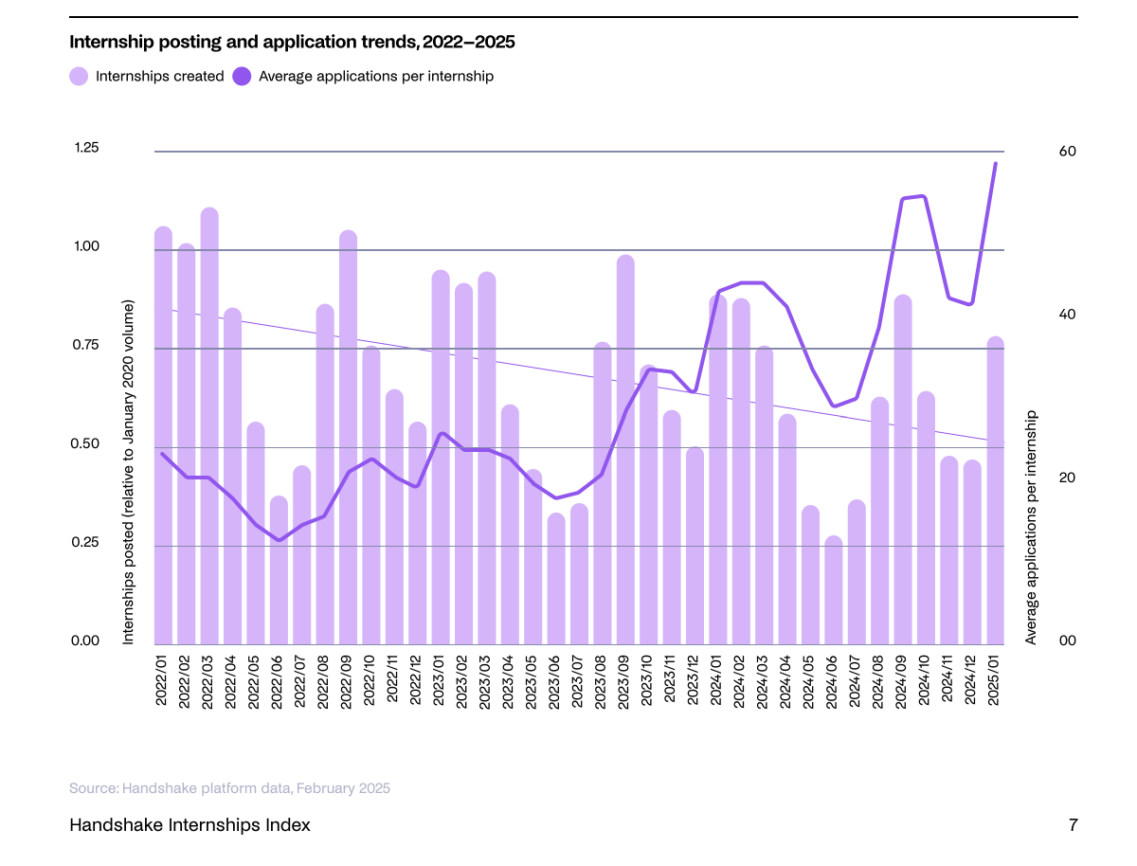
It Is Harder Than Ever to Find an Internship.
“Internship postings on Handshake dropped over 15% between January 2023 and January 2025. But as of January of this year, internship applications for the Class of 2025 rose to 41%” (2)

Slide 4
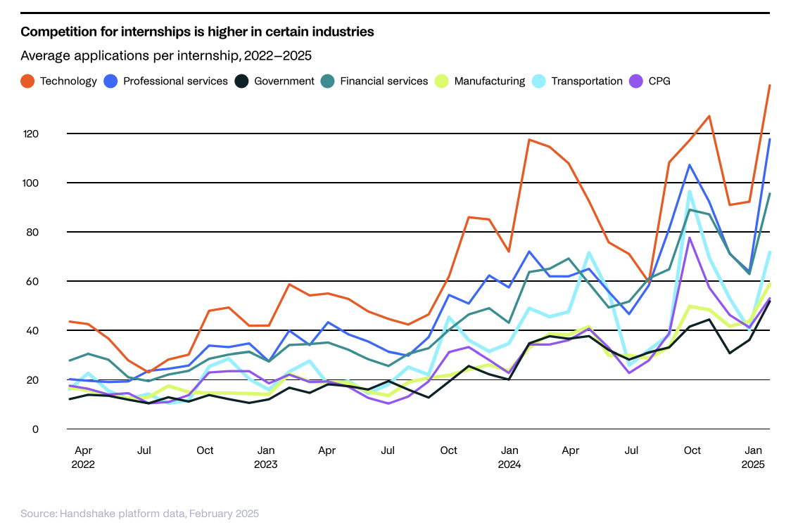
Competition for Internships is Tough.
“Internships in technology and professional services receive about twice as many applications compared to the overall average, and internship postings in both industries have dipped by more than 30%” (1)

Slide 5
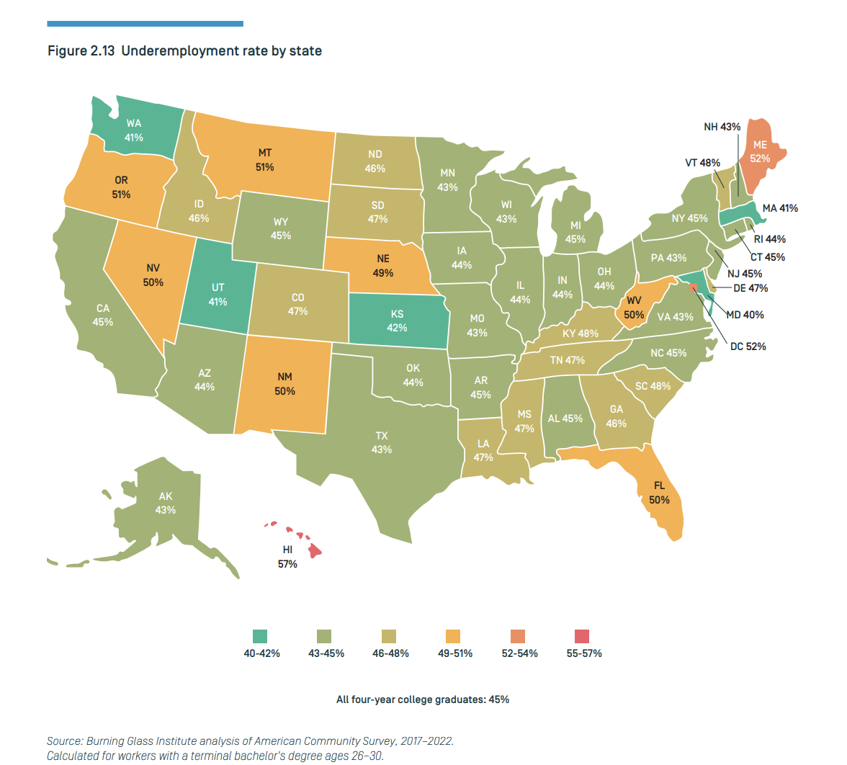
It is Even Harder to Find a Job.

Slide 6
A Degree is no Longer a Guarantee.
38% of employers avoid hiring recent college graduates. Around 58% of managers, directors and executives in the United States say this cohort is unprepared for the workforce. (4)
Today, only about half of bachelor’s degree graduates secure employment in a college-level job within a year of graduation (5)

Slide 7

Introducing TWIN!
Swipe for Success

Slide 8
Works Cited
Handshake. (2025). Handshake internships index 2025. Handshake. https://joinhandshake.com/
WorkingNation. (2025, April 17). Report: Vying for college internships is getting tougher. https://www.workingnation.com/report-vying-for-college-internships-is-getting-tougher
American Council on Education. (2025, March 3). The changing landscape of internships in higher education. Higher Ed Today. https://www.higheredtoday.org/2025/03/03/the-changing-landscape-of-internships-in-higher-education
Kelly, J. (2024, February 15). Why is it so hard for recent college graduates to find a decent job? Forbes. https://www.forbes.com/sites/jackkelly/2024/02/15/why-is-it-so-hard-for-recent-college-graduates-to-find- a-decent-job/
Burning Glass Institute. (n.d.). Underemployment: The long-term effects on careers. https://www.burningglassinstitute.org/research/underemployment?utm_source=chatgpt.com

