Slide 1
Embedded Systems
Final Project

Slide 2
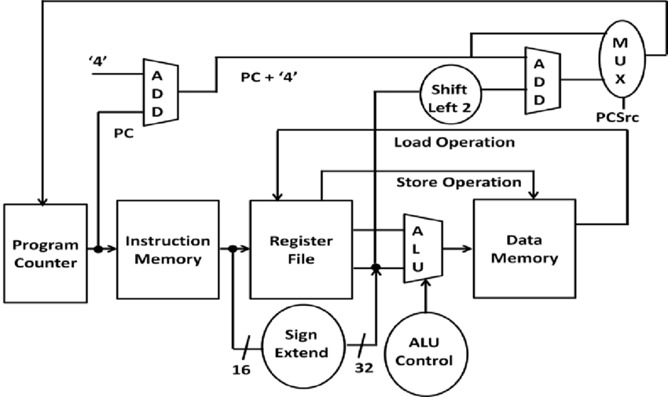

16 bit MIPS Processor
A RISC Processor
16 bit, single cycle
Instruction Set Architecture

Slide 3
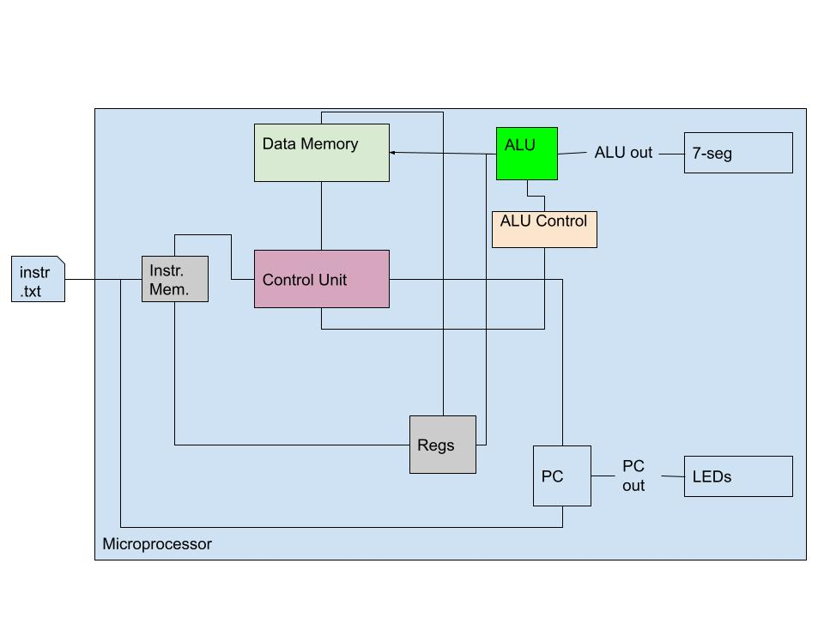
Block Diagram
Will be coded in Verilog
Designed to run on DE-SoC fpga
A potential architecture of the system is displayed on the right

Slide 4
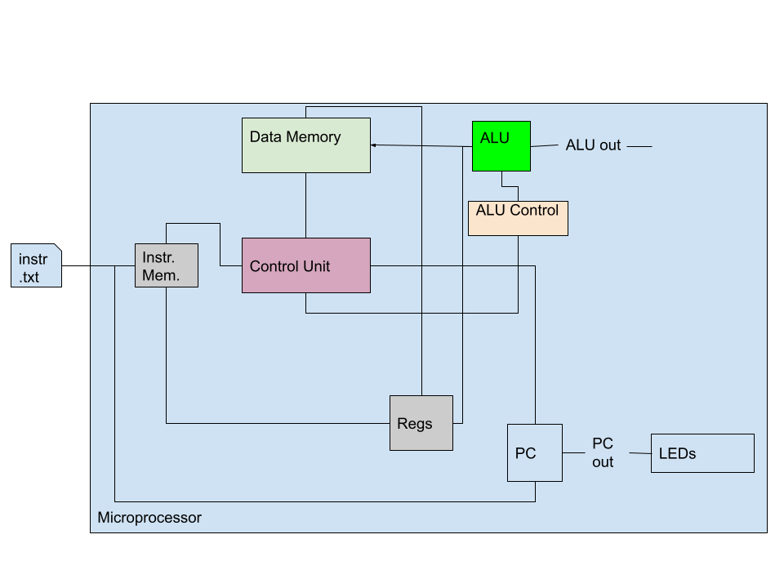

Slide 5
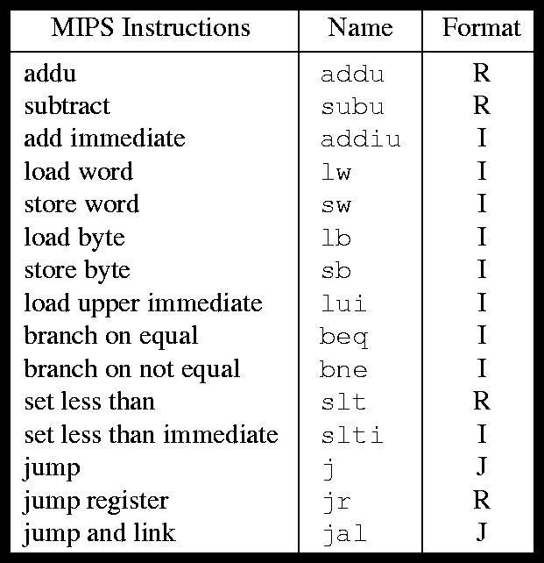
Example MIPS Instructions
We will implement an assembler using a programming language.
It will take assembly code in text file and provide instructions in machine code.

Slide 6
Further Implementations
If we are able to fully implement a single cycle MIPS by the deadline, We would try to implement pipelining.
This would enable the system to carry out multiple instructions on the same cycle.

