Slide 1
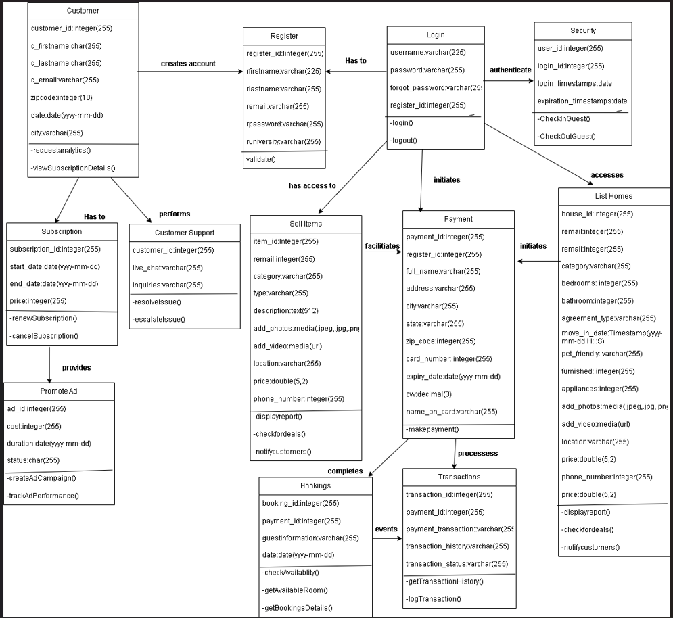
UML Class Diagram
Application Name: Bargain Hunter

