Slide 1


Automatic Detection Of COVID-19 Using Convolutional Neural Networks And X-Ray Images
UNIVERSITÉ MOHAMMED V - Rabat
Ecole Nationale Supérieure d'Informatique et d'Analyse des Systèmes
Master de Recherche
Cloud And High Performance Computing
Master Thesis Dissertation
Realized By : AHSAINE Khadija
Pr. OUACHA Ali FSR President
Pr. EZ-ZAHOUT Abderrahmane FSR Examiner
Pr. ZBAKH Mostapha ENSIAS Supervisor
Pr. TADONKI Claude Mines ParisTech Supervisor
Academic Year : 2020- 2021
Notes:
Hello everyone, I hope you're doing good, I'm here today to defend my end of study thesis, first I would like to thank you for being here and taking time to evaluate my work, a special thanks to Mr Zbakh for supervising me and mentoring me during my research

Slide 2
Problematic
PCR
Availability
Time-consuming

Slide 3
Solution
CNN
Reliable
Fast

Slide 4
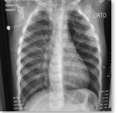
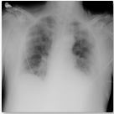
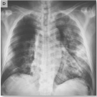
Architecture
Chest X-Ray Images
Pre-Processing
Load Pre-Trained Model
Training Process
Classification Phase
Split Data
Covid-19
MobileNet
InceptionV3
ResNet50
EfficientNetB0
InceptionResNetV2
VGG16
Resize Data (244*244)
Fully Connected Layer with ReLU (128)
Fully Connected Layer with Softma)
MaxPolling2D (2,2)
Flatten
Normal
Data Augmentation
Viral Pneumonia

Slide 5
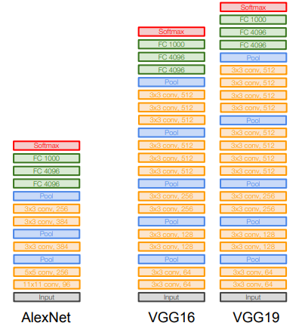
VGG16
Small filters, Deeper networks
Notes:
the VGGNet used smaller filters of 3×3, opposed to AlexNet 11×11 filter

Slide 6
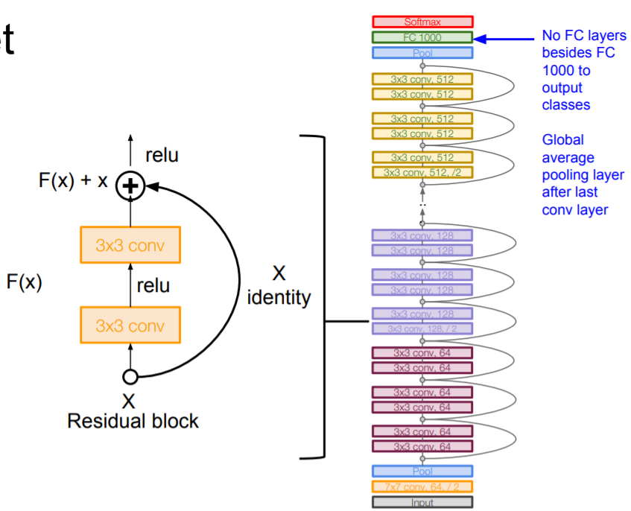
ResNet50
The use of residual layers
Skip connections to solve the problem of vanishing gradients
Vanishing gradients: stopping the weights in the network to further update/change because the gradient value shrink to zero
Notes:
ResNet
ResNet architectures are suggested by He et al. [15] from Microsoft and won 2015 ILSVRC. The main innovation in ResNet architectures is the use of residual layers and skip connections to solve the problem of vanishing gradients that may result in stopping the weights in the network to further update/change. This is mainly a problem in deep networks because the gradient value can vanish, i.e., shrink to zero, when several chain rules are applied consecutively. Skipping connections will help gradients flow backward directly from end layers to initial layer filters enabling CNN models to deepen with 152 layers.

Slide 7
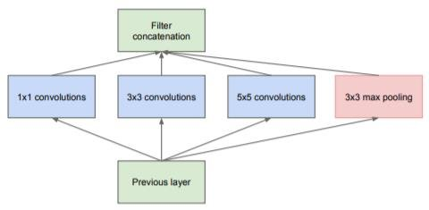
InceptionV3
The use of inception blocks
InceptionV1 proved to be more computationally efficient
Any changes in the Inception network need to assure computational advantages
Adaptation of the model
InceptionV3
Several techniques has been used:
Problem
Solution
Dimension reduction
Regularization
Parallelized computations
Notes:
InceptionNet
Inception network or GoogLeNet is the winner in the 2014 Image net challenge with 93.3% top-5 accuracy. It was a 22-layer network [17], and it has proved to be more computationally efficient, both in terms of the number of parameters generated and the resources consumed by the network. Any changes in the Inception network need to assure computational advantages; therefore, the adaptation of the model for different use cases turns out to be a problem due to the uncertainty of the new network’s efficiency. Inception v3 architecture suggested several techniques for optimizing the network to loosen the constraints for easier model adaptation, among these techniques: factorized convolutions, regularization, dimension reduction, and parallelized computations [18].
Applies several filters in parallel on the output of the previous layer:
- Several filter sizes (1x1, 3x3, 5x5)
- Pooling operation (3x3)
Concatenates all filter outputs

Slide 8
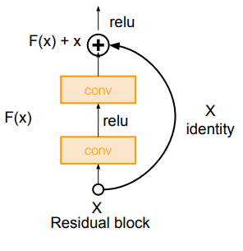
Inception-ResNetV2
Combining the idea of inception blocks and residual layers
Notes:
Inception-ResNetV2
Inception-ResNetV2 was proposed by Szegedy et al. [19] in 2016, combining the idea of inception blocks and residual layers. The purpose of using residual connections is to prevent the problem of degradation caused by deep networks and reduce the training time. The InceptionResNetV2 model used here contains 20 Inception-ResNet blocks that empower the network to become 164 layers deep, and we use the pre-trained weights in these layers to assist our mission of detecting COVID19 in X-Ray images [3].

Slide 9
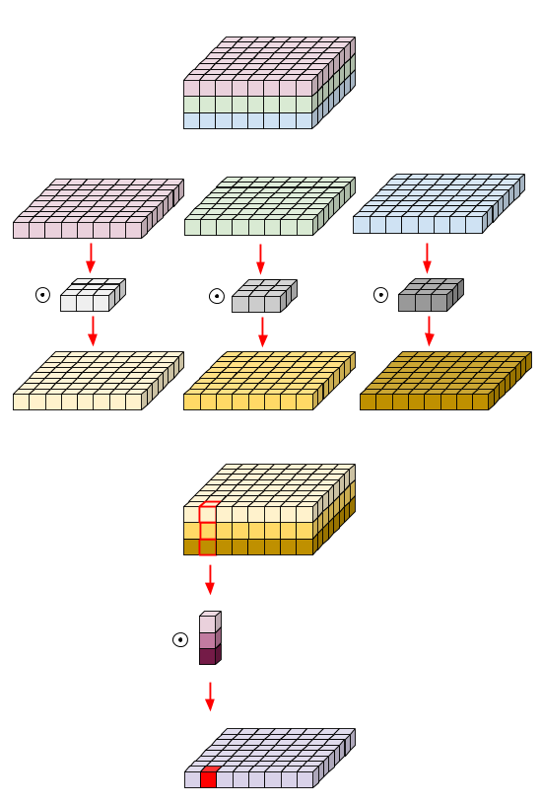
MobileNet
MobileNet model is designed to be used in mobile applications
It uses “Depthwise Convolutions” and “Pointwise Convolution”
Reduce the number of parameters
Notes:
As the name applied, the MobileNet model is designed to be used in mobile applications, and it is TensorFlow’s first mobile computer vision model. MobileNet uses depthwise separable convolutions. It significantly reduces the number of parameters compared to the network with regular convolutions with the same depth in the nets. This results in lightweight deep neural networks.

Slide 10
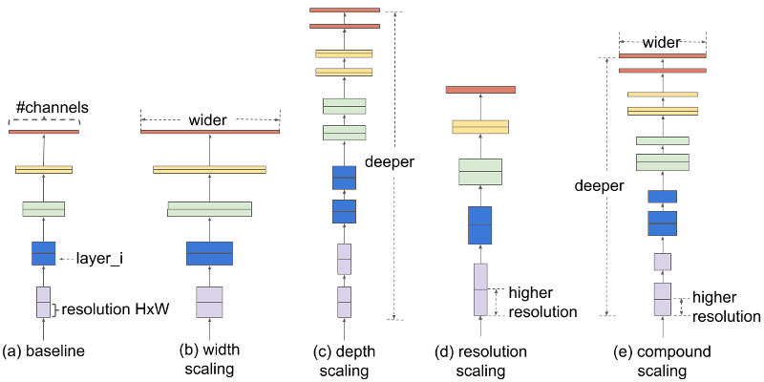
EfficientNetB0
Introduces a new principle method to scale up ConvNets
Scaling-up Methods:
Depth
Width
Image resolution
Notes:
The paper [20] released by Google introduces a new principle method to scale up ConvNets. To get better accuracy, CNN needs to have a careful balance between depth width and resolution. However, the scaling-up process of ConvNets has never been understood. The most common way was to scale up ConvNets by their depth or width. Another less common method was to scale up models by image resolution. So far, we only scale one dimension at a time [21]. There are eight alternative versions of EfficientNet (B0 to B7), and even the simplest one, EfficientNetB0, is outstanding. It achieves a 77.1% Top-1 accuracy performance With 5.3 million parameters.
go more deeper in the network
using more covolontion channel

Slide 11
Dataset
Feed the network with the same number of images per class
All images were resized to 224x224 pixel size in the datasets.
Covid-19 | Normal | Viral Pneumonia
1345 | 1345 | 1345
80%
Training
Flipping
Splitting Data
Data augmentation
Zooming
20%
Testing
Resizing
Notes:
Feed the network with the same number of images per class to prevent the unbalanced data set problem
data augmentation to training set

Slide 12





Experimental Setup
Machine Name | Supermicro X11
Operating System | Windows 10 Professionnel 64-bit
Processor | Intel(R) Core(TM) i7-8700
Cores | 6
Threads | 12
RAM | 16 GB
Graphic Card | NVIDIA GeForce RTX 2070 SUPER
VRAM | 8 GB
Disk | 1000 GB (HDD) 256 GB (SSD)
Adam optimizer
30 epochs
batch size=256

Slide 13
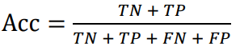




Metrics
Accuracy:
Precision:
Recall:
Specificity:
F1-Score:

Slide 14
Results
Classification Model | Performance Metrics
 | Accuracy (%) | Precision (%) | Recall (%) | F1-Score (%) | Specificity (%) | Training Time (s)
MobileNet | 96.05% | 96% | 96% | 96% | 98.02% | 120.83
InceptionV3 | 89.34% | 89.33% | 89.33% | 89.33% | 94.67% | 131.87
ResNet50 | 95.04% | 95% | 95% | 95.33% | 97.52% | 126.98
EfficientNetB0 | 94.92% | 95% | 95% | 95% | 97.46% | 125.33
InceptionResNetV2 | 89.59% | 90,33% | 89.67% | 89.67% | 94.78% | 142.89
VGG16 | 95.29% | 95.33% | 95.33% | 95.66% | 97.64% | 124.64

Slide 15
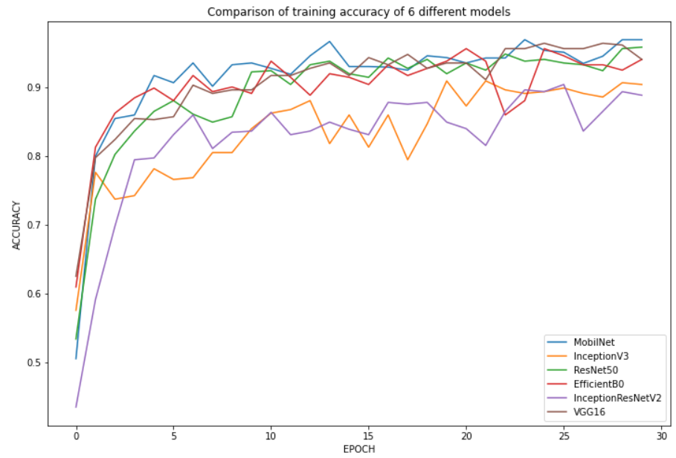
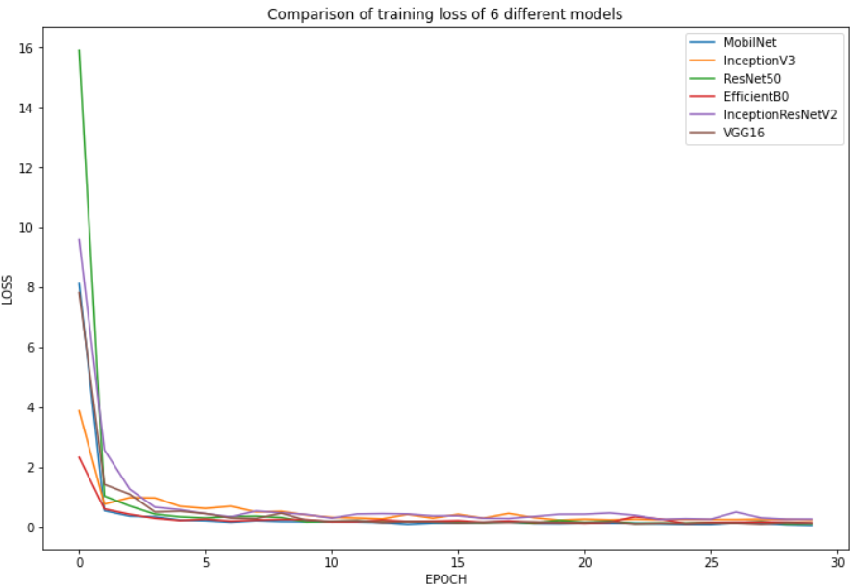
Results
Notes:
30epochs

Slide 16
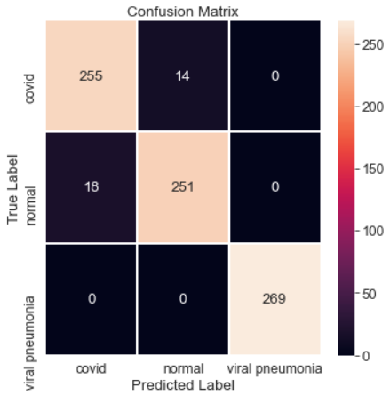
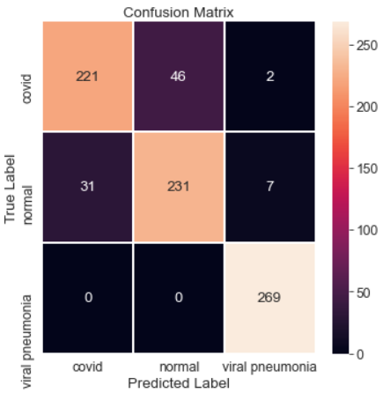
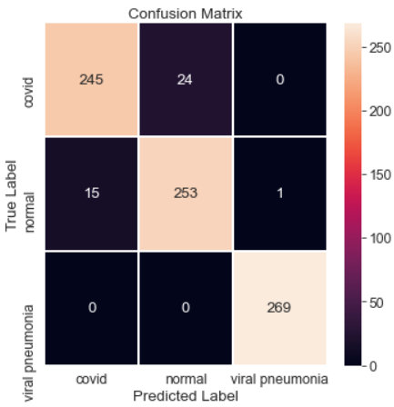

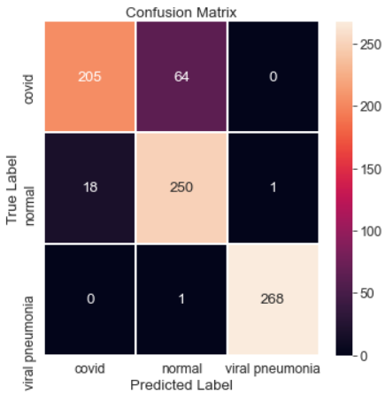
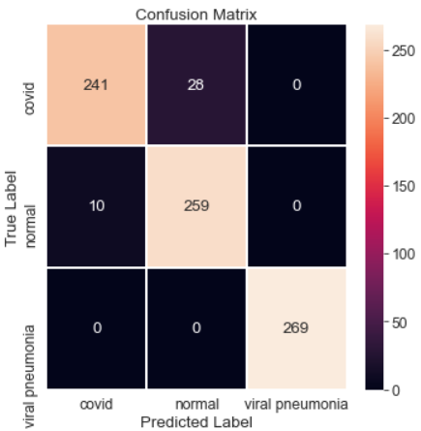
Results
MobileNet
InceptionV3
ResNet50
EfficientNetB0
InceptionResNetV2
VGG16

Slide 17
Conclusion
MobileNet acheived better performance (96.05% accuracy) than the other models
Small + low-latency => Real-Time applications => produce good results in a short time and less number of epochs
VGG16 utilize small filters (3x3)
EfficientNetB0 achieve good accuracy thanks to the compound scaling method
InceptionV3 and InceptionResNetV2 had more complex architecture => more epochs to be trained
Notes:
MobileNet acheived better performance (96.05% accuracy) than the other models because it is a Small + low-latency model designed for mobile applications that are Real-Time so it was able to produce good results in a short time and less number of epochs
VGG16 holding 2nd place because it uses small filters (3x3) that reduce the number of parameters to be trained
EfficientNets is a family of eight models which achieve good accuracy thanks to the compound scaling method. The simplest one, EfficientNetB0, gives already satisfying
However InceptionV3 and InceptionResNetV2 had more complex architecture so it needs more epochs to be trained, as we can see in this graph the accuracy of InceptionV3 and InceptionResNetV2 is getting increased with time

Slide 18
Future Work
Using other CNN architecture and other type of radiography images (CT)
Detecting other diseases
Replacing fully connected layers with other classifier (SVM)
Parallelizing the training of convolutional neural networks

Slide 19

THANK YOU

