Slide 1
PROJECT – HIREBOT A DATA DRIVEN BOT

Slide 2
INTRODUCTION OBJECTIVE: To Screen & Hire candidates and reduce time spent 5 times by the use of chat bot and automating the stuff with Machine Learning and Natural Language Processing. PROBLEM STATEMENT: For screening and hiring a candidate, it takes normally 7 – 15 Business days and when it comes to evaluation, some profiles are giving false information.

Slide 3
SOLUTION By the use of machine learning and NLP screen and hire the candidate based on similarity difference between the job description and resumes. Finally evaluate the profiles by their online forums like stack-overflow, github, linkedin, twitter etc., 2 – Phases Candidate phase Recruiter phase

Slide 4
RECRUITER PHASE

Slide 5
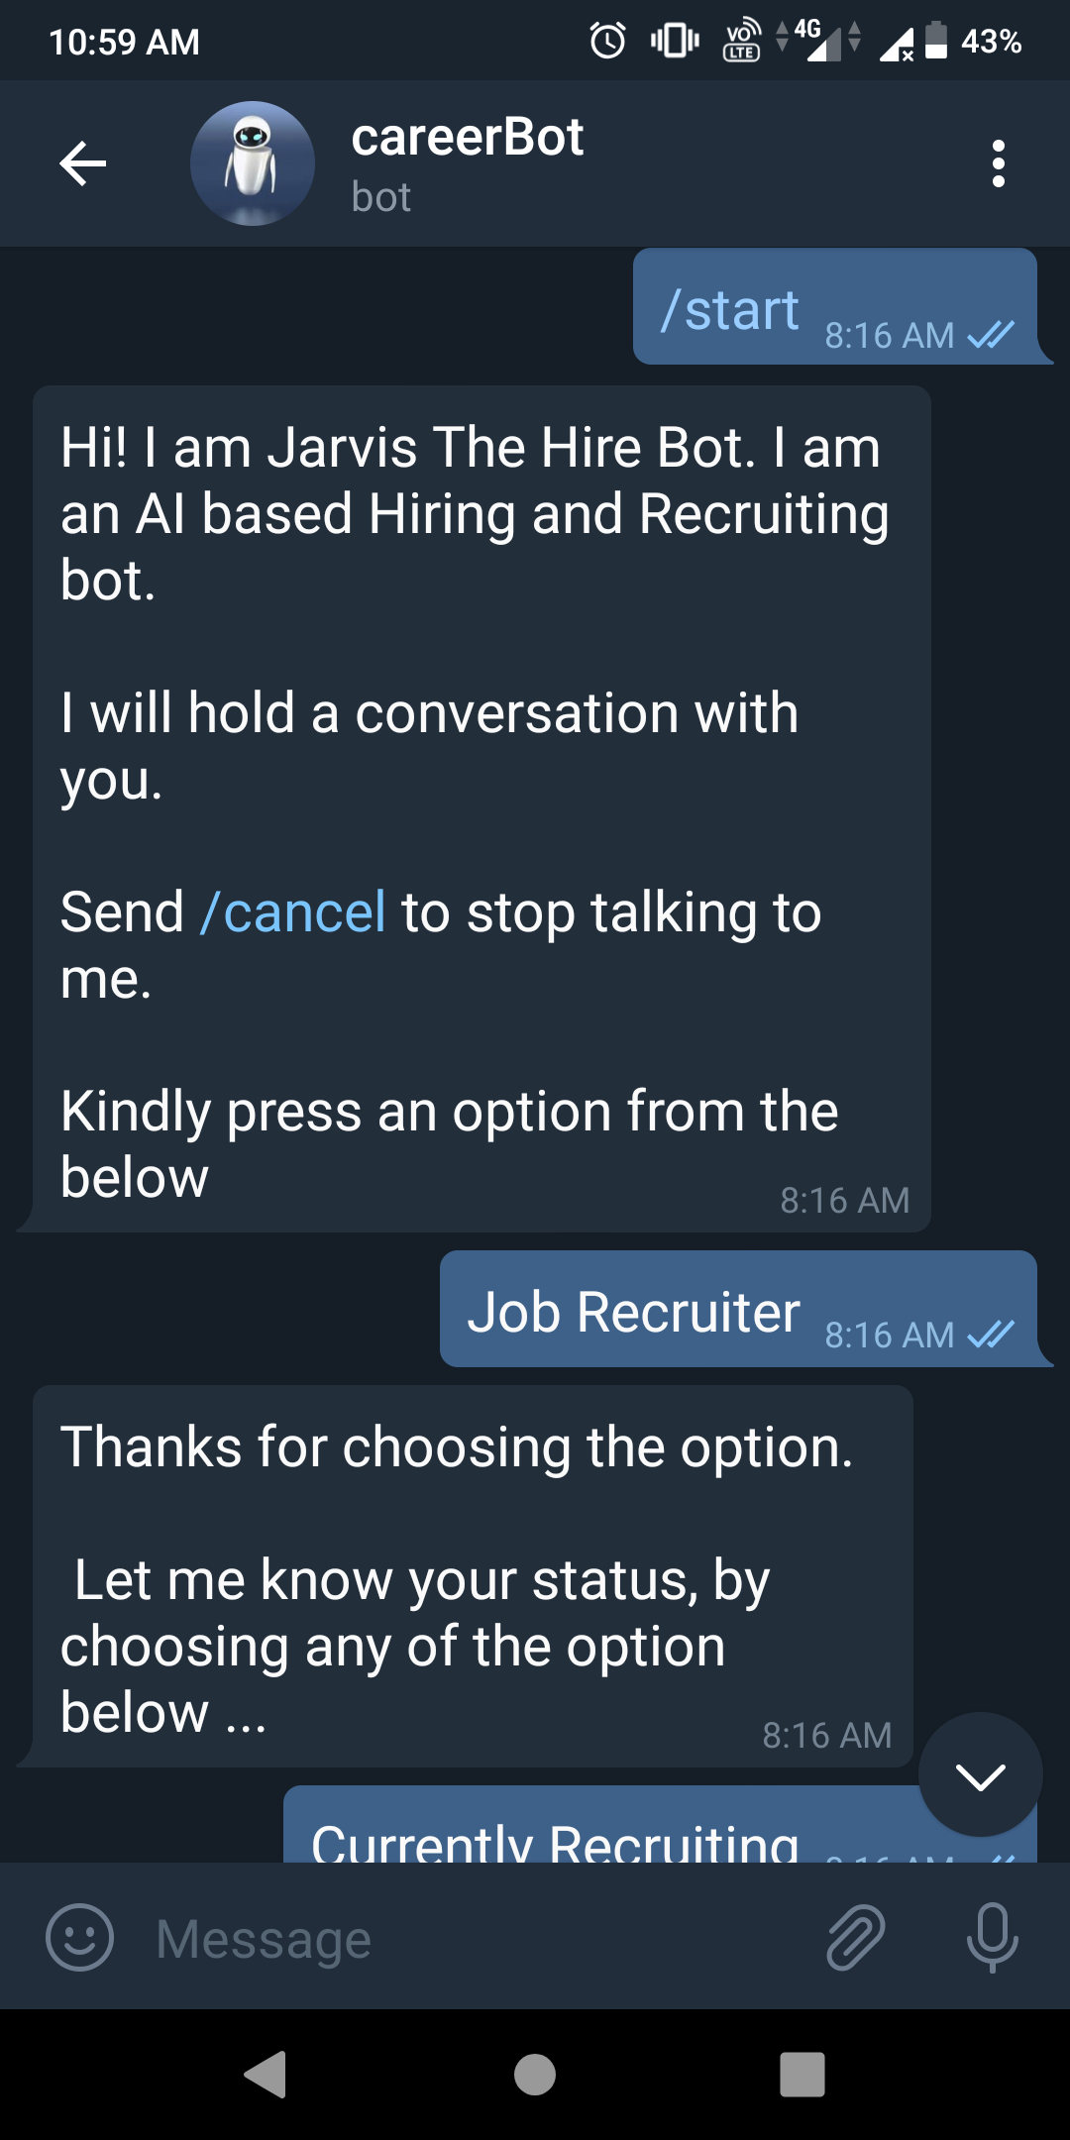
Demo

Slide 6
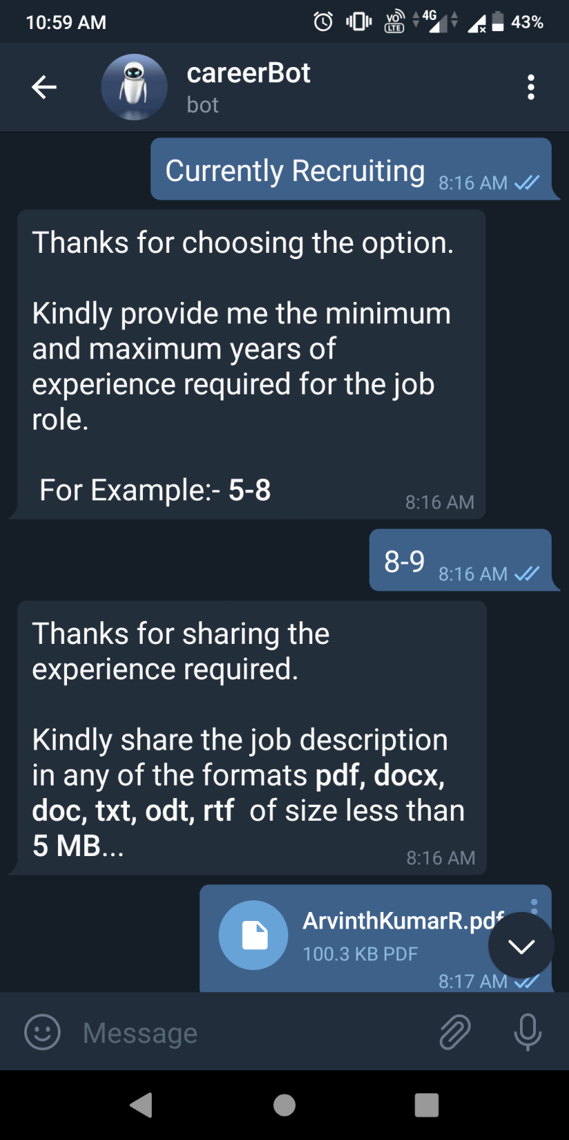

Slide 7
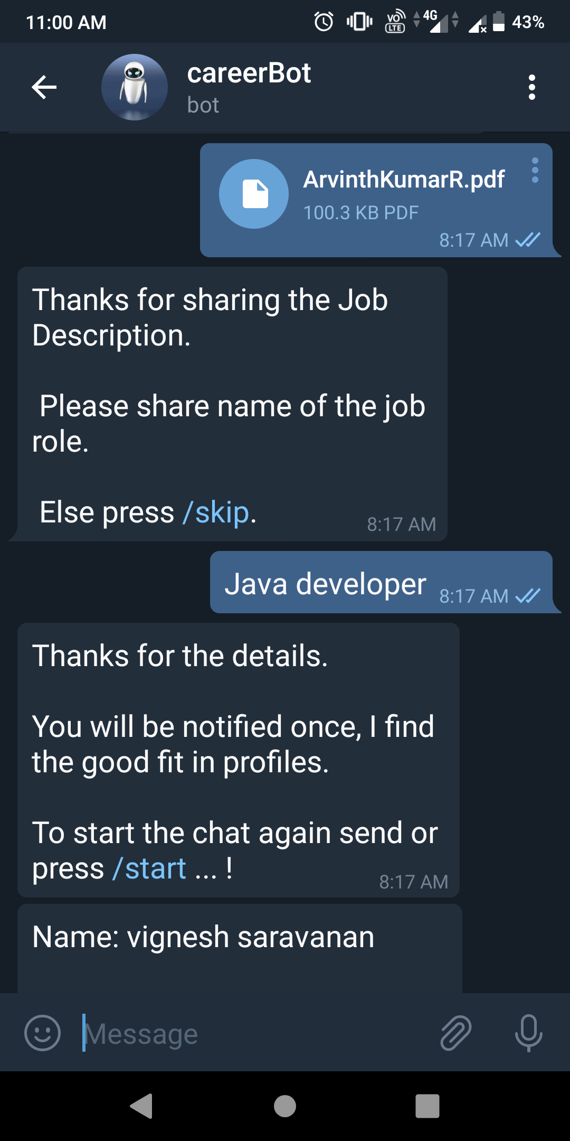

Slide 8
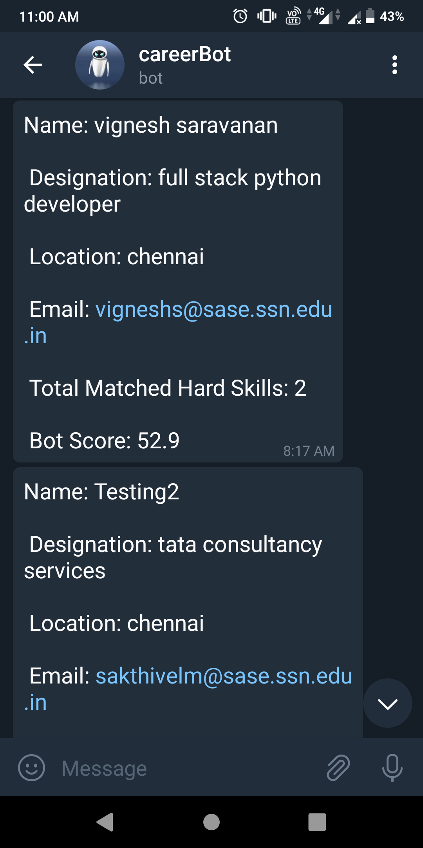

Slide 9
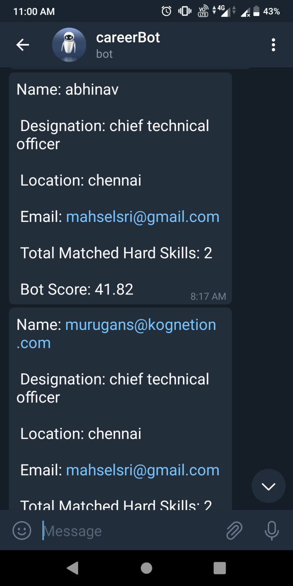

Slide 10
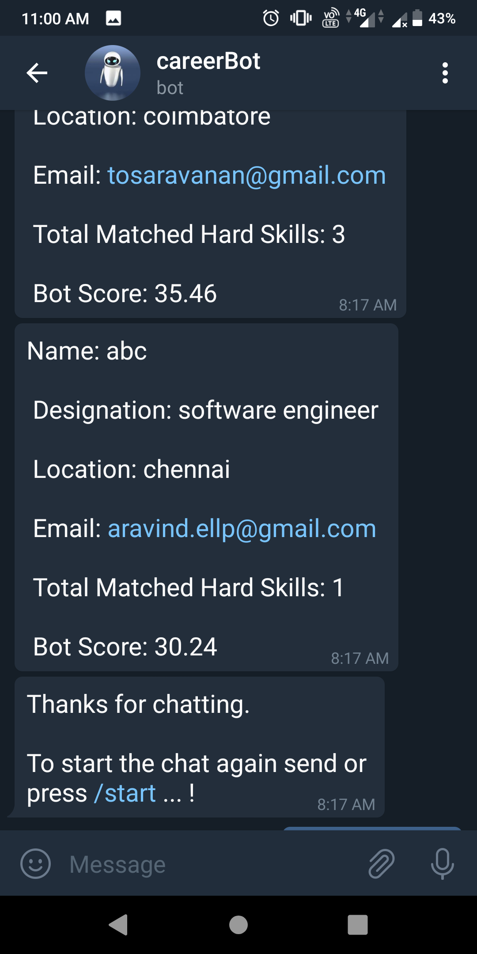

Slide 11
CANDIDATE PHASE

Slide 12
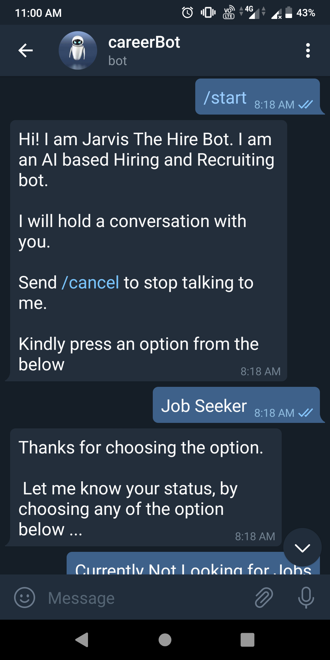

Slide 13
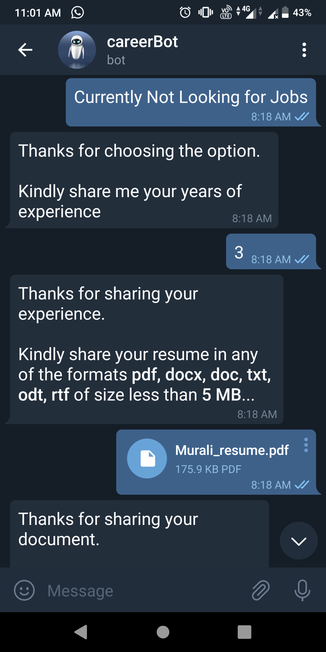

Slide 14
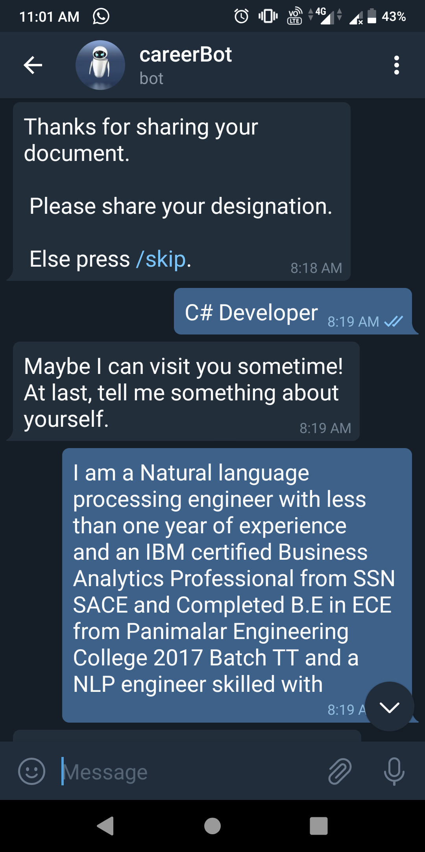

Slide 15
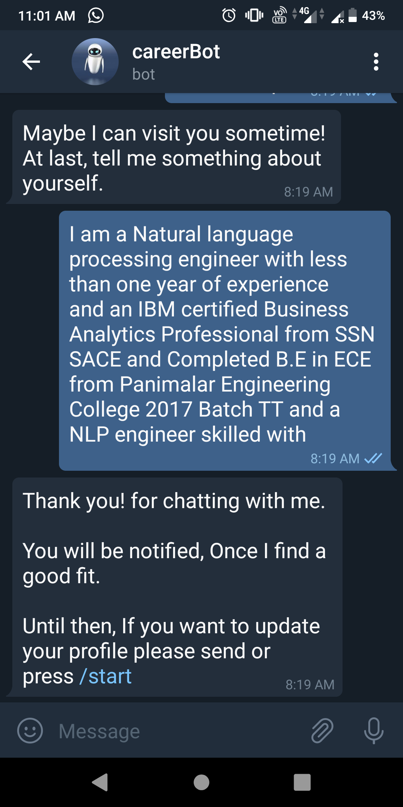

Slide 16
Features: 1. Similarity matching between resumes and job description 2. Recommendation Engine 3. Profile Evaluation with online forums 4. Reduced Hiring time 5. Easy Communication

Slide 17
Technologies Used: Python 3.X Telegram bot mongoDB S3 / Google Drive / external storage device Sklearn Spacy textract

Slide 18
Thanks you

