Slide 1
Dataiku Data Scientist Technical Assessment
F. Ege Hosgungor

Slide 2
OUTLINE
Introduction
Exploratory Data Analysis
Data Preparation
Data Modelling
Model Assessment
Results

Slide 3
INTRODUCTION
The Data:
US Census archive containing detailed, but anonymized, information for approximately 300,000 individuals.
Problem Statement:
Identifying characteristics that are associated with a person making more or less than $50,000 per year.

Slide 4
INTRODUCTION – Background Information
The United States Census Bureau leads the country’s Federal Statistical System
Responsible for collecting data every 10 years upon the American people and economy to help inform strategic initiatives
The data is also used for examining the demographic characteristics of population.

Slide 5
INTRODUCTION – Task Details
Binary Classification Task (Less Than $50,000 – More Than $50,000)
There are 200,000 training examples and 100,000 test examples (2/3 ratio)
Imbalance Data (Most of the data are example of just one class)

Slide 6
EXPLORATORY DATA ANALYSIS
There are 42 features in total, 35 nominal, 8 continuous including the label column.
Here are the ones that worked on most:
Age
Sex
Education
Occupation and Industry Codes
Income **

Slide 7
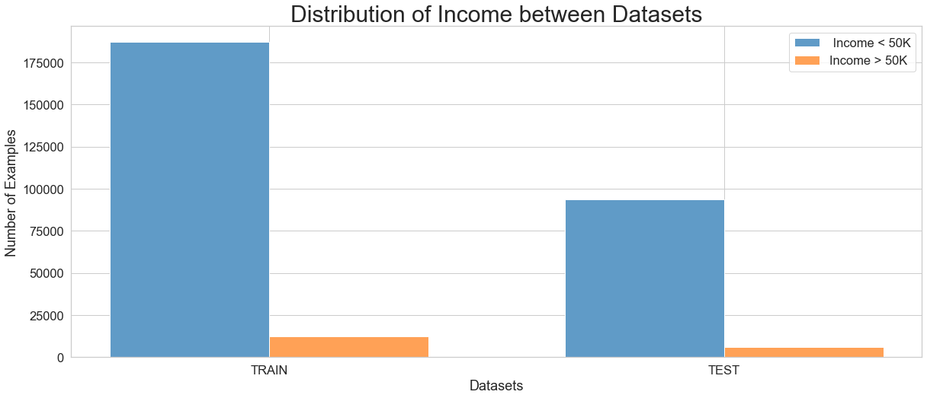
EXPLORATORY DATA ANALYSIS

Slide 8
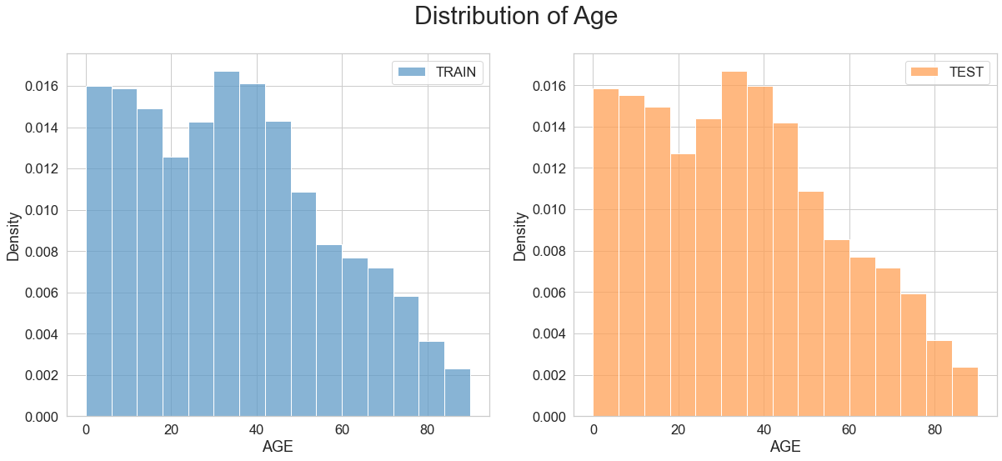
EXPLORATORY DATA ANALYSIS

Slide 9
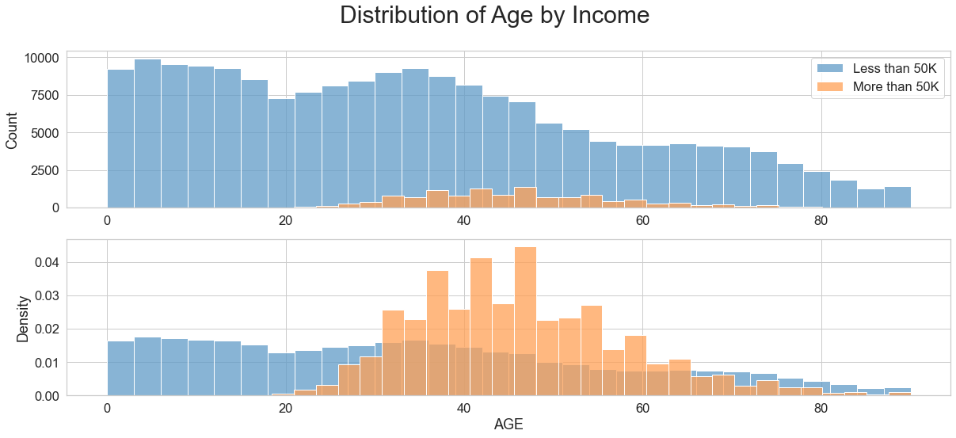
EXPLORATORY DATA ANALYSIS

Slide 10
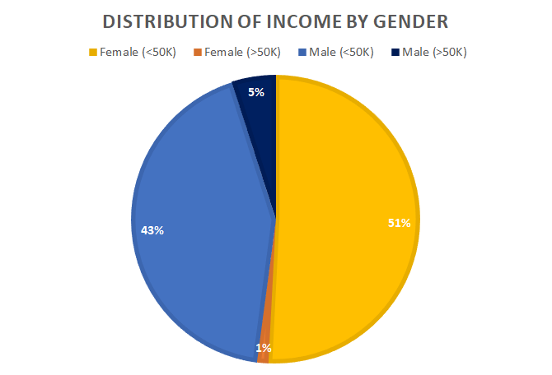
EXPLORATORY DATA ANALYSIS

Slide 11
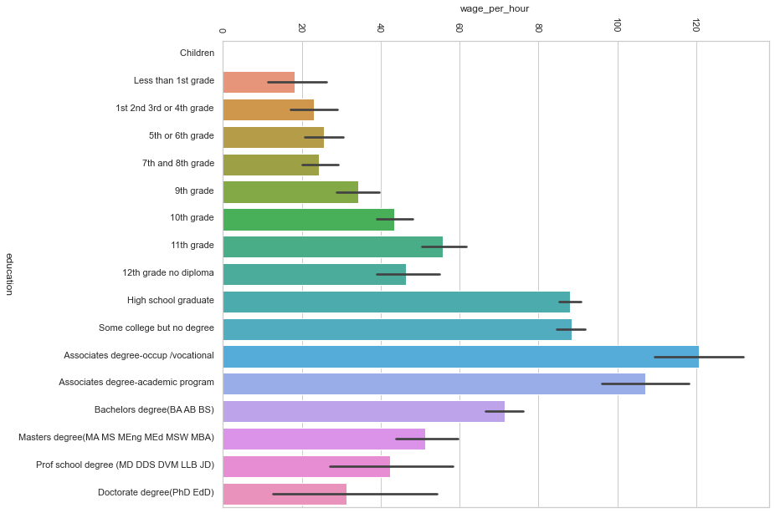
EXPLORATORY DATA ANALYSIS – Education VS Wage p. Hour

Slide 12
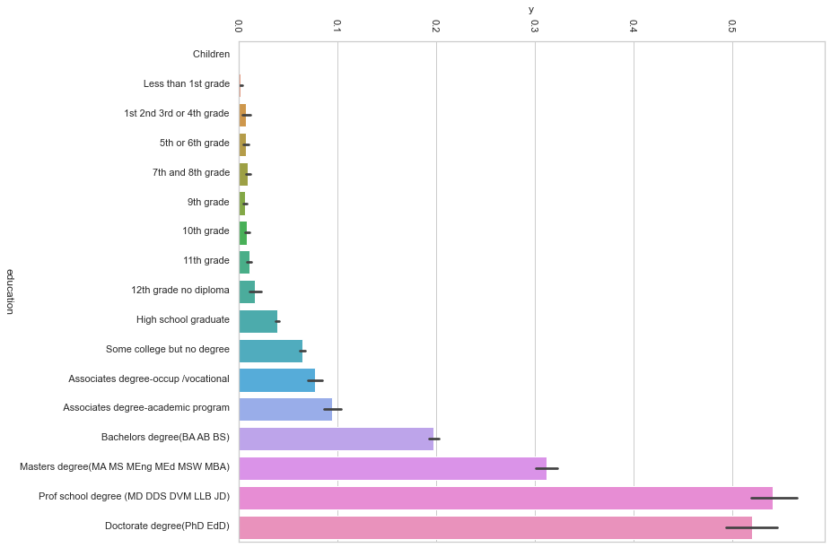
EXPLORATORY DATA ANALYSIS – Education VS Income

Slide 13
DATA PREPARATION

Slide 14
DATA MODELLING

Slide 15
MODEL ASSESSMENT

Slide 16
RESULTS

Slide 17
OUTLINE
F. Ege Hosgungor

