Slide 1
Dataiku Data Scientist Technical Assessment
F. Ege Hosgungor

Slide 2
OUTLINE
Introduction
Exploratory Data Analysis
Data Preparation
Data Modelling
Model Assessment
Results

Slide 3
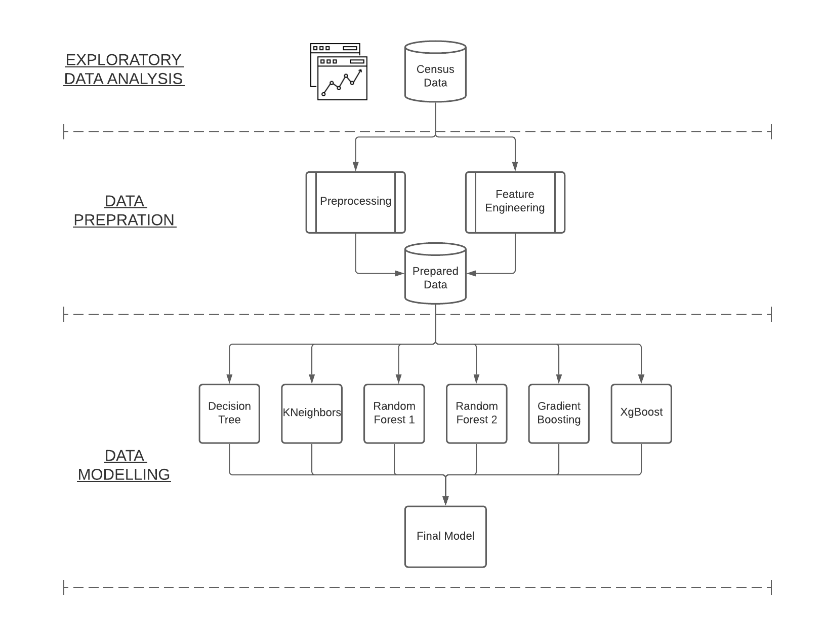
OUTLINE

Slide 4
INTRODUCTION
The Data:
US Census archive containing detailed, but anonymized, information for approximately 300,000 individuals.
Problem Statement:
Identifying characteristics that are associated with a person making more or less than $50,000 per year.

Slide 5
INTRODUCTION – Background Information
The United States Census Bureau leads the country’s Federal Statistical System
Responsible for collecting data every 10 years upon the American people and economy to help inform strategic initiatives
The data is also used for examining the demographic characteristics of population.

Slide 6
INTRODUCTION – Task Details
Binary Classification Task (Less Than $50,000 – More Than $50,000)
There are 200,000 training examples and 100,000 test examples (2/3 ratio)
Imbalance Data (Most of the data are example of just one class)

Slide 7
EXPLORATORY DATA ANALYSIS
There are 42 features in total, 35 nominal, 8 continuous including the label column.
Here are the ones that worked on most:
Age
Sex
Education
Occupation and Industry Codes
Income **

Slide 8
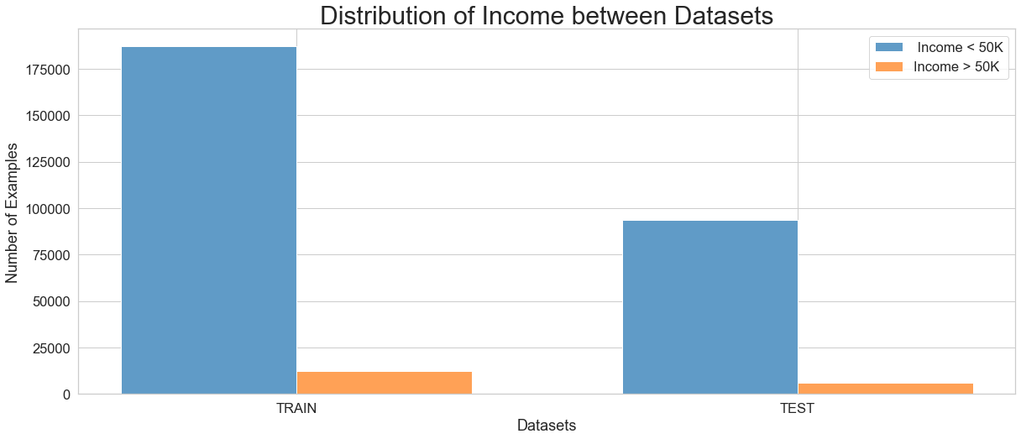
EXPLORATORY DATA ANALYSIS

Slide 9
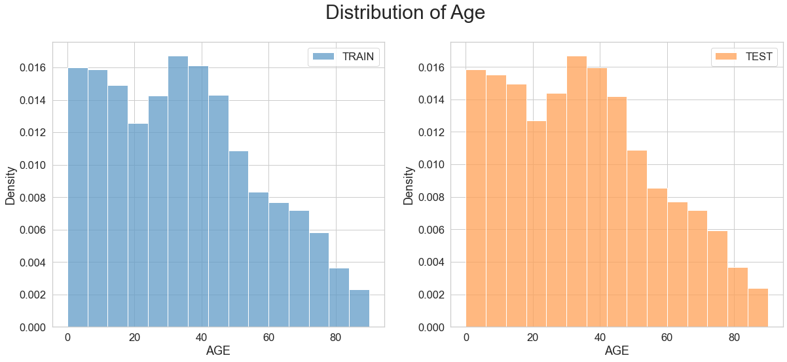
EXPLORATORY DATA ANALYSIS

Slide 10
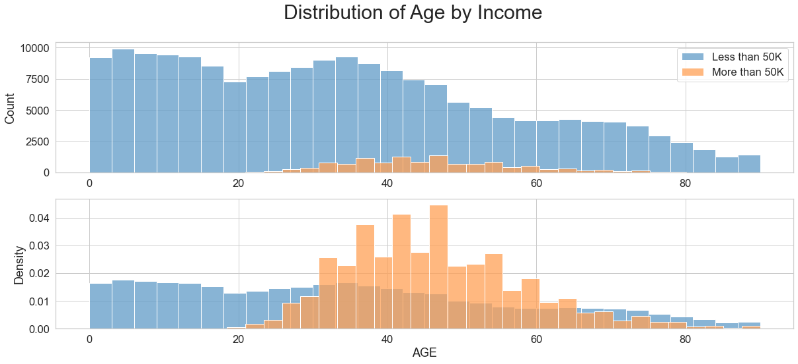
EXPLORATORY DATA ANALYSIS

Slide 11
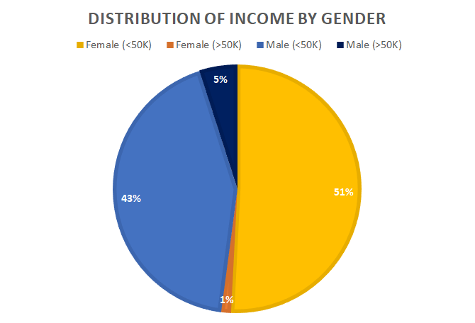
EXPLORATORY DATA ANALYSIS

Slide 12
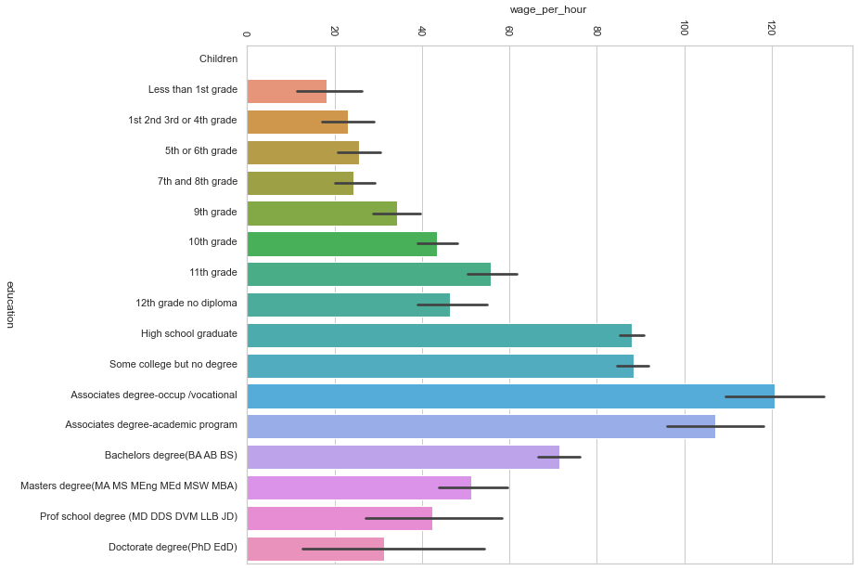
EXPLORATORY DATA ANALYSIS – Education VS Wage p. Hour

Slide 13
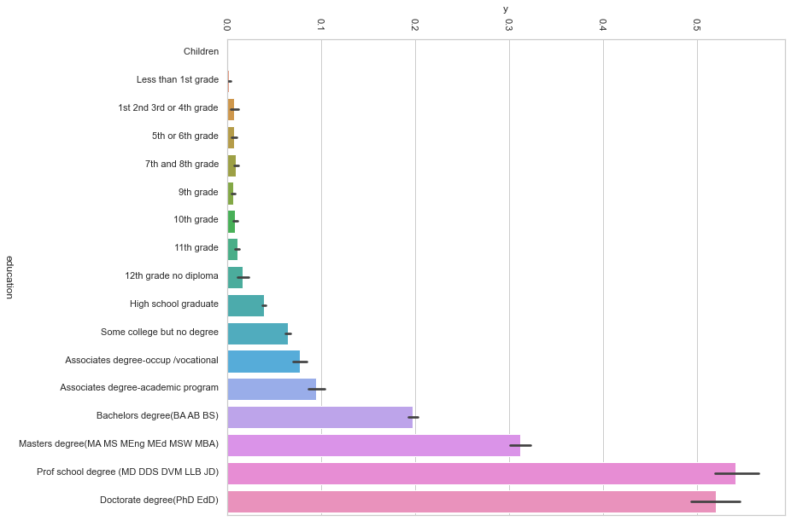
EXPLORATORY DATA ANALYSIS – Education VS Income

Slide 14
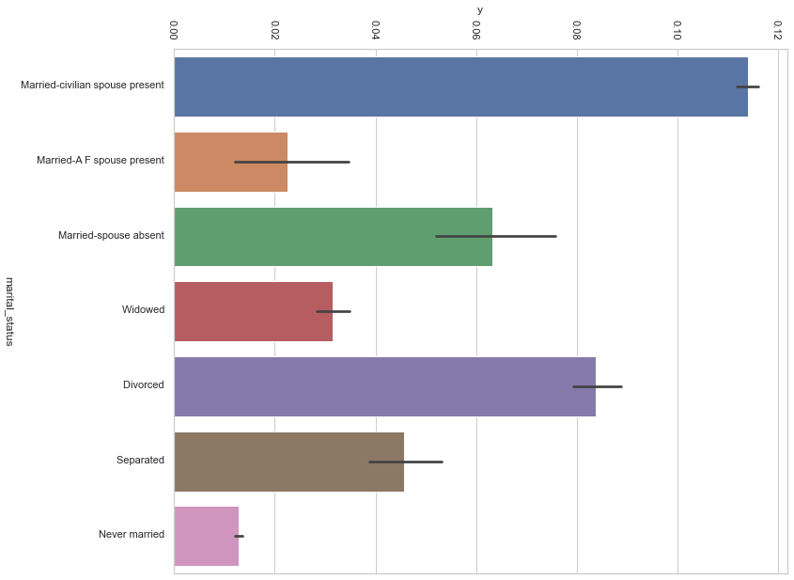
EXPLORATORY DATA ANALYSIS – Marital Status VS Income

Slide 15
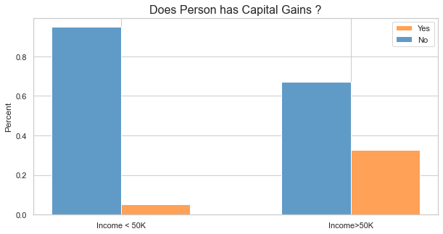
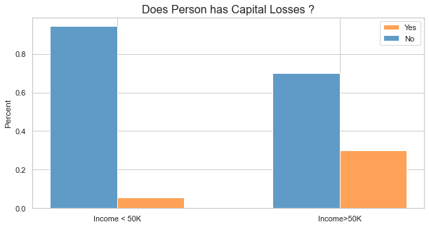
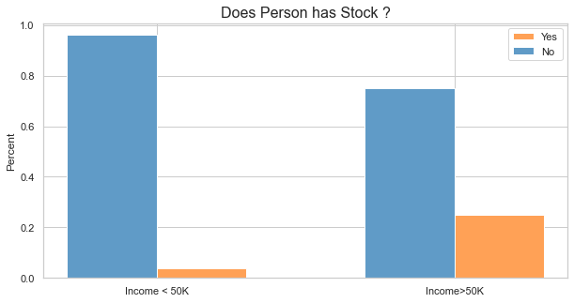
EXPLORATORY DATA ANALYSIS – Has Investing

Slide 16
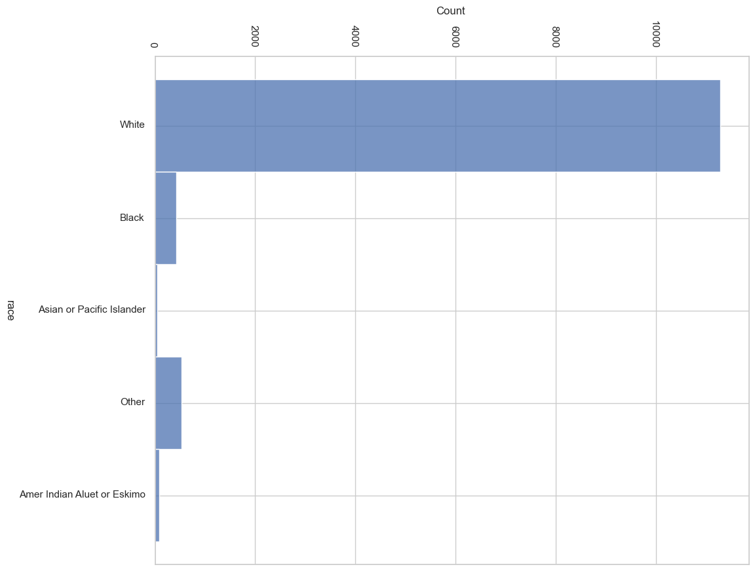
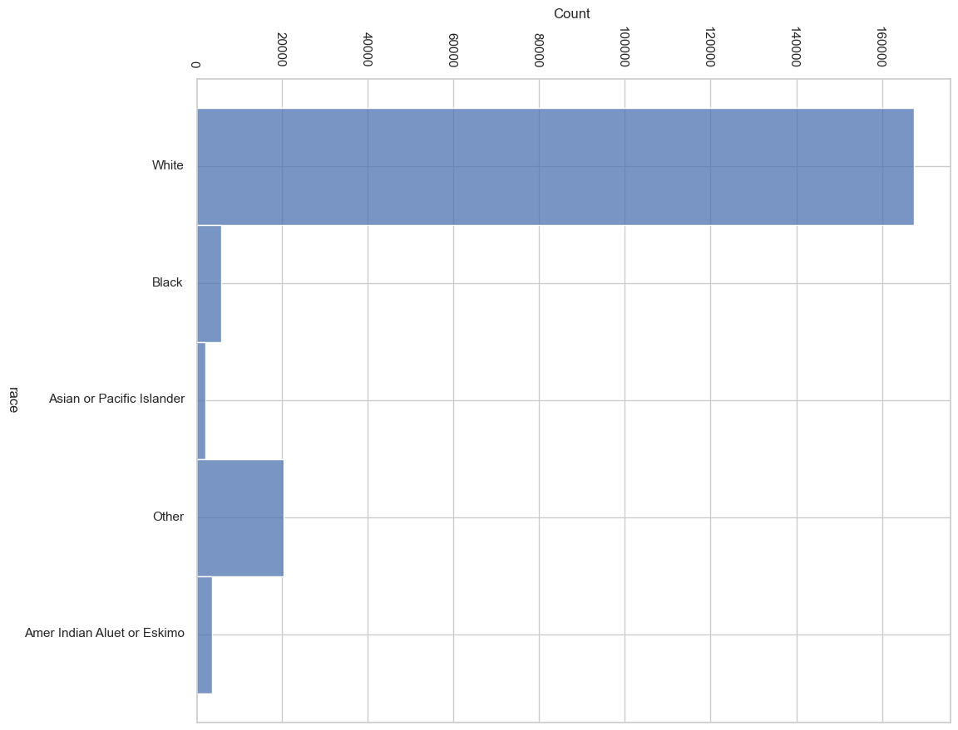
EXPLORATORY DATA ANALYSIS – Race VS Income
Total Race Distribution
Race Distribution where Income > $50K

Slide 17
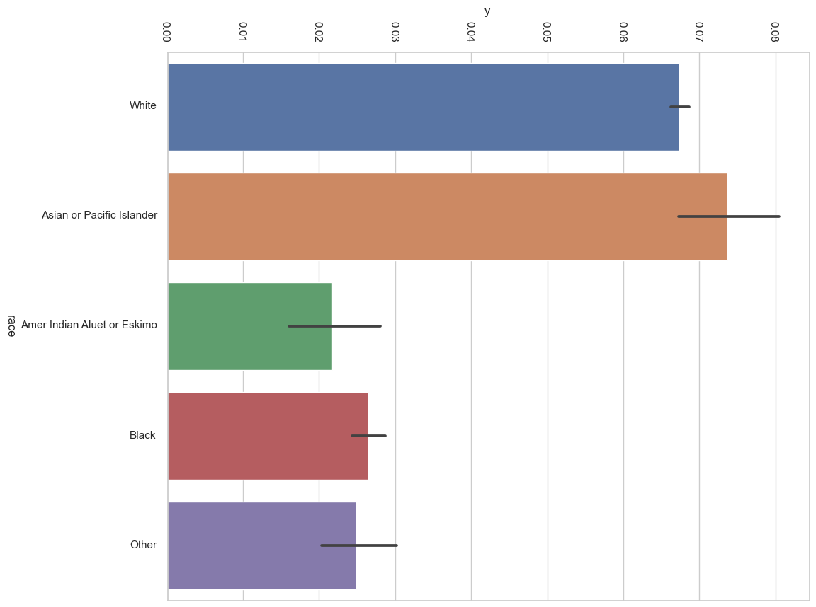
EXPLORATORY DATA ANALYSIS – Race VS Income
Probability of Income>$50K by Race

Slide 18
DATA PREPARATION – Categorization
Encode categories by using LabelEncoder for 28 nominal features out of 35.
Other 7 nominal features were encoded ordinally by researching the features on Current Population Survey Handbook
From Capital Gains,Losses and Dividends, new features are engineered
Some features are normalized for easier training.

Slide 19
DATA PREPARATION – Upsampling & Downsampling
There are 187,000 individuals who has less income than $50K and only 12,300 individuals have more income than $50K. For balancing this imbalance:
Downsample the majority class to 150,000
Upsample the minority class to 15,000
Use different class weights for each class

Slide 20
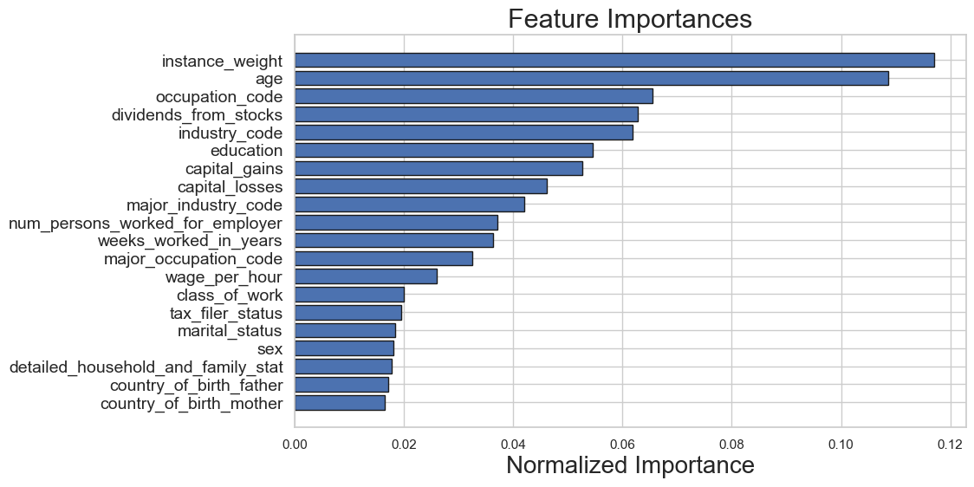
DATA PREPARATION – Feature Importance
Used LightGBM to extract Feature Importance

Slide 21
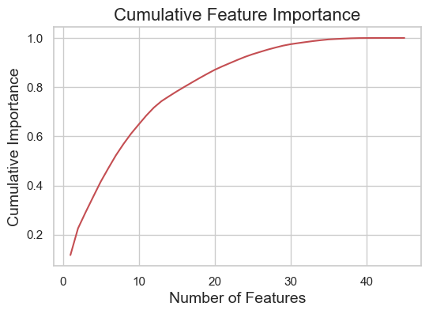
DATA PREPARATION – Cumulative Feature Importance
Removed 22 features from 45 since they weren’t adding any value to the model

Slide 22
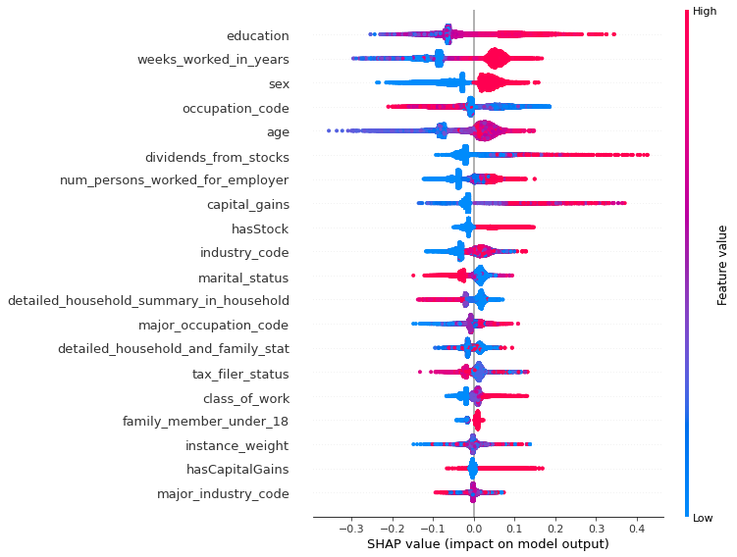
DATA PREPARATION – SHAP Summary Plot

Slide 23
DATA PREPARATION – Feature Selection
From 45 engineered feature, I picked only 22 of them. Added all the selected features as Appendix A.
Education

Slide 24
DATA MODELLING – Model Selection
Rclassification Models have been tested and

Slide 25
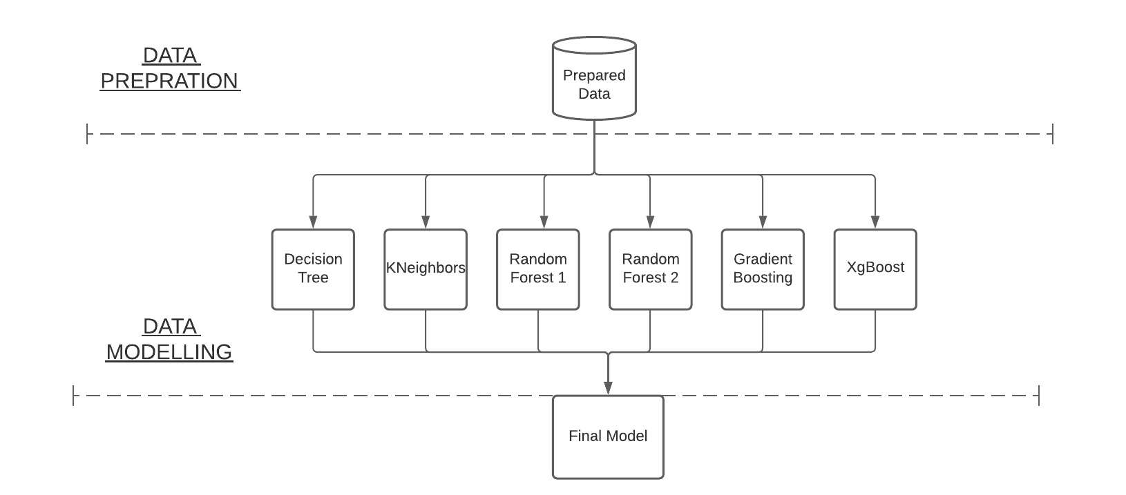
DATA MODELLING – Final Model Diagram

Slide 26
DATA MODELLING – Ensemble Learning
6 different Machine Learning Model has been trained.
Each one of them might be good at capturing some of the data.
Therefore, we get 6 predictions for each example.
On top of that 6 models, there is one final model which decides the final prediction for that example. This is called “Stacking”

Slide 27
MODEL ASSESSMENT
PRECISION | PRECISION | RECALL | F1-SCORE | SUPPORT
INCOME < $50K | 0.97 | 0.99 | 0.98 | 93576
INCOME > $50k | 0.75 | 0.48 | 0.59 | 6186
ACCURACY | - | - | 0.96 | 99762
MACRO AVG | 0.86 | 0.74 | 0.785 | 99762
WEIGHTED AVG | 0.95 | 0.96 | 0.958 | 9976

Slide 28
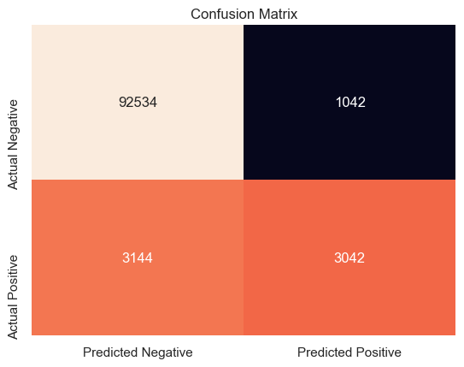
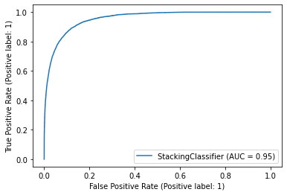
MODEL ASSESSMENT – ROC curve / Confusion Matrix
ROC and Precision/Recall Graph

Slide 29
RESULTS – Model Interpretation (SHAP Graph)

Slide 30
Future Plans
More data from people who earn more than $50K for balancing out the imbalance data.
Hyperparameter Tuning
Model Interpretability by additive explanations (it takes some time and computing power)

Slide 31
Thanks for Listening Q & A
F. Ege Hosgungor

Slide 32
Appendix A – All Selected (22) Features
Age
Class of Worker
Industry Code
Occupation Code
Education
Wage per hour
Marital Status
Major Industry Code
Major Occupation Code
Sex
Capital Gains
Capital Losses
Dividends from Stocks
Tax Filer Status
Detailed Household and family Statistics
Detailed Household summary in household
Instance weight
Number of persons worked for employer
Country of Birth Father
Country of Birth Mother
Own Business or Self Employed
Weeks Worked In Years

Slide 33
Appendix B – What is SHAP
SHAP (SHapley Additive exPlanations) is a game theoretic approach to explain the output of any machine learning model.
Used for analyzing the results of Model.
Takes too much time to compute shap value (Not optimized that much yet)
But has promising results

