Slide 1
Dataiku Data Scientist Technical Assessment
F. Ege Hosgungor

Slide 2
OUTLINE
Introduction
Exploratory Data Analysis
Data Preparation
Data Modelling
Model Assessment
Results

Slide 3
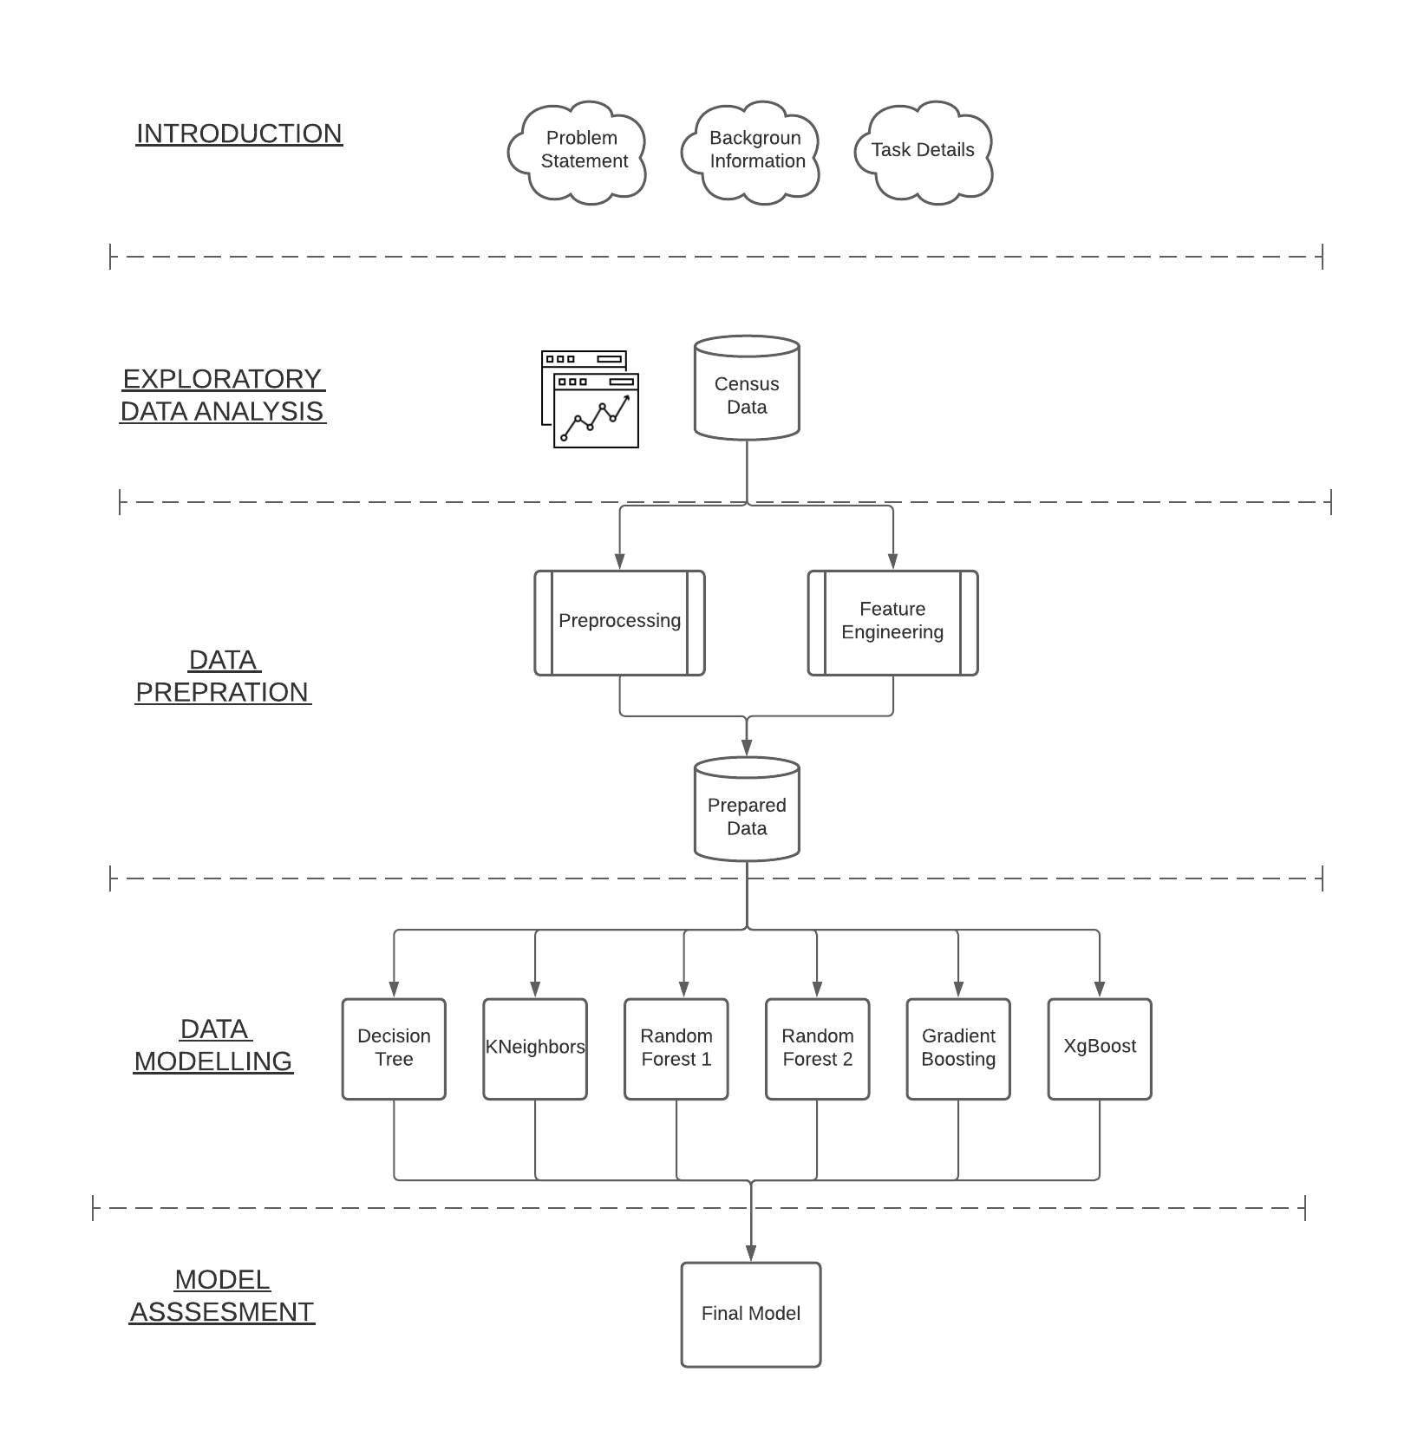
OUTLINE – Whole Process Diagram

Slide 4
INTRODUCTION
The Data:
US Census archive containing detailed, but anonymized, information for approximately 300,000 individuals.
Problem Statement:
Identifying characteristics that are associated with a person making more or less than $50,000 per year.

Slide 5
INTRODUCTION – Background Information
The United States Census Bureau leads the country’s Federal Statistical System
Responsible for collecting data every 10 years upon the American people and economy to help inform strategic initiatives
The data is also used for examining the demographic characteristics of population.

Slide 6
INTRODUCTION – Task Details
Binary Classification Task (Less Than $50,000 – More Than $50,000)
There are 200,000 training examples and 100,000 test examples (2/3 ratio)
Imbalance Data (Most of the data are example of majority class)

Slide 7
EXPLORATORY DATA ANALYSIS
There are 42 features in total, 35 nominal, 8 continuous including the label column.
Here are the ones that I worked on most:
Age
Sex
Education
Occupation and Industry Codes
Income (Target Feature)

Slide 8
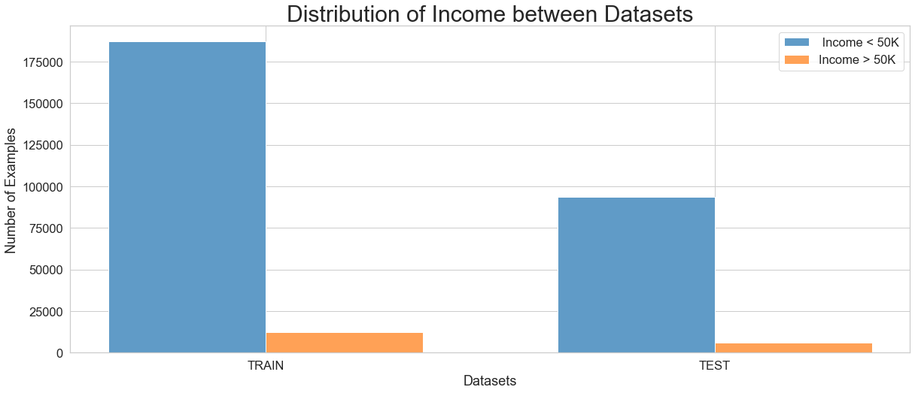
EXPLORATORY DATA ANALYSIS

Slide 9
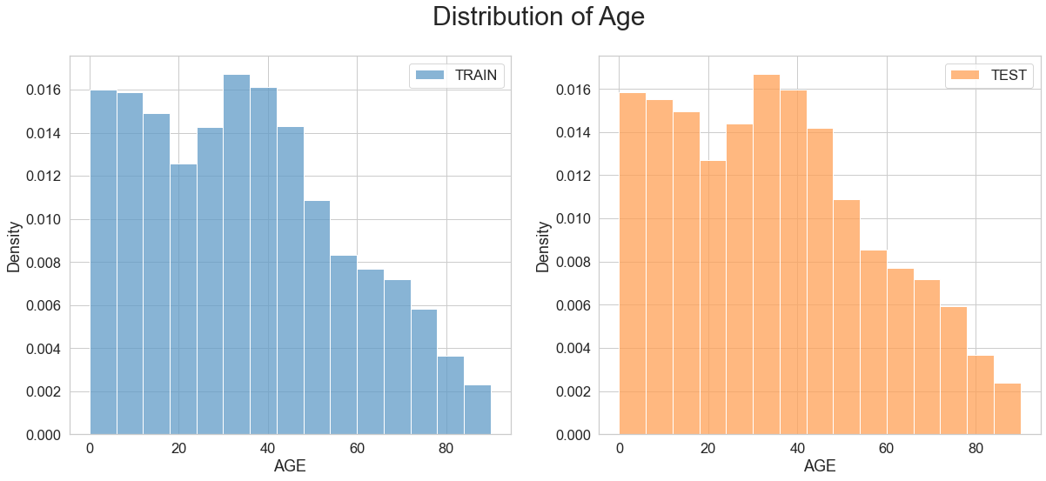
EXPLORATORY DATA ANALYSIS

Slide 10
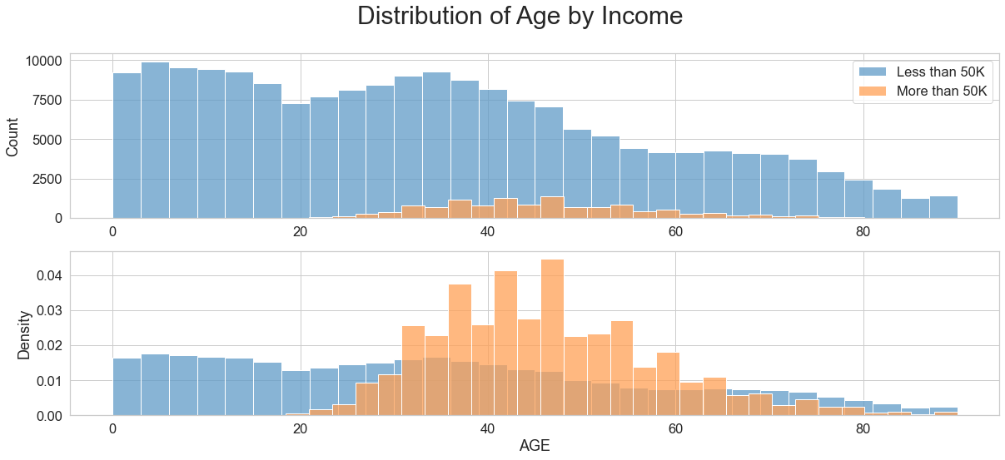
EXPLORATORY DATA ANALYSIS

Slide 11
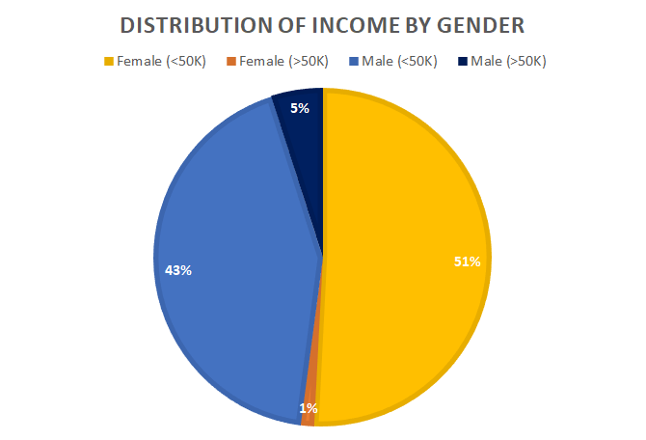
EXPLORATORY DATA ANALYSIS

Slide 12
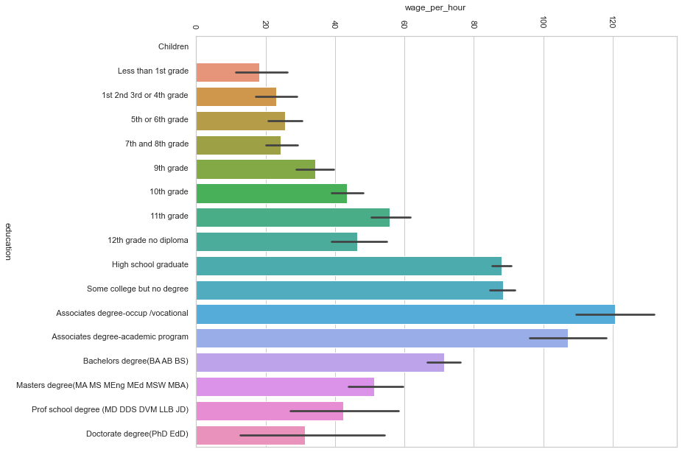
EXPLORATORY DATA ANALYSIS – Education VS Wage p. Hour

Slide 13
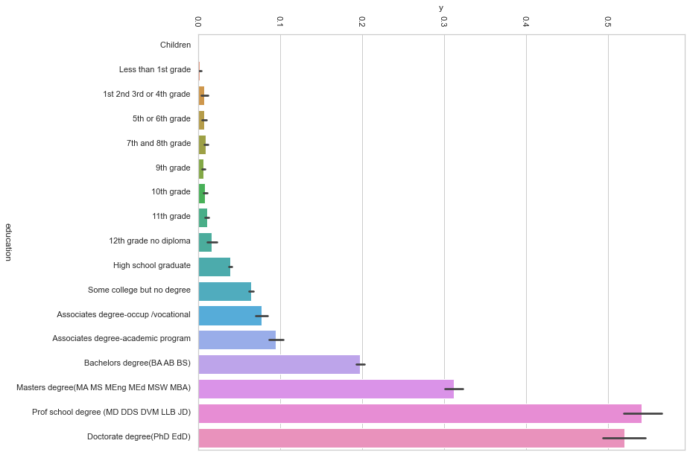
EXPLORATORY DATA ANALYSIS – Education VS Income

Slide 14
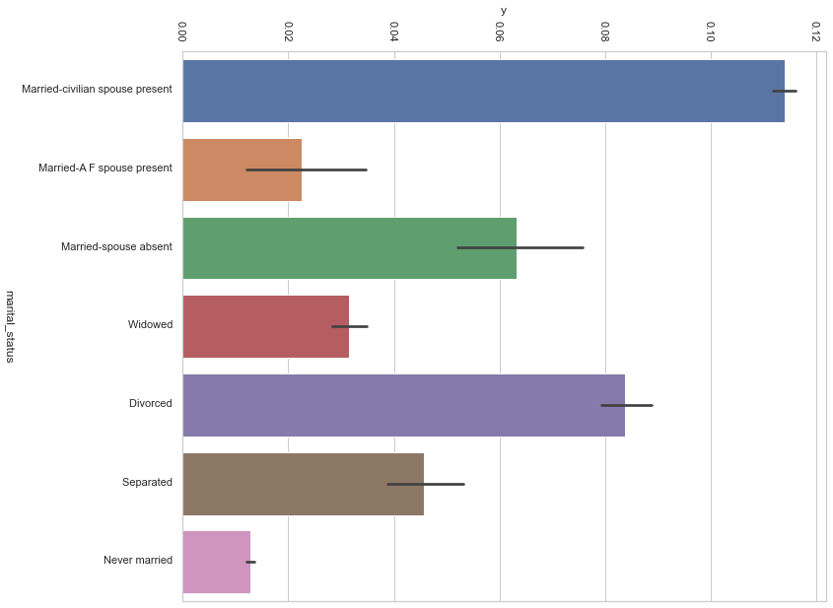
EXPLORATORY DATA ANALYSIS – Marital Status VS Income

Slide 15
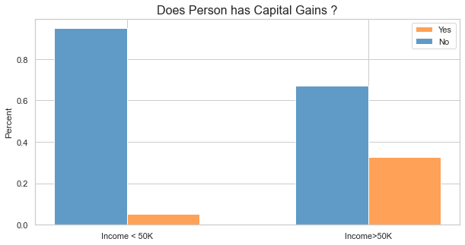
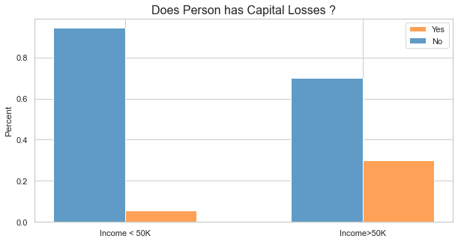
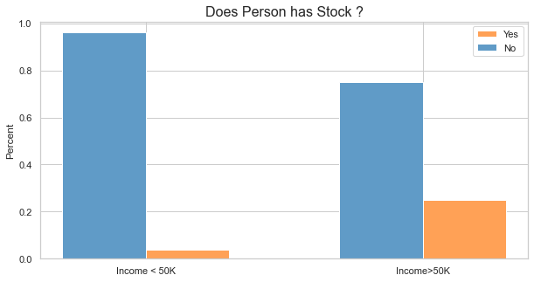
EXPLORATORY DATA ANALYSIS – Has Investing

Slide 16
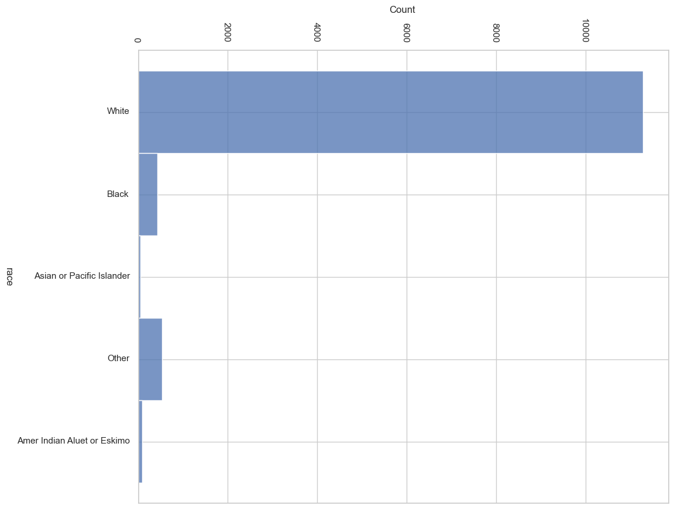
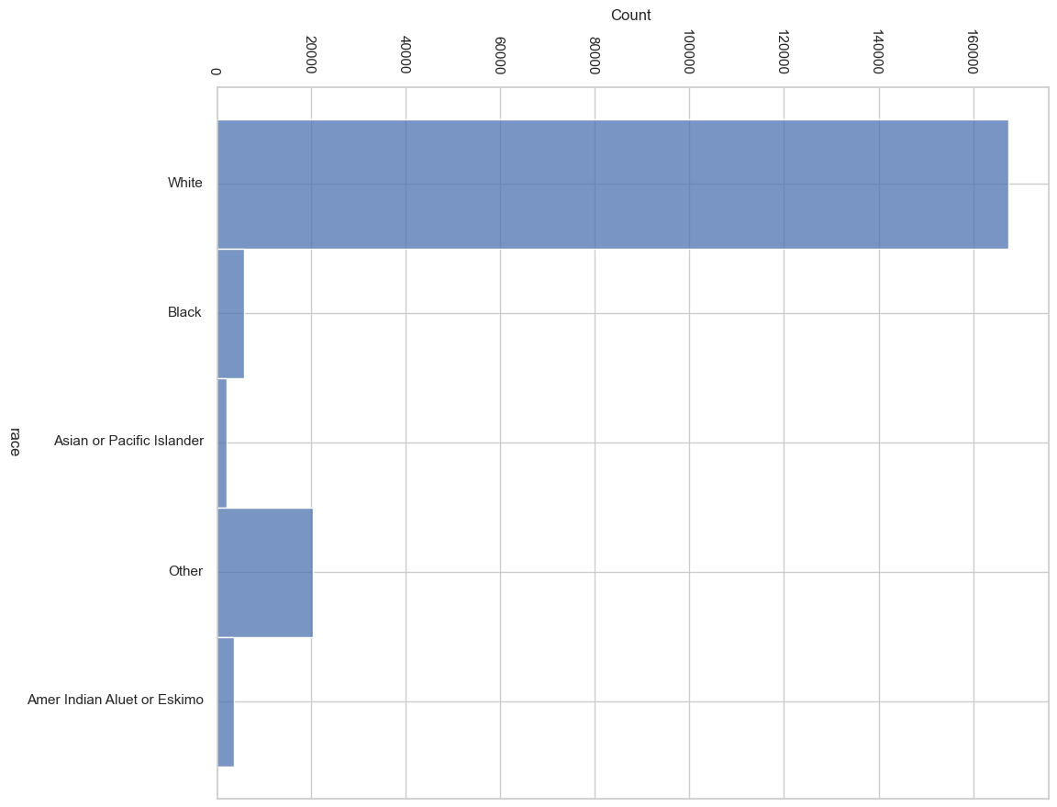
EXPLORATORY DATA ANALYSIS – Race VS Income
Total Race Distribution
Race Distribution where Income > $50K

Slide 17
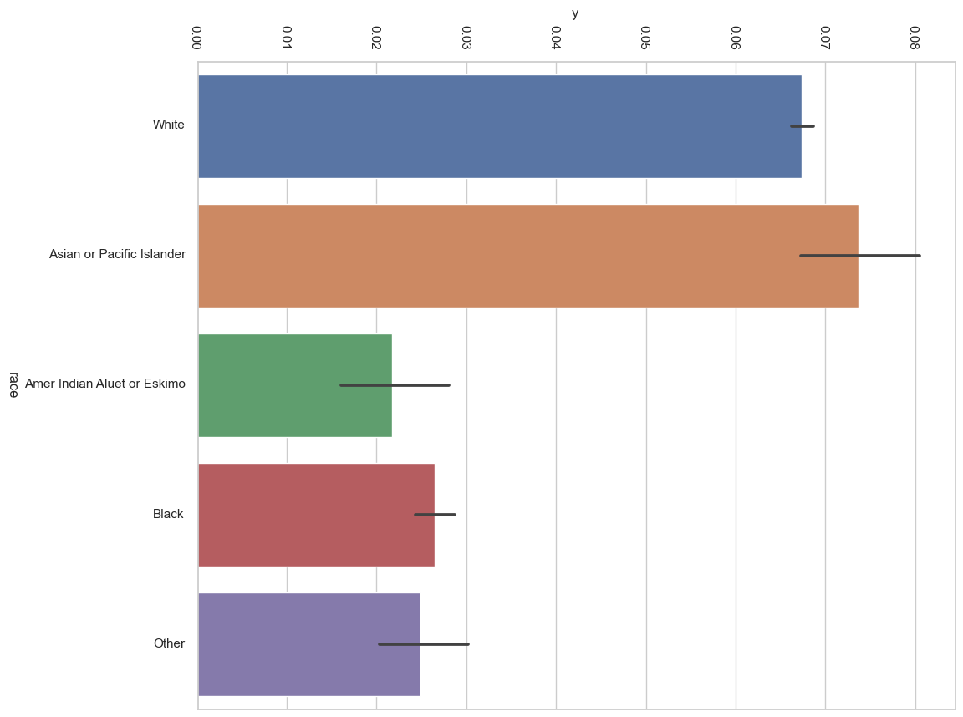
EXPLORATORY DATA ANALYSIS – Race VS Income
Probability of Income>$50K by Race

Slide 18
DATA PREPARATION – Categorization
Encode categories by using LabelEncoder for 28 nominal features out of 35.
Other 7 nominal features were encoded ordinally by researching the features on Current Population Survey Handbook
New features are created (feature engineering)
Some features are normalized for easier training.

Slide 19
DATA PREPARATION – Upsampling & Downsampling
Income > $50K: 187,000 individuals
Income < $50K: 12,300 individuals
How can we handle this problem ?
Upsampling the minority class & downsampling the majority class

Slide 20
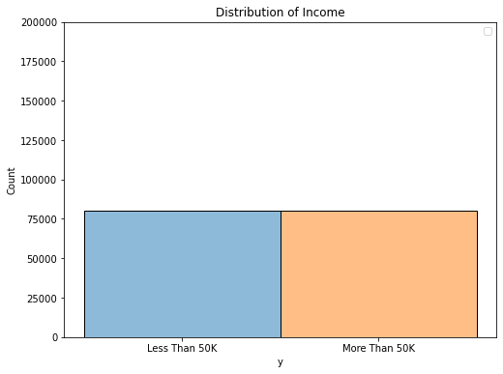
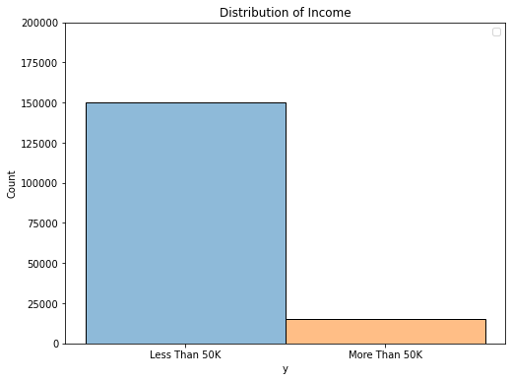
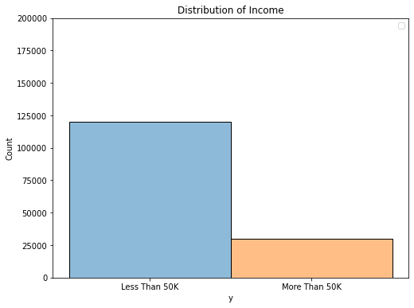
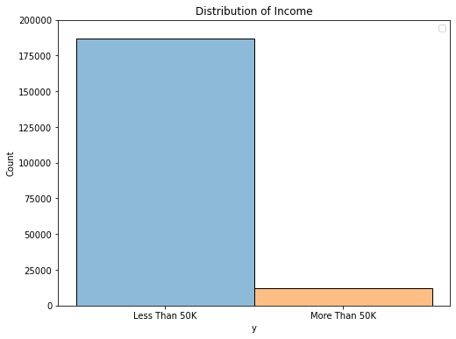
DATA PREPARATION – Upsampling & Downsampling
Best Results:
180K
150K
150K
120K
80K
80K
15K
12K
15K
40K

Slide 21
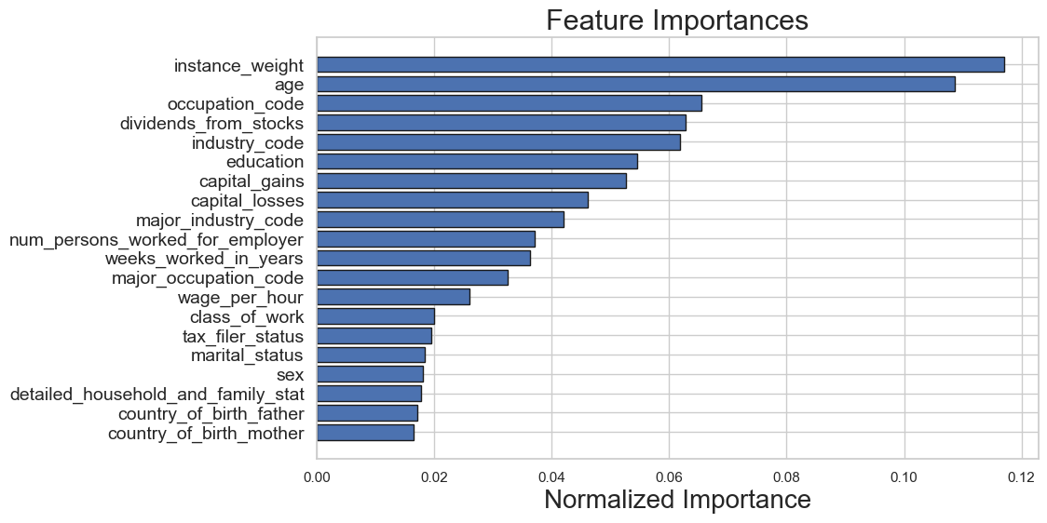
DATA PREPARATION – Feature Importance
Used LightGBM to extract Feature Importance

Slide 22
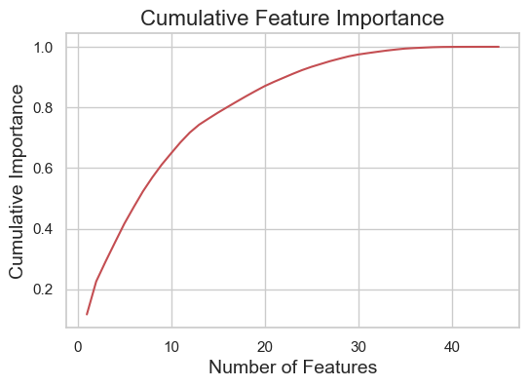
DATA PREPARATION – Cumulative Feature Importance
Removed 22 features from 45 since they weren’t adding any value to the model

Slide 23
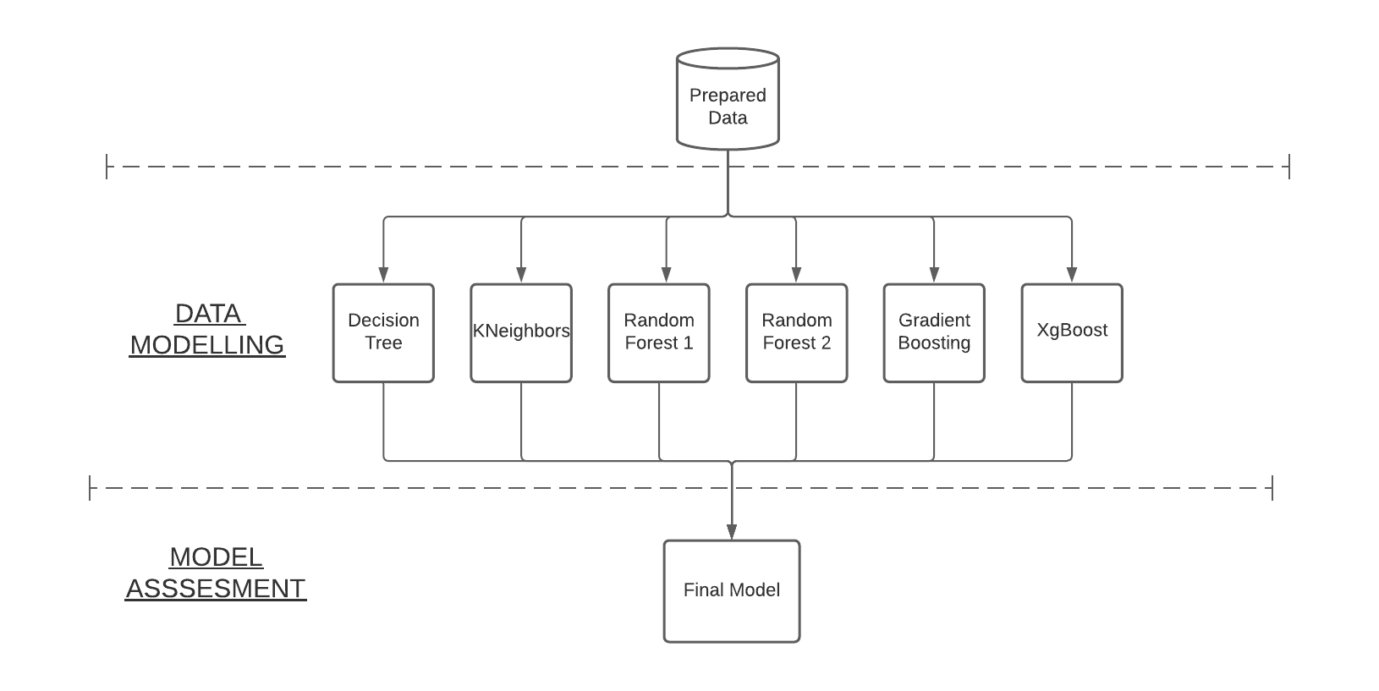
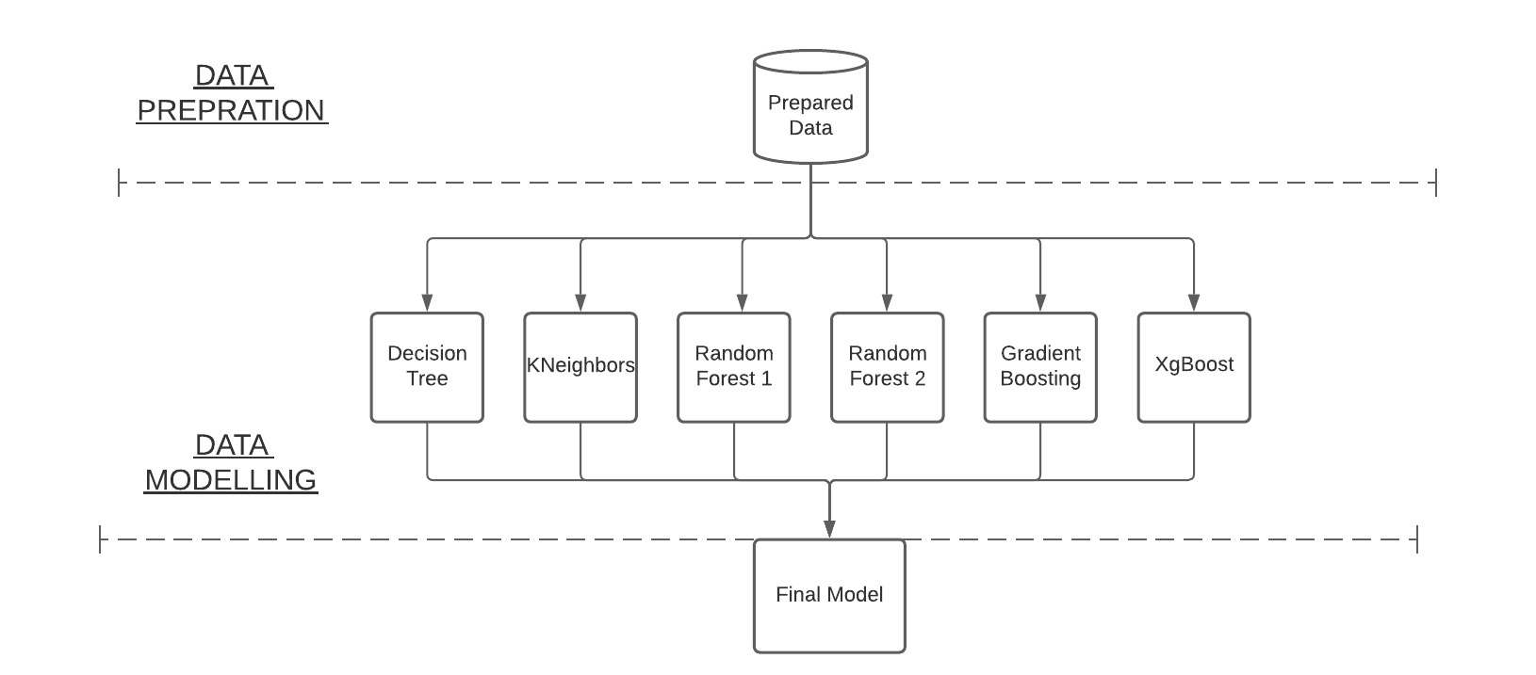
DATA MODELLING – Final Model Diagram

Slide 24
DATA MODELLING – Ensemble Learning
6 different model has been trained.Each one of them might be good at capturing some of the data.
6 predictions for each example.
On top of that 6 models, one linear regression model which decides the final prediction. This is called “Stacking”
Disadvantage: Takes long time to compute prediction for 6 different models.

Slide 25
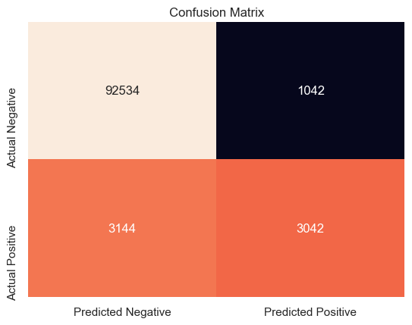
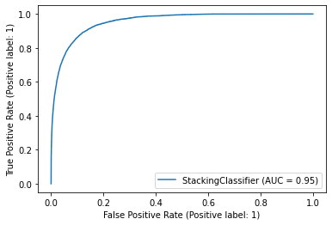
MODEL ASSESSMENT – Confusion Matrix / ROC CURVE
ROC and Precision/Recall Graph

Slide 26
MODEL ASSESSMENT
 | PRECISION | RECALL | F1-SCORE | SUPPORT
INCOME < $50K | 0.97 | 0.99 | 0.98 | 93576
INCOME > $50k | 0.75 | 0.48 | 0.59 | 6186
ACCURACY | - | - | 0.96 | 99762
MACRO AVG | 0.86 | 0.74 | 0.785 | 99762
WEIGHTED AVG | 0.95 | 0.96 | 0.958 | 9976

Slide 27
RESULTS– Quantitivate
97% of the time, individuals who has less income are predicted correctly.
75% of the time , individuals who has more income are predicted correctly.
99% of the individuals who has less income are caught. (So it is obvious if you have less money)
Only 60% of the individuals who has more income are caught.
The accuracy of the model is 96%
The macro average accuracy is 79%

Slide 28
RESULTS - Qualitative
Most of the individuals who have more income than $50K are white but as a ratio Asian or Pacific Islanders have higher probability.
The gender inequality is way higher between high earners.
Having capitals correlates with high earning which indicates these individuals are more willing to take risk and invest their money.
Marrried individuals have more chance to earn >$50K than never married people.
Age is an indicator for predict the individuals with more income.

Slide 29
Future Plans
More data from people who earn more than $50K for balancing out the imbalance data.
More features from Census Data
Up-to-date Data (they are from 94/95)
Hyperparameter Tuning
Model Interpretability by additive explanations (SHAP takes some time and computing power)

Slide 30
Summary

Slide 31
Thanks for Listening Q & A
F. Ege Hosgungor

Slide 32
Appendix A – All Selected (22) Features
Age
Class of Worker
Industry Code
Occupation Code
Education
Wage per hour
Marital Status
Major Industry Code
Major Occupation Code
Sex
Capital Gains
Capital Losses
Dividends from Stocks
Tax Filer Status
Detailed Household and family Statistics
Detailed Household summary in household
Instance weight (Ignore)
Number of persons worked for employer
Country of Birth Father
Country of Birth Mother
Own Business or Self Employed
Weeks Worked In Years

Slide 33
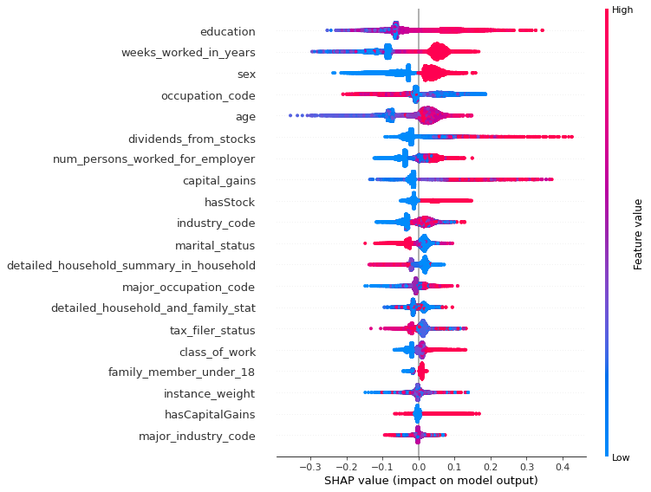
RESULTS – Model Interpretation (SHAP Graph)

Slide 34
Appendix B – What is SHAP
SHAP (SHapley Additive exPlanations) is a game theoretic approach to explain the output of any machine learning model.
Used for analyzing the results of Model.
Takes too much time to compute shap value (Not optimized that much yet)
But has promising results

