Slide 1
C/C++ Program Design
CS205
Prof. Shiqi Yu (于仕琪)
yusq@sustech.edu.cn
http://faculty.sustech.edu.cn/yusq/

Slide 2
Integer Numbers

Slide 3
int
int is the most frequently used integer type
int i; //declare a variable
int j = 10; //declare and initialize
int k;
k = 20; //assign a value
Remember to initialize a variable!
Will the compiler give an error?
int i;
cout << i; //what is i's value?

Slide 4
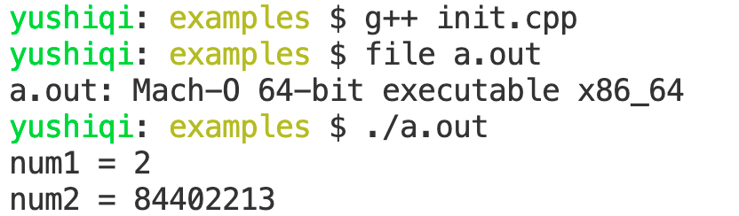
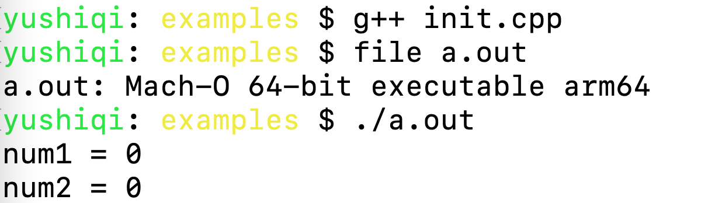
Variable Initialization
Uninitialized variables may have random values
The behavior depends on the compiler. Clang (x86_64) and Clang (arm64) in the demo.
Please initialize variables EXPLICITLY!
init.cpp
#include <iostream>
using namespace std;
int main()
{
int num1; //bad: uninitialized variable
int num2; //bad: uninitialized variable
cout << "num1 = " << num1 << endl;
cout << "num2 = " << num2 << endl;
}

Slide 5
How to initialize
int num;
num = 10;//do not forget this line
int num = 10;
int num (10);
int num {10};

Slide 6
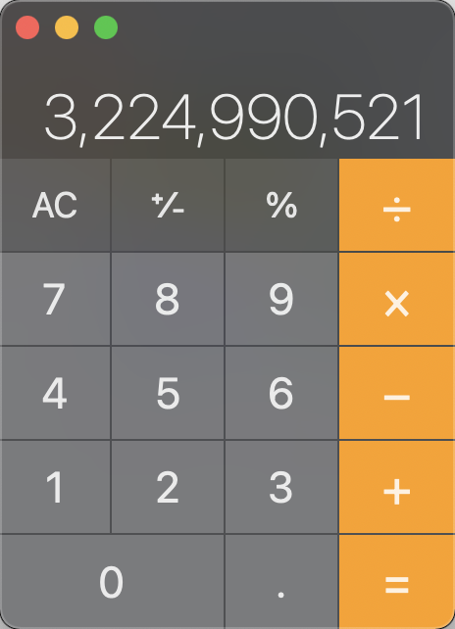
Overflow
overflow.cpp
int a = 56789;
int b = 56789;
int c = a * b;
cout << c << endl;
The output is a negative number!
-1069976775
Because 56789 is 0xDDD5, 16 bits
The correct result is 3,224,990,521 (0x C0 39 73 39).
The sign bit is 1!

Slide 7
signed and unsigned
The following code can give the correct answer.
unsigned int a = 56789;
unsigned int b = 56789;
unsigned int c = a * b;
signed int can be shorten as int. Its range is [-2³¹, 2³¹-1] if it’s 32-bit.
unsigned int: Its range is [0, 2³²-1] if it’s 32-bit.
32 bits for most modern systems, 16 for some old ones.
 | 31 | 30 | 29 | 28 | 27 | 26 | 25 | 24 | 23 | 22 | 21 | 20 | 19 | 18 | 17 | 16 | 15 | 14 | 13 | 12 | 11 | 10 | 9 | 8 | 7 | 6 | 5 | 4 | 3 | 2 | 1 | 0
signed int
unsigned int

Slide 8
Different Data Types for Integer
use long int for longer integers.
use short int for shorter integers.
and long long
But
C and C++ standards do not fix the widths of them

Slide 9
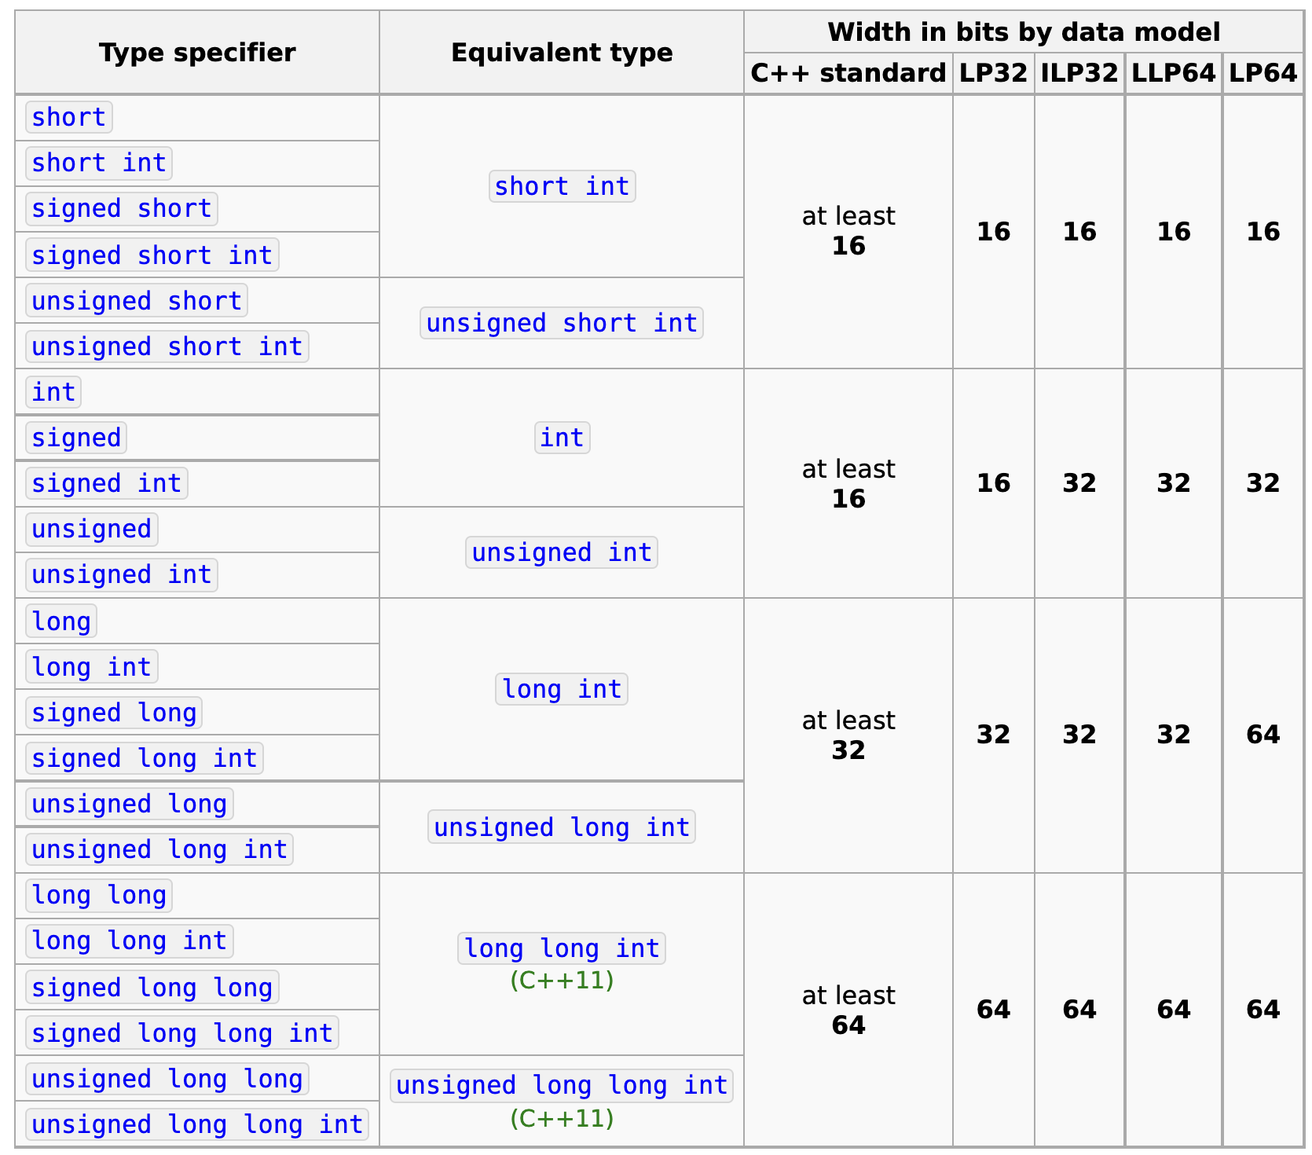
https://en.cppreference.com/w/cpp/language/types
Width in bits of different data models
sizeof operator can return the width in bytes.

Slide 10
sizeof
It is an operator, not a function!
size.cpp
int i = 0;
short s = 0;
cout << "sizeof(int)=" << sizeof(int) << endl;
cout << "sizeof(i)=" << sizeof(i) << endl;
cout << "sizeof(short)=" << sizeof(s) << endl;
cout << "sizeof(long)=" << sizeof(long) << endl;
cout << "sizeof(size_t)=" << sizeof(size_t) << endl;

Slide 11
More Integer Types

Slide 12
char
char: type for character, 8-bit integer indeed!
signed char: signed 8-bit integer
unsinged char: unsigned 8-bit integer
char: either signed char or unsinged char

Slide 13
Integers and characters
How we represent a character?
Use an 8-bit integer
char c1 = 'C’; //its ASCII code is 80
char c2 = 80; //in decimal
char c3 = 0x50; //in hexadecimal
Chinese characters?
char16_t c = u'于'; //c++11
char32_t c = U'于'; //c++11
char.cpp

Slide 14
bool
A C++ keyword, but not a C keyword
bool width: 1 byte (8 bits), NOT 1 bit!
Value: true (1) or false (0)
What is the output?
bool.cpp
bool b = true;
int i = b;
cout << "i=" << i << endl;
cout << "b=" << b << endl;

Slide 15
bool
Boolean data conversion
bool b = true;
int i = b; // the value of i is 1.
bool b = -256; // unrecommended conversion. the value of b is true
bool b = (-256 != 0); // better choice

Slide 16
Boolean in C
Use typedef to create a type
typedef char bool;
#define true 1
#define false 0
Defined in stdbool.h since C99
#include <stdbool.h>

Slide 17
size_t
Computer memory keeps increasing
32-bit int was enough in the past to for data length
But now it is not.
size_t:
Unsigned integer
Type of the result of sizeof operator
Can store the maximum size of a theoretically possible object of any type
32-bit, or 64-bit

Slide 18
Fixed width integer types (since C++11)
Defined in <cstdint>
int8_t
int16_t
int32_t
int64_t
uint8_t
uint16_t
uint32_t
uint64_t
...
intmax.cpp
#include <iostream>
#include <cstdint>
using namespace std;
int main()
{
cout << "INT8_MAX=" << INT8_MAX << endl;
}
Some useful macros
INT8_MIN
INT16_MIN
INT32_MIN
INT64_MIN
INT8_MAX
INT16_MAX
INT32_MAX
INT64_MAX
...

Slide 19

Choose appropriate integer types
Wider integers consume more memory, and slower sometimes
char(byte) is widely used for image pixels
Choose a data type carefully, and consider all possibilities (short for wide dynamic range images)
6720 × 3780 ×3 = 76,204,800 = 76M Bytes

Slide 20
Floating-point Numbers

Slide 21
What’s the output?
float.cpp
#include <iostream>
#include <iomanip>
using namespace std;
int main()
{
float f1 = 1.2f;
float f2 = f1 * 1000000000000000; //1.0e15
cout << std::fixed << std::setprecision(15) << f1 << endl;
cout << std::fixed << std::setprecision(1) << f2 << endl;
return 0;
}

Slide 22
How many numbers in range [0, 1]?
Infinite!
How many numbers can 32 bits represent?
2³²
You want 1.2, but float can only provide you 1.200000047683716...

Slide 23
Understanding Computing
Are computers always accurate?
Floating-point operations always bring some tiny errors.
Those errors cannot be eliminated.
What we can do: to manage them not to cause a problem.

Slide 24

Floating-point types
float: single precision floating-point type, 32 bits
double: double precision floating-point type, 64 bits
long double: extended precision floating-point type
128 bits if supported
64 bits otherwise
half precision floating-point, 16 bits (popular in deep learning, but not a C++ standard)
https://en.wikipedia.org/wiki/Single-precision_floating-point_format

Slide 25
Floating-point VS integers
Represent values between integers
A much greater range of values
Floating-point operations are slower than integer operations
Lose precision
double operations is slower than float

Slide 26
Precision
Will f2 be greater than f1?
float f1 = 23400000000;
float f2 = f1 + 10; // but f2 = f1
Why?
Can we use == operator to compare two floating point numbers?
precision.cpp
if (f1 == f2) //bad
if (fabs(f1 - f2) < FLT_EPSILON) // good

Slide 27
inf and nan
What will f1 and f2 be?
float f1 = 2.0f / 0.0f;
float f2 = 0.0f / 0.0f;
±inf: infinity (Exponent=11111111, fraction=0)
nan: not a number (Exponent=11111111, fraction!=0)
nan.cpp

Slide 28
Arithmetic Operators

Slide 29
Constant numbers
95 // decimal
0137// octal
0x5F // hexadecimal
95 // int
95u // unsigned int
95l // long
95ul // unsigned long
95lu // unsigned long
3.14159 // 3.14159
6.02e23 // 6.02 x 10^23
1.6e-19 // 1.6 x 10^-19
3.0 // 3.0
6.02e23L // long double
6.02e23f // float
6.02e23 // double

Slide 30
const type qualifier
const float pi = 3.1415926f;
pi += 1; //error!
If a variable/object is const-qualified, it cannot be modified.
It must be initialized when you define it.

Slide 31
auto (since C++11)
auto is placeholder type specifier.
The type of the variable will be deduced from its initializer.
auto a = 2; // type of a is int
auto bc = 2.3; // type of b is double
auto c ; //valid in C, error in C++
auto d = a * 1.2;
Question:
auto a = 2; // type of a is int
// will a be converted to a // double type variable?
a = 2.3;
No! 2.3 will be converted to a int 2, then assigned to a

Slide 32
Arithmetic operators
Operator name | Syntax
unary plus | +a
unary minus | -a
addition | a + b
subtraction | a - b
multiplication | a * b
division | a / b
modulo | a % b
bitwise NOT | ~a
bitwise AND | a & b
bitwise OR | a | b
bitwise XOR | a ^ b
bitwise left shift | a << b
bitwise right shift | a >> b
Operator Precedence
If you cannot remember the precedence, use parentheses!
a++
++a
* /
+ -
<< >>

Slide 33
Other operators
Assignment Operators
a = b a += b a -= b a *= b a /= b a %= b a &= b a |= b a ^= b a <<= b a >>= b
Increment/decrement
a++
++a
a--
--a
int a = 3;
int b = a++; // What's the value of b?
int c = ++a; // What's the value of c?

Slide 34
Data type conversions
conversion.cpp
int num_int1 = 9; // initializing an int value to num_int1
int num_int2 = 'C'; // implicit conversion
int num_int3 = (int)'C'; // explicit conversion, C-style
int num_int4 = int('C'); // explicit conversion, function style
int num_int5 = 2.8; //implicit conversion
float num_float = 2.3; //implicit conversion from double to float
short num_short = 650000;
DANGER:
The source code can be compiled successfully (even with warning messages) when the data types do not match.
Please use explicit conversion if possible

Slide 35
Data loss
But
long double
double
float
long
int
short
char
conversion.cpp
int num_int1 = 100000004;
float num_int_float = num_int1;
int num_int2 = (int)(num_int_float);
data loss
no data loss
Will num_int2 be the same with num_int1?

Slide 36
Operator Associativity
Left-to-right associativity or a right-to-left associativity
Ref: https://en.cppreference.com/book/operator_precedence
The following two lines are equivalent.
int i = 17 / 5 * 5;
int i = (17 / 5) * 5;

Slide 37
Divisions
Both operands are integers
Perform integer division
Any fractional part of the answer is discarded to make the result an integer
float f = 17 / 5; // f will be 3.f, not 3.4f.
One or both operands are floating-point numbers
Perform floating-point division
float f = 17 / 5.f; // f will be 3.4f.

Slide 38
Distinct Operations for Different Types
int, long, float, double: four kinds of operations
If the operands are not the four types, automatic convert their types
unsigned char a = 255;
unsigned char b = 1;
int c = a + b; // c = ?
The operands will be converted to one of the four types without losing data: int, long, float, double
Ref: https://en.cppreference.com/w/cpp/language/implicit_conversion

Slide 39
C/C++ Supposes
You (the programmer) are smart enough!
You know what exactly the source code means!

