Slide 1
3D Objects Imaging using HD Scanner
Daniel Fan and Samuel Loho
Project #114
Supervisor: Dr. Waleed Abdulla
Second Examiner: Dr. Catherine Watson

Slide 2
Outline
Motivation
Background
Structured Light Scanner
Objectives
Our Approach
Results
Future Work
Conclusions

Slide 3
Motivation
Technology advancements over the last decade
Limitation on 2D data analysis
Research interest
Making tasks easier – engineers lazy

Slide 4
Background
3D Scanner Types
Theory
Applications

Slide 5
Background – 3D Scanner Types
Types of 3D scanner based on their methods:
Contact
Non-contact:
Active
Passive

Slide 6
Background – 3D Scanner Types
Contact
Utilise a probe to scan the surface of an object directly
Advantage:
Precise reconstruction of the object
Disadvantages:
Dependency on the material of the object
Limitation on the size of the scanned object
Processing time

Slide 7
Background – 3D Scanner Types
Non-Contact
Also known as optical scanner
Differentiated from the control of illumination source
Active: emission of radiation or light and detect the reflection from the object.
Laser: time of flight, phase shift scanner
Light: structured light
Passive: rely on the reflected ambient radiation
Stereoscopic imaging
Photogrammetric imaging

Slide 8
Background - Theory
3D Photography
Triangulation

Slide 9
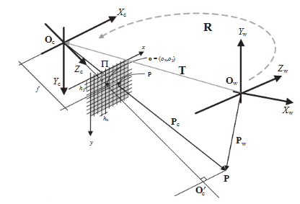

Background - Theory
Camera System: Pin-hole Model
Image plane ∏ denotes the sampled discrete photosensing locations of 3D world scene onto the plane; $h_{x}$and $h_{y}$ are the physical dimensions of a single tile (pixels)
$O_{c}$ together with $X_{c}$, $Y_{c}$, and $Z_{c}$determine the camera coordinate system
$O_{w}$ together with $X_{w}$, $Y_{w}$, and $Z_{w}$determine the external coordinate system
p25

Slide 10

Background - Theory
Projection $O_{c}′$ in the direction of $Z_{c}$ determines the principal point of local coordinates ($o_{x}o_{y}$)
Point p is the image point P, 3D space location, depends on the coordinates systems: camera $P_{c}$, external $P_{w}$
Since optical axis is perpendicular to the plane ∏, $ΔO_{c}po$ and $ΔO_{c}PO_{c}′$ are similar:
$$x=f\frac{X}{Z} ;y=f\frac{Y}{Z} ;z=f$$

Slide 11

Background - Theory
Pin-hole camera model defined by:
Extrinsic parameters
$P_{c}=R(P_{w} −T)$, $R= \left[\begin{matrix}R_{11} & R_{12} & R_{13} \\ R_{21} & R_{22} & R_{23} \\ R_{31} & R_{32} & R_{33}\end{matrix}\right]$, T = $O_{w}$ - $O_{c}$ = $\left[\begin{matrix}T_{1} \\ T_{2} \\ T_{3}\end{matrix}\right]$
Intrinsic parameters
$x=(x_{u} −o_{x})h_{x}$ , $y=(y_{u} −o_{y})h_{y}$

Slide 12
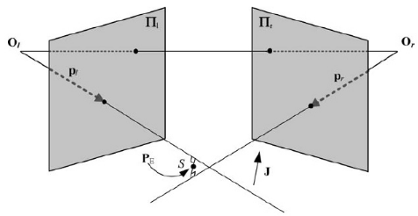

Background - Theory
Stereoscopic Systems
Creates Epipolar Geometry, based on two pin-hole camera models
Similar parameters as pin-hole model
Additional camera plane allows intersection with the base line to create epipolar points $e_{i}$ which then create epipolar plane by 3D point P
Intersection of planes creates epipolar lines which determine the exact space position in 3D space
p32

Slide 13
Background - Theory
Triangulation
p325

Slide 14
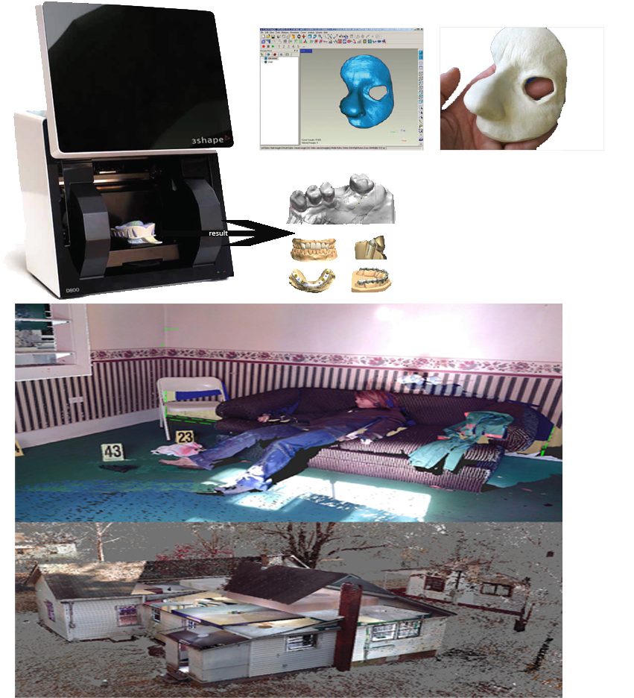
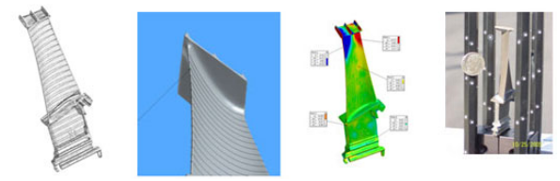
Background – Applications
Medical and Forensic science
Prosthetics, plaster cast moulds, dental implants
Analysis on physical samples – Geology
Captures forensic evidence
Manufacturing
Design, Prototyping, CAM, Quality Control
Reparation or recreation of undocumented parts
Image courtesy of: NextEngine
Image courtesy of: 3shape, Farofocus3D, Handiscan3D

Slide 15
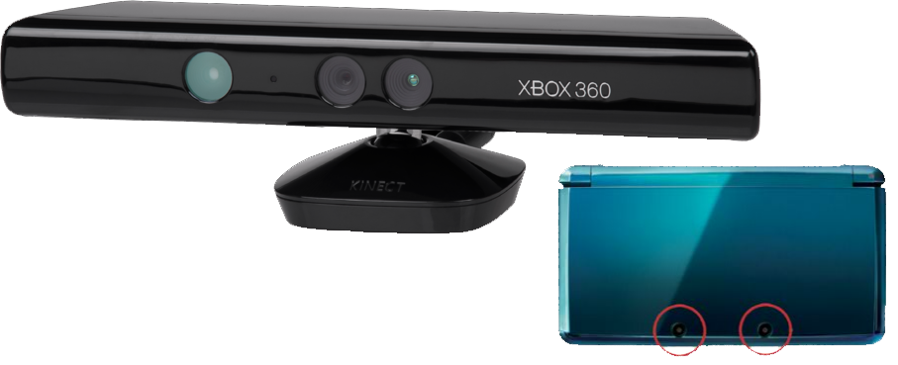
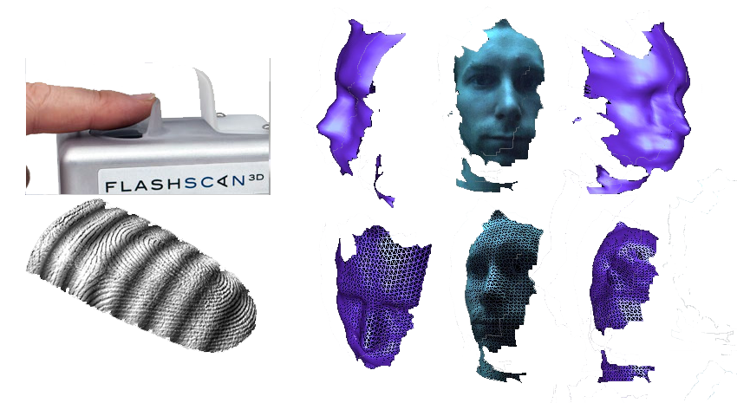
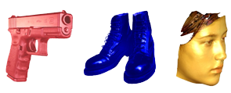
Background – Applications
Entertainment
CGI – visually accurate 3D models
Gaming – Nintendo 3DS, Microsoft Kinect
Biometrics
3D fingerprints, face recognition
Cultural Heritage
Catalogue, preservation of artefacts
Image courtesy of Flashscan3d and the University of York
Image courtesy of: Konica Minolta, Microsoft™ and Nintendo™

Slide 16
Adapted System
3D3Solutions’ Flexscan3d
Structured Light scanner
Types of Structured Light scanners
B/W Binary Pattern (include comparison with graycode/binary)
RGB pattern
Colour stripe pattern
Stereo Analysis

Slide 17
Adapted System – Objectives
Explore the 3D3Solutions’ Flexscan3d Scanner
Setup
Quality of image
Limitations
Devising a method of obtaining 3D data without the used of the Flexscan3d software.

Slide 18
Approach – Flexscan system
Setup:
The scanner system was setup and calibrated in the IE room.
A black background was used to provide clear contrast for the image
Scanning conditions such as distance to the scanner, and the amount of ambient light (lights on or off) are explored.

Slide 19

Approach – Flexscan system
Focus only on the 3D object
Black Box = Flexscan software which acquires the 3D data.
2D Images from the scanner
Black Box
3D Mesh/Cloud Points

Slide 20
Quality of image

Slide 21
Limitations
The following objects can not be scanned:
Highly reflective objects
Dark coloured objects
Objects with a rough surface (scatters light)
For more complex objects, meshing becomes a increasingly difficult task

Slide 22
Simplified Algorithm
Same scanner setup was used
Images from the scanners were processed using Matlab
System parameters
Assumptions and simplifications made.
Notes:
In the method that we devised, many assumptions and simplifications were made to the system parameters.

Slide 23
Quality of Image
Lesser quality than original system
Expected.
Missing information due to pixel-stripe generalisation.
Object still recognisable
Fails with more complicated objects
Notes:
In the method that we devised, many assumptions and simplifications were made to the system parameters.

Slide 24
Limitation s
Similar to the Flexscan system
Notes:
In the method that we devised, many assumptions and simplifications were made to the system parameters.

Slide 25
Results
Flexscan system

Slide 26
Results
Simplified system

Slide 27
Results - Comparison
Comparison with .obj from flexscan (show points?)

Slide 28
Future Work
Refinement and development of the simplified data acquisition model – improve 3D model quality
Improvement on the efficiency of the model – reduce time for data acquisition

Slide 29
Conclusions
High quality image obtained from the Flexscan system
Simplified model yields images of a satisfactory calibre
Further refinement of simplified model may yield results of higher resolution and detail.

Slide 30
Questions

